Slide 1
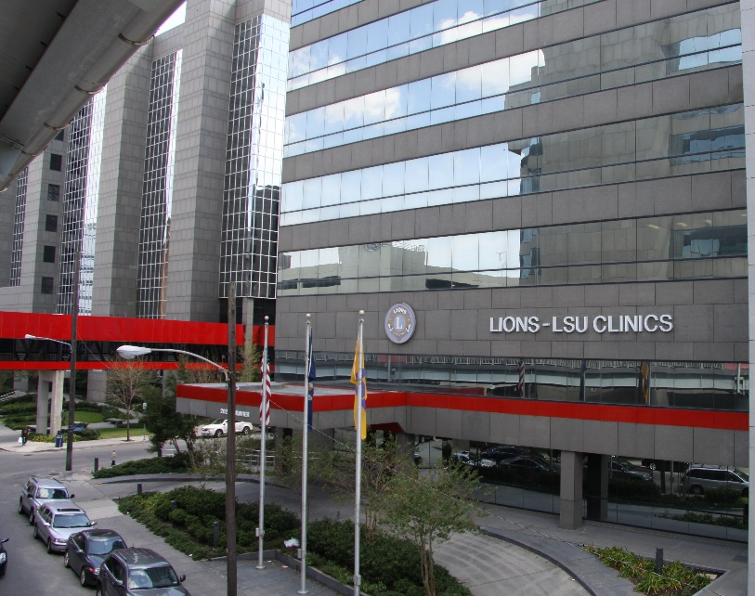
School of Public Health Grant Budgeting
Presented by:
Amee Barattini
Assistant Dean for Finance and Administration
Rev 9/25

Slide 2



Grant Budgeting Process
Step Read the Funding Opportunity Announcement
Review it for any budgetary limitations or expectations that are specific to the particular funding announcement.
Agencies that are within the US Department of Health and Human Services have similar budgetary regulations. (NIH, CDC, HRSA, ARHQ)
Notes:
Be aware agencies may have standard limits or regulations not specific to a funding announcement.
NIH standard limits: NIH requires prior approval 6 weeks prior to the grant submission if direct costs will exceed $500,000 in one year

Slide 3

Personnel Effort on Grants
Identify personnel needed to perform the work and determine how much effort is needed.
Are any new staff or student positions needed? Discuss amount to budget for those positions with your fiscal staff.
Notes:
PI Percentages vary, but 20% is a common percent effort. (1 day per week). Typically recommend effort to be at least 5% for other investigators.

Slide 4

FTE and Calendar Months
FTE stands for full-time equivalent.
2,080 hours annually or 40 hours per week is considered full-time.
Example: 10 hours per week is the anticipated amount of effort.
10 divided by 40 = 25% effort.
Grant applications may also ask for Calendar months.
Example: 25% effort X 12 months = 3 calendar months.
Notes:
PI Percentages vary, but 20% is a common percent effort. (1 day per week). Typically recommend effort to be at least 5% for other investigators.

Slide 5
What are Fringe Benefits?
Fringe Benefits are the expenses to the University associated with providing benefits such as retirement, health insurance, and worker’s compensation to employees.
At LSUHSC we have standard rates by employment category:
Faculty and Staff: 38%
Student Workers: 4.2%
Graduate Assistants: .6%
Rates may change annually when the new fringe benefit agreement is approved.
Notes:
Different organizations have different rates. Some organizations calculated rates per person instead of an average by employment category.

Slide 6
Personnel Effort on Grants Additional Considerations
NIH has a salary cap amount that changes annual
For multi-year grants the new fringe benefit rate must be applied to the grant each year so often re-budgeting is required to account for new fringe rates.
Notes:
Salary cap: Keep in mind non-HHS agencies may not have a salary cap and the forms used by ORS automatically included the cap.

Slide 7
Personnel Budget Example
Notes:
FTE should accurately reflect effort; T&E certifications at intervals to confirm effort is correcrt

Slide 8

Travel
Does the funding opportunity require any travel?
Is out-of-state and/or in-state field travel needed?
Is any conference travel needed?
Which individuals on the project need to travel?
Is the same amount of travel needed each year of the project?

Slide 9
Travel Example
Funding agencies require travel to D.C. for site visit presentation once a year.
3- day trip, for three attendees.
$450 for flight + $270 per night for hotel + $75 per day meals
+ $100 transportation in DC.
One conference per year to disseminate research findings for the PI. 5-day trip.
$500 for flight + $275 per night for hotel + $75 per day meals
+ $150 transportation.

Slide 10
Travel Example Continued
In-State field travel, student workers and graduate assistant travel to Baton Rouge to collect data about once a week.
.70 cents per mile X 160 miles (roundtrip) = $112.00 per trip X 45 trips
(exclude holidays) and they ride together

Slide 11

Supplies
Are computers or furniture needed for staff who are 100% assigned to the project?
Are office supplies needed for staff who are 100% assigned to the project?
Are any project specific supplies needed?
Are there any software purchase needs?
Notes:
While not a budgetary concern unless renting space, Is office space needed?
For federal projects with full indirects. Costs of computers and office supplies should not be included unless individuals are fully funded from those projects.

Slide 12
Supplies Example
Laptop for staff member and students $2,000 each (year 1 only)
$100 per month for office supplies
$1,000 annually for project specific software licenses needed
$1,500 for the year for project specific supplies

Slide 13

Operating Expenses
Are telephone services or wireless services for tablets needed?
Are printing services needed?
Are publication costs needed?
Are there any data purchases or subscription services needed?
Are there any postage needs?

Slide 14
Operating Expenses Example
Phone service at $30 per month for the project coordinator office phone plus one phone for the graduate assistant and student workers to share.
Estimate of $100 per month in copy expenses
$50 per month wireless card X 2 wireless cards for tablets used for data collection
Estimate $250 per year for incidental postage needs

Slide 15

Participant Compensation
Will participants receive compensation for participation?
Does the grant allow tuition remission?
Cost of clincard $5 per card plus $20 payments to participants once survey is complete X 200 participants per year. Plus $1.50 load fee.
Notes:
Note: Participant compensation and tuition remission are not subject to indirect costs. Need to be mindful of cost of cards, replacement cards, and load fees. May want to add extra 5% or 10% incase participants lose cards.

Slide 16

Consultants/Vendors
Individual or company performs services that are part of regular business operations and available to different customers and/or provide consulting services. Does not contribute to the science of the project.
Full indirect costs are charged on this expense.

Slide 17
Consultants/Vendors Example
Contract with testing site to run lab work – 200 lab tests @ $50 per lab test
10- member advisory board to provide consultation to project, $1000 per each member for participation each year

Slide 18

Subcontractors/Consortium
Individual or company who will work closely with the PI to contribute to the science of the project
Indirect costs are charged on the first $25,000 of this expense over the course of the project. Even if it is a multi-year grant, indirect costs are only applied to the first $25,000.

Slide 19
Subcontractors/Consortium Example
Co-PI at LSU A&M to provide 10% effort at a salary of $125,000 with a research associate at a 100% with a salary of $40,000.
Fringe benefit rate of 40%
One conference per year at $1,500 for the Co-PI
Indirect Cost rate of 55%

Slide 20
Consortium Budget

Slide 21

Equipment
Equipment includes a single item at a cost of $5,000 or more.
Indirect costs are not charged for equipment.
$6,000 desk purchase for staff assigned to the project
Notes:
Warranty and shipping is included in the $5,000 threshold for equipment
Different organizations have different equipment thresholds

Slide 22
What are Indirect Costs?
Costs that are incurred for common or joint objectives and can not be identified as a direct cost to the project
Examples of Indirect Costs:
Building depreciation
Utility and maintenance cost
Personnel expenses for central university or central department administration
LSUHSC’s current rate is 50%. Indirect costs remain at the original amount budgeted in year one of a grant and do not change if our rate changes each year.
Notes:
Indirect costs may also be referred to overhead expenses or facility and administrative expenses (FA)
Every institution has different federally negotiated rates
Non-federal funding agencies often have indirect cost rate policies that cap the rate at a much lower level

Slide 23

Budget Justification
The research office or fiscal staff can provide a template with the headings for a budget justification .
PI will need to write the budget justification for personnel to show what education, skills, and experience each individual has and how they will contribute to the project.
Notes:
Finance staff may be able to write portions of the budget justification for travel, operating, and supplies for the Pis review.

Slide 24
Budget Justification – Key Personnel
Personnel $902,573
Dr. A, Associate Professor, PI, 2.4 cal months Dr. A is an experienced researcher in …. Field. Dr. A’s previous relevant research includes…. This experience in addition to his/her expertise will be beneficial to this project because…. Dr. A will oversee all aspects of the project and will be responsible for study design and analysis of research findings.
Dr. B, Assistant Professor, Investigator, 1.2 cal months Dr. B’s previous research experience includes… and will complement Dr. A’s experience in this way…. Dr. B has numerous publications related to …. Which will translate to this research. Dr. B will provide input into study design and be responsible for ensuring the graduate assistant and student workers are trained in research methodologies to successfully carry out the goals of the project.
Dr. C, Professor, Investigator, .6 cal months Dr. C is a seasoned researcher with the following expertise…. Which will be useful this project in this way…. Dr. C’s responsibilities will include mentoring the PI and other investigator in addition to contributing to the analysis of the study findings.

Slide 25
Budget Justification – Other Personnel
BN, Project Coordinator, 12 cal months An individual with previous experience as a project coordinator and/or with the following skill sets…. Will be hired to provide daily operational support to the project. The individual will supervise the graduate assistant and student workers, will coordinate all meetings for the project, will draft reports and timelines as needed for the project.
TBN, Graduate Assistant 6 cal months A graduate assistant will be mentored in study design and analysis and will be expected to provide input into methodologies in the study. The graduate assistant will be responsible for all IRB related items.
TBN, Student Workers, 12 cal months Two students will travel to conduct interviews for the project.
A 3% salary increase is included per year for the full-time faculty and staff.

Slide 26
Budget Justification – Fringe Benefits and Travel
Fringe Benefits $241,180
Fringe benefits are charged in accordance with the University’s approved Fringe Benefit Policy at a rate of 38% for faculty/staff, .6% for graduate assistants, and 4.2% for students.
Travel $55,550
Travel expenses include the cost of the PI and investigators will travel to D.C. for the site visit annually. The PI attending one conference per year for dissemination of research findings. The graduate student and student workers traveling to Baton Rouge for data collection.

Slide 27
Budget Justification – Supplies, Operating and Participant Costs
Supplies $24,500
Supply expenses include the cost of computers and software for the project coordinator and student workers in year 1. Expenses also include office supplies and project related supplies for years 2 to 5. Project related supplies include….
Operating $15,050
Operating expenses include telephone expenses, wireless cards for tablet connectivity, copier expenses and postage costs.
Participant Costs $26,500
200 participants per year will receive a $20 clincard for completion of the study survey and sample submission.

Slide 28
Budget Justification – Consultants & Consortiums
Consultants/Vendors $100,000
A lab testing site will be selected to run the sample testing at a cost of $50 per lab test for 200 tests per year. Additionally, an advisory board consisting of 10 members with expertise related to the project will be selected and paid $1,000 per year each for the participation on the board.
Subcontracts/Consortium $642,245
A subcontract will be issued to LSU A&M to provide the services of Dr. Co-PI whose expertise is… and role on the project is… The subcontract will also include the cost of a research associate and conference travel for the Co-PI.

Slide 29
Budget Justification – Equipment and Totals
Equipment $6,000
A desk will be purchased for the project coordinator.
Total Direct Costs: $1,778,128
Indirect Costs $681,9227
Indirect costs are charged at a rate of 47% of modified total direct cost in accordance with the University’s approved indirect cost rate agreement.
Total project costs $2,683,774

Slide 30
Modular Budgets
Modular budgets are submitted to NIH instead of detailed budget when direct costs are $250,000 per year or less.
Modular budget must be requested in increments of $25,000.
While total consortium costs must be included in the overall requested modular direct cost amount, it does not count against the $250,000 maximum.

Slide 31
Routing Process
At LSUSHC all grant proposals must be routed a minimum of 10 days before the due date for review and approval via the Office of Research Services. The current electronic process is via Kuali. Required documents include:
Abstract
Budget
Budget Justification
Consortium Letter
Then a minimum of 5 days before the due date, the full proposal is due. Only an organizations “Authorized Organizational Representative” can submit grant proposals.

Slide 32

Post-Award
Sometime budget adjustments are needed post-award and funders typically allow some flexibility to realign the budget within the different categories as needed
As PI you need to thoroughly read the Notice of Award for any special provisions, requirements, reporting due dates etc…

Slide 33


Questions?

