Slide 1

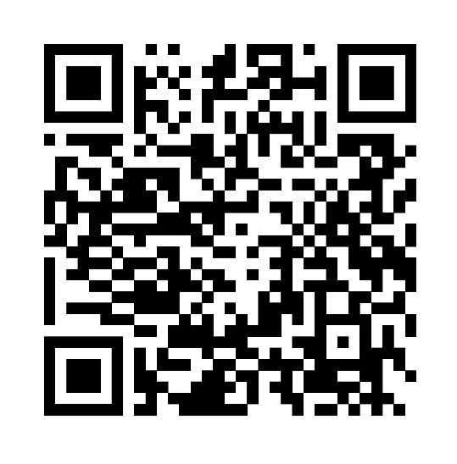
Insurance Trends among Populations at Risk for HIV in New Orleans, LA
Alayna Gillespie¹$,$William T. Robinson^{1,2}
¹Louisiana State University Health Sciences Center, School of Public Health; ²Louisiana Department of Public Health STI/HIV/Hepatitis Program (SHHP)
publichealth.lsuhsc.edu
Background
Results
Discussion
Health insurance is associated with improved health outcomes, fewer disease related deaths, and reduced financial burden.¹ Medicaid, a government funded health insurance for people with low incomes, provides members with vital access to preventative care, testing, and treatment at no or reduced cost.² In 2016, Louisiana expanded Medicaid coverage for adults aged 19 to 64 to include those with household incomes between 100% and 138% of the federal poverty level. Within the first year, Louisiana had enrolled over 430,000 new members.³
The impact of expansion on the general population is documented; however, little is known about Medicaid membership among key populations who are at increased risk for HIV and who may be hidden or hard to reach. The National HIV Behavioral Surveillance (NHBS) conducts annual, rotating behavioral surveillance focused on men who have sex with men (MSM), people who inject drugs (PWID), and heterosexual people at increased risk for HIV living in New Orleans, LA. Access to NHBS data provides an opportunity to explore longitudinal trends in insurance status among key populations.
Prior to Medicaid expansion, MSM reported the lowest Medicaid membership (9%) and uninsurance (26%). Uninsurance among HET decreased by 1% and Medicaid membership increased 2% between 2016 and 2019. Prior to expansion, 58% of PWID reported being uninsured dropping to 30% in 2018. Highest Medicaid membership was reported by PWID in 2022 at 74%, a 47% increase from pre-expansion. Insurance status was found to have a statistically significant association with Medicaid expansion status (p<.001).
By examining NHBS data from 2014 to 2024, we found that Medicaid membership increased among all populations after Medicaid expansion in Louisiana, with highest increases in membership among PWID. PWID are vulnerable to health risks beyond HIV including HCV, abscesses, overdose, and harmful injection practices. Having adequate health insurance is integral in providing access to primary care, harm reduction services, naloxone, HCV testing, and treatment to mitigate potential health risks. Medicaid membership among PWID has also provided the opportunity to introduce free HCV treatment through Medicaid directly to the population with greatest need.
While HET income eligibility directly corresponds with Medicaid eligibility (income below 138% of federal poverty line), Medicaid membership and uninsurance changed only a small amount after expansion. Due to COVID-19 related closures, we could not examine status among HET participants beyond 2019.
MSM also saw a slight increase in Medicaid membership although most participants reported having private insurance. MSM reported higher incomes than other key populations making them less likely to qualify for Medicaid.⁵
Table 1. Demographic Characteristics by NHBS Population, 2014-2024
Variable | MSM N=1436 | PWID N=2245 | HET N=1184
Age (years), Mean (SD)¹ | 38 (12) | 42 (11) | 42 (12)
Race, n (%)
Black/African American | 454 (32) | 961 (43) | 1002 (85)
White | 812 (58) | 1082 (49) | 106 (9)
Other | 140 (10) | 187 (8) | 68 (6)
Gender, n (%)
Male | 1436 (100) | 1559 (70) | 661 (56)
Female |  | 654 (30) | 523 (44)
HIV rapid test result, n (%)
Non-reactive | 1024 (78) | 2088 (94) | 1109 (95)
Reactive | 292 (22) | 127 (6) | 60 (5)
HCV rapid test result, n (%)²
Non-reactive | 363 (96) | 764 (35) | 389 (78)
Reactive | 16 (4) | 1414 (65) | 108 (22)
Objective
Future Steps
The objective of this study was to examine longitudinal trends in Medicaid membership and health insurance status among key populations at risk for HIV in New Orleans, LA between 2014 and 2024.
Apply lessons learned in Louisiana to guide Medicaid expansion in other states in the Deep South.
Utilize Medicaid enrollment or reenrollment to promote other related healthcare initiatives such as HCV testing, treatment, or risk reduction services.
Continue to examine Medicaid membership over time within the context of changing policies and funding.
^{1 SD: Standard Deviation}
2 HCV tests were not conducted in 2014, 2016, or 2023
Methods
Table 2. Insurance Status by Medicaid Expansion, 2014-2024
Anonymous hour-long interviews and rapid blood-based HIV/HCV testing were conducted between 2014 and 2024 in New Orleans, LA. Participants were recruited through venue-based sampling (VBS) and respondent-driven sampling (RDS). MSM were recruited at venues where they commonly socialized. PWID and HET were recruited through RDS, a modified chain referral technique for hidden or hard to reach populations where participants recruit their peers into the study. Trained project staff administered computer assisted personal interviews, rapid blood-based HIV and HCV tests, brief counseling, and linkage to resources. Participants received incentives for the survey and HIV test, about $50, on a reloadable gift card. RDS participants received additional incentives for recruiting others, about $10 per person. ⁴
Eligible NHBS participants were at least 18 years old, lived in the New Orleans Metropolitan Statistical Area (MSA), had not previously participated that year, and were able to conduct the interview in English or Spanish. MSM reported having sex with a man in the past 12 months, PWID had injected a drug not prescribed to them in the past 12 months, and HET reported household income below 138% of the federal poverty line.⁴
Univariate and bivariate analyses were conducted using SAS v. 9.4. RDS data were not weighted to account for unequal probability of selection. Note that COVID-19 closures resulted in skipped or altered research cycles and HCV test data were not available in 2014, 2016, or 2023.
 | Pre-Expansion (2014-2016) N=1811 | Post-Expansion (2017-2024) N=2955 | P-value²
Insurance status, n (column %) |  |  | <.001
Medicaid only | 594 (33) | 1507 (51)
Other type¹ | 601 (33) | 925 (31)
Uninsured | 616 (34) | 523 (18)
1 Other type includes private (from employers or purchased directly), Medicare, Veteran’s Administration Coverage, TRICARE/CHAMPUS, or another health insurance.
2 Chi-square test for significance. P-values<.05 are considered statistically significant.
References
Figure 1. MSM, PWID, and HET Insurance Status by Year
¹ Bin Abdul Baten, R., Noman, A., & Rahman, M. N. (2024). Affordable Care Act Medicaid expansion, access to health care, and financial behavior of the United States adults. Journal of public health policy, 45(4), 740–756. https://doi.org/10.1057/s41271-024-00522-0
² Buchmueller TC, Cliff BQ, Levy H. (2020). The Benefits of Medicaid Expansion. JAMA Health Forum. 2020;1(7):e200879. doi:10.1001/jamahealthforum.2020.0879
³ Louisiana Department of Health. (2017). Medicaid Expansion 2016-2017 Annual Report.
⁴ Kanny, D., Broz, D., Finlayson, T., Lee, K., Sionean, C., Wejnert, C., & NHBS Study Group (2022). A Key Comprehensive System for Biobehavioral Surveillance of Populations Disproportionately Affected by HIV (National HIV Behavioral Surveillance): Cross-sectional Survey Study. JMIR public health and surveillance, 8(11), e39053. https://doi.org/10.2196/39053
⁵ Artenie, A., Facente, S. N., Patel, S., Stone, J., Hecht, J., Rhodes, P., 3rd, McFarland, W., Wilson, E., Vickerman, P., & Morris, M. D. (2022). A cross-sectional study comparing men who have sex with men and inject drugs and people who inject drugs who are men and have sex with men in San Francisco: Implications for HIV and hepatitis C virus prevention. Health science reports, 5(4), e704. https://doi.org/10.1002/hsr2.704
Acknowledgement
expansion
The authors would like to thank the Centers for Disease Control and Prevention and local NHBS project staff.

