Slide 1


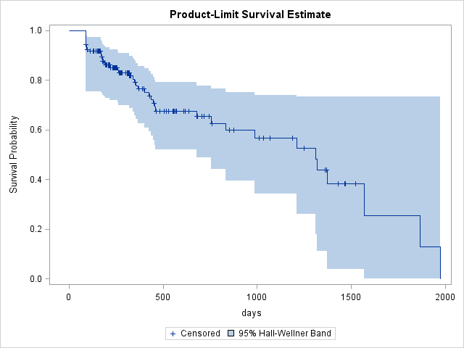
Analyzing Pre-exposure Prophylaxis (PrEP) Persistence: Insights to Louisiana’s TelePrEP Program
Sarah Northup, Debbie Wendell Mei-Chin Hsieh, Madison Albright, Thalia Nakouzi, Jan Mandani, Emma De la Rosa, STD/HIV/Hepatitis Program (SHHP), Louisiana Office of Public Health, and Louisiana State University Health Sciences Center, New Orleans, LA 70112, USA.
Louisiana State University Health Sciences Center School of Public Health
publichealth.lsuhsc.edu
Background
Results
Characteristics of Clients Enrolled in TelePrEP
Results: Characteristics of Clients
HIV (human immunodeficiency virus) is a virus that attacks the body’s immune system and if not treated can progress to AIDS.
PrEP (Pre-exposure Prophylaxis) is a medication for HIV-negative people who want to maintain their negative status.
To address HIV transmission disparities, the Louisiana Office of Public Health, STD/HIV/Hepatitis Program (SHHP) piloted the launch of the TelePrEP Program in 2018, which allows people to connect virtually with a qualified, clinical PrEP provider without going to a clinic/doctor’s office.
Table 1: Characteristics of Clients Enrolled in TelePrEP for at Least 90 Days vs Those Who Dropped Out
Table 2: Adjusted Cox PH Model of Covariates Associated with PrEP Persistence
Of the 219 individuals, 34.7% were black, 81.3% were male, and 35.6% preferred to be contacted by email. The median time to first PrEP discontinuation was 1,310 days.
In multivariate analysis, email (aHR=5.68, 95% CI 2.75-11.76), black (aHR=2.10, 95% CI 1.04-4.07), and multiracial/other (aHR=6.47, 95% CI 2.84-14.78) significantly influenced dropout rates in both models analyzed (90 days and 180 days). Sexual orientation, age, gender, and insurance were not significant.
Objective
The objective of this study was to determine what characteristics are predictors of PrEP persistence, defined as the time to first PrEP discontinuation (i.e., the ability of clients to continue using PrEP over time).
Methods
Results
We retrospectively reviewed program records from May 2018 to September 2023, identifying 219 eligible clients. Clients were considered to be enrolled if they received at least one filled prescription (equivalent to a 90-day or 3-month supply) of PrEP.
To assess the persistence of PrEP, we employed two statistical methods. First, we used Kaplan-Meier analysis to estimate the probability of individuals remaining on PrEP over time. Second, we applied Cox Proportional Hazard Modeling to account for covariates that may influence this relationship.
Additionally, we conducted a sensitivity analysis in Model 2, which included individuals with two or more prescriptions (equivalent to a 180-day or 6-month supply), aiming to mitigate bias from recently enrolled participants.
Figure 1: Kaplan-Meier Survival Plot of PrEP Persistence
Conclusion
Overall, contact method and race were significant predictors of PrEP persistence. However, insurance type, sexual orientation, and age groups were not significant predictors of staying on PrEP.
Clients who were black or multiracial/other had a consistently higher dropout rate compared to white clients highlighting potential racial disparities in engagement with the TelePrEP program. In addition, clients who preferred to be emailed had a higher dropout rate compared to the texting group. Clients who preferred to be contacted by telephone had a lower dropout rate but the effect was not significant in both models.
The program should find ways to engage black/multi-racial clients and explore the contact methods that lead to improved engagement. Tailoring communication to client preferences and adjusting the method of contact when a response is not timely may improve outcomes.

