Slide 1
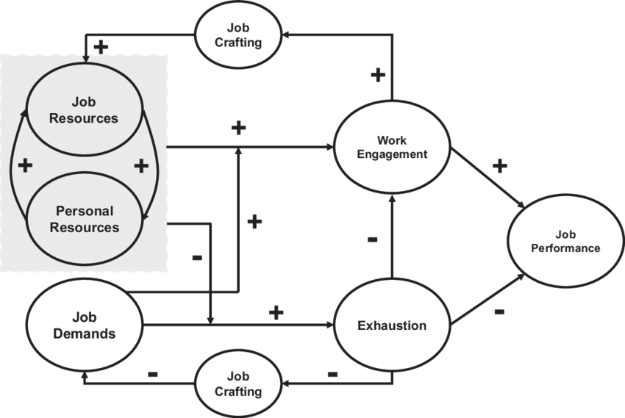
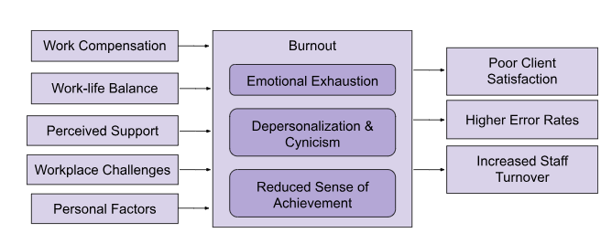
A Deeper Delve Towards Understanding Burnout Among Child Welfare: A Comparative Analysis
Viet Le, BS; Amy Rinner, PsyD.; Sebastián Del-Corral-Winder, Psy.D.; Amy Dickson, PsyD. LSUHSC Department of Public Health
Louisiana State University Health Sciences Center School of Public Health
publichealth.lsuhsc.edu
Background
Methods
Theoretical Framework
Burnout among child welfare workers poses significant challenges to workforce well-being and service delivery.
By mitigating burnout, DCFS can enhance workforce resilience and effectiveness, ultimately improving outcomes for the vulnerable populations they serve (Figure 1).
Comparing data from different DCFS communities allows identification of shared and unique factors contributing to burnout in a specific state, facilitating targeted interventions.
This study follows a mixed-methods approach:
Burnout will be quantitively measured through a comprehensive survey administered via validated measurements such as the Maslach Burnout Inventory (MBI)
Etiologies of burnout & current strategies to combat burnout will be qualitatively discovered via focus groups and tailored questions from the survey.
The Job Demands-Resources (JD-R) model (Figure 2) is a burnout-focused model; it categorizing workplace factors into job demands and resources.
Job demands require sustained effort and are associated with certain physiological and/or psychological costs (e.g., workload, emotional demands).
Job resources function in achieving work goals, reduce job demands and the associated costs, or stimulate personal growth and development.
Study Design
Figure 2. The Job Demands-Resources Model (Bakker & Demerouti, 2014)
Project Planning
Define Scope & Objectives
Identify Stakeholders & Establish Project Team
Survey & Focus Group Design
Literature Review
Create Focus Group Questions
Incorporate Validated Measurements
Develop Tailored Quantitative Survey Questions
Figure 1. Preliminary Logic Model for Burnout in DCFS.
Study Objectives:
Pilot Testing
Assess burnout rates among two different DCFS communities
Identify contributing factors contributing to burnout for DCFS workers in both communities
Evaluate existing strategies and interventions used between both aimed at mitigating burnout
Inform future strategies to improve employee wellbeing and retention going forward
Organize Feedback Groups for Questions
Refine Survey & Focus Group Questions
Data Collection
Distribute Surveys
Organize & Conduct Focus Groups
Discussion & Conclusion
Data Analysis & Evaluation
By understanding and mitigating burnout, DCFS can enhance workforce resilience and effectiveness, ultimately improving outcomes for the vulnerable populations they serve.
Moving forward, ongoing monitoring and evaluation of workplace practices and interventions will be essential to sustainably address burnout within DCFS.
Draft Survey Report
Theme Analysis on Focus Group & Survey Questions
Prepare presentation & Dissemination Materials
Present Findings to DCFS Leadership
Outline Steps for Further Intervention

