Slide 1

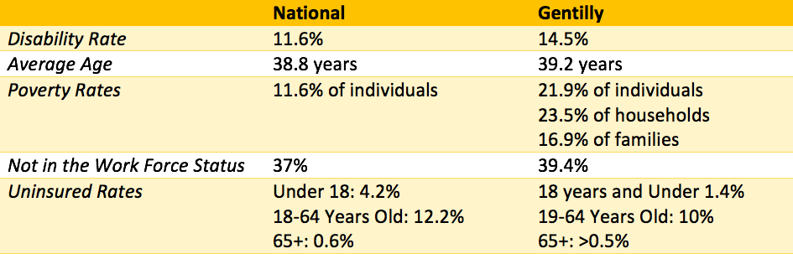
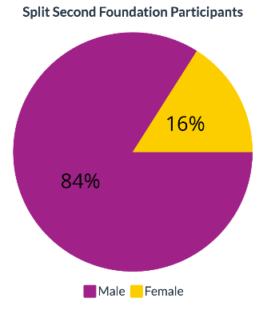
ASSET MAPPING FOR PEOPLE WITH DISABILITIES IN GENTILLY COMMUNITY
GV Gonzalez¹, KN Witmeier¹, M Norman², P Wilson², M Delahoussaye³, TS Tseng¹
¹Louisiana State University Health Sciences Center, School of Public Health; ²Human Development Center, Louisiana State University Health Sciences Center ; ³Split Second Foundation
Purpose
Results
Discussions
Gentilly, a central New Orleans neighborhood, is noted as a racially diverse and historic community. Limited sources provide insight into the Gentilly community’s makeup and needs, particularly identifiable existing services, resources, and supports for individuals living with disabilities. Through asset mapping, this study aimed to identify existing community resources and demographics to gain insight into the community’s strengths and needs. Along with the Split Second Foundation (SSF), we plan to conduct future qualitative interviews to discover needs of those living with spinal cord injuries (SCI) and develop future interventions.
Our analysis identified 14.5% (n=10,700) of Gentilly as having a disability higher than the national average of 11.6%.
Demographic analyses designated 68.7% of the community as Black/African American, 21.9% earning income below the poverty level, and 39.4% not in the labor force.
The Gentilly neighborhood consists of two community health centers serving the public, varied disability-related programs, health and social services, recreational spaces, and grocery stores.
The Gentilly neighborhood is a community of color with high rates of those with disability and who are insured. We also identified lower-than-average income and employment rates. While community services exist, we know little about the availability and quality of these resources. There is an overall lack of resources, including available specific and patient-centered care and ADA-accessible public transportation.
The SSF assists clients from the Gentilly and surrounding areas to assist in the transition from inpatient rehab back into society, including increased assess to mental healthcare, support, resource navigation, and other services.
Tables/Figures
Background
Comparison of National vs. Gentilly Demographics
Spinal cord injuries (SCI) are medically complex and impactful disabilities resulting from injury to the spinal cord or surrounding tissue. According to the Christopher Reeve Foundation, the annual incidence of SCI is approximately 54 cases per one million people in the U.S., or about 18,000 new SCI cases annually. The population of Louisiana (4,553,384) comprises about 13.4% of the U.S. population. A rough conservative estimate of the number of people living with a SCI in Louisiana can be established at 33,500 by extrapolating from the estimated number of individuals living with SCI in the U.S. Common risk factors for spinal cord injuries include being male, engaging in alcohol use, performing risky behavior, and having certain diseases, such as osteoporosis. SCIs can result from many things, including but not limited to motor vehicle accidents, falls, acts of violence, and medical or surgery injuries. Two age ranges at highest risk for SCI include those 16 to 30 years and over 65. There is growing recognition that mental health and social impacts (e.g., depression, anxiety, sense of belonging) influence health outcomes and QOL of persons with SCIs.
Future Steps
Further study is needed to collaborate with community partners to conduct qualitative interviews/focus groups with community members to determine the community's availability of services and needs. This may assist with garnering insight into the community’s perceived needs and identifying ways to address unknown community deficits. After conducting qualitative interviews to determine the needs of those living with disability, we will implement a 2 years study to assess the feasibility and acceptability of a Community Navigator delivered approach to supporting persons with SCI in high-poverty communities in New Orleans using sequential mixed methods.
References
Barclay, L., Mcdonald, R., Lentin, P., & Bourke-Taylor, H. (2016). Facilitators and barriers to social and community participation following spinal cord injury. Australian Occupational Therapy Journal, 63(1), 19–28. https://doi.org/10.1111/1440-1630.12241
Barclay, L., Robins, L., Migliorini, C., & Lalor, A. (2021). Community integration programs and interventions for people with spinal cord injury: a scoping review. Disability and Rehabilitation, 43(26), 3845–3855. https://doi.org/10.1080/09638288.2020.1749889
Boakye, M., Leigh, B. C., & Skelly, A. C. (2012). Quality of life in persons with spinal cord injury: comparisons with other populations. Journal of Neurosurgery. Spine, 17(1 Suppl), 29–37. https://doi.org/10.3171/2012.6.AOSPINE1252
Centers for Disease Control and Prevention. (2020). Common barriers to participation experienced by people with disabilities. https://www.cdc.gov/ncbddd/disabilityandhealth/disability barriers.html
Cimino, S. R., Cadel, L., Guilcher, S. J. T., Wasilewski, M., & Hitzig, S. L. (2023). Social disconnectedness and perceived social isolation in persons with spinal cord injury/dysfunction living in the community: A scoping review. Journal of Spinal Cord Medicine, 46(3), 367–389. https://doi.org/10.1080/10790268.2022.2129170
Clark, J. M. R., & Krause, J. S. (2022). Life Satisfaction in Individuals With Long-Term Traumatic Spinal Cord Injury: An Investigation of Associated Biopsychosocial Factors. Archives of Physical Medicine and Rehabilitation, 103(1), 98–105. https://doi.org/10.1016/J.APMR.2021.09.002
Dyck, D. G., Weeks, D. L., Smith, C. L., & Shaw, M. (2021). Multiple family group intervention for spinal cord injury: Quantitative and qualitative comparison with standard education. The Journal of Spinal Cord Medicine, 44(4), 572–582. https://doi.org/10.1080/10790268.2019.1710946
Guízar-Sahagún, G., Grijalva, I., Franco Bourland, R. E., & Madrazo, I. (2023). Aging with spinal cord injury: A narrative review of consequences and challenges. Ageing Research Reviews, 90, 102020. https://doi.org/10.1016/J.ARR.2023.102020
Gurung, S., Jenkins, H.-T., Chaudhury, H., & Mortenson, W. Ben. (2023). Modifiable Sociostructural and Environmental Factors That Impact the Health and Quality of Life of People With Spinal Cord Injury: A Scoping Review. Topics in Spinal Cord Injury Rehabilitation, 29(1), 42–53. https://doi.org/10.46292/sci21-00056
Mayo Clinic. (2021). Spinal cord injury. https://www.mayoclinic.org/diseases-conditions/spinal-cord-injury/symptoms-causes/syc-20377890
National Institute of Neurological Disorders and Stroke. (2023). Spinal Cord Injury. https://www.ninds.nih.gov/health-information/disorders/spinal-cord-injury
The Data Center. (2023). Planning District 6. The Data Center. https://www.datacenterresearch.org/data-resources/neighborhood-data/district-6/
Tschoepe, R., Benfield, A., Posey, R., & Mercer, V. (2022). A Systematic Review of the Effects of Community Transition Programs on Quality of Life and Hospital Readmissions for Adults With Traumatic Spinal Cord Injury. Archives of Physical Medicine and Rehabilitation, 103(5), 1013-1022.e12. https://doi.org/10.1016/j.apmr.2021.08.002
U.S. Census Bureau. (2022). American Community Survey. United States Census Bureau. https://www.census.gov/programs-surveys/acs
World Health Organization. (2013). International perspectives on spinal cord injury. https://www.who.int/publications/i/item/international-perspectives-on-spinal-cord-injury
Methods
A community needs assessment was conducted using community asset mapping and descriptive analyses with academic partners (LSUHSC Human Development Center and School of Public Health) and community partners (Split Second Foundation and FQHC). The US Census Bureau’s national data was analyzed, and the demographics of individuals with disabilities who use the Split Second Foundation were surveyed. Existing resources serviceable to people with disabilities were identified, including Medicaid services, recreational centers, and disability services. Altogether, this provided a macroscopic understanding of the community.
Acknowledgements
Thank you to Dr. Wilson and Michael Norman from the Human Development Center for initiating our collaboration. Thank you to Mary Delahoussaye for trusting our team to aid clients at the SSF. Special thanks to Dr. Tseng and Kelsey Witmeier at the LSUHSC School of Public Health for the continued teamwork and determination.

