Slide 1
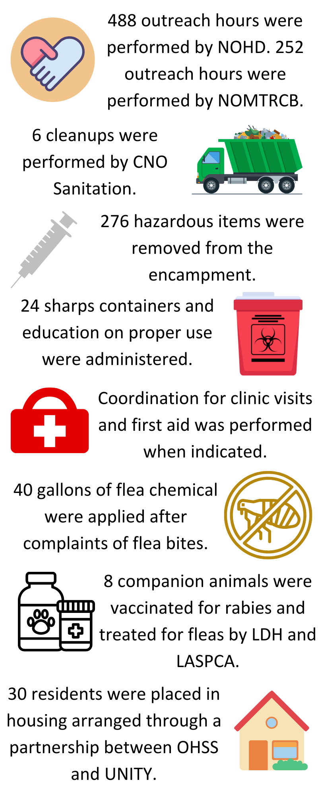
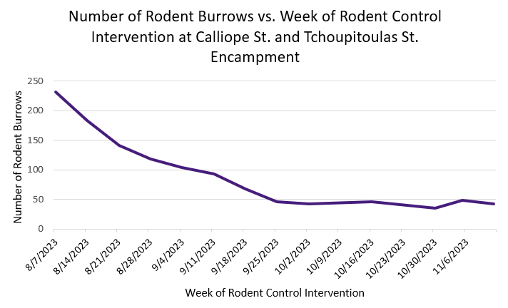
Interdepartmental Collaboration to Address Public Health Issues in a Homeless Encampment in New Orleans
Rachel Denny, MSPH^{1,5}; Rachel Kimble, MPH²; Nathaniel Fields³; Amy Bunch, DVM, MPH⁴; Claudia Riegel, PhD⁵; Susanne Straif-Bourgeois, PhD, MPH, MS¹
¹LSU Health Sciences Center School of Public Health, New Orleans, LA; ²City of New Orleans Health Department, New Orleans, LA; ³City of New Orleans Office of Homeless Services and Strategy, New Orleans, LA; ⁴Louisiana Department of Health, New Orleans, LA; ⁵City of New Orleans Mosquito, Termite, and Rodent Control Board, New Orleans, LA
Louisiana State University Health Sciences Center School of Public Health
Background
Accomplishments
In 2023, the Point in Time survey (PIT) conducted by the City of New Orleans and UNITY identified 1.390 unhoused persons living in Orleans and Jefferson Parishes ([UNITY], 2023)
Homeless encampments, or communities of unhoused individuals living together in an area, lack proper infrastructure for sanitation, hygiene, and shelter. They represent a breakdown in healthcare access for a vulnerable population (Badiaga et al., 2008).
Unhoused populations are a small, high-risk subset of the larger population that can indicate potential infectious disease outbreaks in the community when there are gaps in public health and medical infrastructure (Smith et al., 2002).
Figure 2. Rodent population pressure (as estimated by rodent burrow counts) decreased by 80-85%. 1,682 burrows were treated and 4.205 pounds of dry ice were applied.
Description
Representatives from the City of New Orleans and other state agencies formed a collaborative workgroup in August of 2023 to address and mitigate environmental and social issues contributing to adverse health outcomes in the unhoused population at the encampment located at the intersection of Calliope Street and Tchoupitoulas Street.
Organizations represented in the workgroup included:
City of New Orleans Mosquito, Termite and Rodent Control Board [NOMTRCB]
City of New Orleans Office of Homeless Services and Strategy [OHSS]
City of New Orleans Health Department [NOHD]
City of New Orleans Department of Sanitation [CNO Sanitation]
New Orleans Police Department [NOPD]
Louisiana Department of Health [LDH]
Louisiana SPCA [LASPCA]
Discussion
Interdepartmental and interagency collaboration allowed for issues contributing to adverse health outcomes in the Calliope & Tchoupitoulas encampment to be addressed from environmental, social, and One Health perspectives.
The encampment at Calliope & Tchoupitoulas was closed on 11/17/2023. Before the closure, there were no major infectious disease outbreaks reported.
Personal relationships developed from individual, 1-1 interactions with encampment residents during outreach contributed heavily to the success of intervention efforts, indicating the need for compassion and care when implementing public health measures.
Text
Text
Text
Future Steps
The City of New Orleans will continue to use an interdepartmental and interagency working model to address public health issues within the encampments. NOHD continues weekly cleanups.
NOMTRCB aims to collect data on pathogen prevalence in vectors/reservoirs of infectious disease in homeless encampments to improve public health interventions.
OHSS will continue to expand its efforts to house encampment residents with partner organizations and close the remaining encampments.
Encampment Intervention Objectives
References
Badiaga, S., Raoult, D., & Brougi, P. (2008). Preventing and controlling emerging and reemerging transmissible diseases in the homeless. Emerging Infectious Diseases, 14(9): 1353-1359.
Smith, H.M., Reporter, R., Rood, M.P., Linscott, L.M., Mascola, W., Hogrefere, W., & Purcell, R.H. (2002). Prevalence study of antibody to ratborne pathogens and other agents among patients using a free clinic in downtown Los Angeles. The Journal of Infectious Diseases, 186(11): 1673-1676.
UNITY of Greater New Orleans [UNITY]. (2023). Progress Reversed: After Pandemic Initiatives Drive Homelessness Down, Soaring Rents Push Numbers Back Up. 2023 Point in Time Report.
1.
2.
3.
4.
Keep disease-carrying waste and pests away from people.
Prevent the spread of sanitation-related diseases.
Break existing disease transmission cycles.
Improve the target population’s health and quality of life.
Figure 1. Infographic summary of the accomplishments of collaborative efforts at the Calliope St. & Tchoupitoulas St. Encampment
Acknowledgments
Acknowledgments to all of the partner organizations and employees of the City of New Orleans, LSUHSC, UNITY, LDH, and LAPSCA working to improve the health and quality of life for the unhoused population in the Greater New Orleans area.

