Slide 1
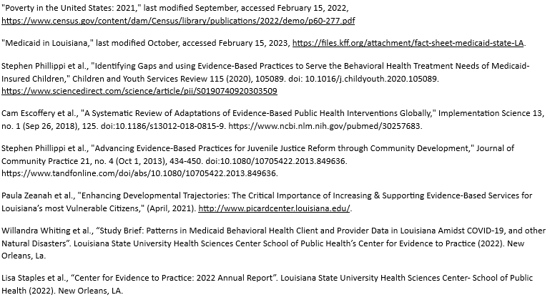
Implementation Science Applied: Expansion of Evidence-Based Programs in Louisiana
Willandra Whiting, MPH, REHS; Sara Juneau, MPH; Ashley Fenton, MS; Kelsey Witmeier, MPH; Stephen Phillippi, Jr., PhD, LCSW, CCFC
Louisiana State University Health Sciences Center School of Public Health
publichealth.lsuhsc.edu
Background
Accomplishments
Discussion
According to the most recent 2021 US Census Bureau data, Louisiana ranks as the 2nd most impoverished state in the country , with approximately half of its children enrolled in Medicaid.
Given that behavioral health conditions can develop in children whose vulnerabilities make them susceptible to poverty's effects, it is understandable that Medicaid is the US's largest payer of behavioral healthcare services.
Research has shown that evidence-based programs (EBPs), referred to as the "gold standard," are more effective in improving children's long-term behavioral health outcomes and reducing the amount entering the juvenile justice system.
There has been a notable growth of EBP provider teams from 2006, to the present . The Center for Evidence to Practice (The Center), in collaboration with LDH/OBH, works to expand the breadth of the utilization of EBPs in Louisiana by providing training to clinicians, mapping services and providers and monitoring EBP use across Louisiana
Louisiana has remained the nation's first and second in terms of FFT and MST usage, per capita, since 2014.
LA 2006 EBP Map
LA 2014 EBP Map
Combining a top-down, bottom-up approach to implementation science, Louisiana matches state-supported EBP dissemination standards and addresses grass-roots community needs.
Expanding behavioral healthcare services in Louisiana by increase training access to providers, streamlining the EBP certification process, and track training cohorts is paramount to the continued growth of EBPs in Louisiana.
These implementation driven outcomes are promising from the currently tracked EBPs and provide a template for the potential proliferation of other EBPs used statewide
Future Steps
LA 2019 EBP Map
LA 2022 EBP Map
Text
Text
Text
Continue monitoring behavioral healthcare access in Louisiana and identify gaps in EBP uptake.
Continue improving the timeliness and accuracy of the EBP provider map updates maintained by The Center to improve referral accuracy and reduce frustration with accessing care.
Description
References
The Center has tracked the provision of EBP services by offering a public online mapping service utilizing ArcGIS, providing the geolocation of EBP providers in Louisiana.
The Center is currently tracking three interventions: Multisystemic Therapy (MST), Functional Family Therapy (FFT), and Home Builders that are presently identifiable in Medicaid claims based on their use of tracking codes termed EBP modifiers.
The other services tracked by The Center largely through self-reported provider data: Child Parent Psychotherapy (CPP), Eye Movement Desensitization and Reprocessing (EMDR), Functional Family Therapy- Child Welfare (FFT-CW), Nurse Family Partnership (NFP), Parents as Teachers (PAT), Parent Child Interaction Therapy (PCIT), Positive Parenting Program (Triple P), Preschool PTSD Treatment (PPT), Trauma Focused Cognitive Behavioral Therapy (TF-CBT), and Youth PTSD Treatment (YPT).
Annually the map is updated by the confirmation of providers through a REDCap survey, emails, phone calls and updated list of statewide providers. The map lists providers, EBPs they are trained to offer, managed care organization affiliations and contact information.
2006-2014
The graphics show the start of MST and FFT implementation in 2006 and the progression and growth of those services into 2014 (Referenced from Louisiana Models for Change EBP expansion initiative)
2019
In 2019, The Center developed a mapping system for EBP providers in LA using ArcGIS
2022
The current state of EBPs in Louisiana and the current dissemination of EBPs for youth and families in the state.
Acknowledgement
The Center for Evidence to Practice in collaboration with the Louisiana Department of Health- Office of Behavioral Health (LDH/OBH)

