Slide 1
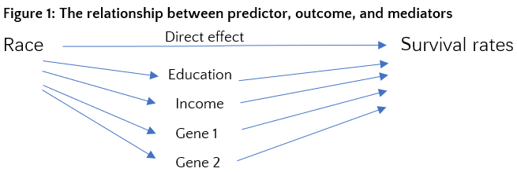
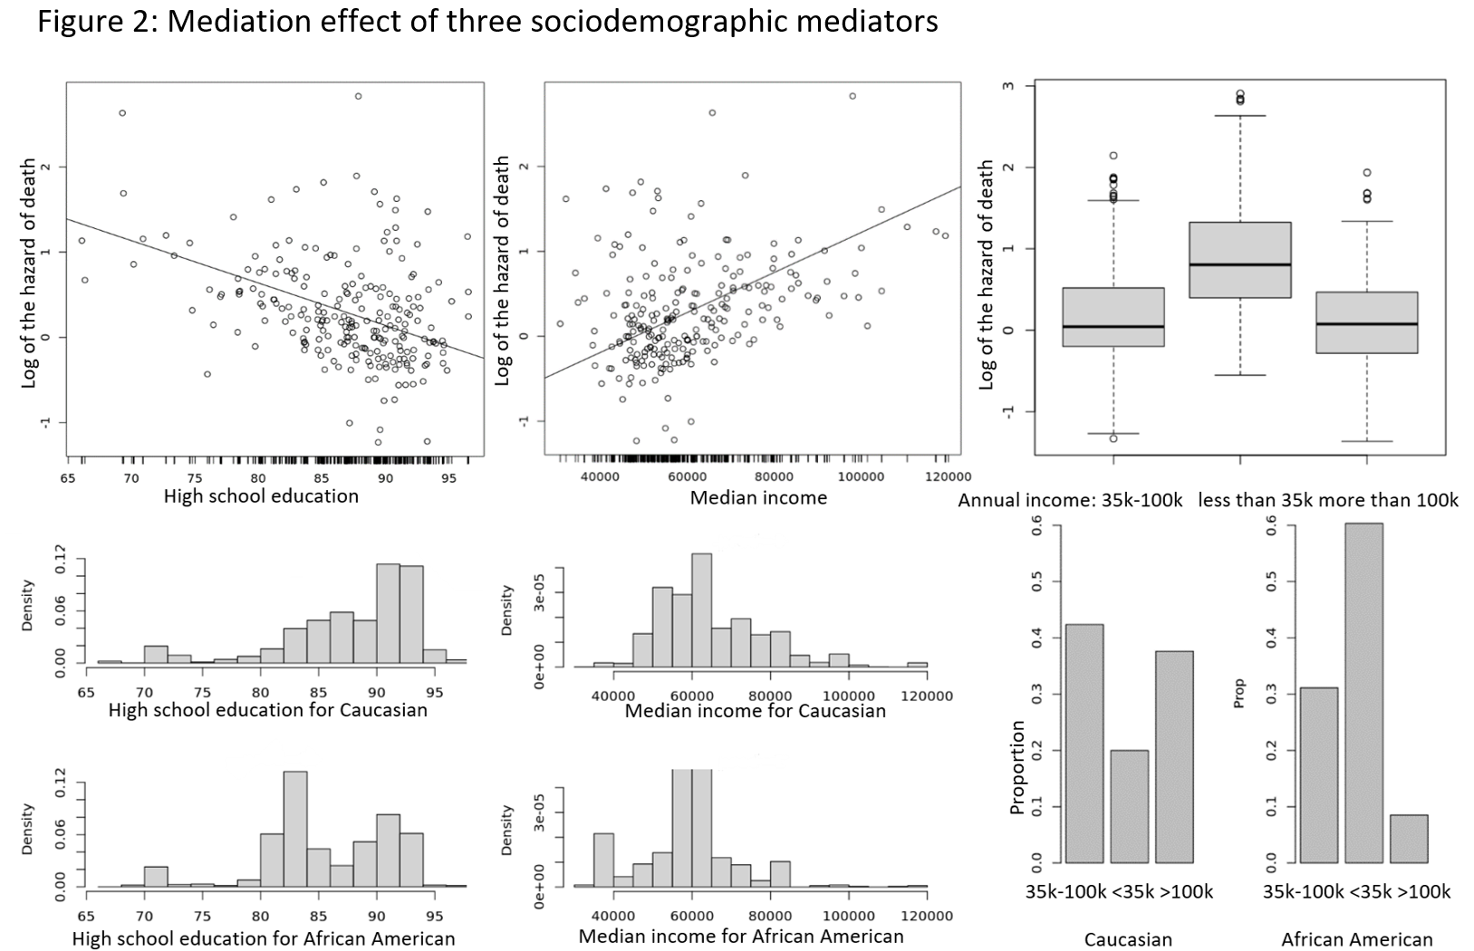
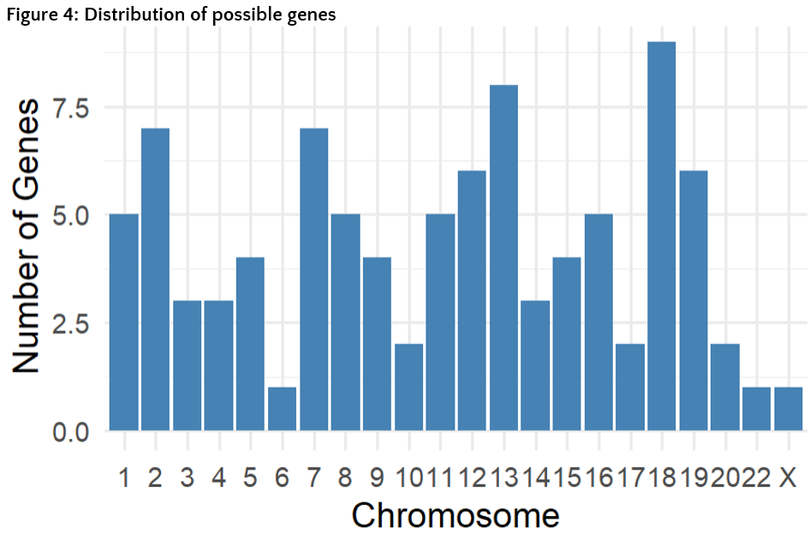
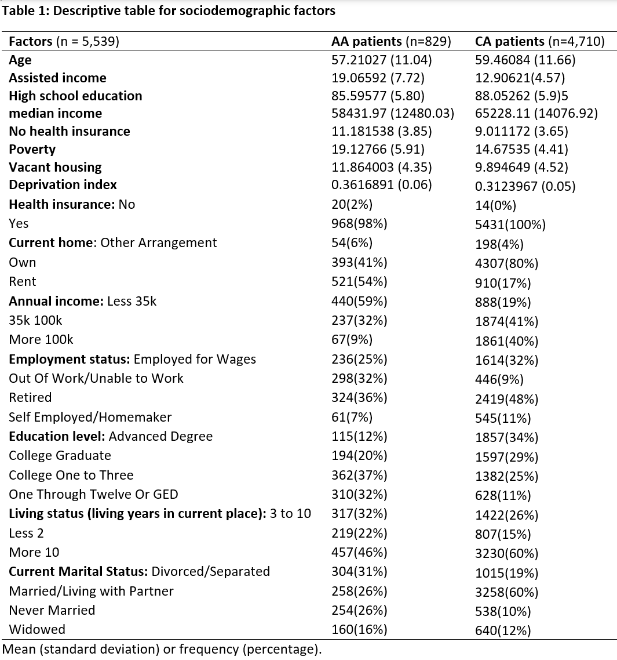
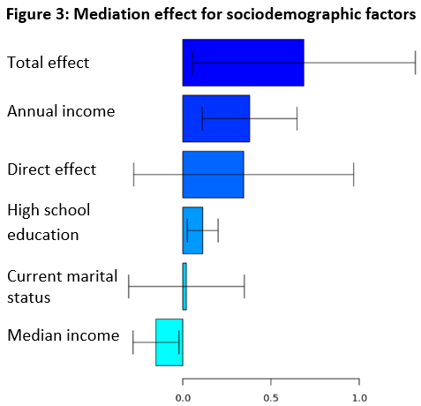
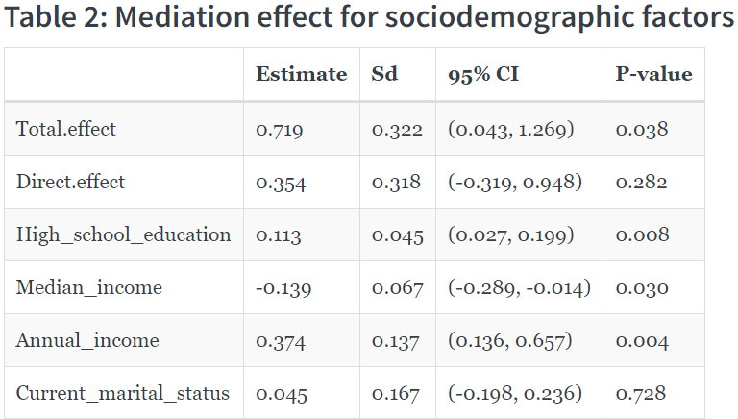
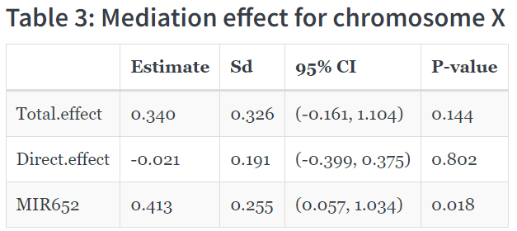
Environmental, Behavioral, and Genetic Factors on Racial Disparities in Breast Cancer Outcomes
Yaqi Zou$^{1}$, Nubaira Rizvi$^{1}$, Kennedy Dorsey$^{1}$, Yaguang Xi$^{2}$, Qingzhao Yu$^{1}$
${ }^{1}$ LSUHSC School of Public Health; $^{2}$ LSUHSC School of Medicine
Louisiana State University Health Sciences Center School of Public Health
publichealth.lsuhsc.edu
Introduction
Race with Survival Rates: The log-rank test was used to test the association between the survival rates and race, p-value is 0.007, indicating that there is a significant racial disparity in breast cancer survival rates.
Mediation Analysis for Sociodemographic factors: All factors are significant in univariate cox proportional hazard model, after pooling all significant factors into a multivariable cox proportional hazards regression model, R package “mma” was then used to identify and quantify mediate effects based on General Linear Models. As a result, high school education, median income, and annual income were found to be mediators. The significance level was set at 0.05 for all tests.
rates (control sample contamination), including only variants above the set minor allele frequency threshold, excluding variants which deviate from Hardy–Weinberg equilibrium (indicator of genotyping error), keeping variants with call rates greater than 95%, there are around 50,000 genes across 23 chromosomes.
Analysis for Genes: For each chromosome, univariate cox proportional hazard models were used to screen genes at significant level 0.005. Then put all genes after screening into a single model for each chromosomes. 85 genes were found to relate to survival rates. In addition, 73 of these genes were found to distribute differently between the AA and CA populations.
Background: Health disparities in cancer-related outcomes disproportionately affect African American and Hispanic populations in the US. The All of Us (AoU) program integrates health data from a diverse group of participants in the United States. The AoU study provides a great opportunity for researchers to investigate health disparities, considering interactive factors from multiple levels.
Objectives: This study aims to identify mechanisms underlying racial and ethnic disparities in breast cancer survival rates among female patients based on the AoU program's database.
Methods and Results
Future Steps
Identify possible genes on each of the 23 chromosomes that explain the racial disparity in breast cancer survival using the “mma” method with nonlinear models. A preliminary analysis found one gene on the X chromosome to be associated with racial disparities in survival rates.
Conclusions
Gene data: Of all breast cancer patients, 1,754 had genetic data available, among which 230 were African American (AA) and 1,524 were Caucasian (CA).
Whole genome sequencing data was used, after quality control: removing highly related individuals, excluding individuals with high or low heterozygosity
In conclusion, racial disparities exist in survival rates among breast cancer patients. Notably, higher levels of education and yearly income can partially explain the racial disparity. Moreover, around 73 genes, spread across the 23 chromosomes, may also contribute to the racial disparity in survival.

