Slide 1
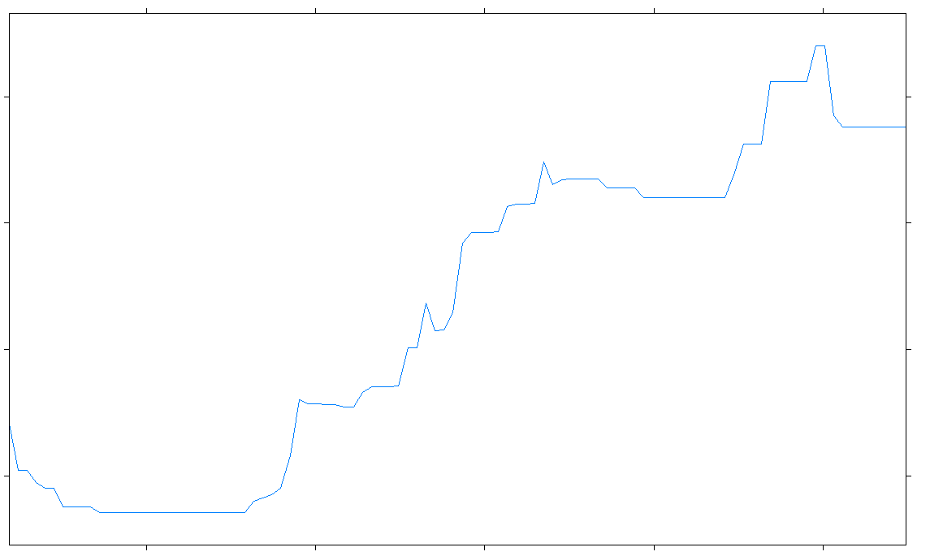
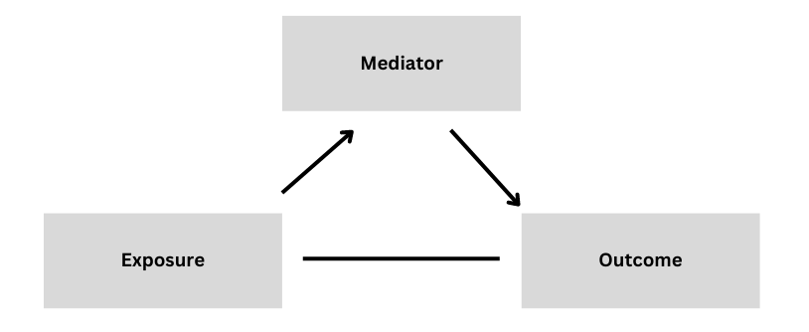
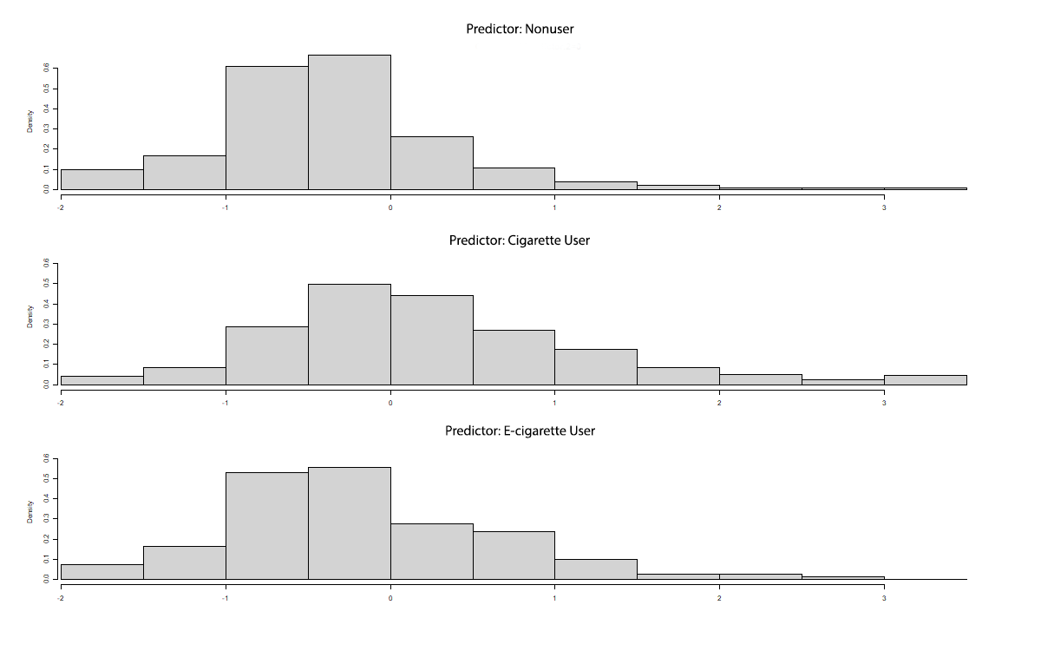
Explaining Differences in Cardiovascular Disease Occurrence for Cigarette Users
Kennedy Dorsey, Michael Celestin, PhD, & Qingzhao Yu, PhD
Louisiana State University Health Sciences Center School of Public Health
publichealth.lsuhsc.edu
Background
Accomplishments
Discussion
Cigarette smoking has been associated with negative cardiovascular health outcomes ¹. In addition, e-cigarette use can expose one to harmful chemicals when exposed to its vapor ². Quantifying the health risk of an individual can help in disease prevention, and biomarkers can aid in understanding someone’s risk for disease.
Using data from the Population Assessment of Tobacco and Health (PATH) Study, mediation analysis was conducted to see if any biomarkers mediate, or help explain, the differences in cardiovascular disease occurrence for cigarette and e-cigarette users, if such a relationship exists ^{3,4}.
Inflammation biomarkers high sensitivity C-reactive protein (hsCRP) and soluble adhesion molecule-1 (sICAM-1) had significant indirect effects. A polycyclic aromatic hydrocarbon, 1-naphtol, was significantly related with the outcome, but not the exposure variable.
The odds of cardiovascular disease occurrence for cigarette users was 1.11 times the odds of that for nonusers (p < 0.001).
There was no significant difference in the odds of cardiovascular disease occurrence for e-cigarette users and nonusers.
The direct effect of user type (cigarette use vs. nonuse) on the occurrence of cardiovascular disease was insignificant.
Inflammation biomarkers hsCRP, sICAM-1 show potential in explaining the differences in cardiovascular disease occurrence for cigarette users. This agrees with previous research ^{5,6}.
E-cigarette use was not associated with a difference in cardiovascular disease occurrence, agreeing with previous research ⁷.
A polycyclic aromatic hydrocarbon, which has evidence of association with cigarette use, was related with the outcome, the occurrence of disease, but not with cigarette or e-cigarette use ⁸.
Limitations include small sample sizes, only accounting for the conditions high blood pressure, high cholesterol, and diabetes, and not accounting for length of cigarette/e-cigarette use or possible change in cigarette/e-cigarette use after Wave 1.
Description
The factors from the PATH Study include age, gender, race, ethnicity, education level, tobacco user type, and disease occurrence status. Conditions include congestive heart failure, stroke, heart attack, and other cardiovascular conditions. The biomarkers include all biomarkers collected by the PATH Study (N=59).
Using gradient boosting trees, a predictive model was fit on the occurrence of disease. Only the biomarkers with nonzero relative influence were included in the mediation analysis.
In the mediation analysis, nonlinear methods were used. The exposure variable was tobacco user type, with nonuser as the reference. The outcome was occurrence of disease, a binary variable. The biomarkers were the potential mediators.
Biomarker | Relative Indirect Effects (95% CI)
hsCRP | 82.7% (51.2%, 100%)
sICAM-1 | 20.7% (4.5%, 45.6%)
Future Steps
Note: Figures are approximate and not from exact analysis.
Future steps include performing the analysis using future PATH Study waves as the data becomes available. Another potential step is to look for ways to account for length of cigarette/e-cigarette use and changes in user type that may occur throughout the study waves.
Log odds disease occurrence
0.09
0.08
0.07
References
0.06
1. U.S. Department of Health and Human Services (USDHHS). 1, Introduction, Evaluation of Evidence on Mechanisms of Disease Production, and Summary. in How Tobacco Smoke Causes Disease: The Biology and Behavioral Basis for Smoking-Attributable Disease: A Report of the Surgeon General (Centers for Disease Control and Prevention (US); National Center for Chronic Disease Prevention and Health Promotion (US); Office on Smoking and Health (US), 2010).
2. Marques, P., Piqueras, L. & Sanz, M.-J. An updated overview of e-cigarette impact on human health. Respir. Res. 22, 151 (2021).
3. United States Department of Health and Human Services, National Institutes of Health, National Institute on Drug Abuse, and United States Department of Health and Human Services, Food and Drug Administration & Center for Tobacco Products. Population Assessment of Tobacco and Health (PATH) Study [United States] Restricted-Use Files. (2022).
4. United States Department of Health and Human Services, National Institutes of Health, National Institute on Drug Abuse, and United States Department of Health and Human Services, Food and Drug Administration & Center for Tobacco Products. Population Assessment of Tobacco and Health (PATH) Study [United States] Biomarker Restricted-Use Files. (2022).
5. Becker, A. et al. Why is soluble intercellular adhesion molecule-1 related to cardiovascular mortality?: sICAM-1 and cardiovascular mortality. Eur. J. Clin. Invest. 32, 1–8 (2002).
6. de Ferranti, S. D. & Rifai, N. C-reactive protein: a nontraditional serum marker of cardiovascular risk. Cardiovasc. Pathol. 16, 14–21 (2007).
7. Berlowitz, J. B. et al. E-Cigarette Use and Risk of Cardiovascular Disease: A Longitudinal Analysis of the PATH Study (2013–2019). Circulation 145, 1557–1559 (2022).
8. U.S. Department of Health and Human Services (USDHHS). 3, Chemistry and Toxicology of Cigarette Smoke and Biomarkers of Exposure and Harm. in How Tobacco Smoke Causes Disease: The Biology and Behavioral Basis for Smoking-Attributable Disease: A Report of the Surgeon General (Centers for Disease Control and Prevention (US); National Center for Chronic Disease Prevention and Health Promotion (US); Office on Smoking and Health (US), 2010).
-1
0
1
2
3
Density
sICAM-1
Density
Nonusers
There were 3453 cigarette users, 228 exclusive e-cigarette users, and 2339 nonusers who did not develop a cardiovascular condition during Waves 2-5.
There were 308 cigarette users, 15 exclusive e-cigarette users, and 130 nonusers who developed a cardiovascular condition during Waves 2-5. None of the participants were diagnosed with a cardiovascular condition at or before Wave 1.
Cigarette Users
Acknowledgements
Density
This research was partially supported by the National Institute On Minority Health And Health Disparities of the National Institutes of Health under Award Number 2R15MD012387-02 and by the National Cancer Institute award number R01CA275089. Thank you to the LA Tobacco Control Initiative for their support.
Density
E-cigarette Users
sICAM-1

