Slide 1
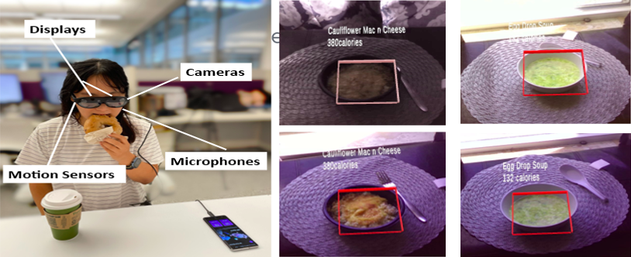
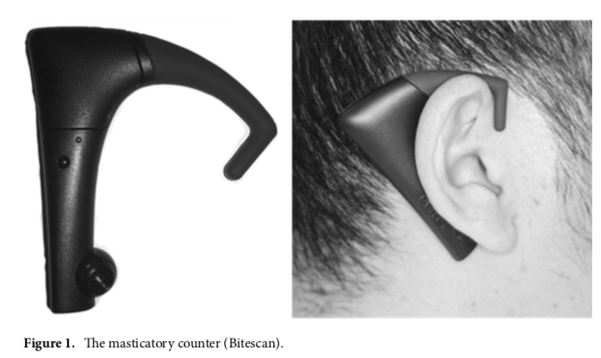
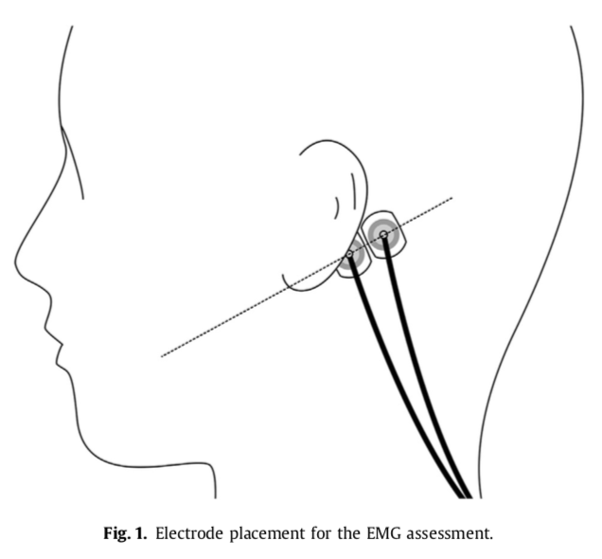
Extended Reality and Binge Eating Behaviors Among Diverse Racial and Ethnic Groups
GV GONZALEZ¹, C Wang², R Wang², TS Tseng¹
¹Louisiana State University Health Sciences Center (LSUHSC) School of Public Health, ²Louisiana State University (LSU) School of Electrical Engineering and Computer Science
sph.lsuhsc.edu
Purpose
Results
Discussions
Binge eating disorder (BED) research lacks diversity and focus on women of varying racial and ethnic backgrounds
Speed eating among binge eaters is a risk factor for obesity
Eating disorder research is applying sensor technology to monitor eating behaviors
Extended reality technology can possibly monitor eating behaviors, such as fast chewing
Binge eating treatment can benefit from extended reality methods to improve health outcomes in diverse racial and ethnic groups.
Literature Review Aim: To explore the application of extended reality technology to monitor binge eating behaviors and dietary control to reduce racial and ethnic disparities in binge eating disorder research.
Benefits of VR and AR
Enhanced eating disorder retention, assessment, and treatment protocols
Improve nutritional healthcare education
Improve self-regulation, self-monitoring, and self-motivation
Gaps in Literature
Lack of studies dedicated to women of color
Black and Hispanic women have high prevalence for BED and sub-threshold BED
No current augmented reality studies dedicated to minority groups
VR interventions designed for general population
Top Barriers to BED treatment among minority groups
Lack of access or availability of treatments
Poor retention rates
Interventions not designed with cultural relevance to various groups
Top Issues Contributing to Binge Eating Disparity
Black women experience stress, trauma, and food insecurity
Asian American and Hispanic women face weight stigma and shaming
Obesity interventions must include binge eating component
Potential for Augmented Reality
Extended reality can bridge gaps in obesity research
User friendly, adaptable for real life scenarios
Favorable and innovative tool
Better understand chewing behavior and binge eating through AR interventions
Methods for BED interventions and AR technology
Focus on hunger cues, influence of eating patterns, and breaking disordered eating
Reduce urges to eat in response to non-appetite stimuli
Prevent/reduce disordered eating with feedback from AR technology
Recommendations
Background
Limited knowledge on eating habits and association with energy intake
Objective measure of chewing during mealtimes needed to understand relationship between chewing and weight status
Limited studies devoted to the application of AR to reduce binge eating in minority populations
Focus AR technology on nutrition education and chewing behavior
Funding needed to bring technology to populations in need
Opportunity to improve methodological approach, community application, and assessment of dietary behaviors
Literature review highlights need for culturally appropriate screening tools, interventions, and treatments for racial and ethnic minorities in BED research
Binge eating is the most common eating disorder in the U.S
Severe, life-threatening and treatable eating disorder that includes recurrent episodes of rapidly eating large quantities of food
Faster eating rate can possibly lead to increased energy intake and increase body adiposity
Fast chewing can cause satiation and caloric intake
AR is used in nutrition education, portion size control, and dietary monitoring
Black women report higher rates of binge eating, obesity, and lack of access to ED services
Hispanic women have a higher lifetime prevalence of BED than other racial/ethnic groups
Limited BED research designed for diverse populations.
Augmented Reality Technology
References
Augmented reality glasses experiment and chewing + swallowing methodology
(Chen & Chen; LSU School of Electrical Engineering and Computer Sciences)
Beccia, A. L., Jesdale, W. M., & Lapane, K. L. (2020). Associations between perceived everyday discrimination, discrimination attributions, and binge eating among Latinas: results from the National Latino and Asian American Study. Annals of Epidemiology, 45, 32–39. https://doi.org/10.1016/j.annepidem.2020.03.012
Bell, B. M., Martinez, L., Gotsis, M., Lane, H. C., Davis, J. N., Antunez-Castillo, L., Ragusa, G., & Spruijt-Metz, D. (2018). Virtual Sprouts: A Virtual Gardening Pilot Intervention Increases Self-Efficacy to Cook and Eat Fruits and Vegetables in Minority Youth. In Games for Health Journal (Vol. 7, Issue 2, pp. 127–135). https://doi.org/10.1089/g4h.2017.0102
Chai, J. J. K., O’Sullivan, C., Gowen, A. A., Rooney, B., & Xu, J. L. (2022). Augmented/mixed reality technologies for food: A review. Trends in Food Science and Technology, 124(February), 182–194. https://doi.org/10.1016/j.tifs.2022.04.021
Goode, R. W., Cowell, M. M., Mazzeo, S. E., Cooper-Lewter, C., Forte, A., Olayia, O. I., & Bulik, C. M. (2020). Binge eating and binge-eating disorder in Black women: A systematic review. In International Journal of Eating Disorders (Vol. 53, Issue 4, pp. 491–507). https://doi.org/10.1002/eat.23217
Lee-Winn, A., Reinblatt, S., Mojtabai, R., & Mendelson, T. (2016). Gender and Racial/Ethnic Differences in Binge Eating Symptoms in a Nationally Representative Sample of Adolescents in the United States. Eating Behaviors, 22, 27–33. https://doi.org/https://doi.org/10.1016/j.eatbeh.2016.03.021
Mama, S. K., Schembre, S. M., Connor, D. P. O., Kaplan, C. D., Bode, S., & Lee, R. E. (2016). Effectiveness of lifestyle interventions to reduce binge eating symptoms in African American and Hispanic women. 269–274. https://doi.org/10.1016/j.appet.2015.07.015.Effectiveness
National Institute of Diabetes and Digestive and Kidney Diseases. (2021). Definition & Facts for Binge Eating Disorder. https://www.niddk.nih.gov/health-information/weight-management/binge-eating-disorder/definition-facts
Wu, Y. K., Berry, D. C., & Schwartz, T. A. (2020). Weight stigmatization and binge eating in asian americans with overweight and obesity. International Journal of Environmental Research and Public Health, 17(12), 1–14. https://doi.org/10.3390/ijerph17124319
Yoshimura, S., Hori, K., Uehara, F., Hori, S., Yamaga, Y., Hasegawa, Y., Akazawa, K., & Ono, T. (2022). Relationship between body mass index and masticatory factors evaluated with a wearable device. Scientific Reports, 12(1), 1–9. https://doi.org/10.1038/s41598-022-08084-5
Blechert, J., Liedlgruber, M., Lender, A., Reichenberger, J., & Wilhelm, F. H. (2017). Unobtrusive electromyography-based eating detection in daily life: A new tool to address underreporting? Appetite, 118, 168–173. https://doi.org/10.1016/j.appet.2017.08.008
Methods
Acknowledgements
Wearable Masticatory Counter (Bitescan), (Yoshimura et al., 2022)
Unobstructive electromyography-based eating detection electrodes (Blechert et al., 2017)
Special thanks to our collaborators, Dr. Chen Wang, PHD, and Ruxin Wang, MS at the LSU School of Computer Science and Engineering. Additional thanks to Dr. Tung-Sung Tseng, DrPH, MS, CHES/MCHES of the LSUHSC School of Public Health.

