Slide 1
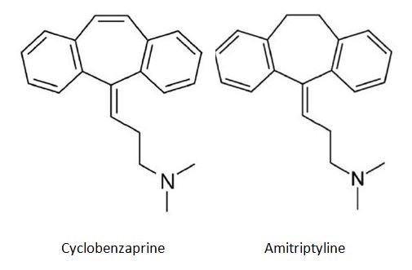
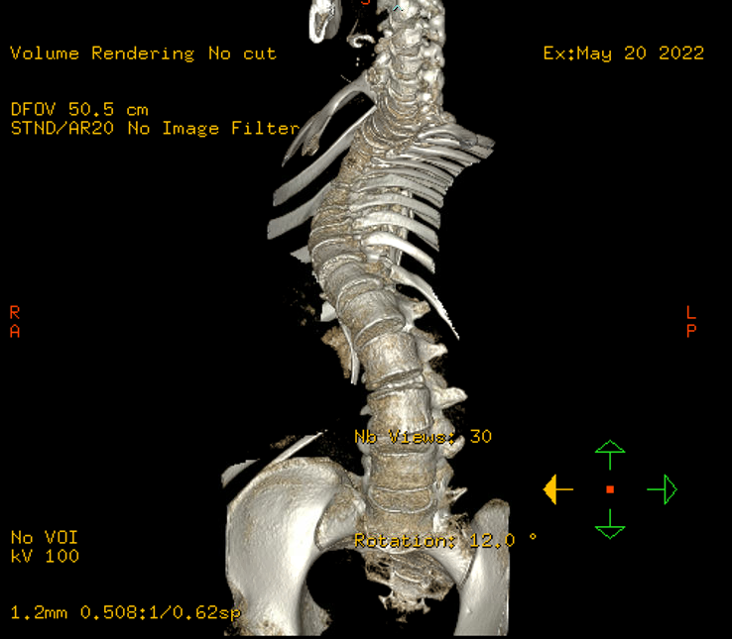
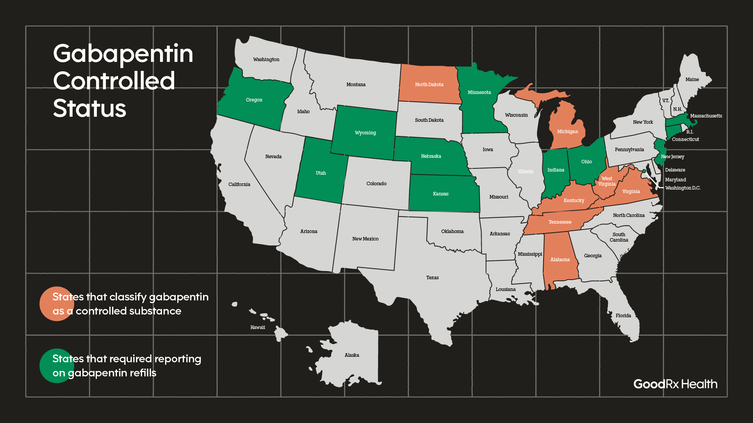
Gabapentin to Cyclobenzaprine: A Case of Acute Reversible Iatrogenic Anticholinergic Delirium Influenced by Schedule V Classifications Viet Le, BS, Sanjana Easwar, BS, Jacob Cambre, BS, Michael Dicharry, MD
Purpose
Case Presentation
Discussion
With Gabapentin likely becoming a controlled substance, practitioners prescribing the drug may shift to alternative medications, such as cyclobenzaprine due to a perceived favorable safety profile. The effects of this change may not be fully understood and may lead to an increase in number of life-threatening side effects in certain populations.
This case highlights a situation in which a patient in federal custody is prompted to take Cyclobenzaprine (Flexeril) in lieu of a consideration of controlled substance classification changes regarding Gabapentin and experiences significant adverse effects as a result.
L is a 23-year-old African-American male with a past medical history of a Grade II/IV astrocytoma and severe thoracic kyphoscoliosis (Figure 3), presenting in the ED in federal custody when his guards noted altered mental status.
A week prior to admission, the prison removed gabapentin from the patient's regimen, and the patient's pain medication was changed to Flexeril 10 mg TID.
On interview, the patient claimed he saw someone chasing him in his cell and was noted by staff to be 'acting crazy' a week prior. Stated his mood was "good" and reported talking to himself often.
He reported his hallucinations occurred most often in the morning, and he often thinks of himself as if he was running in the forest of his home-town.
The psychiatric ED noted a mildly increased rate of speech and tangential thought processes. He also reported he had been awake over the past few nights.
The patient tested negative for illicit substances and medications.
No past mood or psychotic disorders or family psychiatric history was noted by the patient or through extensive chart review.
While in the ED, psychiatry recommended that the patient be taken off Flexeril 10 mg TID and monitored overnight. The following day, no acute symptoms of psychosis were noted in the patient after Flexeril was discontinued.
Cyclobenzaprine's ability to cause delirium, psychotic and mood symptoms can be attributed the similarity of its biochemical structure to that of amitriptyline and other tricyclic antidepressants.
Past documentation of iatrogenic psychotic symptoms caused by cyclobenzaprine has often been recorded in the setting of prior psychiatric diagnoses, particularly bipolar disorder.
Given the temporal correlation of the patient's medication change, mental status change, and subsequent resolution of altered mental status with discontinuation, iatrogenic delirium is the most likely diagnosis.
Reclassification of gabapentin as a controlled substance/Schedule V drug may lead to higher rates of prescription of alternatives such as cyclobenzaprine in populations due to their perceived favorable side effect profile and perceived lack of abuse potential.
Introduction
Cyclobenzaprine, like Gabapentin, is a commonly applied muscle relaxant in the setting of neuropathic pain.
Psychosis and delirium secondary to cyclobenzaprine has been documented in the past (Cohen & Guilbault 2018)
Due to its perceived abuse potential, Gabapentin has been classified in a Schedule V drug in several states (Figure 2).
Tricyclic Antidepressants | Cyclobenzaprine
Dry mouth (27%) | Dry mouth (32%)
Fatigue (11%) | Fatigue (6%)
Dizziness (23%) | Dizziness (10%)
Insomnia (7%) | Drowsiness (38%)
Headache (14%) | Headache (5%)
Nausea (11%) | Nausea (2%)
Conclusions
Our case highlights the importance of careful monitoring after changing from gabapentin to cyclobenzaprine. In setting of Gabapentin's rescheduling as a Schedule V drug, we recommend extensive psychiatric history taking, monitoring of anticholinergic and antihistaminergic adverse events, and monitoring of acute psychiatric symptoms when changing to cyclobenzaprine.
Figure 1. Chemical structure of cyclobenzaprine vs amitriptyline
Table 1. Side effect profiles of Cyclobenzaprine vs. amitriptyline (Adapted from Trindade et. al, 1998)
References
Cohen, J. Y., & Guilbault, A. (2018). Induction of Psychosis by Cyclobenzaprine. Psychopharmacology bulletin, 48(4), 15–19.
Douglass MA, Levine DP. Hallucinations in an Elderly Patient Taking Recommended Doses of Cyclobenzaprine. Arch Intern Med. 2000;160(9):1373.
GIBBS, J. J. (1987). Symptoms of Psychopathology among Jail Prisoners: The Effects of Exposure to the Jail Environment. Criminal Justice and Behavior, 14(3), 288–310.
Premont, Makaela, PharmD. GoodRx. (n.d.). Is gabapentin a controlled substance? in some states, yes. GoodRx. Published July 16,2022. Retrieved January 23, 2023, from https://www.goodrx.com/gabapentin/is-gabapentin-a-controlled-substance
Santucci, Karen. “Psychiatric disease and drug abuse.” Current opinion in pediatrics vol. 24,2 (2012): 233-7. doi:10.1097/MOP.0b013e3283504fbf
Trindade E, Menon D, Topfer LA, et al. Adverse effects associated with selective serotonin reuptake inhibitors and tricyclic antidepressants: a meta-analysis. 1998. In: Database of Abstracts of Reviews of Effects (DARE): Quality-assessed Reviews [Internet]. York (UK): Centre for Reviews and Dissemination (UK); 1995
Acknowledgements
Figure 2. Gabapentin Controlled Status within the USA. Louisiana is currently under consideration (Premont, 2022)
Figure 3. Significant kyphoscoliosis as seen on MRI prior to event.
This project was supported by the LSUHSC New Orleans Department of Psychiatry. Special thanks to Dr. Brain McGee, Dr. Steven Giepert, and Ankur Khanna for collaboration.

