Slide 1
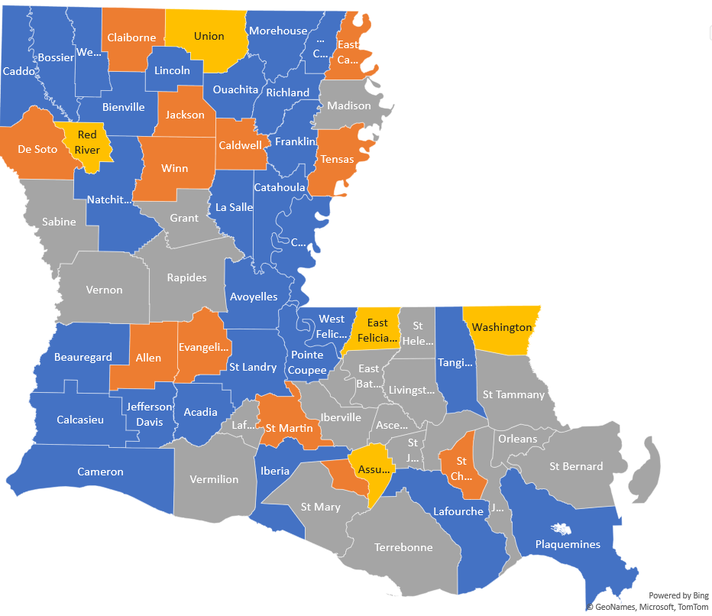
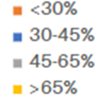
Molecular testing (MSI/IHC) rates in newly diagnosed CRC patients in Louisiana, with differences by race and level of urbanization
Bienvenue, Benjamin
Louisiana State University Health Sciences Center School of Public Health
publichealth.lsuhsc.edu
Background
Molecular Testing Rates by Parish
Testing Rates for Health Systems
Lynch Syndrome (LS) is an inherited disorder caused by deficiency in mismatch repair (dMMR) genes.
Individuals with LS have increased risk for several cancers, including colorectal (CRC)
NCCN guidelines (2018) recommend all newly diagnosed CRC cases receive molecular testing for LS.
 | Molecular Testing (%)
Race
White | 64.7
Black | 62.4
Health insurance
Private | 65.7
Medicare/ other public | 63.5
Medicaid | 60.9
No insurance | 53.3
Urbanization
Metro | 61.5
Non-metro | 86.7
Objectives
To provide an overview of the status of molecular testing in Louisiana for newly diagnosed CRC cases.
To evaluate and diminish disparities which lead to poor cancer outcomes.
To work with TACL to provide recommendations in closing gaps in cancer treatment and prevention in disadvantaged groups to ensure more equitable benefits from this testing in Louisiana.
Discussions
While payer data seemed to show lower rates of testing, this may be due to issues with recording, collecting or reporting data. Standardization of these processes can serve to eliminate errors and give more accurate data.
Payers also serve populations more widespread than health systems.
Methods
Molecular testing data was collected for the year 2021 from 3 health systems and 7 payer organizations.
Overall testing rates were grouped by race/ethnicity, health insurance, and urbanization.
Testing Rates for Payer Organizations
Recommendations
Coordinate with partners serving lower-performing regions to assess the challenges in molecular testing in these communities.
Using this project as a foundation for comparison, continue tracking molecular testing for LS over time to see where there are improvements and use these to inform planning for future goals.
Using intra-organizational data collection so that TACL partners can have a role in their surveillance.
Results
Payer system data shows lower rates of testing in Blacks, as well as rural and Medicaid patients.
Health System data showed higher rates overall, with metropolitan patients and uninsured being tested at the lowest rates.
3-year data showed improvement for all LDH regions except Regions 4 and 5.
Acknowledgement
I would like to thank all partnering organizations within TACL who shared their aggregate data for this project.
I would also like to thank Terry Birkhoff, Executive Director, for being my mentor in this project as well as Myriah Legaux, who served as this project’s direct supervisor.

