Slide 1
Adherence to Antipsychotic Medications for Individuals with Schizophrenia
Katherine Nelson
LSUHSC New Orleans
School of Medicine, Class of 2026
AmeriHealth Caritas Intern
October 24, 2025

Slide 2
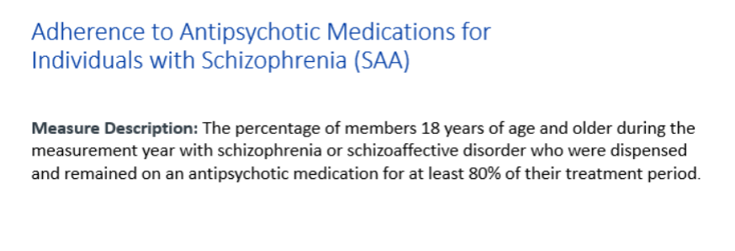
Additional HEDIS Measures: SAA

Slide 3
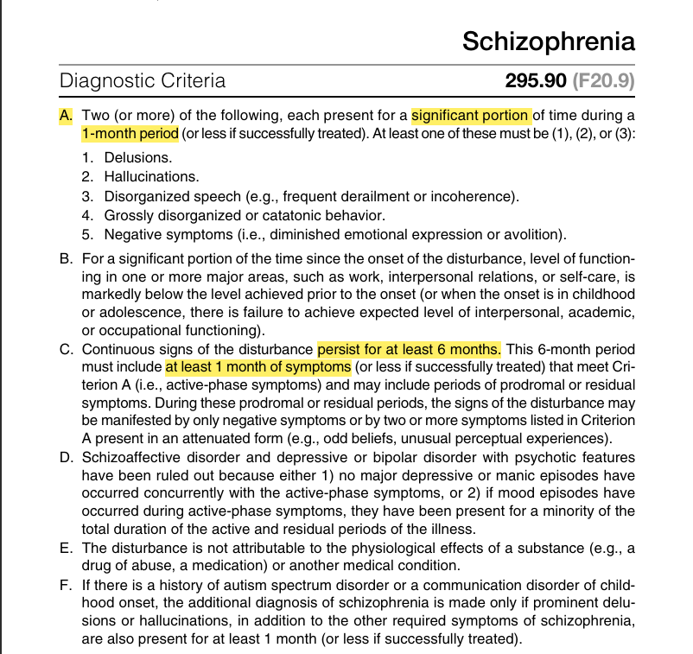
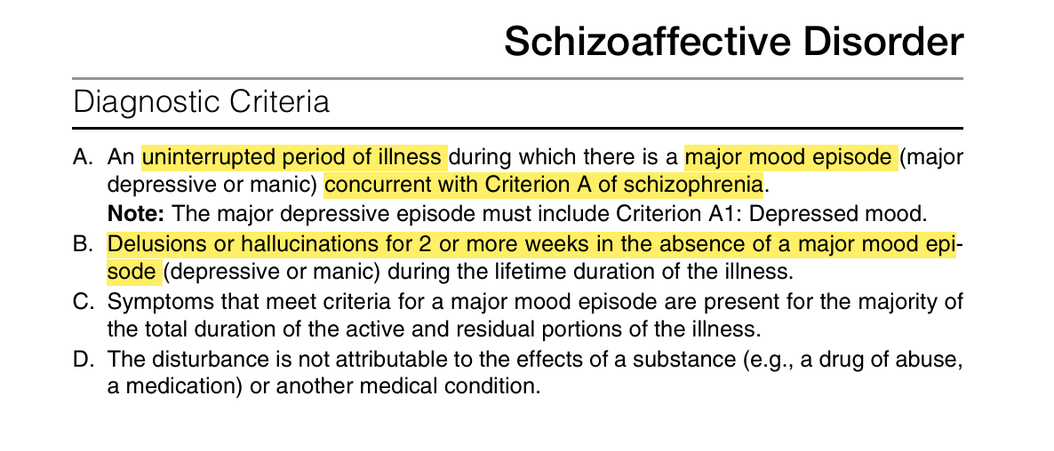
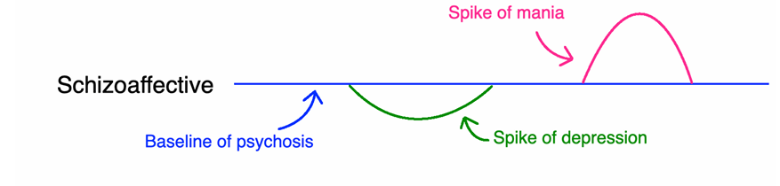
DSM V
Notes:
--
Citation: DSM-V
Mehlman Medical HY Psych

Slide 4

Background
Prevalence peaks in early adulthood
M>F
Black> Caucasian
Social drivers?
Affects ~3 million adults in the US
Economic burden
> $155 billion annually
direct healthcare costs: $37.7 billion (24%)
Indirect costs: $117.3 billion (76%)
Notes:
Prevalence: highest risk age of onset 20-24, with greatest illness burden 35-39 (individuals with schizophrenia decompensate overtime with compounding episodes of acute psychosis, which actively damages the brain with each event)
-age of onset in males is earlier than females
(neighborhood)
-”US retrospective study by Kaiser of ~6million pts found black and American Indian/ Alaska native individuals had an almost 2fold higher incidence of nonaffective psychotic disorder diagnosis compared to white individuals. Asian and Hispanic individuals had a lower incidence. Black and multiracial individuals had higher odds of receiving a diagnosis of schizophrenia compared to non-Hispanic white individuals” (neighborhood)
-social drivers: education, employment, housing status/ configuration (vacant, owner-occupied)
Study adjusted for social vulnerabilities and found that ethno-racial differences in odds ratio for SSD and psychotic symptoms between black and white individuals, making them statistically nonsignificant= social drivers of health contribute to difference in psychosis diagnosis bw ethnoracial groups
Socially vulnerable neighborhoods: increased stress w/ biopsycho consequences and/or decreased opportunities to reduce daily stressors
For minority groups, especially black individuals, social vulnerability shaped by longstanding structural racism impacting access to housing and education, as well as influencing laws and policies, economic structures that disproportionately negatively impact these populations across generations.
Adjusted SVM scores attenuated the difference in SSD bw multiracial and white groups, but difference remained significant
------
Economic burden:
-reduced QOL, increased risk of homelessness, unemployment, living in poverty, decreased life expectancy (15-20 years below avg)
-direct healthcare cost= medication, outpt and inpt services (inpt and medications were largest contributors)
-indirect cost: high unemployment rates, caregiver burden were largest contributors (schizophrenia: opportunities to improve outcomes and reduce economic burden through managed care)
--
Louis Wane: artist with Schizophrenia; progression of disease thought to be correlated with changes in his artistic style
https://urldefense.com/v3/__https:/psychiatryonline.org/doi/10.1176/appi.ajp.2017.17111235__;!!E4aHFgIl6QUyrQ!4OPeUoIztHgC-vUGpZT_hdsmKSTgKID0j1BR4GSEW2p2q11UAwob2ge-3gv9MkUZKS7fzmTVlQryTHd51aWQPdGv$

Slide 5
Current Strategies & Program Goals
Current Strategies
Text message campaigns
Shared decision making: LAI
Providing transportation to scheduled appointments
Program Goals
2% increase in compliance rates from previous year OR reach 50th percentile
Increase administration of LAI in ER
Currently no incentives, consider adding incentives
Notes:
--
https://ldh.la.gov/assets/medicaid/MCPP/5_29_25/LouisianasMedicaidManagedCareQualityStrategy_5.29.2025.pdf [ldh.la.gov]

Slide 6
What I did
Collected compliance data from 2023, 2024, 2025 (Jan-Aug)
Compliance data*
Minimum cutoff for utilizing data by group: 25
Analyzed compliance data by various groups
Region, setting, age, race
Observed trends within groups from 2023, 2024
Notes:
To be considered compliant, individual must be >= 80% compliant with medications over measurement year

Slide 7
Overall Compliance
 | 2023 | 2024
ACLA Overall Compliance | 48.56% | 63.18%
NCQA Overall Compliance | 61.09% | 64.91%
Notes:
Since SAA measures compliance over time within the measurement year, the rate will naturally start off low (typically at 0.00) and then build month to month.
We are trending lower than last year for August (waiting for September’s data to come in). As we end the year we will have a better measurement of who was able to adhere for 80% or more of their treatment period!
Increase in >2% from 2023→ 2024; in 2024, also saw >50th percentile compliant
Current 2025 data incomplete, hard to judge compliancy data without full year data set
2025 LA to date: 19.29%
For Measurement year 2024 the average rate was 64.91
For Measurement year 2023 the average rate was 61.09
For Measurement year 2022 the average rate was 59.93
--
citation: NCQA
**change LA to ACLA overall compliance
National ACLA overall compliance
Remove goal line – draw a goal line in with red dashed line + insert text box with “goal”
Can remove table
“overall compliance”

Slide 8
Compliance by Region
Region | 2023 | 2024
1 | 47.90% | 64.26%
2 | 58.55% | 71.43%
3 | 50.99% | 71.20%
4 | 48.51% | 61.14%
5 | 53.33% | 65.88%
6 | 44.37% | 66.07%
7 | 41.74% | 54.38%
8 | 45.66% | 54.82%
9 | 49.21% | 64.66%
Notes:
Chart sorted from lowest to highest compliance rates in 2024 within regions
In 2023: lowest compliance in regions 6 & 7
In 2024: lowest compliance in regions 7 & 8, although all met program goals at 54%

Slide 9
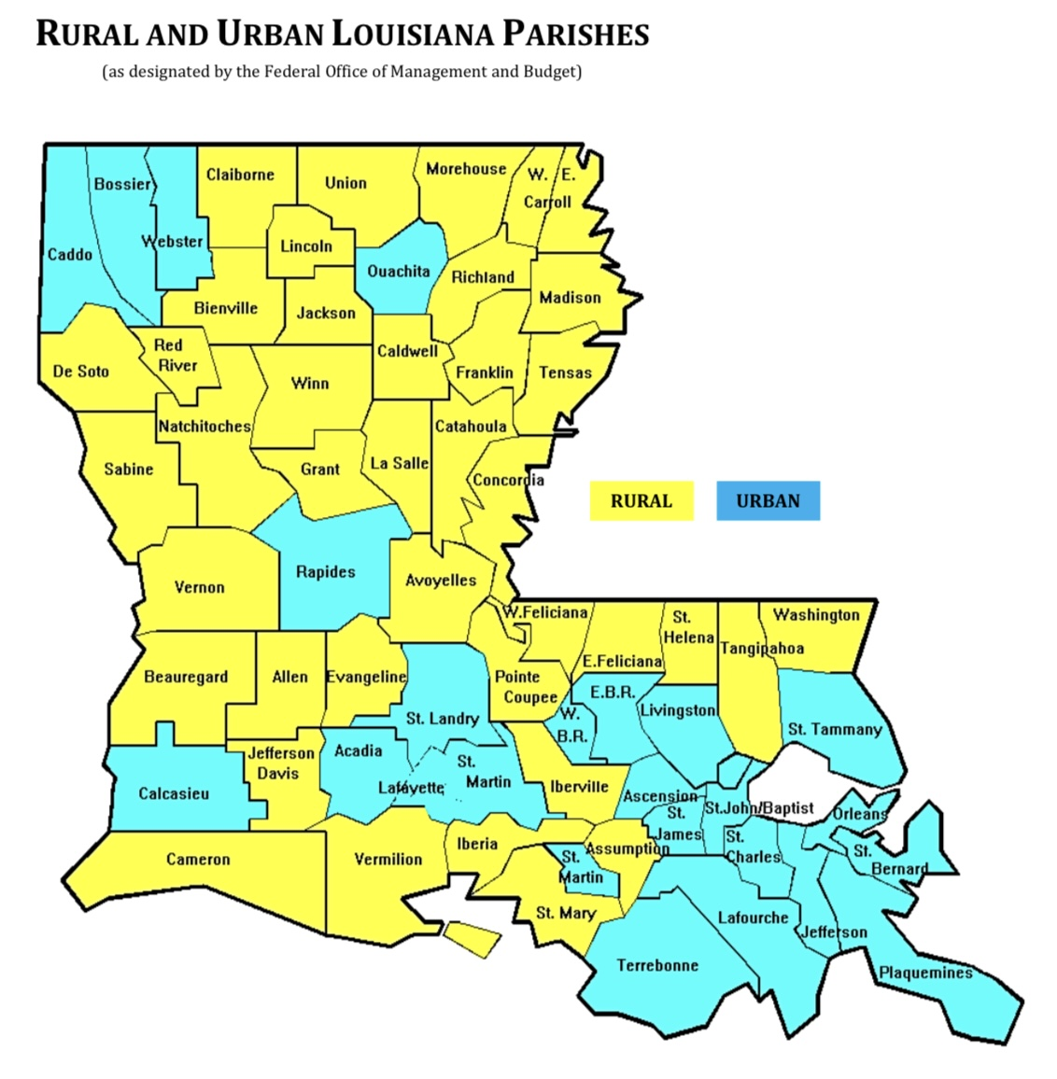
Compliance by Setting
Notes:
Rural> urban compliance
2023: rural compliance 51.12%, urban compliance 47.91%
2024: rural compliance 63.48%, urban 63.21%
--
Map: https://ldh.la.gov/assets/docs/BayouHealth/Dental/Louisiana_Rural_Parishes_Map.pdf [ldh.la.gov]

Slide 10
Compliance by Age
Age | 2023 | 2024
18-24 | 38.51% | 55.24%
25-34 | 45% | 61.81%
35-44 | 46.98% | 59.09%
45-54 | 50.46% | 66.99%
55-64 | 60.63% | 71.98%
Notes:
Organized by compliance data in 2024
2023: lowest compliant group 18-24 at 38.51% followed by 25-34 at 45%; most compliant were 55-64
2024: all age groups surpassed goal of increasing by 2% or being greater than 50%
-least complaint remained 18-24 yo at 55.24%, most compliant remained 55-64 yo at 71.98%

Slide 11
Compliance by Race
Race | 2023 | 2024
White | 53.47% | 55.24%
Black/ African American | 46.23% | 61.81%
Notes:
Organized by compliance data in 2024
Not enough data on American Indian/ Alaska Native, Asian, Native Hawaiian, 2 or more races= did not reach minimum cutoff, data not included
In 2023: black/ African American below goal of 50th percentile, but reached goal in 2024
In 2024: white did not reach goal of increasing by 2% (53.47%→ 55.24%)

Slide 12
Review of Trends
Region | 2023 | 2024
1 | 47.90% | 64.26%
2 | 58.55% | 71.43%
3 | 50.99% | 71.20%
4 | 48.51% | 61.14%
5 | 53.33% | 65.88%
6 | 44.37% | 66.07%
7 | 41.74% | 54.38%
8 | 45.66% | 54.82%
9 | 49.21% | 64.66%
Overall ACLA compliance increased from 48.56% (2023) to 63.18% (2024)
Regional Trends:
In 2023, the following regions were below the goal of 50th percentile: 1, 4, 6-9
In 2024, all regions were above the goal of 50th percentile AND all regions had increased compliance by >2% from previous year
Lowest compliance in 2024: regions 7 & 8 at 54.38% and 54.82%, respectively
Greatest compliance in 2024: regions 2 & 3 at 71.43% and 71.20%, respectively
Setting Trends: urban and rural compliance rates similar
Age Trends:
18-24 least compliant
55-64 most compliant
Race trends:
2023: Black/ African American below 50th percentile goal
2024: Black/ African American increased by >2% and surpassed 50th percentile goal
White did not meet goal of increasing by 2% from previous year
Notes:
AGE: 2023: lowest compliant group 18-24 at 38.51% followed by 25-34 at 45%; most compliant were 55-64
2024: all age groups surpassed goal of increasing by 2% or being greater than 50%
-least complaint remained 18-24 yo at 55.24%, most compliant remained 55-64 yo at 71.98%
RACE: In 2023: black/ African American below goal of 50th percentile, but reached goal in 2024
In 2024: white did not reach goal of increasing by 2% (53.47%→ 55.24%)
Big improvements bw 23 24, highlight what stood out
Rural/urban not a big difference, if theres certain groups struggling
Point out groups doing well

Slide 13
Recommendations
Early intervention vital in decreasing morbidity of this disease
Age group 18-24 least compliant
How to increase compliance in this group?
Allowing transportation to pharmacy as discrete trip
Currently, pharmacy trips are “add ons” to scheduled appointments
Consider incentives
Including community outreach care teams
Future ACLA studies:
compliance differences in PO vs LAI medication
Utilization of services (inpatient psychiatric unit/ ER) associated with compliant vs noncompliant patients
What interventions worked in regions 2 & 3 that allowed for such high compliance rates?
Consider renaming “compliance data”→ adherence data
Clinical language in transition
Notes:
“early, personalized interventions and sustained treatment adherence can improve outcomes. Changes in healthcare systems, such as access to psychiatric treatment, drug supply, and integration of rehabilitation services, play an important role. (trends)
Increase compliance in young adults: engage social/ family supports, encourage shared decision making about LAIs, address medication AEs and perceived lack of benefit, which are common reasons patients in this age group are nonadherent
text messaging campaigns are also beneficial, if pts have a cell phone and organization has

Slide 14


Acknowledgements
Renee Wells
Marlon Boutin
Dr. Gregory Randolph
Dana Smith
Shea Good
Carrie Blades
Jana Baylock
Rhonda Baird
Thank you!
Questions?

Slide 15
References
Adherence to antipsychotic medications for individuals with schizophrenia (SAA). NCQA. (2025, August 1). https://www.ncqa.org/report-cards/health-plans/state-of-health-care-quality-report/adherence-to-antipsychotic-medications-for-individuals-with-schizophrenia-saa/ [ncqa.org]
The cats of Louis Wain: A thousand ways to draw one’s mind | American Journal of Psychiatry. (n.d.-b). https://psychiatryonline.org/doi/10.1176/appi.ajp.2017.17111235 [psychiatryonline.org]
DSM-V Diagnostic and statistical manual of mental disorders. (2013). . American Psychiatric Association.
Mehlmanmedical. (2025, October 19). Hy psych. MEHLMANMEDICAL. https://mehlmanmedical.com/hy-psych/ [mehlmanmedical.com]
Rural and urban Louisiana parishes. (n.d.-a). https://ldh.la.gov/assets/docs/BayouHealth/Dental/Louisiana_Rural_Parishes_Map.pdf [ldh.la.gov]
Luo W, Gao J, Guo Z, Han X, Song J, Su X, Da X, Liu X. Trends and cross-country inequalities in schizophrenia from 1990 to 2021, with prediction to 2035: a systematic analysis of the global burden of disease study 2021. BMC Psychiatry. 2025 Oct 2;25(1):928. doi: 10.1186/s12888-025-07273-6. PMID: 41039404; PMCID: PMC12492733.
Anglin DM, Olfson M, van der Ven E, Oh H, Lewis-Fernández R, DeVylder J, Oluwoye O, Dixon L, Stroup TS, Guyer H, Bareis N. Neighborhood Social Vulnerability and Racial Disparities in Schizophrenia Spectrum Disorder Prevalence. Am J Psychiatry. 2025 Sep 1;182(9):850-860. doi: 10.1176/appi.ajp.20240906. PMID: 40887946; PMCID: PMC12404665.
Lin C, Zhang X, Jin H. The Societal Cost of Schizophrenia: An Updated Systematic Review of Cost-of-Illness Studies. Pharmacoeconomics. 2023 Feb;41(2):139-153. doi: 10.1007/s40273-022-01217-8. Epub 2022 Nov 21. PMID: 36404364.
Wander C. Schizophrenia: opportunities to improve outcomes and reduce economic burden through managed care. Am J Manag Care. 2020 Mar;26(3 Suppl):S62-S68. doi: 10.37765/ajmc.2020.43013. PMID: 32282176.

Slide 16
Demographic Characteristics
age | 2023 | 2024 | 2025 | pooled compliance
18-24 | 38.51% | 55.24% | 14.15% | 35.97%
25-34 | 45.00% | 61.81% | 22.02% | 42.94%
35-44 | 46.98% | 59.09% | 19.82% | 41.96%
45-54 | 50.46% | 66.99% | 16.60% | 44.69%
55-64 | 60.63% | 71.98% | 20.90% | 51.17%
65+
Notes:
65+ only had 18 individuals, not enough data

Slide 17
Demographic Characteristics
race key | compliance by race | 2023 | 2024 | 2025 | pooled | total n
white | 1 | 53.47% | 66.07% | 24.25% | 47.93% | 1615
black/african american | 2 | 46.23% | 61.17% | 16.57% | 41.32% | 2612
American Indian or Alaska native | 3 | 7.69% | 71.43% | 22.22% | 33.78% | 36
Asian | 4 | 33.33% | 55.56% | 14.29% | 34.39% | 22
Native Hawaiian or Pacific Islander | 5 | 0.00% | 50.00% | 50.00% | 33.33% | 4
Other race | 6 | 0.00% | 0.00% | 0.00% | 0.00% | 0
2 or more | 7 | 60.87% | 76.00% | 16.67% | 51.18% | 66
Declined | 8 | 0.00% | 0.00% | 0.00% | 0.00% | 0
unknown | 9 | 39.39% | 50.00% | 0.00% | 29.80% | 72

Slide 18
