Slide 1

Timeliness of Prenatal Care Vi Luong

Slide 2
Agenda
Background
2024-2025 Rates
Rates based on Subgroups
Geographic location, Parish, Region, Race, Ethnicity Age
Current Interventions
Recommendations

Slide 3
Background
The U.S. leads high-income countries in healthcare spending, yet it has the highest maternal and infant mortality outcomes.
The CDC reports that more than 80% of pregnancy-related deaths were preventable and cites that improving prenatal care is one of the top recommended interventions needed.
The American College of Obstetrics and Gynecology (ACOG) recommends a standard schedule of regular prenatal visits, beginning in the first trimester, for pregnant women who have an uncomplicated pregnancy.
A low or falling rate indicates that pregnant women are not receiving prenatal care during the first trimester, which may result in higher rates of adverse pregnancy outcomes.

Slide 4
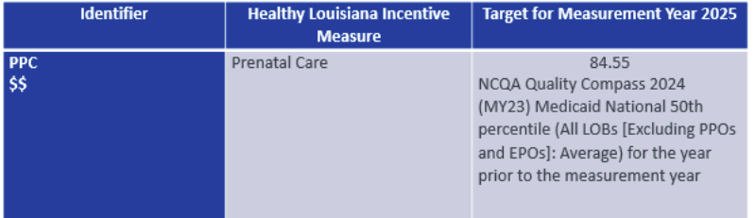
ACLA Measure: Timeliness of Prenatal Care
The Prenatal and Postpartum Care—Timeliness of Prenatal Care indicator measures the percentage of live birth deliveries that received timely prenatal care.
Numerator: Deliveries that received a prenatal care visit as a member of the organization in the first trimester, on the enrollment start date or within 42 days of enrollment in the organization
Denominator: Deliveries with a live birth 12/20/2023-8/25/2025
Subgroups with fewer than 25 births were excluded from analysis
Notes:
-combined years
-25 denom limit

Slide 5
Overall Compliance Rate 2024-2025
73.7% of 4370 of enrolled pregnant women received prenatal care in the first trimester
Notes:
Round to .1

Slide 6
Geographic Location

Slide 7
Region
Notes:
Remove .00%
Remove Data Label above bar

Slide 8
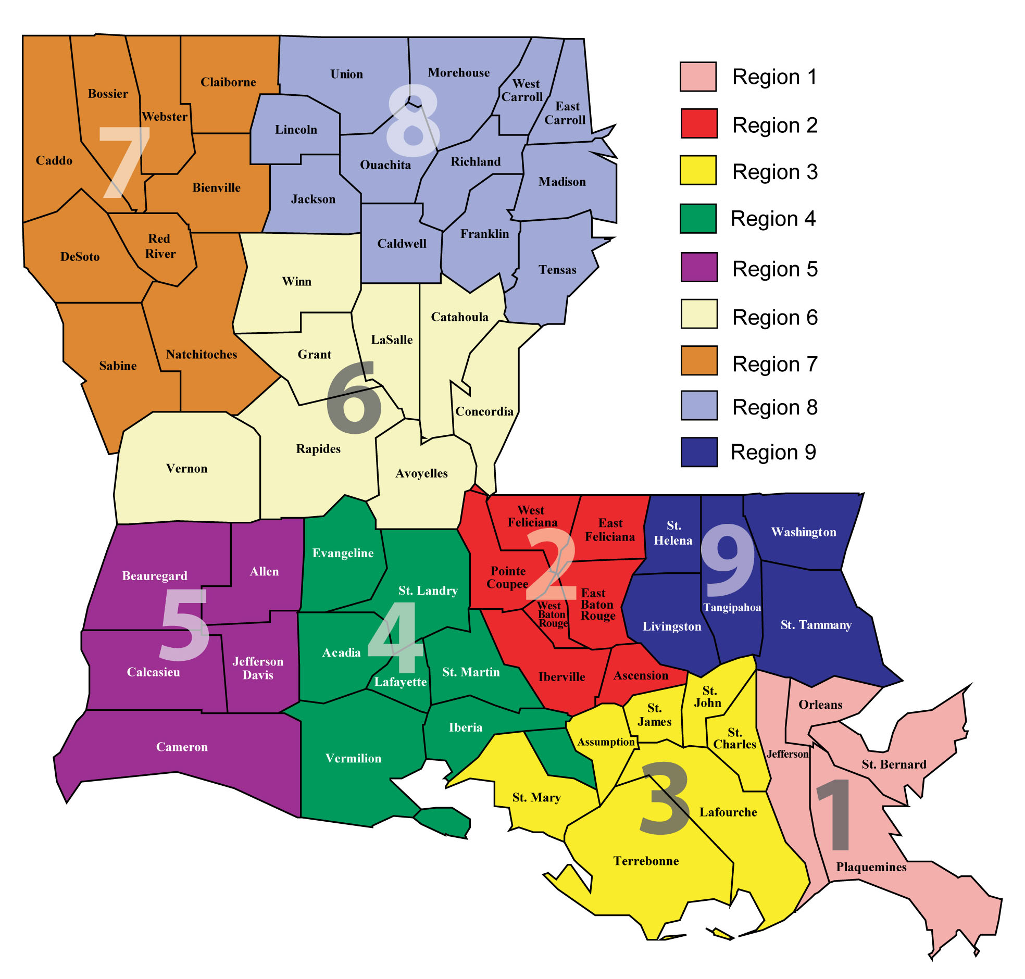
Lafourche - 41.2%
76.5%
Vermilion - 91.1%
77.0%
De Soto – 60%
71.1%
Sabine - 89.3%
Calcasieu 61.4%
82.4%
St. Mary - 88.9%
64.1%
Richland 64.3%
79.0%
Terrebonne – 88.8%
69.3%
Caddo 64.7%
74.1%
Tangipahoa 88.5%
82.2%
Saint Martin - 64.9%
Avoyelles - 66.7%
Beauregard - 68.0%
Bossier - 68.4%
Lincoln - 68.9%
Webster - 71.7%
East Baton Rouge - 72.3% Ouachita - 72.5%
Orleans - 72.8%
Union - 73.1%
Saint Bernard - 75.7%
Saint Charles - 75.8%
Iberville - 76.9%
Rapides - 78.3%
Saint Tammany - 78.5%
Acadia - 88.2%
Evangeline - 86.4%
St John The Baptist - 84.6% Livingston - 84.0%
Vernon - 83.8%
Iberia - 83.6%
Lafayette - 83.2%
Ascension - 83.0%
Natchitoches - 80.9%
Franklin - 80.8%
Washington - 80.4%
Saint Landry - 80.2%
Jefferson - 79.9%
Morehouse - 79.1%
Notes:
Parishes with less than 25 eligible births were not counted (38 parishes)
Left/Red is least compliant, Right/green is most compliant
Lafourche and Terrebonne / De Soto and Sabine are neighbor parishes with starkly different rates. What are these compliant parishes doing differently?
High performing/ bright spots
Lafourche – racial/ethnic composition?

Slide 9
Race
Notes:
Am Indian: 28 / 102
Asian: 29 / 33
Omit unknown

Slide 10
Ethnicity
Notes:
Omit unknown

Slide 11
Age
Notes:
Age range 12-46
Q5 - 18-25,25-30,30-25
Double check 25+ denom (45+ excluded)

Slide 12
Current ACLA Interventions
Provider Interventions
Provider education, training, and alerts
Provider report card
HEDIS Tip Sheets, Documentation and Coding Guidelines
Member Interventions:
Member education, newsletters, maternity transportation flyer
Interpregnancy outreach
Bright Start Program
Maternity Health Equity Project
Notes:
Bright Start: The program connects with mothers-to-be with care coordination and educational needs, and addresses various issues throughout the member’s pregnancy and the postpartum period. Bright Start offers a multifaceted approach to engagement through innovative programming, technology, member incentives, and provider partnerships to address the diverse needs of our birthing population and at-risk children.
-also have community baby shower

Slide 13
Recommendations
Investigate intra-regional variation in compliance rates
Identify best practices in high-performing parishes
Address low compliance among American Indian and Alaskan populations
Continue efforts to reduce pregnancy-related stigma and increase education among adolescents
Examine rural vs. urban compliance differences
Notes:
Parish differences
Native American
Urban vs rural : barriers in urban, waitlist?, could ask audience
Teen population

Slide 14
Adverse Outcomes

Slide 15
Thank you
Acknowledgements:
Dr. Gregory Randolph, Dana Smith, Renee Wells, Shea Good, Carrie Blade, Lekitha Gregory, Rhonda Baird, Jennifer Manuel
Resources:
NCQA Prenatal and Postpartum Care
Maternal Mortality and Maternity Care in the United States
ACOG Prenatal Care
HEDIS Tip Sheet
ACLA Improving Maternal Health Outcomes

Slide 16
69.25%
74.07%
76.95%
78.97%
82.22%
64.11%
82.41%
71.05%
76.50%
Notes:
Bottom: 5,7,3 Top: 4, 9, 6

