Slide 1


Understanding Delays In Skin Cancer Treatment: The Impact Of Socioeconomic And Regional Factors On Time From Diagnosis To Treatment For Non-melanoma Skin Cancers Amongst ACLA Members
Alex Wandler
Louisiana State University Health Sciences Center
New Orleans
School of Medicine, Class of 2026
Population Health Management
Notes:
Project Proposal :To investigate the burden of non-melanoma skin cancers among Medicaid enrollees in Louisiana and identify key factors contributing to delays in treatment following diagnosis. By identifying disparities in access to dermatologic services and treatment delays, we can explore the influence of social determinants of health – including socioeconomic status, geographic access to dermatologic care, and employment type.

Slide 2
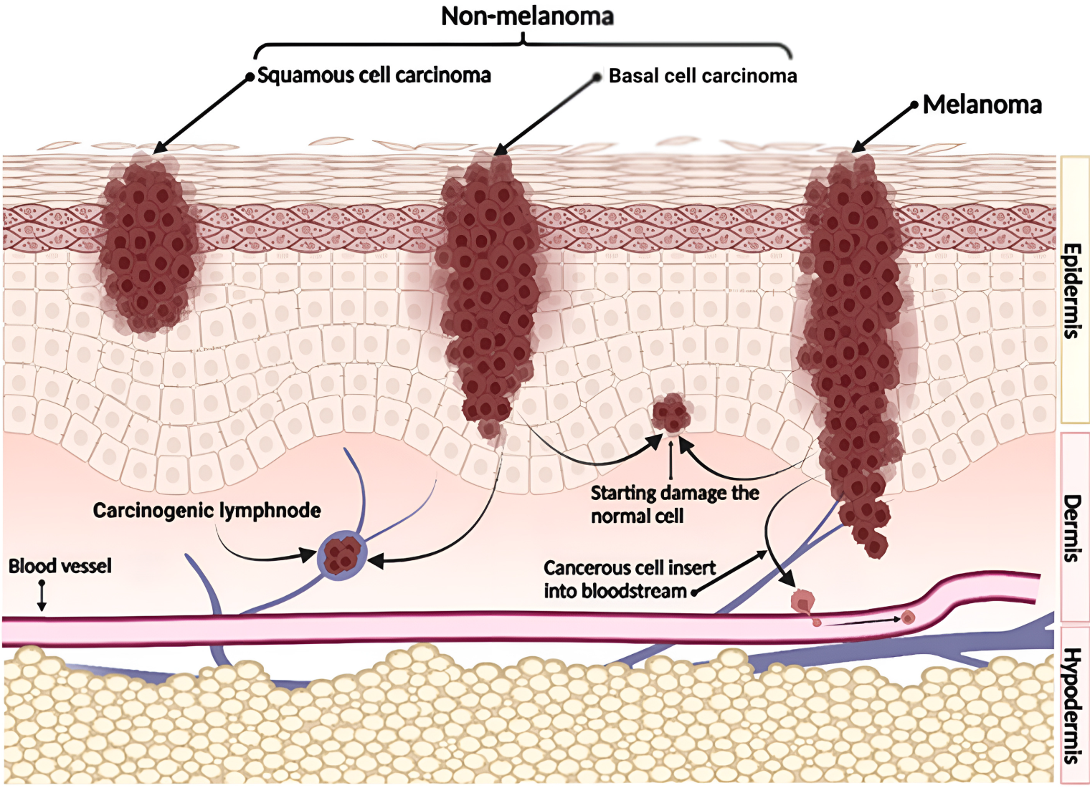
What is Skin Cancer and why does it matter?
Basal Cell Carcinoma
Melanoma
Skin Cancer is the most common form of cancer in the US
Squamous Cell Carcinoma
Basal Cell Carcinoma (BCC) being the most prevalent form of skin cancer.
Non-Melanoma Skin Cancer
Each year ~6 million people are treated for skin cancer with annual medical cost for treatment being $8.9 billion.
Incidence of NMSC is 18-20x higher than melanoma skin cancer.
An estimated 33,826 ED visits for sunburn are reported each year, for a total cost of $11.2 million.
90,365 new cases of melanoma were diagnosed in 2021
8,214 people died from melanoma in 2022
Notes:
Population health problem
Incidence/prevalence/healthcare cost/average number of people affected per year/
Incidence world wide is continuing to increase.
Stratum corneum, Stratum lucidum, stratum granulosum, stratum spinosum, stratum basale
BCC from basal cells of epidermis (locally destructive, rarely metastasizes) – most common
SCC from keratinocytes in epidermis
MM from melanocytic cells of epidermis – high rate of metastasis

Slide 3
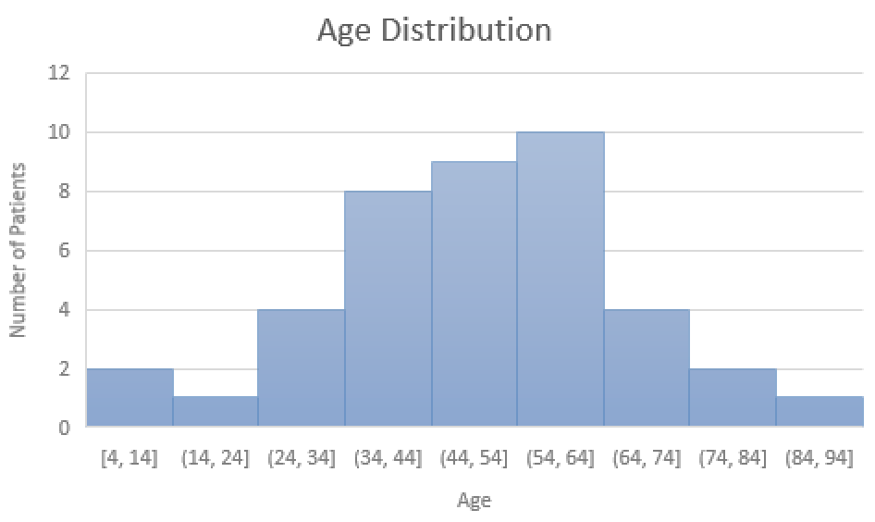
Non-Melanoma Skin Cancer in Louisiana
Min: 4 Mean age: 53.3 Max: 94
Notes:
Demographics from October 2023 to July 2025
142 patients
Average age 53 years old, minimum age 4, maximum age 94
Female: 44.4%
Males: 55.6%
Mid 20’s-Mid 50’s = 14.7% of patients
We know risk of NMSC is greater in rural areas (UV exposure, less access to care, rural older outdoor workers- reflective surfaces ** farming) – unlikely and potentially due to poor access to care.

Slide 4
ACLA NMSC Data (October 2023-July 2025)
n = 142 members with diagnosis of squamous cell carcinoma and/or basal cell carcinoma
Applied the earliest screening date recorded for coinciding member ID to determine time from Dx to Tx
817 data entries reporting BCC and/or SCC diagnosis
154 entries reported screening dates occurring after treatment
48 entries remained and were excluded
952 reported NMSC diagnosed
196 NMSC diagnosed in rural community
Beauregard Parish (36), Saint Mary Parish (33), Vermilion Parish (31)
759 NMSC diagnosed in urban community
Saint Tammany Parish (130), Jefferson Parish (113), Plaquemines Parish (101)
Notes:
154 number of data entries had screening dates after treatment dates – in these cases I calculated time from diagnosis to treatment using the earliest screening date listed for that particular patient to calculate the time from diagnosis to treatment. Of these 154 dates, 48 entries remained negative even when applying the earliest screening date – these 48 entries were removed (769 entries used).
By using the earliest listed date this may have falsely increased the time from diagnosis to treatment ***
817 entries – then removed 48 (106 entries were adjusted**)
952 skin cancers diagnosed
SCC: 561
BCC: 391
Despite using the earliest listed screening, 46 entrys remained with screenings occurring after treatment date – listed as unknown
Ended up with removing 11 patients – n = 131
N= 392; 817 entry’s total (excluding benign lesion data and those with screening dates that fell after treatment dates even after adjusting screening dates)

Slide 5
ACLA Skin Cancer Treatment
Recommended treatment with excision within 4-6 weeks from diagnosis
Time between diagnosis and treatment for NMSC
Time from Diagnosis to Treatment | BCC | SCC | NMSC | Percentage of NMSC
6 weeks or less | 255 | 124 | 379 | 40%
Rural |  |  | 117 | 30.9%
Urban |  |  | 262 | 69.1%
More than 6 weeks, Never treated | 306 | 267 | 573 | 60%
Rural |  |  | 79 | 13.7%
Urban |  |  | 494 | 86.3%
Notes:
952 skin cancers diagnosed
SCC: 561
BCC: 391
Treated ON TIME 6 weeks or less
BCC (255 lesions), 106 treated in rural area, 149 treated in urban parish
SCC (124 lesions), 11 treated in rural, 113 treated in urban
OVER TIME More than 6 weeks/never treated
Of the NMSC treated within 6 weeks, 31% were treated in rural areas and 69% treated in urban areas.
More patients received treated after the recommended time frame or received no treatment (60% as compared to 40% of those who received treatment within recommended time frame)
For both those treated within the appropriate time frame and after, majority were located in urban communities. – potentially due to more diagnoses with increased number of dermatologist in the area however delay in treatment is still present. Also, is the data skewed from applying the earliest screening date?
Overall, more NMSC diagnosed in Urban communities as opposed to rural. Does not mean there is a lower incidence in rural communities.
As of 2022, ACLA members were treated within the recommended time window
Loss to follow up and advancement of disease -- focus on barriers to care (access to dermatologist, child care/work, transportation)
Stage of skin cancer at presentation – more advanced for certain populations?

Slide 6
Other Factors
 | Received treatment within 6 weeks | Received treatment after 6 weeks or never
Average Age | 56.7 | 57.6
Gender | Received treatment within 6 weeks | Received treatment after 6 weeks or never
Female | 41% | 29%
Male | 59% | 71%
Language | Received treatment within 6 weeks | Received treatment after 6 weeks or never
English | 254 (83%) | 472 (92%)
Rural | 53 | 51
Urban | 201 | 421
Two or More Languages (Rural Only) | 12 (4%) | 26 (5%)
Vietnamese (Urban Only) | 0 | 4 (1%)
Declined to state | 41 (13%) | 8 (2%)
Rural | 22 | 0
Urban | 19 | 8
Notes:
For language – one percent increase in delayed treatment for those who spoke 2 or more languages and Vietnamese speaking patients. Important to distinguish what their native language is.
Those recorded as speaking 2 or more languages were only from rural areas.
Absence of significance likely due to limited data – expect lack of transportation, language, education to influence patient follow up. Further more, would expect
Anticipate larger percentage for white/Caucasian given rates of NMSC are highest for those with lighter skin tone – most at risk for developing NMSC

Slide 7
Influence of Socioeconomic Factors…
Education
 | Within 6 weeks | After 6 weeks, Never treated
Stable Education | 10% (32) | 18% (93)
Declined/Blank/Missing | 90% (275) | 82% (417)
Transportation
 | Within 6 weeks | After 6 weeks, Never treated
Stable Transportation | 20% (62) | 20% (100)
Unknown status | 80% (245) | 80% (400)
Notes:
N= 817
Data insufficient – for future can use greater set of data including more years – ideally majority of patients answer screening questions…
For Transportation = 162 “NMSC diagnoses” reported stable transportation with 655 not responding to question.
Of the 162 diagnoses, 62 received treatment within 6 weeks. 100 diagnoses with stable transportation did not receive treatment within recommended time.

Slide 8
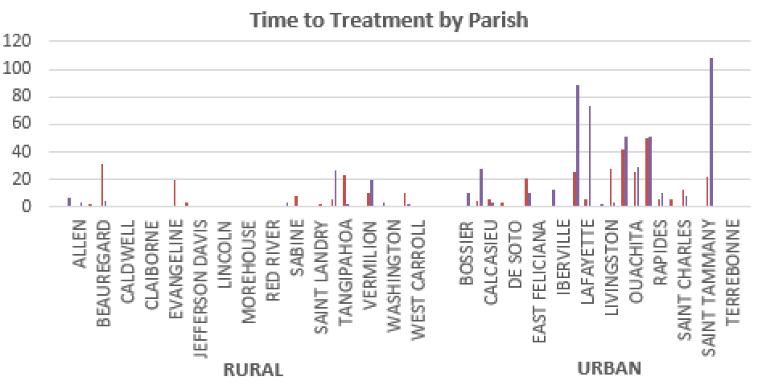
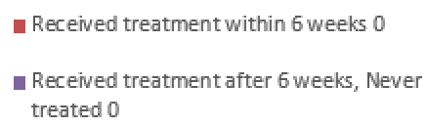
Treatment within 6 weeks
Parish |  | Rate (Dermatologist per 100,000 Population)
Rural | Beauregard | 2.73
 | Tangipahoa | 1.46
 | Evangeline | 3.13
Urban | Plaquemines | 0.00
 | Orleans | 20.28
 | Livingston | 0.67
Treatment after 6 weeks, Never treated
Parish |  | Rate (Dermatologist per 100,000 Population)
Rural | Saint Mary | 0.00
 | Vermilion | 1.76
 | Acadia | 0.00
Urban | Saint Tammany | 9.15
 | Jefferson | 9.86
 | Lafayette | 5.24
Notes:
When comparing treatment within 6 weeks compared to after 6 weeks/no treatment, urban parishes surprisingly have more inadequately treated NMSC although overall have more NMSC diagnoses compared to rural parishes.
Top 3 parishes with the most skin cancer tx within 6 weeks or less
Rural: Beauregard (31), Tangipahoa (23), Evangeline (20)
Urban: Plaquemines (50), Orleans (42), Livingston (28)
Top 3 parishes with the most skin cancer tx that took More than 6 weeks, Never treated
Rural: Saint Mary (27), Vermilion (20), Acadia (7)
Urban: Saint Tammany (108), Jefferson (88), Lafayette (73)
Parishes with 0 reported dermatologist (data from 2022) but with increased number of NMSC treated within appropriate time frame– derm density data from 2022 and out data is from 2023-2025 however this could also be due to the influence of primary care physicians?
Study from 2013 reported Rate for rural areas usually between 0 and 1 with urban areas having a rate around 4 with expectation that these rates will continue to increase.
HRSA Data Warehouse (Health Resources and Services Administration) Rate of dermatologist per 100,000 population AMA Physician Professional Data, 2022 Census Pop Estimates)– Data from 2022
Rural parishes/counties have ~ 0.085 to 1.05 per 100,000 population vs metropolitan areas with 4.11 per 100,000

Slide 9
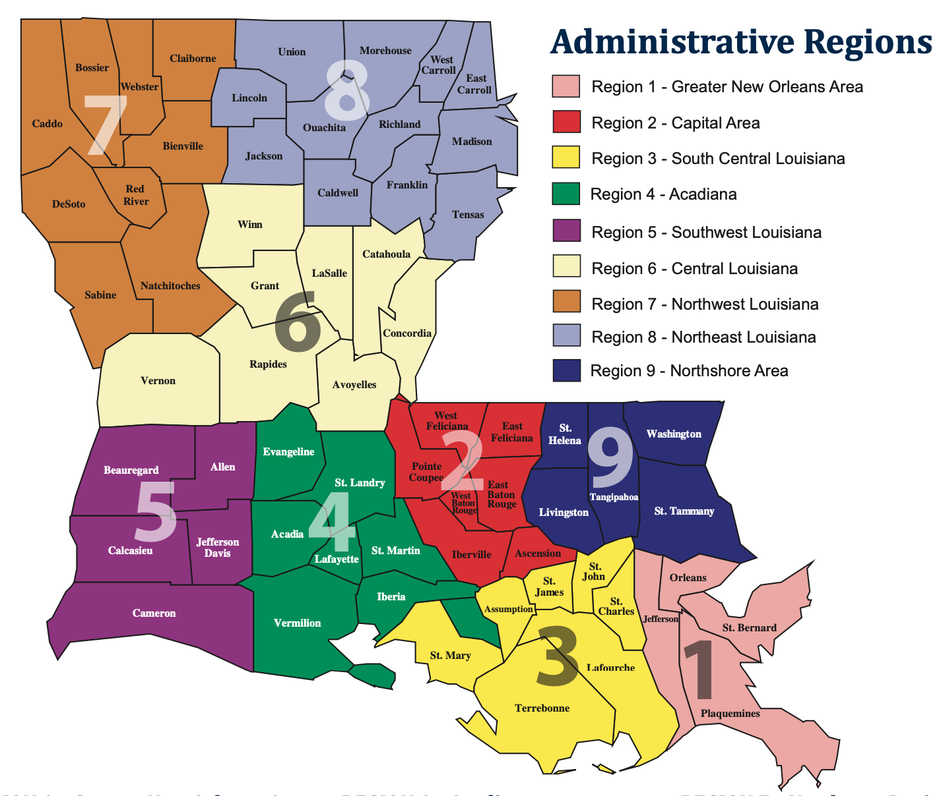
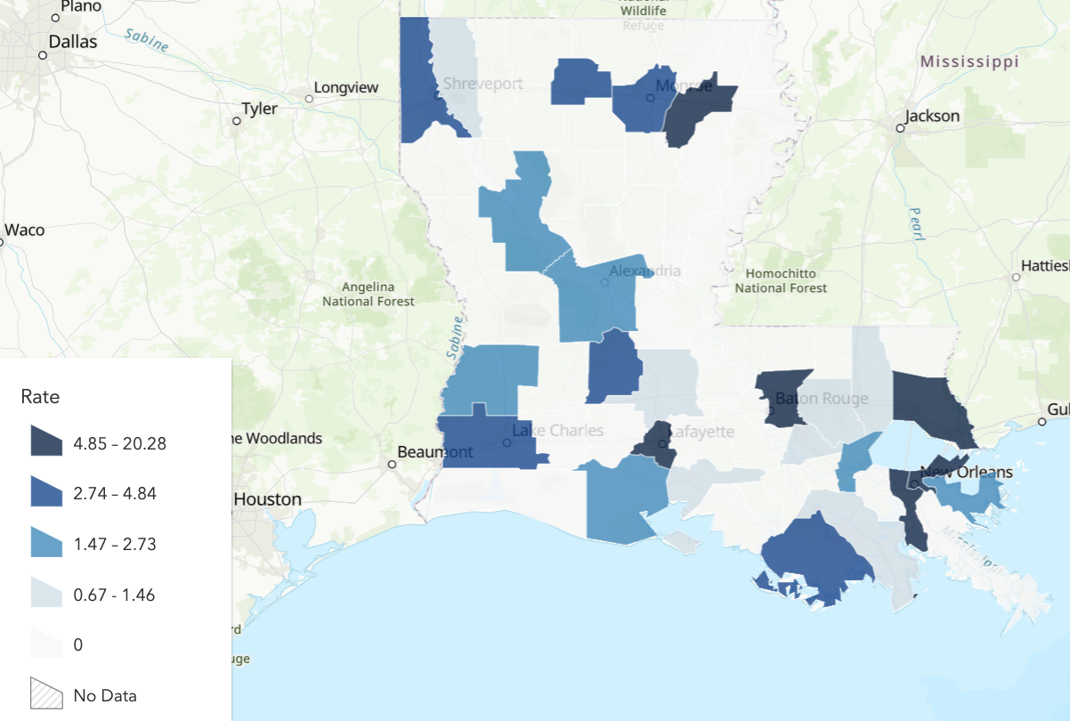
Takeaways
Notes:
Red (rural and urban) = 6 weeks or less for treatment
Dark purple (rural and urban)= NOT TREATED ON TIME - Over 6 weeks/Never for treatment
Rate of dermatologist per 100,000 – density of providers (from 2022)
Evaga

Slide 10
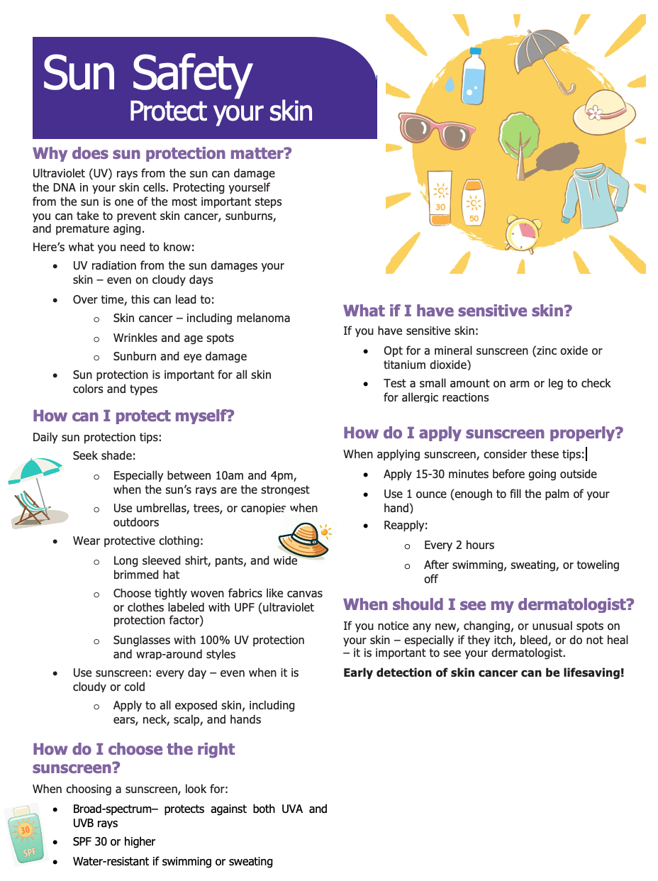
Recommendations
Primary Prevention
Continue to encourage education around sun safe practices in schools and within the workplace.
Youth: Focus on educating from a young age to develop safe practices and awareness early on.
Utilization of SPOTs Program
Continue social media presence, educating on sun safety and providing reminders of the risks of sun exposure especially during the summer months
Educational handouts in Spanish
Increase access to sun protection
Access to SPF (Vital Signs Media – SPF Kiosk)
Implementation of shaded areas in local parks, playgrounds
Addressing Delays in treatment:
Doctor’s offices: automated reminders for follow up and routine skin checks
Investigate further additional factors and influence of SES contributing to delays in care: transportation, language, childcare, leave from work
Amerihealth caritas transport, access to translators, easy to read educational pamphlets
Notes:
Screening not recommended by USPSTF. Continues to state evidence is insufficient to access risk/benefit of skin exams
For future, add additional information to handouts, more information for patients with skin of color and emphasis on prevention (younger age)
Reminders for skin checks, schedule next appointment at the end of visit.
Primary prevention
ACLA implemented social media reminders

Slide 11
Moving forward…
Investigate further data entries with screening dates occurring after treatment dates
Determine true screening dates to allow for more accurate calculation of delays in treatment
Explore diagnosis date and stage of NMSC at diagnosis
Expand data set to include multiple years given limited data regarding transportation and education
Further explore additional factors that allow parishes will lower rates of dermatologist per 100,000 to be successful in reducing delay of treatment.
Notes:
Absence of significance likely due to limited data – expect lack of transportation, language, education to influence patient follow up. Further more, would expect
Investigate further why dates are not in sequential order – likely that the time may be inaccurately increased between Dx and Tx due to adjusting the screening date to the earliest visit documented.

Slide 12
References
Area Health Resources Files. (n.d.). Retrieved August 25, 2025, from https://data.hrsa.gov/topics/health-workforce/nchwa/ahrf
CDC. (2024, July 1). Sun Safety Facts. Skin Cancer. https://www.cdc.gov/skin-cancer/sun-safety/index.html
CDC. (2025, July 25). Health and Economic Benefits of Skin Cancer Interventions. National Center for Chronic Disease Prevention and Health Promotion (NCCDPHP). https://www.cdc.gov/nccdphp/priorities/skin-cancer.html
Feng, H., Berk-Krauss, J., Feng, P. W., & Stein, J. A. (2018). Comparison of Dermatologist Density Between Urban and Rural Counties in the United States. JAMA Dermatology, 154(11), 1265–1271. https://doi.org/10.1001/jamadermatol.2018.3022
Roky, A. H., Islam, M. M., Ahasan, A. M. F., Mostaq, M. S., Mahmud, M. Z., Amin, M. N., & Mahmud, M. A. (2025). Overview of skin cancer types and prevalence rates across continents. Cancer Pathogenesis and Therapy, 3(2), 89–100. https://doi.org/10.1016/j.cpt.2024.08.002
‌Vital Signs Media. (n.d.). Vital Signs Media. Retrieved August 27, 2025, from https://www.vitalsignsmedia.com
Notes:
Dr Randolph, Renee, Dana, Shea, and the ACLA AmeriHealth Caritas Team

