Slide 1
Stroke Care Across Louisiana: Length of Hospital Stay and Discharge Condition
Nina N. Patel
LSU School of Medicine, Class of 2026
AmeriHealth Caritas Louisiana

Slide 2
Background on Stroke
Life-threatening medical emergency caused by sudden interruption of blood flow to the brain (ischemic or hemorrhagic)
Leading cause of morbidity and mortality​
  Fifth leading cause of death in the U.S.
  Major cause of long-term disability ​
Costs approximately $56 billion annually
Stroke diagnosed late or with severe complications carries the highest economic burden due to prolonged hospitalization, rehabilitation, and long-term disability care
Access to stroke-certified hospitals varies by geography​
  Rural areas often lack direct access to Comprehensive Stroke Centers or Primary Stroke Centers requiring transfers and longer transport times ​
Rural populations face unique barriers related to distance, transport, socioeconomic factors
  Patients in rural parishes have higher transport times, fewer EMS resources, and higher Medicaid dependence, all of which are associated with worse outcomes

Slide 3
Current ACLA Interventions
Enrollee Education
Make Every Calorie Count: Management program for qualifying enrollees with hypertension, diabetes, or a BMI over 28
Ochsner Health Digital Medicine Program: Blood pressure monitoring and clinical support for enrollees with hypertension
Blood Pressure Pocket Guide: Recommended questions, overview on blood pressure medications, and log for monitoring blood pressure and tracking PCP appointments
StayWell Health Library: Online quizzes and tools for eating health, exercise, and smoking/tobacco use
Care Management
Chronic Disease Care Center: Offers education, screenings, and health coaching for conditions like high blood pressure, heart disease, and diabetes
Complex Case Management: Voluntary program for high-risk members with chronic disease including diabetes and cardiovascular disease that provides individualized, disease-specific care plans with ongoing reassessment
Rapid Response Team: Assistance to providers who have enrollees with urgent needs related to case management, appointment scheduling, and transportation assistance
Adherence Monitoring
Chronic Blood Pressure Medication Adherence Project: Monthly monitoring of anti-hypertensive medication refills to determine current patient adherence

Slide 4
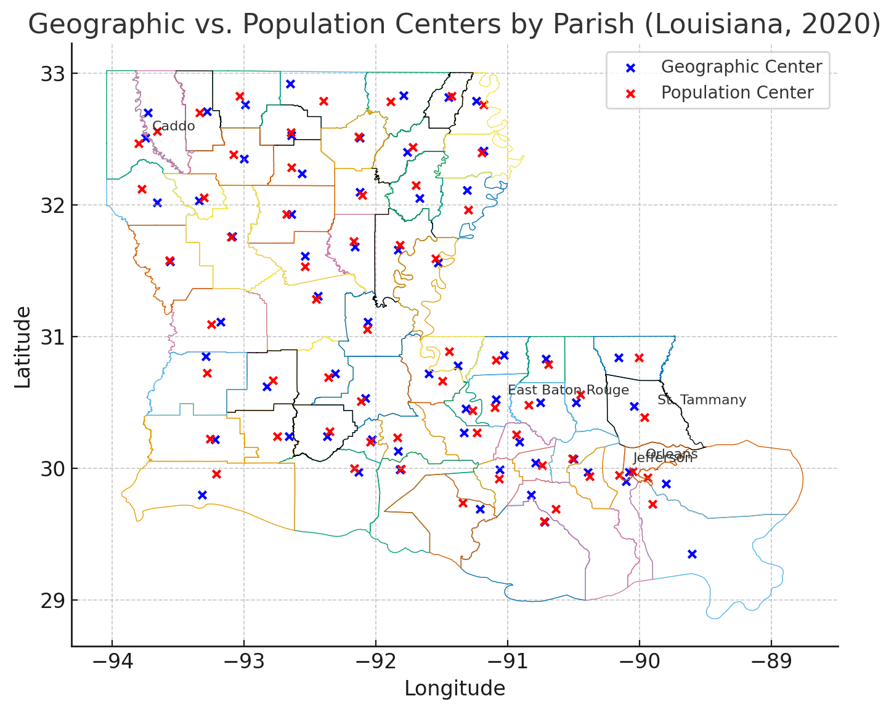
Data Sources
Patient claims data
Stroke diagnosis
Length of stay (LOS)
Discharge disposition
Patient’s home parish
Parish lookup file
Urban vs. rural classification of each parish
Geographic & population-weighted centroids
Travel distances and estimated transport times to closest stroke certified hospitals
Stroke certified hospital lookup file
Certification levels: Comprehensive Stroke Centers (CSC), Primary Stroke Centers (PSC / PSC-E), Acute Stroke Ready Hospitals (ASRH)

Slide 5
Overview of Stroke Incidence

Slide 6
Overview of Stroke Incidence

Slide 7
Length of Stay

Slide 8
Discharge Disposition
Home/Self-care
Home Health
Intermediate Care Facility
Skilled Nursing Facility (SNF)
Transfer to acute hospital/LTACH
Expired
Stroke Disparities Project | Draft Template

Slide 9
Findings
Length of Stay: Average did not differ significantly between rural and urban patients
  65+ age group with borderline significantly longer length of stay
Discharge Disposition: Patients with rural home parish were 3x more likely to be discharged from the hospital to a long-term care facility to another acute care facility

Slide 10
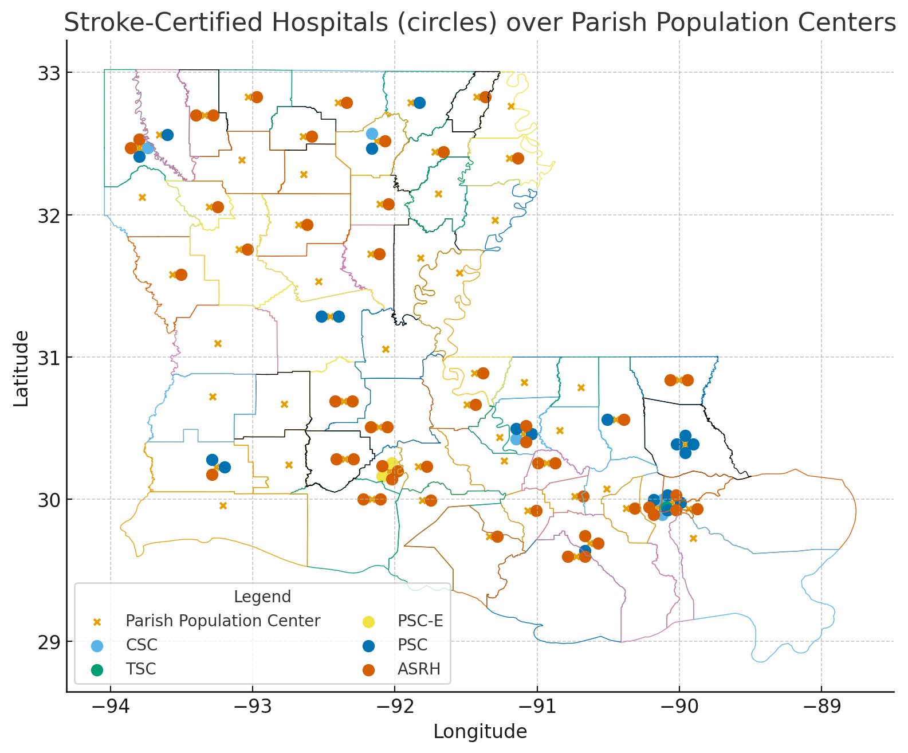
Proximity to Nearest Stroke Certified Hospital
Stroke Disparities Project | Draft Template

Slide 11
Areas for Further Research
Utilization of ancillary services including PT, OT, and speech therapy during hospital stay
  Cost per patient/total costs per admission
Bypass/Transfer Rates: Comparison of direct admissions vs. inter-hospital transfers based on rurality.
Readmission rates for stroke-related complications
Analysis of hospital course and discharge disposition stratified by hypertension control status and other patient comorbidities

Slide 12
References
American Heart Association & CDC. Economic Burden of Stroke in the United States, 2019–2020.
AmeriHealth Caritas Louisiana. Provider Manual. Rapid Response & Outreach Team; Complex Care Management.
https://www.amerihealthcaritasla.com/content/dam/amerihealth-caritas/acla/pdf/provider/resources/manual/handbook.pdf
CDC/NCHS. Underlying Cause of Death Data, 2021.
Centers for Disease Control and Prevention (CDC). Stroke Facts. Updated 2023. https://www.cdc.gov/stroke/facts.html
Howard G, et al. Disparities in Stroke Incidence and Mortality by Geography and Socioeconomic Status. Stroke.2017;48:2198–2205.
Howard G, et al. REGARDS study. Trends in Stroke Mortality and the Rural–Urban Gap. Stroke. 2016–2022 analyses.
Miller J, et al. Geographic Access to Certified Stroke Centers in the United States. Stroke. 2021;52:234–241.
Yang Y, et al. The Effect of Comorbidity and Age on Hospital Mortality and Length of Stay in Patients with Stroke. J Crit Care. 2010;25(3):398–405.

Slide 13
Acknowledgements
Thank you to Dr. Randolph, Dana Smith, Renee’ Wells, Shea Good, Rhonda Baird, and the IT Enterprise team for their help!

