Slide 1
Statin Therapy for Patients with Diabetes
Salena Sinnasone
LSUHSC New Orleans – Population Health Management Course
October 22, 2025

Slide 2
Learning Objectives
Describe the current rates of statin adherence among adults aged 40-75 with diabetes and without clinical atherosclerotic cardiovascular disease in LA
1
Analyze variations in statin prescribing and adherence among different demographic groups (e.g., age, race, geographic region)
2
Identify potential disparities and social determinants of health that influence differences in statin adherence
3
Develop data-driven recommendations to improve adherence rates for patients with diabetes in LA
4

Slide 3
What is Diabetes?
Diabetes mellitus (DM): complex micro-vascular disease affecting multiple organ systems including kidneys, eyes, nerves, cardiovascular
Complications of DM: Heart disease, stroke, amputation, end-stage kidney disease, blindness
Role of Statins in DM
Lowers lipid levels - reduces risk of atherosclerotic cardiovascular disease (ASCVD)
Stabilizes atherosclerotic plaques
Improves endothelial function
Decreases CV morbidity and mortality
Recommendation
Begin lipid-lowering therapy with statin in most patients with DM
Notes:
Statins
ADA and AHA recommend statin therapy for nearly all adults w DM aged 40-75 years, regardless of baseline LDL cholesterol for both primary and secondary prevention of ASCVD events
Studies have shown substantial reduction in CV morbidity and mortality

Slide 4
Background
Diabetes in America
According to CDC, >38 million Americans aged 18+ have diabetes (DM) & 98 millions adults with pre-diabetes
Diabetes in Louisiana
According to American Diabetes Association (ADA), LA has approximately 568,000 adults diagnosed with DM (14.5% of adult population)
Diabetes is expensive
In LA, diagnosed DM cost ~$6.9 billion each year (includes direct medical expenses and indirect costs from lost productivity due to DM)

Slide 5
ACLA Current Interventions
SPD RELAY Texting Experience to noncompliant members
Notes:
Texting service that sends out monthly reminders to patients that have not received their statin in 60 days

Slide 6
NCQA vs ACLA Averages
Adherence = no more than 1 gap in enrollment of up to 45 days during the measurement year, meaning member may not have more than 1 month gap in coverage; ≥80% coverage during the treatment period
Notes:
LA has 17% higher rate of people receiving their statin after initiation than national average
However, LA also has 12% lower statin adherence rates in diabetic patients than national average

Slide 7
Statin Adherence Rates by Age - 2024
Notes:
Age 70-75 excluded due to low count of members who meet criteria
Ages 40-49 with lowest adherence rates
Ages 60-69 with highest adherence rates
Lower adherence rates due to lower perceived CV risk, greater optimisms bias regarding their health, misconceptions about necessity of statin?

Slide 8
Statin Adherence Rates by Race - 2024
Notes:
Hispanic excluded due to low number of individuals meeting the inclusion criteria
I calculated the average adherence rate across all races and found avg adherence to be 59%
Black and Indian had below average adherence rates
Why? – Mistrust in healthcare system, cultural differences, or healthcare literacy
Asian/Pacific Islander had greatest adherence rate
Why? – Are they able to afford their medications compared to other groups?

Slide 9
Statin Adherence Rates - Rural vs Urban - 2024
Notes:
In 2024, rural > urban adherence rates
Why?
Urban residents may have different lifestyle factors compared to rural individuals (may be able to take off from work less to visit doctor, financial situation may be different)
Unreliable transportation to pick up prescription or attend follow up visits compared to rural individuals who might have more reliable transportation since they live so far away from communities

Slide 10
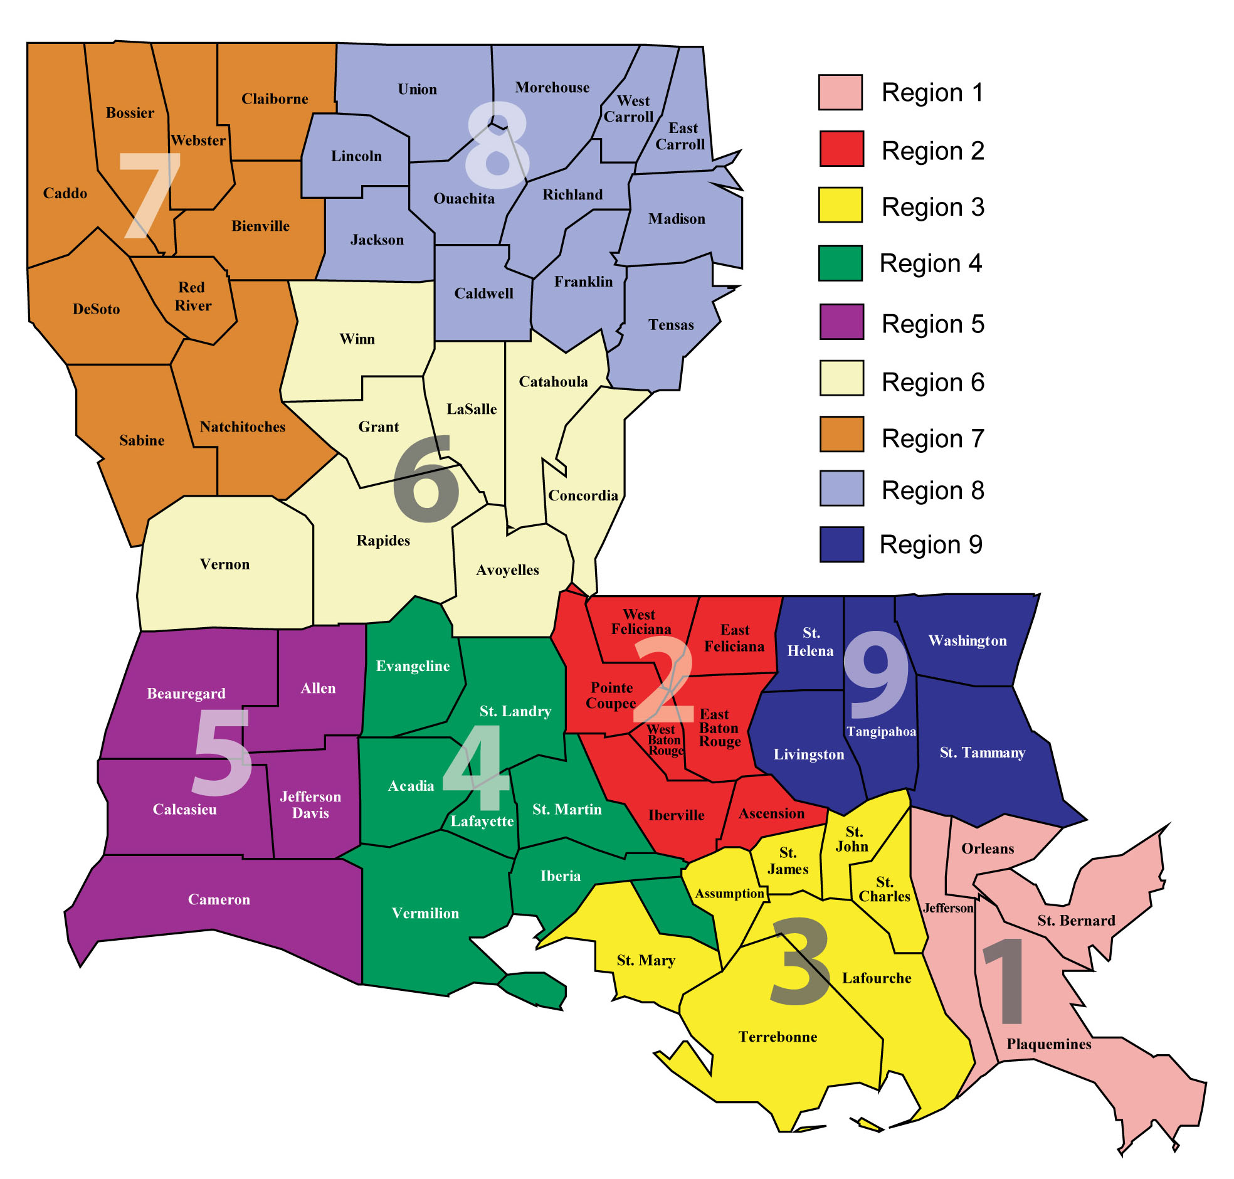
LDH Regions
Notes:
Average 55% adherence rate among LDH regions
Region 8 (northeast LA) had lowest adherence rates - <50%
Region 3 (river and bayou parishes) had highest adherence rates – 60%
Other regions to note that have lower adherence rates – Region 7, 6, 2

Slide 11
Summary
LA has 12% lower statin adherence rates in diabetic patients than national average
Age
Ages 40-49 with lowest adherence rates
Ages 60-69 with highest adherence rates
Races
All races had ≥50% of their population that were adherent to statin therapy
Black and Indian patients had lower than average adherence rates
Asian/Pacific Islander had greatest adherence rate
Urban vs Rural
People living in urban areas were more non-adherent to statin medication compared to those living in rural areas
Regions
Region 2, 6, 7, 8 had lowest adherence rates
Region 3 had highest adherence rates
Notes:
Language was analyzed but due to low threshold of individuals, excluded from study

Slide 12
Recommendations
Target younger populations (age 40-49) with social media campaigns or mobile apps with reminders
Why do Black and Indian populations have lower adherence rates?
Consider mistrust in healthcare system, cultural differences, or healthcare literacy
Urban populations have lower adherence rates than rural populations
Transportation issues? Inability to take time off from work?
Increase educational campaigns in Regions 2, 6, 7, 8 on statin adherence and benefits on CV morbidity and mortality
Analyze why Asian/Pacific Islander population and Region 3 have highest adherence rates
Notes:
Lower adherence rates – lack of understanding of disease condition, side effects (myopathy), cost of medication

Slide 13
Recommendations
Motivational interviewing
Simplifying medication regimens
Reminder systems
Incentives to promote adherence
Notes:
Motivational interviewing – encourage providers to practice open-ended questions and explore why pts aren’t adhering to statin (side effects, affordability?)
Simplifying medication regimens – advice providers to prescribe fixed-dose combinations or synchronizing pharmacy pickups (reduces polypharmacy)
Reminder systems – automated phone calls, continued text messages
Incentives to promote adherence – reducing co-payments, paying patients and clinicians for achieving disease management goals

Slide 14

Thank you!
Dr. Gregory Randolph
Dana Smith
Renee Wells
Shea Good
Carrie Blade
Lekitha Gregory
Rhona Baird
Jennifer Manuel

Slide 15
Resources
https://diabetes.org/sites/default/files/2025-08/louisiana-diabetes-08-26-25.pdf
https://ldh.la.gov/assets/docs/BayouHealth/Dental/Louisiana_Rural_Parishes_Map.pdf
https://www.ncqa.org/report-cards/health-plans/state-of-health-care-quality-report/statin-therapy-for-patients-with-diabetes-spd/
https://jamanetwork.com/journals/jama/article-abstract/2718800?utm_source=openevidence&utm_medium=referral
https://pmc.ncbi.nlm.nih.gov/articles/PMC5973378/#:~:text=Reminders,or%20therapists%20can%20improve%20adherence.&text=Techniques%20commonly%20involve%20phone%20calls,be%20the%20most%20effective%20strategies.&text=A%20Cochrane%20database%20review%20by,adhe

