Slide 1
Sepsis: Relation to Comorbidities and Hospital Length of Stay
Nicole Vasilakos
LSU HSC New Orleans
MD-MPH, Class of 2025
AmeriHealth Caritas Intern
April 2, 2025

Slide 2
Background
Life threatening medical emergency caused by the body’s extreme response to infection
Costs approximately $38 billion annually in the U.S
Sepsis diagnosed after admission or with increasing severity have the highest economic burdens
Early identification is crucial to alleviate severity and financial costs
Nicole Vasilakos
Page #

Slide 3
Background
Sepsis accounts for 270,000 deaths/yr
Leading cause of death in hospitals (1 in 3 hospital deaths)
Hospital Costs: Sepsis present at admission ~$18,023/pt and not present at admission ~$51,022/pt
Median LOS: Hospital onset- 19 days vs. Community onset- 8 days
Association in the literature of increased LOS with increased # of comorbidities (COPD, CHF, CKD, DM, ESRD, immunosuppression, HTN)
Nicole Vasilakos
Page #

Slide 4
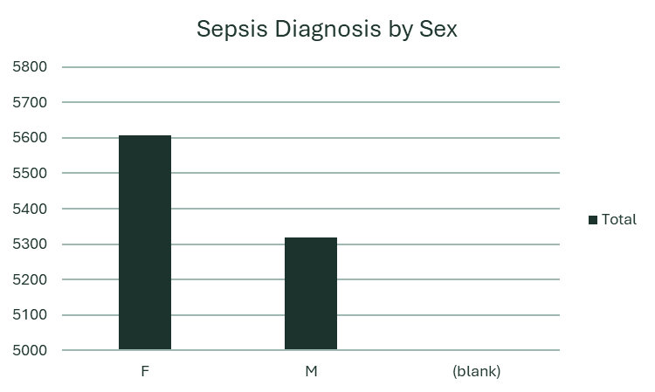
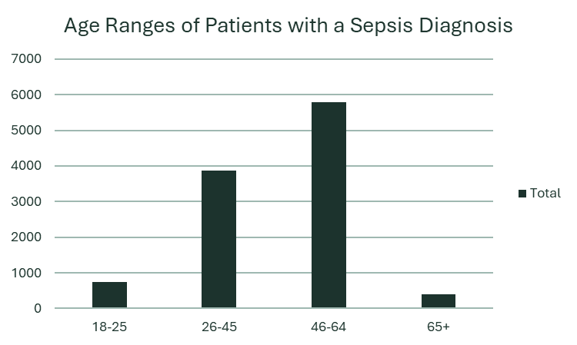
Age & Sex of Pts w/ Sepsis Diagnosis
Number of Patients
Number of Patients
Sex
Age Ranges in Years
Nicole Vasilakos
Page #
Notes:
Add time frame, insert ACLA pts

Slide 5
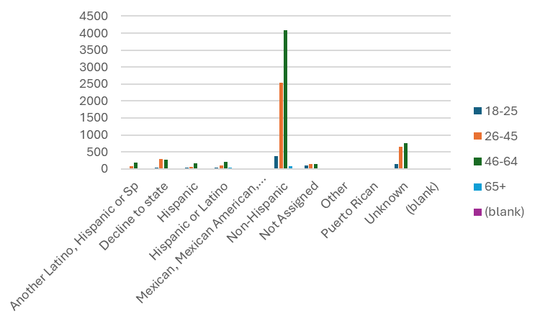
By Ethnicity
Number of Patients
Nicole Vasilakos

Slide 6
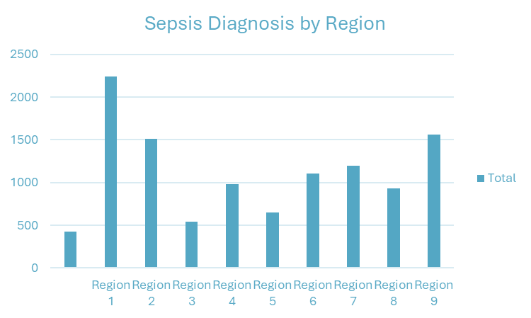
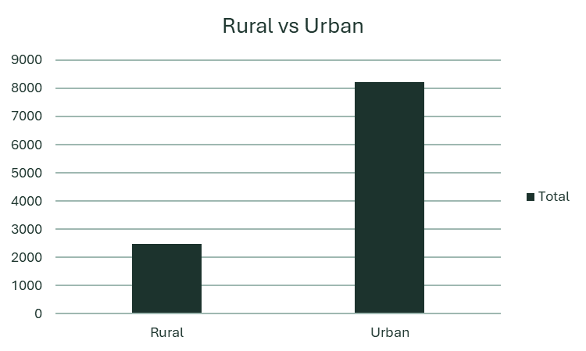

Number of Patients
Number of Patients
By Location
Nicole Vasilakos
Page #

Slide 7
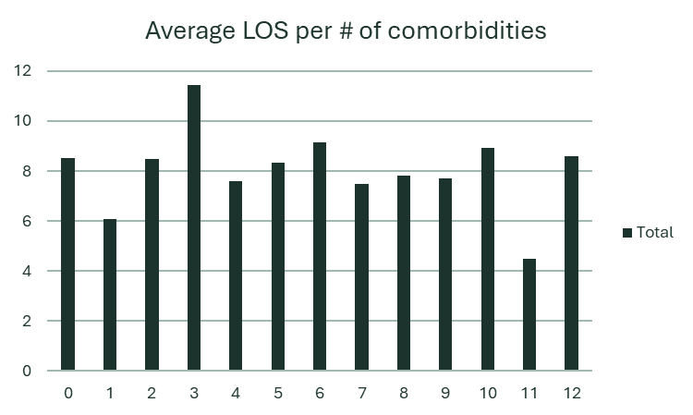
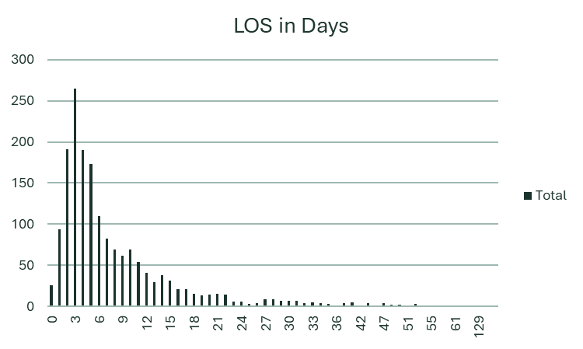
Average LOS: 8.42 Days
Average LOS per # of Comorbidities
LOS in Days
LOS in Days
Number of Patients
# of Comorbidities
LOS
Team Name
Page #

Slide 8
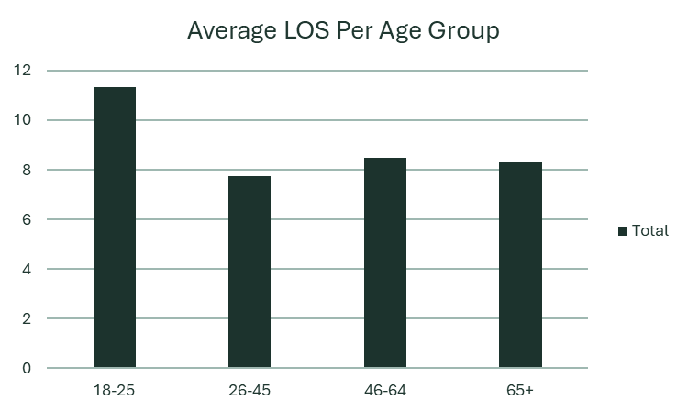
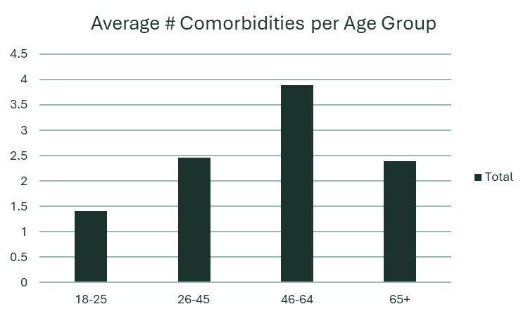
Average LOS per Age Group
Average # Comorbidities per Age Group
Average LOS
# of Comorbidities
Age Ranges in Years
Age Ranges in Years
Nicole Vasilakos

Slide 9
LOS in Days per Comorbidity
Longest: Is Transplant 11.6,
Renal 11.4, Parkinson's 10.3
Shortest: Pregnant 4.1,
Glaucoma 7.3, Asthma 7.4
Prevalence & Average LOS of Comorbidities:
Depression: 8.6 days
HTN: 8.3 days
Diabetes: 8.6 days
Lipid: 8.5 days
Asthma: 7.4 days
Back: 9.2 days
COPD: 7.7 days
Renal: 11.4 days
CHF: 8.7 days
Schizophrenia: 8.1 days
IHD: 8.1 days
Hypothyroid: 8.0 days
HIV: 7.9 days
Parkinson's: 10.3 days
Glaucoma: 7.3 days
Pregnant: 4.1 days
Is Transplant: 11.6 days
Osteo: 7.4 days
Prevalence & Average LOS per Comorbidity
Nicole Vasilakos
Page #
Notes:
1. 4586 pts 18. 142 pts

Slide 10
Next steps
Longest LOS Comorbidities:
Is Transplant 11.6 days
Renal 11.4 days
Parkinson's 10.3 days
Flagging patients with these conditions could potentially alleviate some sepsis related costs
Nicole Vasilakos
Page #

Slide 11
Next steps
Areas for Further Research:
Severity of acute illness may be stronger predictor than comorbidity count in this patient population
Sepsis-related complications may drive LOS more than baseline conditions (VAP, ICU delirium, prolonged ventilation)
Chart review of patients in 18-25 age range to assess other factors that increase LOS
Cost per patient/total costs per admission
Hospital vs community onset in this patient population
Nicole Vasilakos

Slide 12
References
Hollenbeak, Christopher S., et al. “Costs and Consequences of a Novel Emergency Department Sepsis Diagnostic Test: The IntelliSep Index.” Critical Care Explorations, vol. 5, no. 7, 1 July 2023, p. e0942, journals.lww.com/ccejournal/fulltext/2023/07000/costs_and_consequences_of_a_novel_emergency.14.aspx, https://doi.org/10.1097/CCE.0000000000000942.
Epidemiology and Costs of Sepsis in the United States—an Analysis Based on Timing of Diagnosis and Severity Level.” Critical Care Medicine, vol. 46, no. 12, Dec. 2018, pp. 1889–1897, https://doi.org/10.1097/ccm.0000000000003342.
https://bmcinfectdis.biomedcentral.com/articles/10.1186/s12879-024-09081-x#:~:text=Hypertension%20is%20the%20most%20prevalent,mortality%20in%20patients%20with%20sepsis.
Paoli, Carly J., et al. “Epidemiology and Costs of Sepsis in the United States—an Analysis Based on Timing of Diagnosis and Severity Level.” Critical Care Medicine, vol. 46, no. 12, Dec. 2018, pp. 1889–1897, https://doi.org/10.1097/ccm.0000000000003342.
Rhee, Chanu, et al. “Epidemiology of Hospital-Onset versus Community-Onset Sepsis in U.S. Hospitals and Association with Mortality.” Critical Care Medicine, vol. 47, no. 9, Sept. 2019, pp. 1169–1176, https://doi.org/10.1097/ccm.0000000000003817.
Whiles, Bristol, et al. “Comorbid Conditions Predict Outcomes in Patients with Severe Sepsis.” Chest, vol. 149, no. 4, Apr. 2016, p. A170, https://doi.org/10.1016/j.chest.2016.02.176. Accessed 17 Nov. 2019.
Yang, Yong, et al. “The Effect of Comorbidity and Age on Hospital Mortality and Length of Stay in Patients with Sepsis.” Journal of Critical Care, vol. 25, no. 3, 1 Sept. 2010, pp. 398–405, pubmed.ncbi.nlm.nih.gov/19836195/, https://doi.org/10.1016/j.jcrc.2009.09.001.
Nicole Vasilakos
Page #

