Slide 1
Colorectal Cancer in Louisiana: Statewide variation in screening and incidence
Claire Carr, MS4
LSU School of Medicine – New Orleans
05/02/2025

Slide 2
Background Information
Colorectal cancer (CRC) is the 3rd most common cause of cancer related death among men and women in the United States.
CRC incidence is increasing, particularly among individuals under 50 years of age
Louisiana has the 5th highest rate of CRC-related mortality in the United States.
Screening and prevention are important: Early detection of CRC can decrease mortality by 90%. Colonoscopy screening every 10 years from ages 50 through 75 can reduce CRC incidence by 62% to 88% and mortality by 79% to 90%.
USPSTF recommends CRC screening for all adults aged 45-75.
Across the US, 25% of eligible individuals are not up to date on CRC screening.

Slide 3
Colorectal Cancer Screening Methods
USPTF recommends regular colorectal cancer screening for all adults ages 45-75.
Populations at increased risk for developing colorectal cancer include rural, male, white/Caucasian, and low SES.
Guaiac-based fecal occult blood test (gFOBT) – yearly.
Fecal Immunochemical Test (FIT) – yearly or FIT-DNA every 3 years
Flexible Sigmoidoscopy – every 5 years.
Colonoscopy – every 10 years.
CT Colonography – every 5 years.
Notes:
https://www.cdc.gov/colorectal-cancer/screening/index.html

Slide 4
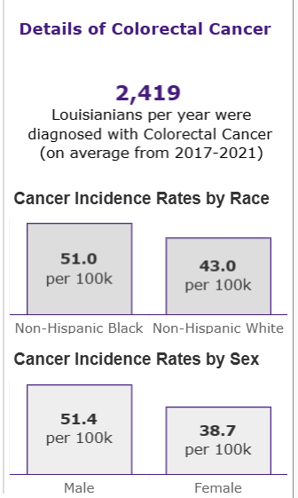
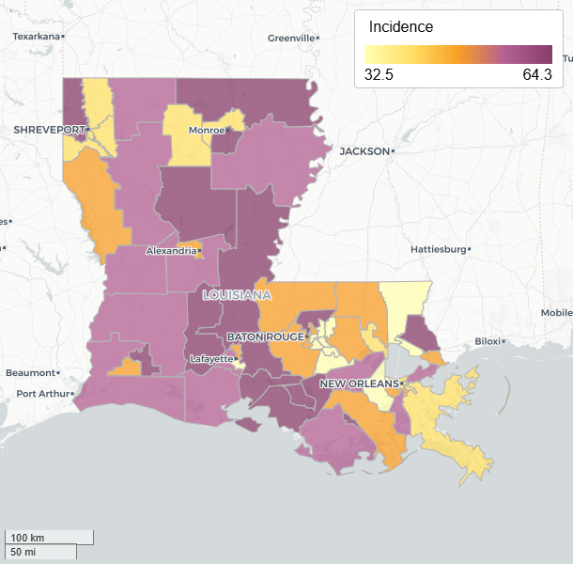
Colorectal Cancer in Louisiana
LSU Tumor Board Database

Slide 5
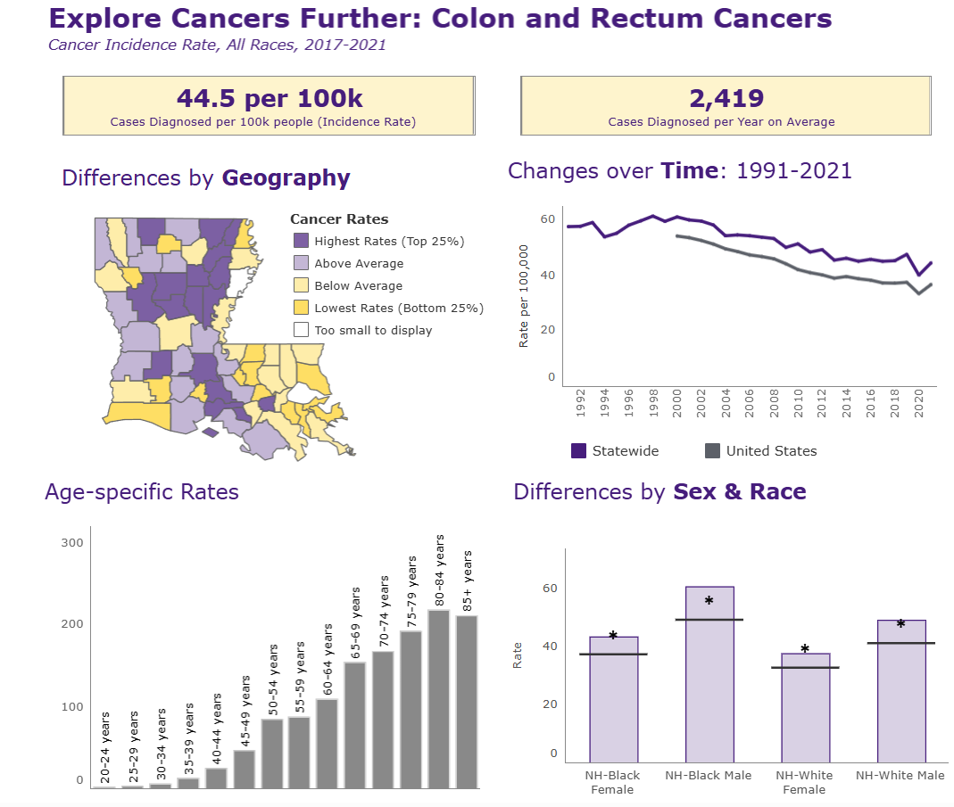
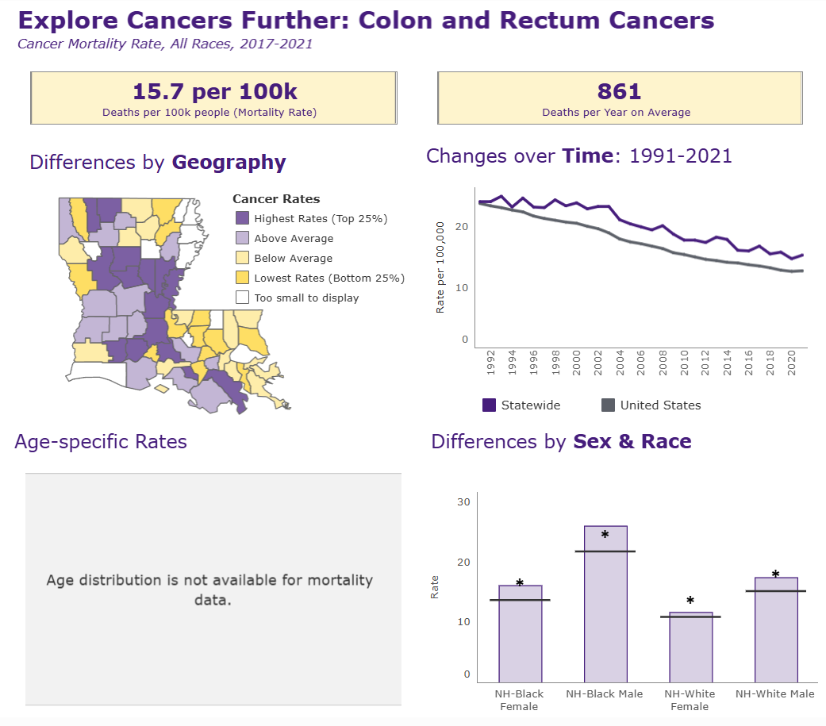
Mortality
Incidence
LSU Tumor Board Database

Slide 6
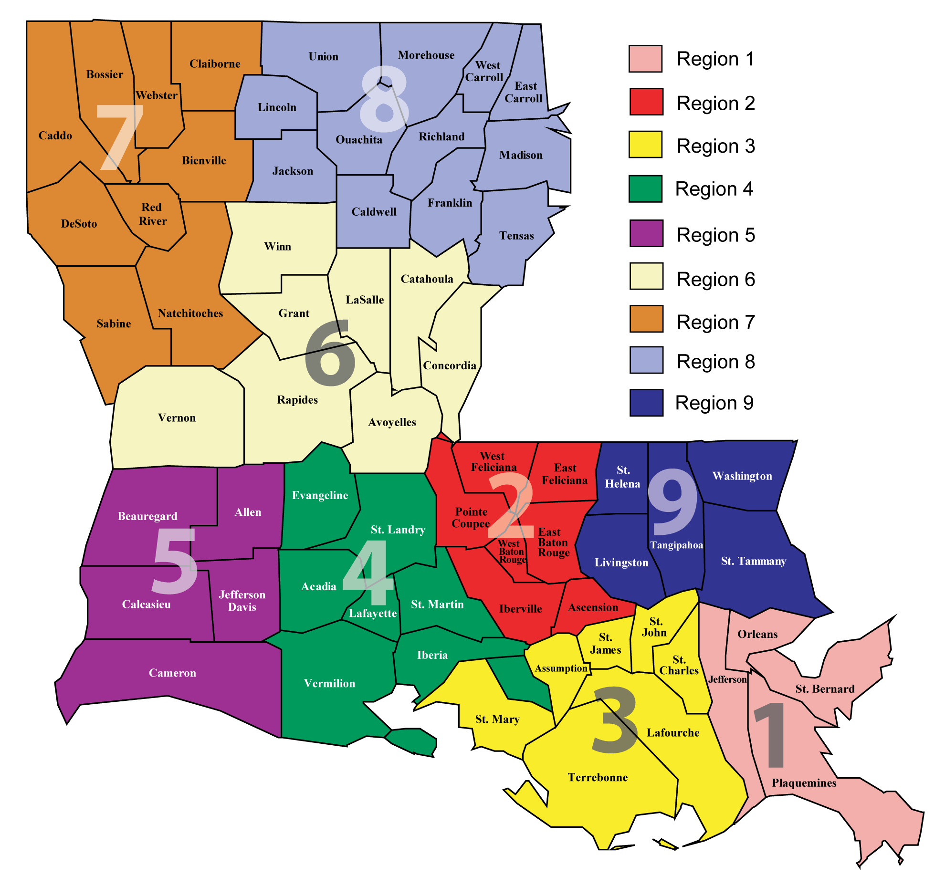
Previous ACLA Data Findings
LA regions 6 and 8 have the lowest rates of CRC screening despite comparable rates of PCP visits.
Males statewide are less likely to be UTD on CRC screening than females
Colonoscopy has been decreasing as the most common screening modality, with an increase in Stool DNA Screening
Credit: Rutger Fury

Slide 7
Regional Discrepancies in CRC Screening 2022-2024 (ACLA Data)
ACLA Data
Notes:
While these numbers are in line with the LDH’s goal of increasing colorectal cancer screening they fall far short of ACS goal of 80% in every community.

Slide 8
Screening methods by type in underscreened areas
ACLA Data
Notes:
Note FIT becoming far more common in all regions but especially in those areas that have low use

Slide 9
Demographic breakdown of screening compliance in underscreened regions

Slide 10
ACLA Data

Slide 11
ACLA Data

Slide 12
ACLA Data

Slide 13
ACLA Data

Slide 14
2022 CRC Incidence
ACLA Data

Slide 15
2022 CRC Incidence by Sex
ACLA Data

Slide 16
CRC Incidence by Area
ACLA Data

Slide 17
CRC Incidence by Race and Ethnicity
ACLA Data
Notes:
Still need to do by Race sorry

Slide 18
Summary
Louisiana exceeds the national average in both CRC incidence & mortality.
LDH Regions 6 & 8 have especially low rates of CRC screening compliance despite comparable access to primary care.
Screening compliance is increasing in all regions to meet LDH screening goals, including in regions 6 & 8. Fecal DNA testing is increasing in popularity as a screening modality, particularly in those regions with lower screening compliance.
Screening compliance is lowest among men, particularly Black and Hispanic men and men living in rural areas. These groups are the same in regions of low screening compliance.
Screening in regions of low compliance is increasing accordingly with Louisiana as a whole.
Colorectal cancer incidence in this population was not highest in regions with the lowest screening compliance. It is greatest in urban areas, among females, and among white patients.

Slide 19
Current ACLA Initiatives and Next Steps
Current ACLA Initiatives
- Exact Sciences Cologuard Project, including a project to implement a texting campaign
- Care Card incentive
- Participation with TACL (Taking Aim at Cancer in Louisiana)
- Social media campaign with messaging for our Black or African American members utilizing NCCRT Guidebook for Messaging
- Educating during provider visits
- Targeted mailers
- Member newsletters
- Attend LCCRT
Next Steps
Provide messaging and media for Primary Care Providers to encourage offering CRC screening to patients.
Continue the Exact Sciences Cologuard Project and implement texting campaign
Tailor screening initiatives to men, especially Black/African American and Hispanic/Latino men.
Ensure mailers are delivered to rural areas and consider other media to reach rural areas i.e. billboards
Investigate availability of endoscopy providers including gastroenterologists, surgeons and endoscopy-trained PCPs.

Slide 20


Acknowledgements
Dr. Gregory Randolph
Renee Wells
Dana Smith
Shea Good
Rhonda Baird
Carrie Blades
Rutger Fury
Thank you!

Slide 21
References
https://www.cdc.gov/colorectal-cancer/screening/index.html
Louisiana Cancer Data Visualization, based on November 2023 submission data (2017-2021): Louisiana Tumor Registry; https://sph.lsuhsc.edu/louisiana-tumor-registry/data-usestatistics/louisiana-cancer-data-visualization-dashboard, December 2024.
https://www.ldi.la.gov/docs/default-source/documents/ldi-convention/2023-presentations/physician-shortage-in-la-culotta-and-fraiche.pdf?sfvrsn=7ece4752_0
https://nccrt.org/our-impact/80-in-every-community/
AGA Clinical Practice Update on Risk Stratification for Colorectal Cancer Screening and Post-Polypectomy Surveillance: Expert Review. [pubmed.ncbi.nlm.nih.gov]
Issaka RB, Chan AT, Gupta S.
Gastroenterology. 2023;165(5):1280-1291. doi:10.1053/j.gastro.2023.06.033.
Leading Journal
Colorectal Cancer Screening for Average-Risk Adults: 2018 Guideline Update From the American Cancer Society. [pubmed.ncbi.nlm.nih.gov]
Wolf AMD, Fontham ETH, Church TR, et al.
CA: A Cancer Journal for Clinicians. 2018;68(4):250-281. doi:10.3322/caac.21457.
Leading Journal
State Disparities in Colorectal Cancer Rates: Contributions of Risk Factors, Screening, and Survival Differences. [pubmed.ncbi.nlm.nih.gov]
Lansdorp-Vogelaar I, Goede SL, Ma J, et al.
Cancer. 2015;121(20):3676-83. doi:10.1002/cncr.29561.

