Slide 1
Transitioning Care following Behavioral Health Admission
Alexandra Hebert
LSU NOLA MS4

Slide 2
Background Statistics
National public health coverage 2023
19% Medicaid
19% Medicare
Louisiana Department of Health 2023
36% of non-elderly adults in Louisiana are on Medicaid
58% of Louisiana children are on Medicaid
Notes:
2023 census data

Slide 3
Introduction
AmeriHealth Caritas Louisiana (ACLA)
Behavioral Health Measures
Transitions in care following hospital discharge data
Percent compliance with outpatient follow up
Healthcare Setting: Urban vs Rural
Region
Parish
Diagnosis
Race
Overall compliance 2023 = 28%
Overall compliance 2024 = 29%
Notes:
Overall compliance 2023 28%
Overall compliance 2024 29%

Slide 4
Compliance by Healthcare Setting
Higher % compliance in rural settings for both 2023 and 2024
2023
31% compliance in rural setting
28% compliance in urban setting
2024
32% compliance in rural setting
28% compliance in urban setting
Overall trend
Slight improvement in compliance in the rural healthcare setting from 2023 to 2024
Notes:
Overall compliance 2023 28%
Overall compliance 2024 29%

Slide 5
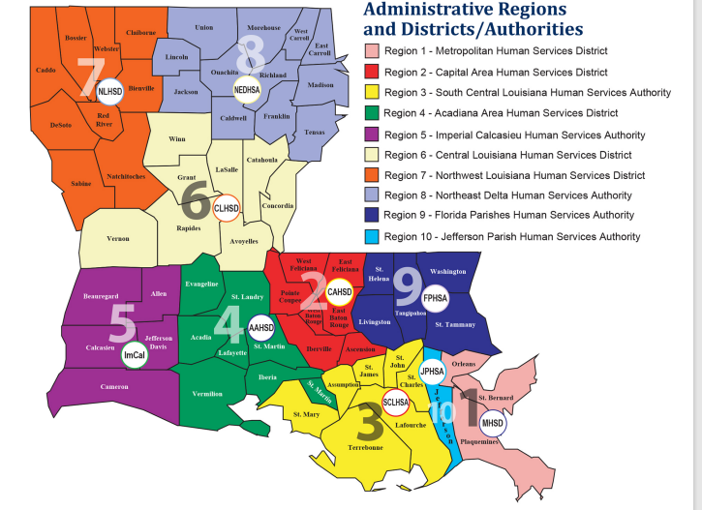

Slide 6
Compliance by Region
Highest compliance 2023
34% Region 3
34% Region 6
Lowest compliance 2023
24% Region 1
25% Region 8
Highest compliance 2024
35% Region 3
34% Region 6
Lowest compliance 2024
23% Region 1
25% Region 8
Largest improvement
6% increase Region 9
Largest decline
1% decrease Region 7
Notes:
4 = 5% increase
5 = 3% increase
1-2% increase = 2 and 3

Slide 7
Compliance by Parish
Lowest compliance 2023
Orleans 23%
Ouachita 24%
Highest compliance 2023
East Baton Rouge 35%
St. Tammany 30%
Lowest compliance 2024
Orleans 19%
Ouachita 23%
Highest compliance 2024
St Tammany 35%
Rapides 35%
Largest improvement
Rapides 10% increase
St Tammany 5% increase
Largest decrease
East Baton Rouge 6%
Orleans 3%
Notes:
Top 10 results --> potentially skewed but since it has the largest sample size of population I decided to go with it
Analyzed changes between the 2 years
% Increase = calcasieu 3, laf 3.7
% decrease = caddo 2
State avg compliance 28%

Slide 8
Compliance by Diagnosis
Lowest compliance 2023
Schizophrenia 19%
Adjustment disorder 22%
Highest compliance 2023
Disruptive Mood Disorder 41%
Major Depressive Disorder 29%
Lowest compliance 2024
Adjustment disorder 14%
Schizophrenia 27%
Highest compliance 2024
Disruptive Mood Disorder 43%
Bipolar and Major Depressive Disorders 31%
Important trends
8% increase in patients with Schizophrenia
8% decline in patients with Adjustment disorder
Notes:
Adj --> with 3 months of stressor and resolves with 6 months of event--> dec f/u tdue to quick resolution of dz (expected process)
DMDD--> pediatric dz --> parental management
Over 100 cases total included

Slide 9
Compliance by Race
Similar rates of compliance between African American and white patients
27% AA 2023/2024
30% white 2023/2024
Notes:
Excluded other populations due to low sample size
-increase efforts with AA pops but lots of work can be done holistically

Slide 10
ACLA measures
Recently submitted the data and interventions from 2022-2025 relative to follow up rates following discharge for behavioral health admission.
Healthy Louisiana intervention measures for follow-up after
Hospitalization for mental illness within 7 and 30 days of discharge
Emergency Department visit for mental illness within 7 and 30 days of ED visit
Emergency Department visit for substance use within 7 and 30 days of ED visit

Slide 11
Current Interventions
Link members to aftercare with BH providers prior to discharge from hospital or emergency department
Pilot program with a high-volume hospital to offer outpatient/telehealth bridge follow-up appointments following inpatient discharge
Utilize BH CM staff who hold licensure as LMHPs to outreach members in the FUH population to conduct a post-discharge follow-up assessment to close gaps internally

Slide 12
Conclusions
Lower % compliance in urban settings
Largest increase in % compliance in Region 6 (investigate further into what changed)
6% decrease in compliance in East Baton Rouge Parish
10% increase in compliance in Rapides Parish
8% increase in compliance in patients with Schizophrenia
8% decrease in compliance in patients with Adjustment disorder
3% less compliance in African American population compared to white population

Slide 13
Resources
LDH_RegionalMap.pdf
Behavioral Health Transitions in Care Quarter 2 2025 ACLA PIP
Louisianafor-AHCJ2024.pdf
Medicare and Medicaid by the Numbers
Health Insurance Coverage in the United States: 2023

