Slide 1
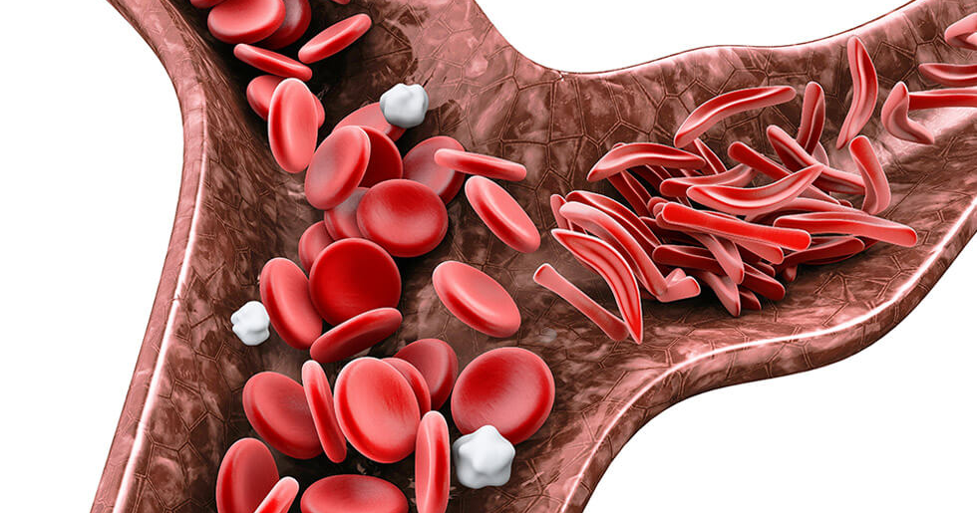
Beyond the Crisis: A Demographic Analysis of VOC and ACS Readmissions in Louisiana Medicaid
Population Health Management Clerkship
Block 2
Alia Fleury, MS
Class of 2025

Slide 2
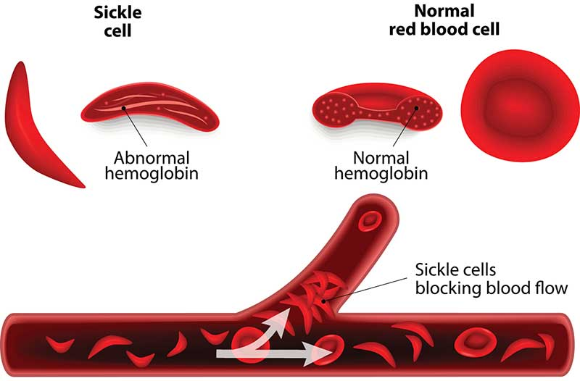
Background on Sickle Cell Disease
Definition & Pathophysiology
Sickle cell disease (SCD) is a genetic blood disorder that leads to sickle-shaped, rigid red blood cells that can obstruct small vessels and cause ischemic pain and organ damage.

Slide 3
Background on Sickle Cell Disease
Types of Sickle Cell Disease
There are several genotypes of SCD:
  Hemoglobin SS (Hb-SS)
    Often called sickle cell anemia
    Most common and typically the most severe form
    Occurs when a person inherits two sickle hemoglobin genes (Hb S) from both parents
  Hemoglobin SC (Hb-SC)
    A person inherits one Hb S gene and one Hb C gene
    Tends to be less severe than Hb-SS, but complications may still arise
  Sickle Cell Beta-Thalassemia
    HbS β⁺ Thalassemia (beta-plus)
      One Hb S gene, one beta-thalassemia gene
      Allows some normal hemoglobin
      Usually milder with great variability
    HbS β⁰ Thalassemia (beta-zero)
      One Hb S gene and a severe beta-thalassemia gene that produces no normal hemoglobin
      Cinically similar to Hb-SS
  Other Rare SCD Variants
    Include combinations like Hb SE, Hb SO, Hb SD, and more
    Generally rarer and often milder, though clinical severity varies.

Slide 4
Background on Sickle Cell Disease
Additional Information
Key Complications:
  Vaso-occlusive crises (VOC)
  Acute chest syndrome (ACS)
  Anemia
  Chronic organ damage
  Infections
  Stroke
  Early mortality
    Life expectancy of those with SCD is more than 20 years shorter than the average expected
Epidemiology:
  Affects over 100,000 individuals in the U.S
  Roughly 1 in 365 African-American
  1 in 16,300 Hispanic-American
  Most have Medicaid or CHIP coverage

Slide 5
Background on Sickle Cell Disease
Key Complications
Vaso-occlusive crises

Slide 6
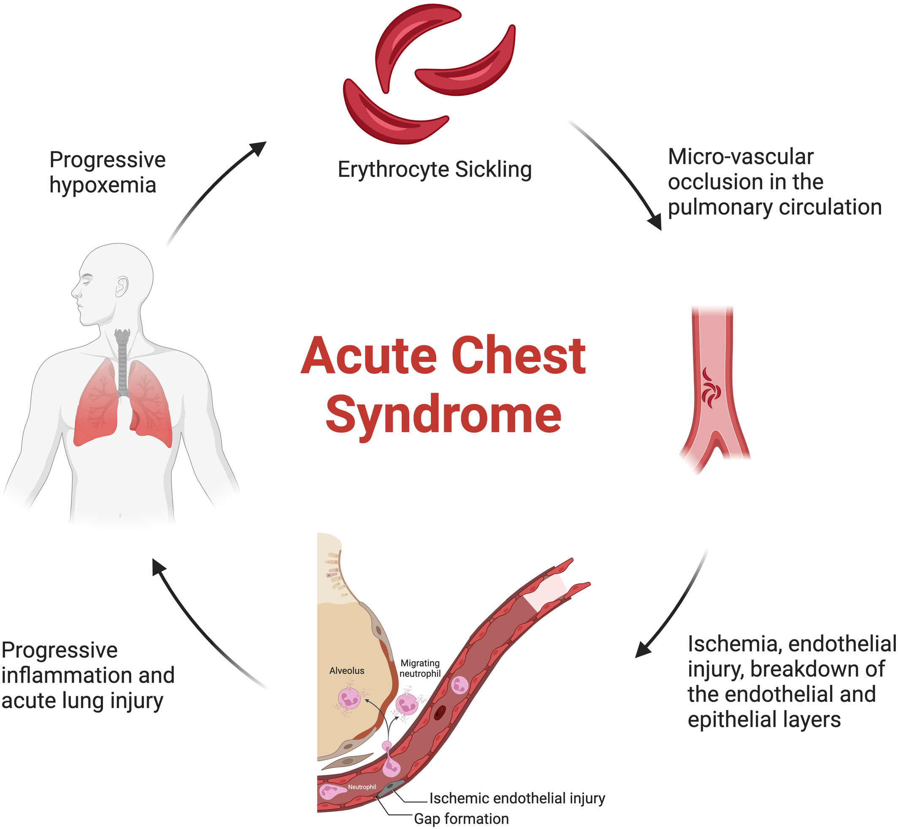
Background on Sickle Cell Disease
Key Complications

Slide 7
Background on Sickle Cell Disease
Louisiana Specifics
According to the 2017 Medicaid and CHIP Sickle Cell Disease Report
  SCD prevalence among Medicaid/CHIP enrollees in Louisiana is approximately 167 per 100,000—among the highest nationally
    Between 2009–2014, there were 5,749 Medicaid-eligible individuals with SCD-related claims
    In 2011, SCD was the top diagnosis for readmissions, with a 19.2% readmission rate
The state has established a SCD registry (Skylar-Cooper Database) for surveillance and policy support, authorized in 2022

Slide 8
Project Purpose Statement
To identify and reduce inequities in hospital readmission risk among adult Medicaid enrollees (age 18–64) hospitalized for VOC or ACS in Louisiana by assessing demographic disparities, ultimately informing quality improvement and population health strategies
  Evaluate relationships between readmission risk (Plan PCR measure) and patient factors such as race, gender, geographic area, and county
  Provide actionable insights for provider education, care management, and acute pain protocol enhancements

Slide 9
Data Included & Study Limitations
PCR population with unique admission dates who have a primary diagnosis of Sickle Cell Vaso-Occlusive Crisis (VOC) or Acute Chest Syndrome (ACS)
Readmission information if the stay was within 30 days of the first discharge
Additional Data Included:
  Race
  Gender
  Region/Parish/County
  Geographic Classification
Of the original 60,213 admissions listed in the PCR source file, 1,053 have VOC or ACS diagnoses. This includes:
  16 admissions matching to multiple claims
  57 admissions matching to 1 claim multiple times
Excluded Social Determinants of Health due to paucity of information amongst data collected

Slide 10
Demographic Analysis of VOC and ACS Readmissions in Louisiana Medicaid
ACLA Data by Variant of SCD

Slide 11
Demographic Analysis of VOC and ACS Readmissions in Louisiana Medicaid
ACLA Data by Race, Age, Geographic Classification

Slide 12
Demographic Analysis of VOC and ACS Readmissions in Louisiana Medicaid
ACLA Data by Parish (County)
Parish (County) | Average of Actual Readmission Rates | Average of Expected Readmission Rates
Caddo | 59% | 1.95%
Bossier | 84% | 0.45%
Orleans | 70% | 0.89%
East Baton Rouge | 48% | 2.87%
Jefferson | 93% | 0.22%
Assumption | 89% | 0.29%
Terrebonne | 98% | 0.00%
Claiborne | 31% | 3.00%
Livingston | 91% | 0.00%
St Landry | 77% | 1.39%
Cado
90 admissions
2 patients with 30+ admissions
Jefferson
53 admissions
1 patient with 32 admissions
15 admissions in 2023
10 admissions in 2024
7 admissions already in 2025
Terrebonne – 49 admissions
1 patient making up all 49 admissions
16 admissions in 2022
12 admissions in 2023
12 admissions in 2024
9 admissions already in 2025
All but 1 led to readmission

Slide 13
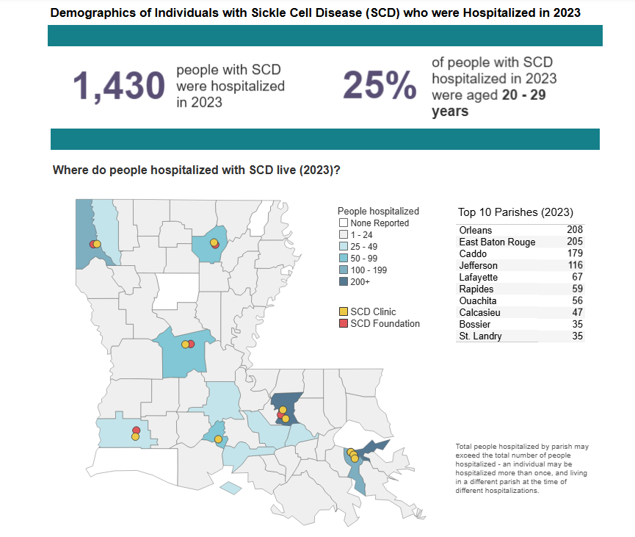
Demographic Analysis of VOC and ACS Readmissions in Louisiana Medicaid
Parish (County) Data
Parish (County) | Average of Actual Readmission Rates | Average of Expected Readmission Rates
Caddo | 59% | 1.95%
Bossier | 84% | 0.45%
Orleans | 70% | 0.89%
East Baton Rouge | 48% | 2.87%
Jefferson | 93% | 0.22%
Assumption | 89% | 0.29%
Terrebonne | 98% | 0.00%
Claiborne | 31% | 3.00%
Livingston | 91% | 0.00%
St Landry | 77% | 1.39%

Slide 14
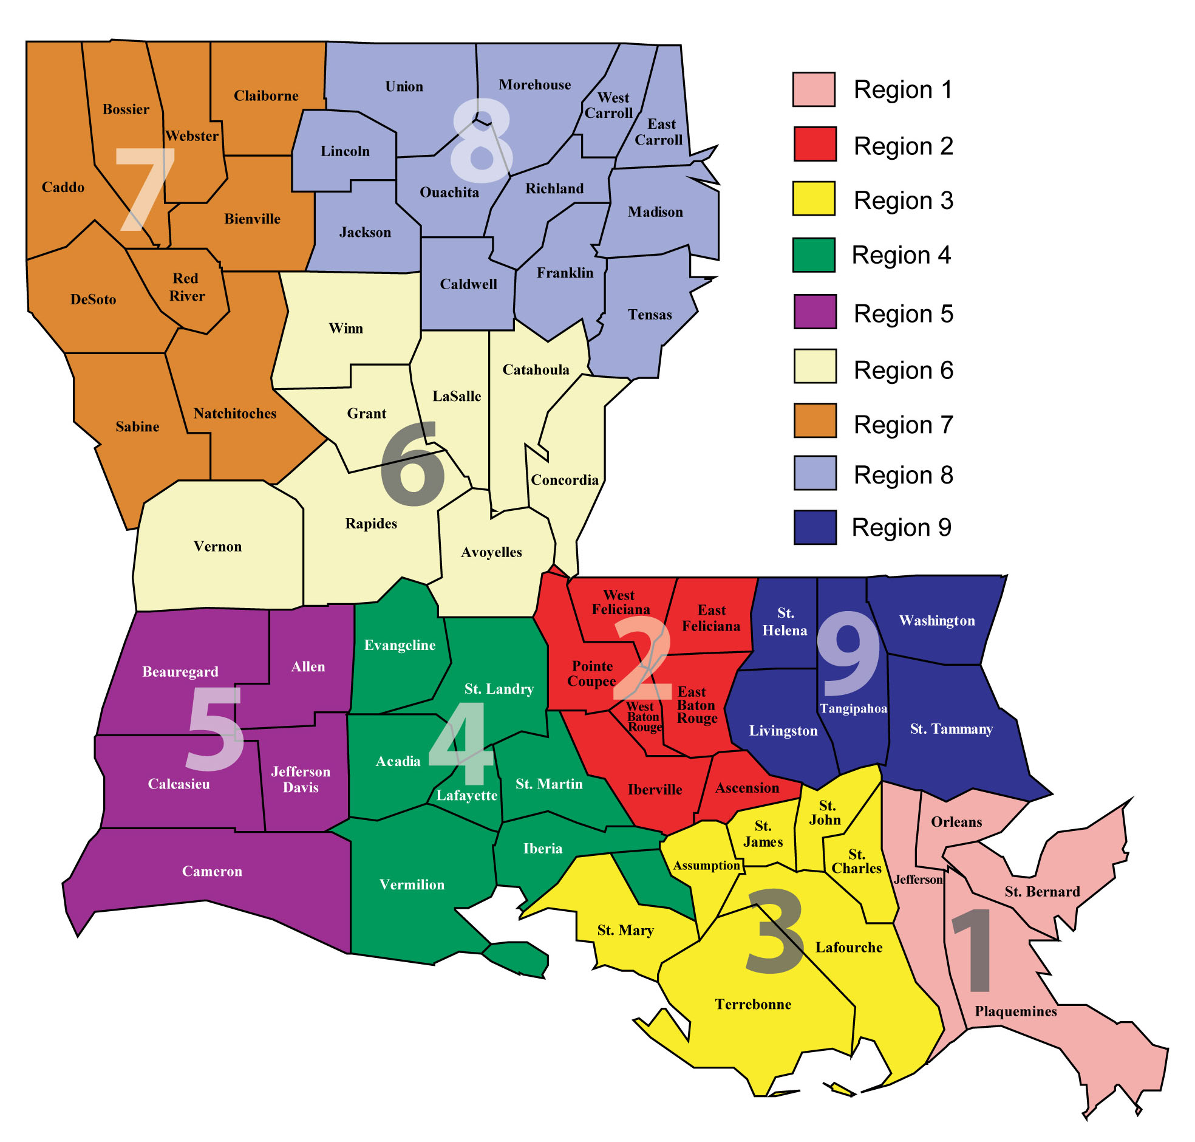
Demographic Analysis of VOC and ACS Readmissions in Louisiana Medicaid
ACLA Data by Region

Slide 15
Beyond the Crisis: A Demographic Analysis of VOC and ACS Readmissions in Louisiana Medicaid
Key Implications
Systemic Gaps in Care
  Frequent readmissions suggest underlying issues.
    Are symptoms being dismissed or undertreated?
  Are key responsibilities overlooked at discharge, such as medication provision or pain management planning?
Fraught Patient Experience
  Persistent hospital cycling can foster frustration and harm trust, not just for patients, but for providers seeing return “visitors.”
Untapped Preventive Opportunity
  These patterns highlight a case for enhanced case management, including:
    Home health services
    Transfers to larger, better-resourced centers
    Tailored medical homes for high-utilizers

Slide 16
Beyond the Crisis: A Demographic Analysis of VOC and ACS Readmissions in Louisiana Medicaid
Key Implications
Successful Precedents
  Many hospitals (e.g., Ochsner, UMC) now ensure medications are provided at bedside before discharge and follow-up appointments are scheduled in advance. This simple step improves continuity. Services like their integrated pharmacies and “MyOchsner” portal enable easy refill access and care coordination.
Effective Models from Literature
  Case Management + Community Health Workers improved outcomes and reduced acute utilization in adult SCD populations
  Individualized multimodal care plans, combining provider coordination and discharge strategies, showed steep decreases in readmissions—dropping from ~33% down to ~11% in one study
  Clinics that reserved follow-up slots, double-booked for convenience, and provided direct scheduling instructions saw improved adherence and coordination—though ED re-visits did not change immediately, the groundwork was laid

Slide 17
Beyond the Crisis: A Demographic Analysis of VOC and ACS Readmissions in Louisiana Medicaid
Key Implications
Successful Precedents
  Many hospitals (e.g., Ochsner, UMC) now ensure medications are provided at bedside before discharge and follow-up appointments are scheduled in advance. This simple step improves continuity. Services like their integrated pharmacies and “MyOchsner” portal enable easy refill access and care coordination.
Effective Models from Literature
  Case Management + Community Health Workers improved outcomes and reduced acute utilization in adult SCD populations
  Individualized multimodal care plans, combining provider coordination and discharge strategies, showed steep decreases in readmissions—dropping from ~33% down to ~11% in one study
  Clinics that reserved follow-up slots, double-booked for convenience, and provided direct scheduling instructions saw improved adherence and coordination—though ED re-visits did not change immediately, the groundwork was laid

Slide 18
Beyond the Crisis: A Demographic Analysis of VOC and ACS Readmissions in Louisiana Medicaid
Implications & Recommendations
Intensive Case Management & Care Coordination
Discharge Pharmacy Access + On-site Medication Deliveries
Scheduling of Follow-Up Appointments Pre-Discharge
Consideration of Home Health Services/Transfer to Specialized Care Centers
Monitor High-Utilizers via Registry/Medical Home Approach

Slide 19
References
https://ldh.la.gov/page/sickle-cell-disease-database-Louisiana
https://www.dshs.texas.gov/sites/default/files/newborn/pdf/2017NovSCACSickleCellLouisiana.pdf?
https://ldh.la.gov/assets/docs/LegisReports/Act670_2022RS_LDHReport_2023.pdf?
https://www.medicaid.gov/medicaid/quality-of-care/downloads/scd-rpt-jan-2021.pdf?
https://www.cdc.gov/sickle-cell/communication-resources/index.html
https://www.medicaid.gov/medicaid/quality-of-care/quality-improvement-initiatives/improving-care-for-sickle-cell-disease
https://doi.org/10.1182/blood-2019-130441
https://doi.org/10.1182/blood.V124.21.444.444
https://www.ihi.org/sites/default/files/lms/legacy/education/IHIOpenSchool/Courses/Documents/SCD_Poster.pdf?utm_source=chatgpt.com

Slide 20
Special thank you to Dr. Gregory Randolph, Dana Smith, Renee Wells, Shea Good, and the entire ACLA AmeriHealth Caritas LA team for your help!
Questions?

