Slide 1



An analysis of Behavioral Health Measures: “Follow-Up After Emergency Department Visit for Alcohol or Other Drug Abuse”
AmeriHealth Caritas x LSUHSC School of Medicine
Sloan Robinson, MS4
September 24, 2025

Slide 2
Outline of Project:
ACLA Behavioral Health Measure
Why this topic matters
Findings in the data
Incentives in action and thoughts moving forward

Slide 3
ACLA FUA measure: Follow-up After Emergency Department Visit for Substance Use –within 30 days of the ED visit
ACLA members 13+ years of age on the date of the ED visit with a principal diagnosis of substance use disorder (SUD)
Data contained chief dxs of Alcohol and other drug, drug overdose, and substance abuse.
Percentage of discharges in which patient had follow up within 7 days
Percentage of discharges in which patient had follow up within 30 days
Goal: 50th percentile for NCQA Quality Compass 2024 (MY23)
Measured years in this analysis 2023, 2024, and Jan-June 2025
Notes:
Note: We do not have specifications of which type of behavioral health provider patients followed up with
36.18 was listed, but measured data by newest 50th percentile of 30.9
NCQA Quality Compass 2024 (MY23) Medicaid National 50th percentile (All LOBs [Excluding PPOs and EPOs]: Average) for the year prior to the measurement year

Slide 4
Why it Matters: The Importance of a Follow up in Substance Use.
Observational studies show that patients who receive follow up within 7 days after opioid use disorder related ED visit have a 9% risk reduction in fatal or nonfatal overdose within 6 months. (HR=0.91, 95% CI)
Regarding alcohol use disorder, post discharge follow up and initiation of medications for alcohol use disorder are associated with significant reductions in 30-day mortality and hospital readmission.
Qualitative data show that patients emphasize proactive discharge planning, individualized care plans, and post-discharge outreach to facilitate connection to treatment and support.
Notes:
The American society of addiction medicine identifies timely outpt follow up as key safety measure particularly within 7 days→ necessary first step for care coordination/treatment engagement after acute care episodes/detox. Window supported by predictive validity for improved outcomes and aligns with HEDIS quality measure for SUD.
Sources here: Medicaid Outcomes Distributed Research Network. “Follow up after ED Visits for Opioid Use Disorder: Do They Reduce Future Overdoses?” Journal of Substance Abuse Treatment. 2022 Nov
“Outcomes After Initiation of medications for alcohol use disorder at hospital discharge… Jama network

Slide 5
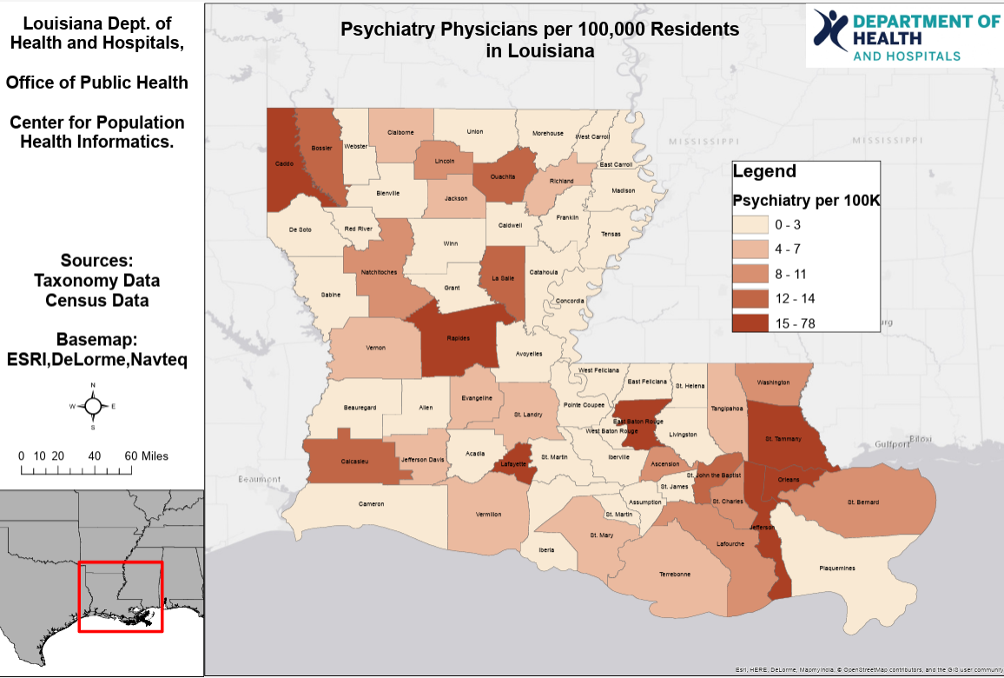
Substance Abuse Providers in Louisiana
332.4 per 100,000 people
This is the number of psychiatrists, psychologists, licensed clinical social workers, counselors, marriage and family therapists and advanced practice nurses specializing in mental health care per 100,000 population. We rank #26 in the nation.
Notes:
The Health resource services administration and American psychiatric association states that it is generally considered sufficient to have 1 psychiatrist per 20,000 people. Health professional shortage areas (HPSA)’s usually designate an area as having a shortage if the target of 1 psychiatrist per 30k is not met. 33-50 psychiatrists is usually the goal per 100,000.

Slide 6
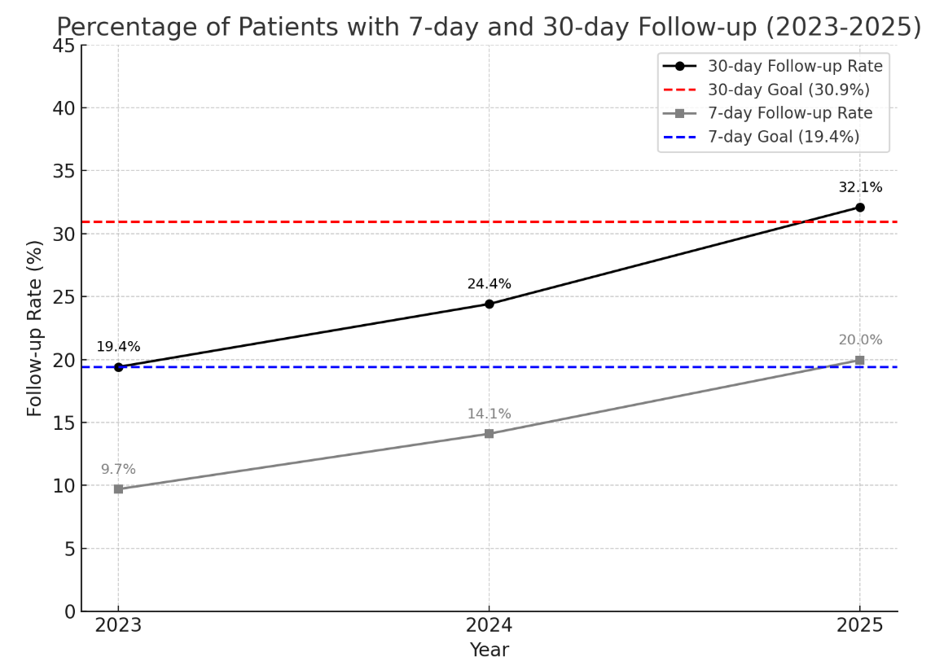
Data Analysis: Percentage of patients with follow up within 7 and 30 days
2023- 152/783 patients followed up at 30 days and 76/783 at 7 days.
2024- 135/553 patients followed up at 30 days and 78/553 at 7 days.
2025 through July- 148/461 patients followed up 30 days and 92/461 at 7 days.
Notes:
Target goat at 30.9% so we have seen steady increase in patients following up with a mental health provider within 30 days of ED visit

Slide 7
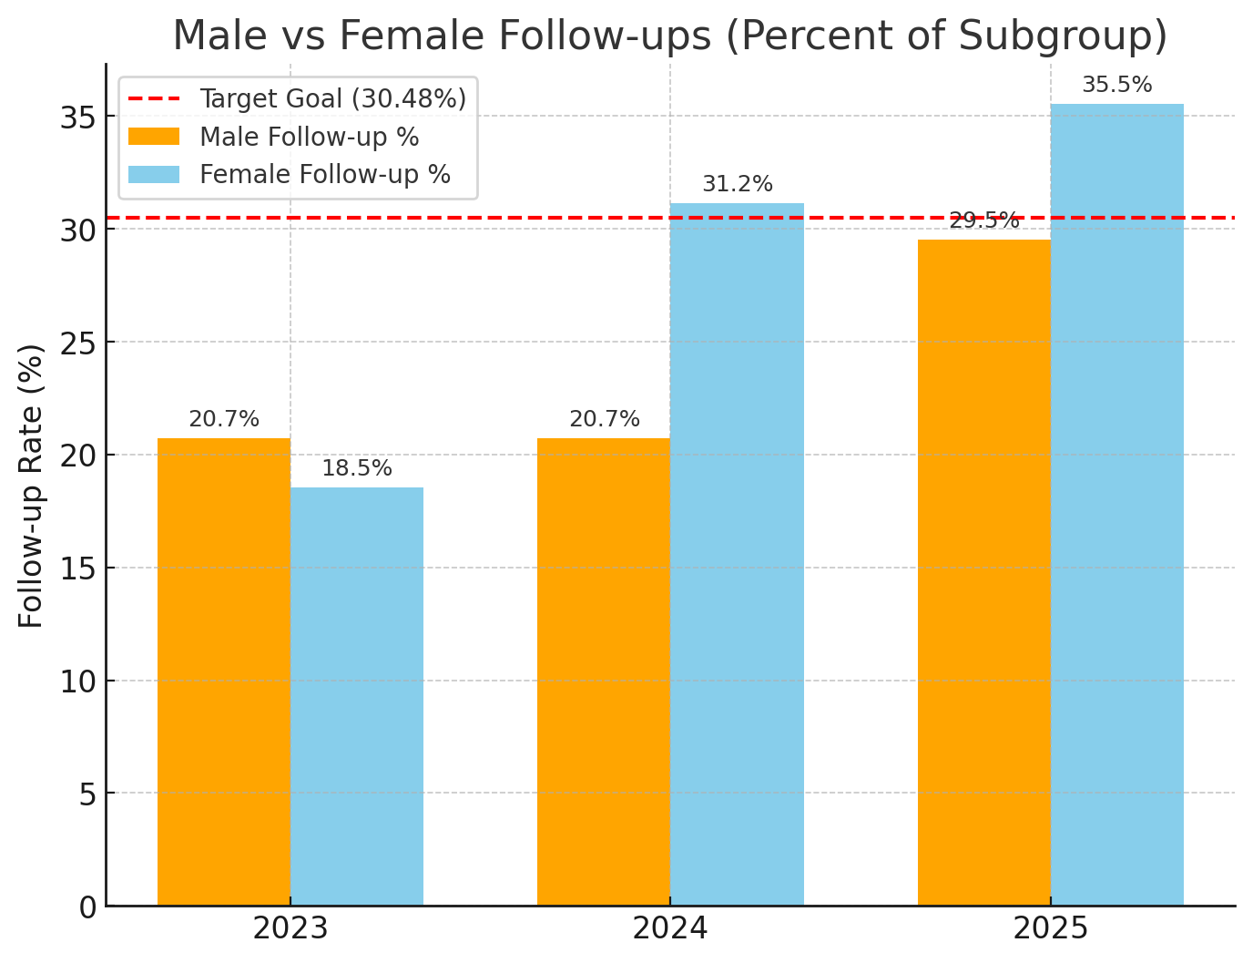
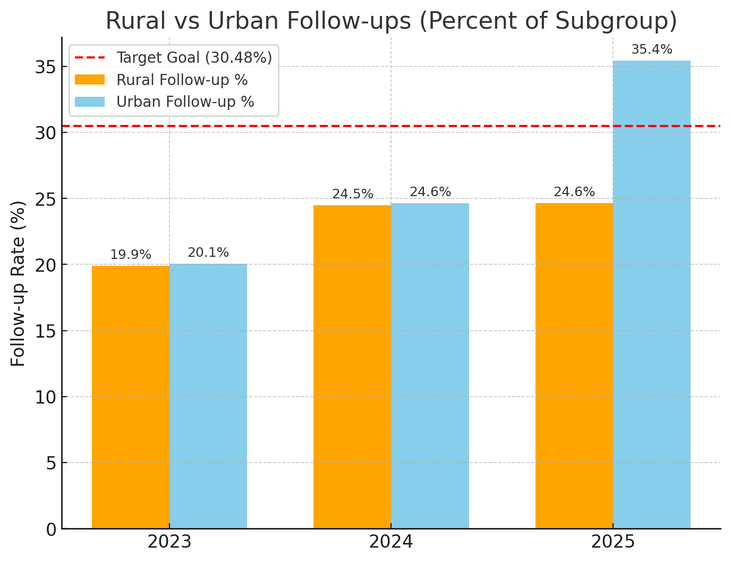
Rural vs. Urban and Male vs. Female
Notes:
2023:
Rural followed up 35/176
Urban followed up 119/593
2024:
rural followed up 35/143
urban followed up 100/406
2025-July:
28/97 rural patients
124/362 urban patients
Male v female
2023
103/497 males followed up
53/286 females followed up
2024
males followed up 69/333
females followed up 67/215
2025
males followed up 69/333
females followed up 67/215

Slide 8
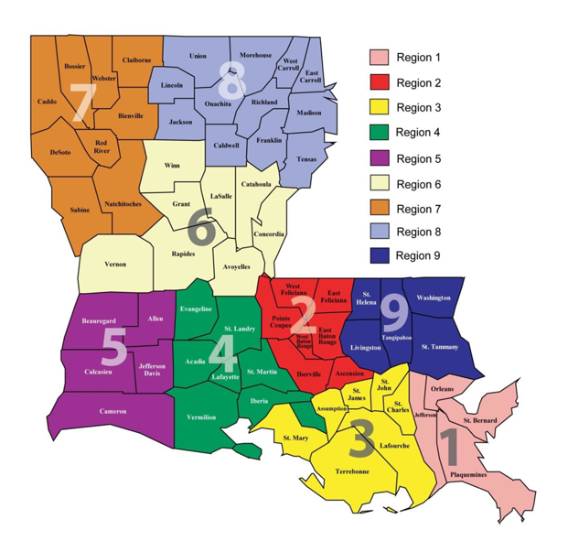
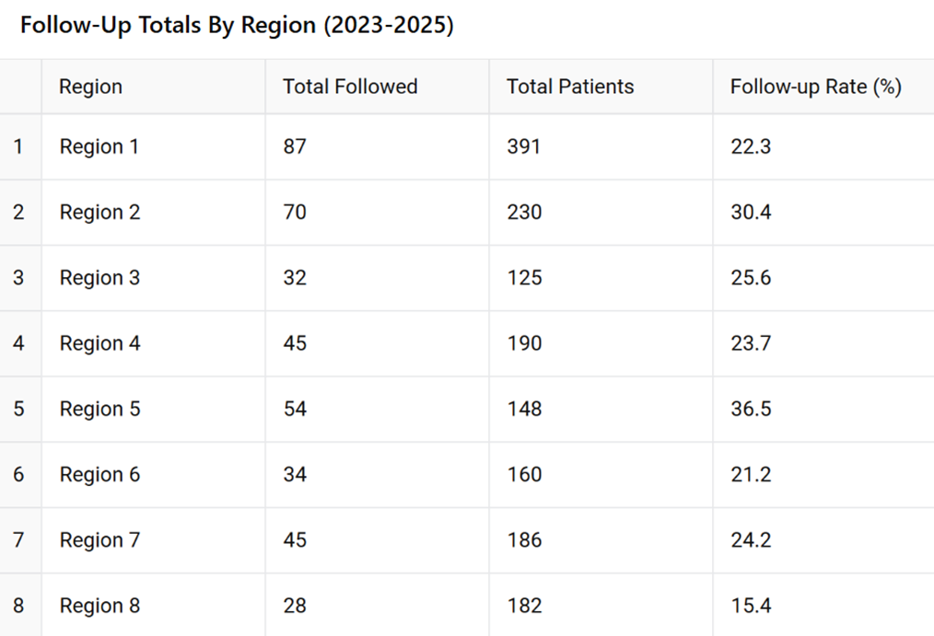
Follow up by region
Notes:
Region 5—circle region 5– talk about improvement→ look at individual parishes
Region 5 specifically saw increased improvement in follow up. Within 2023, 2024, and 2024→ specifically 2023- 23.4% patients following up, 2024-26.7% following up, and 2025- 55.4% following up. (disclaimer-small sample size of 40-50s patients)
2 regions above target for combined average of all 3 years: region 2 and region 5.

Slide 9
Great job ACLA! Initiatives in action.
Provider incentives for ACLA behavioral health providers to initiate follow-up care within 30 days of ED admission (email originally sent October 18,2023)
Behavioral health provider portal alerts sent when members are inpatient sent on weekly basis
Educating emergency departments partnerships on scheduling 7 day follow ups and making members aware of BH providers in their area/how to schedule their own appointments
Manage care coordination between ED care team and behavioral health providers → member clinical summary is available in provider portal… obtain ongoing provider feedback via email notifications
Educate ED on transportation of benefits available to members to resolve barriers to attending appointments
Notes:
Providers include psychiatrists, psychiatric NP/advanced nurses, psychologists, licensed counselors
O

Slide 10
Next steps..
Continue the current course…Great job!
Excel document of Behavioral health providers for convenient ED use?
Are incentives in place for members to follow up?
Other ideas from the crowd..?

Slide 11
Citations
Drug Overdose Mortality | Stats of the States | CDC
ACLA data
SAMHSA, Center for Behavioral Health Statistics and Quality, National Survey on Drug Use and Health, 2021 and 2022.
https://ldh.la.gov/assets/oph/Center-PHI/maps
Medicaid Outcomes Distributed Research Network. “Follow up after ED Visits for Opioid Use Disorder: Do They Reduce Future Overdoses?” Journal of Substance Abuse Treatment. 2022 Nov
Bernstein EY, Baggett TP, Trivedi S, Herzig SJ, Anderson TS. Outcomes After Initiation of Medications for Alcohol Use Disorder at Hospital Discharge. JAMA Netw Open. 2024 Mar 4;7(3):e243387. doi: 10.1001/jamanetworkopen.2024.3387. PMID: 38551564; PMCID: PMC10980961.

Slide 12
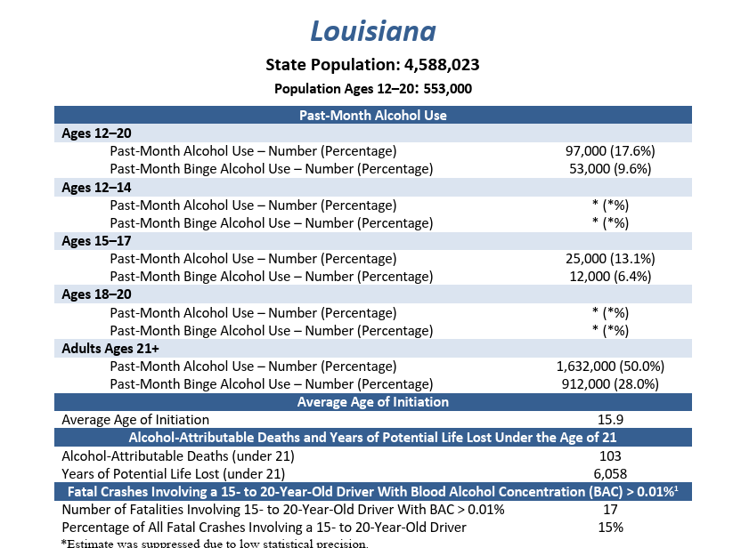
Alcohol intake rates in Louisiana in the youth
Notes:
Source: the interagency coordination committee on the prevention of underage drinking

Slide 13
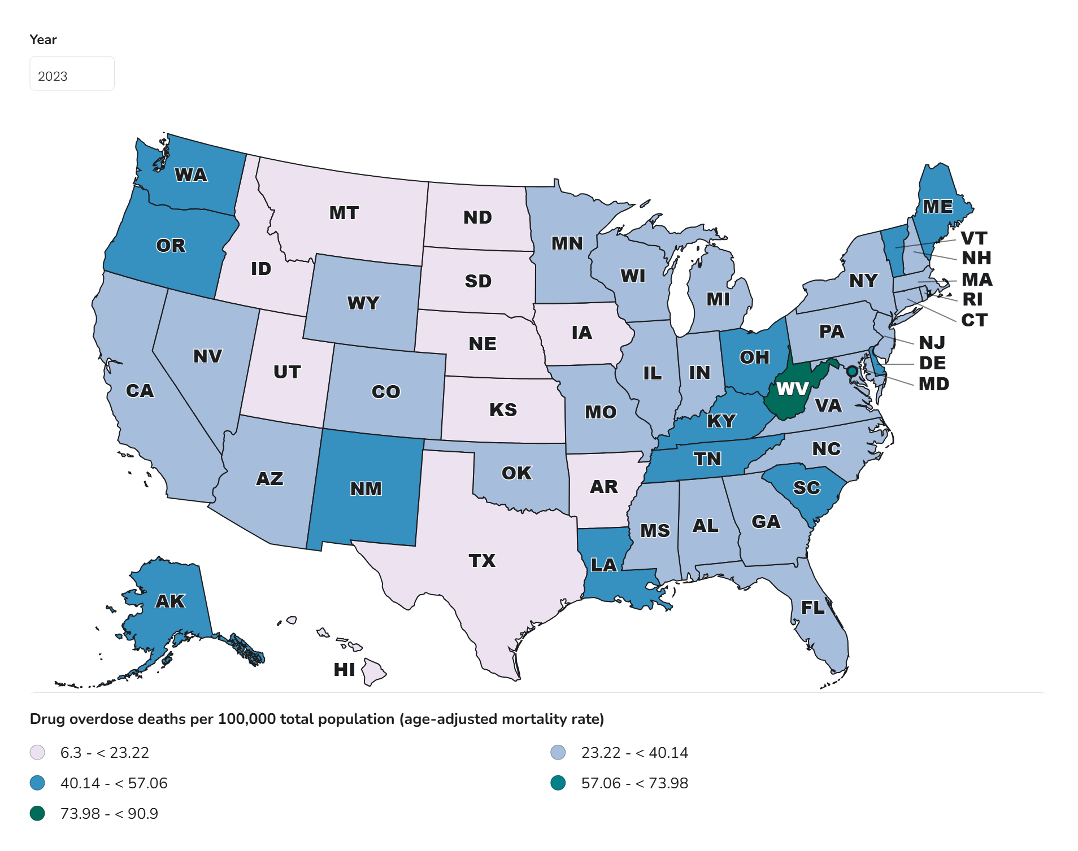
Substance Abuse in Louisiana:
Louisiana ranked #5 in the nation in 2023 in overdose deaths with 50.6 per 100,000 people accounting for 2,224 deaths.
Notes:
From CDC website– causes of mortality 50.6 substance overdose deaths per 100,000 in Louisiana accounting for 2224 deaths in 2023 in LA

