Slide 1

Statin Therapy for Patients with Cardiovascular Disease
Samhita N. Basavanhalli
LSUHSC New Orleans – Population Health Management Course
March 11th 2025

Slide 2
Learning Objectives
Describe the current rates of statin adherence among adults with clinical atherosclerotic cardiovascular disease in LA
Analyze variations in statin nonadherence among different demographic groups (e.g., rural vs urban, race, geographic region)
Identify potential disparities and social determinants of health that influence differences in statin adherence
Develop data-driven recommendations to improve adherence rates for patients

Slide 3
Background
Atherosclerotic cardiovascular disease (ASCVD) in the US
Currently, ASCVD- related conditions remain the leading cause of morbidity and mortality globally
ASCVD in Louisiana
According to the CDC, heart disease is the #1 killer in LA and is responsible for 25% of all deaths in the state. LA ranks 5th in the nation for heart attack death rate.

Slide 4
What is ASCVD?
Atherosclerotic cardiovascular disease, otherwise known as ASCVD, is caused by plaque buildup in arterial walls and refers to conditions that include:
  Coronary Heart Disease (CHD), such as myocardial infarction, angina, and coronary artery stenosis.
  Cerebrovascular disease, such as a transient ischemic attack, ischemic stroke, and carotid artery stenosis.
  Peripheral artery disease, such as claudication.
  Aortic atherosclerotic disease, such as abdominal aortic aneurysm and descending thoracic aneurysm.
Statins play an essential role as they lower lipid levels → reducing the risk of ASCVD
Statins are HMG-CoA Reductase inhibitors: inhibiting the synthesis of cholesterol in the body
  Stabilizes atherosclerotic plaques
  Improves endothelial function
  Decreases cardiovascular morbidity and mortality
Notes:
Statin prescription rates for primary prevention have risen significantly, reaching approximately 62.8% in 2024 for eligible U.S. adults according to the NIH
Despite this, about 40% of eligible patients remain untreated. Utilization is highest among older adults (48% for ages 75+) and those with, or at high risk for, cardiovascular disease.

Slide 5
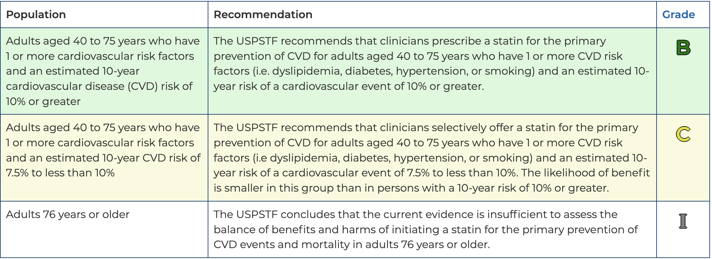
Current USPSTF Guidelines on Statins:
Notes:
USPSTF- US Preventative Services Task Force

Slide 6
ACLA Current Measurements
Measure Description: The percentage of males 21–75 years of age and females 40–75 years of age during the measurement year who were identified as having clinical atherosclerotic cardiovascular disease (ASCVD) and met the above criteria. The following rates are reported:
Statin Adherence 80%. Members who remained on a high-intensity or moderate-intensity statin medication for at least 80% of the treatment period.
Notes:
This presentation will focus on nonadherence rates among the analyzed data to better identify specific trends and make recommendations to decrease nonadherence rates

Slide 7
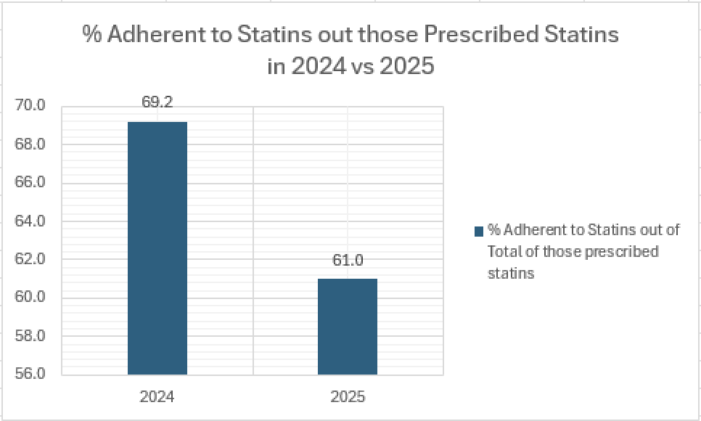
Notes:
Slight decline
- Will look into breakdown of these adherence rates by race, rural vs urban environment, and regions to investigate potential causes of this decrease in adherence and how this can be addressed

Slide 8
Statin Nonadherence Rates by Race – 2024 vs 2025
Notes:
AA: nonadherence rates went from 40.7 to 43.8
White: 25.8 to 36.2- very significant increase
- Several factors such as mistrust in healthcare or healthcare literacy may be playing into this difference from 2024 to 2025
Black/ AA had second highest nonadherent rate
Why? – Mistrust in healthcare system, cultural differences, or healthcare literacy
Other than two or more races, Black and White races remained in the top races with highest nonadherence rates
- They had the biggest sample sizes and sample sizes were the reason several other groups were taken out of the analysis

Slide 9
Statin Adherence Rates- Rural vs Urban 2024 and 2025
x
x
Notes:
Urban areas had an increased in nonadherence from 31.8 to 39.2%
Rural areas had a slight increase in nonadherence from 28.7 to 38.7%

Slide 10
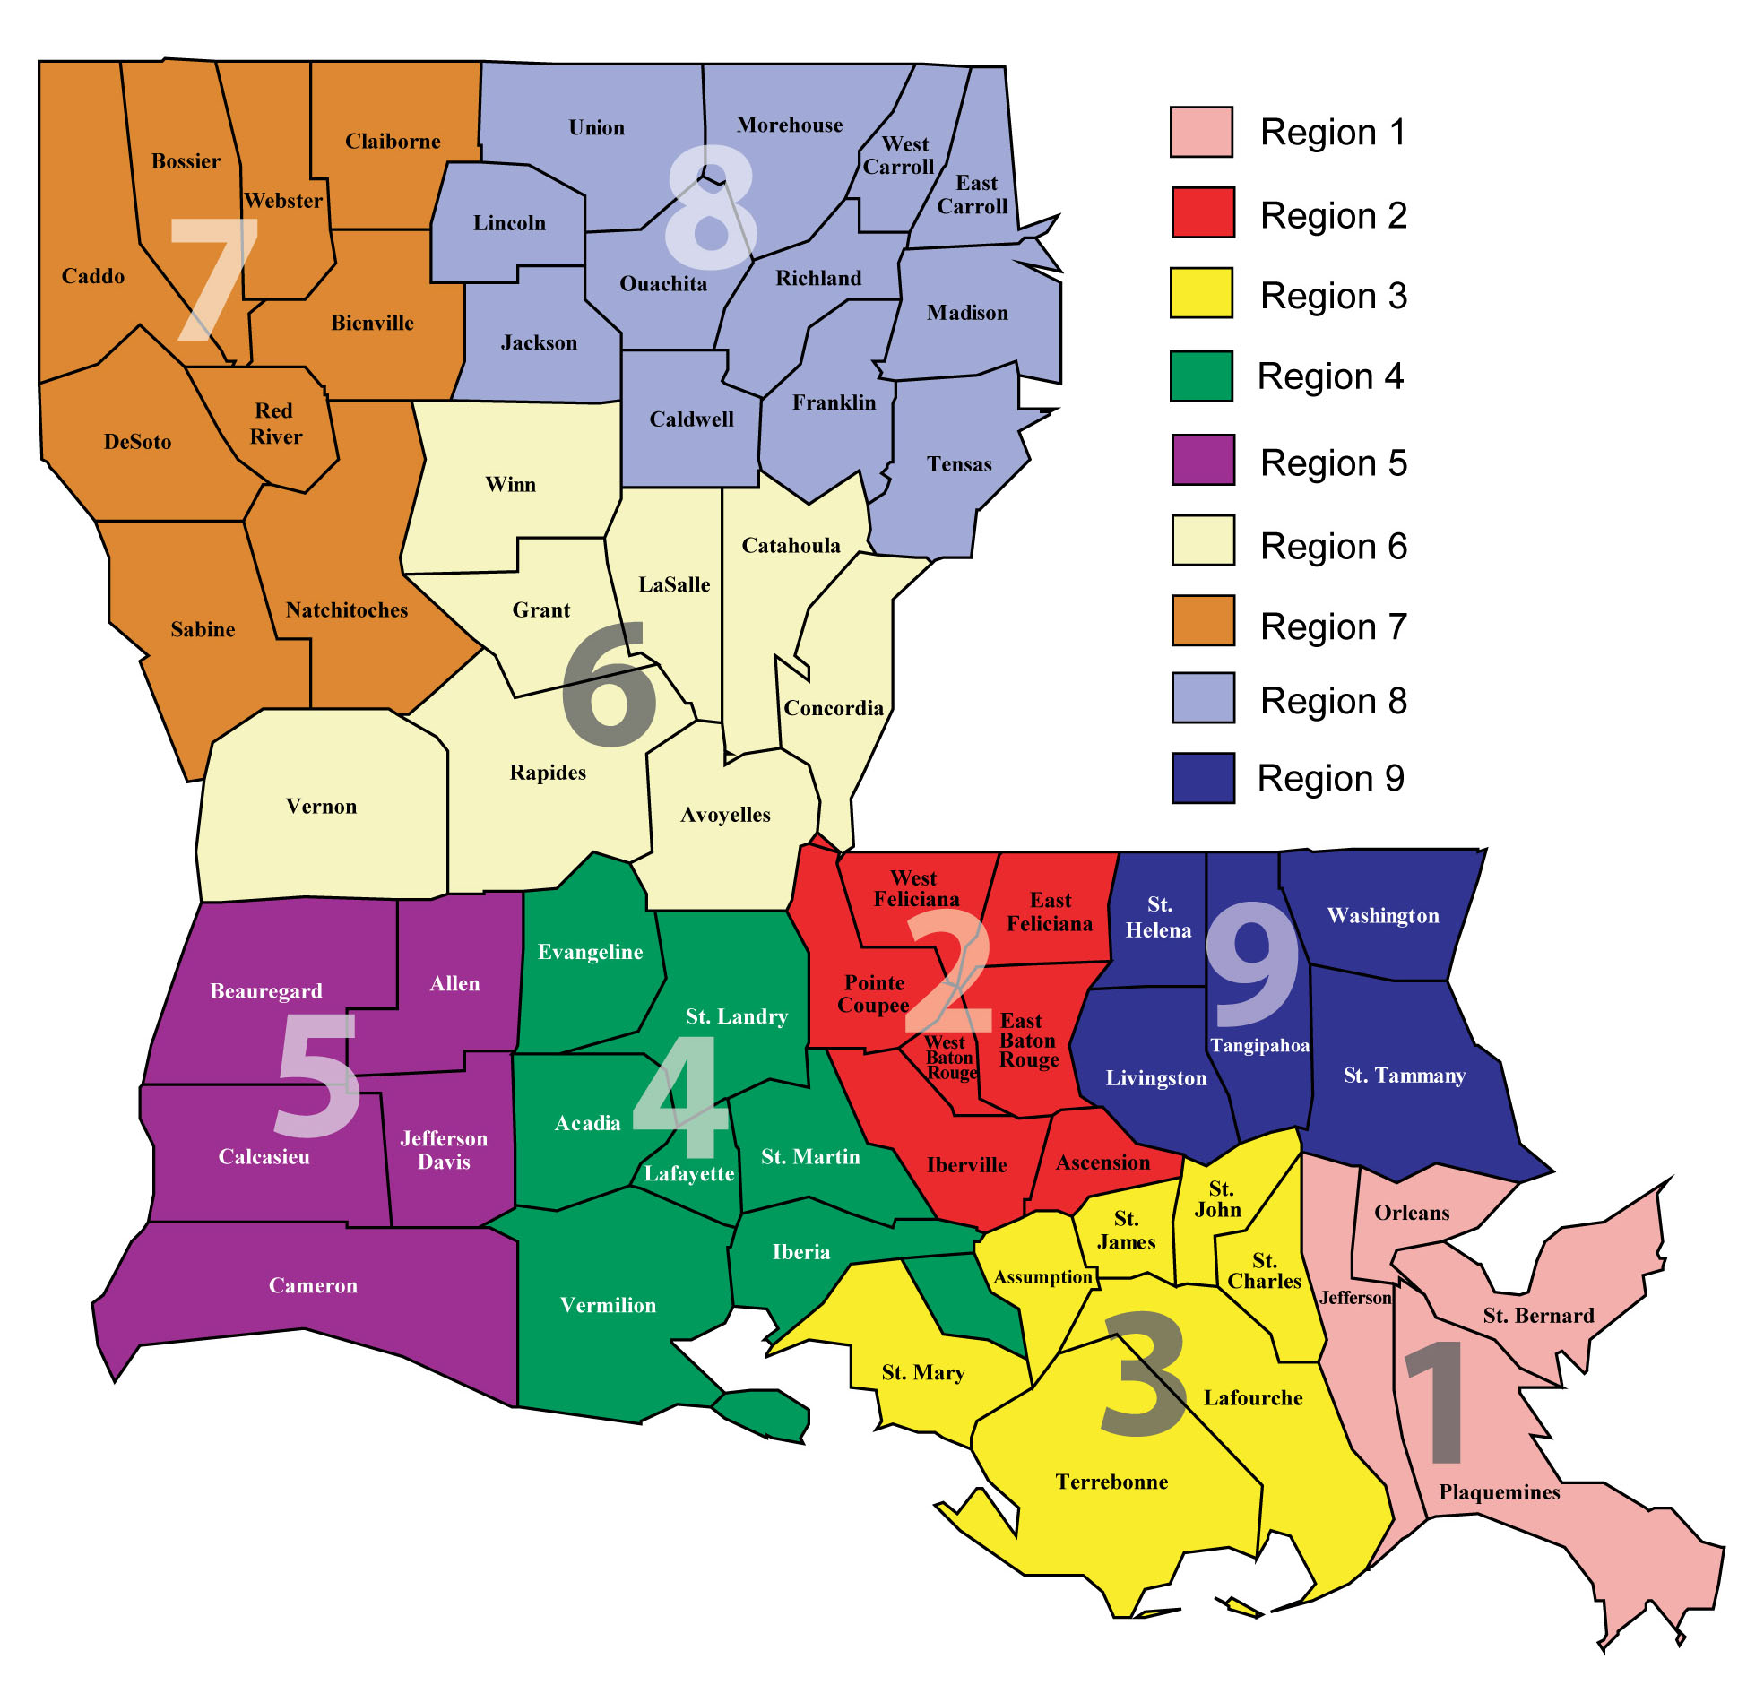
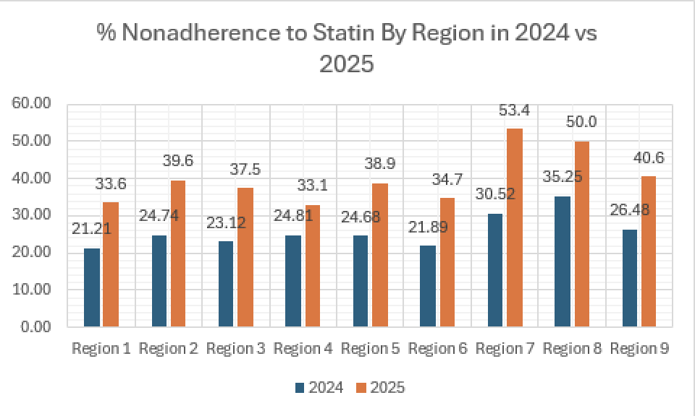
LDH Regions
Notes:
2024: Regions 8, 7, 9 had the highest nonadherence rates
Same regions had highest nonadherence rates but by a much higher number
Region 7 (Northwest): Bienville, Bossier, Caddo, Claiborne, Desoto, Natchitoches, Red River, Sabine, and Webster.
- Mostly rural
Region 8 (Northeast): Caldwell, East Carroll, Franklin, Jackson, Lincoln, Madison, Morehouse, Ouachita, Richland, Tensas, Union, and West Carroll.
- Mostly rural
Region 9 (Southeast/Northshore): Livingston, St. Helena, St. Tammany, Tangipahoa, and Washington.
- Slightly more urban areas but still rural

Slide 11
Summary
2025 had lower overall adherence rates to statin therapy than 2024
Distribution by race
  Black/African American and White patients had higher nonadherence rates
  Among both groups, nonadherence rates increased from 2024 to 2025
Urban vs Rural- both groups had increased nonadherence
  Urban areas had an increase in nonadherence from 31.8 to 39.2%
  Rural areas had a slight increase in nonadherence from 28.7 to 38.7%
Regions
  Region 7,8,9 had lowest adherence rates in both 2024 and 2025

Slide 12
Recommendations- Population Health Level
Need to consider and investigate more on why African American/Black and White populations have higher nonadherence rates?
  Consider factors like mistrust in healthcare system, cultural differences, or healthcare literacy
Rural populations had a bigger increase in nonadherence rates than urban populations
  Consider factors like transportation issues, difficulty accessing medications, not understanding importance/significant of taking a statin
Increase educational campaigns in Regions 7,8,9 on statin adherence and benefits on ASCVD mortality
  Consider talking to providers in these areas to collaborate on increasing adherence rates
Notes:
Lower adherence rates – lack of understanding of disease condition, side effects (myopathy), cost of medication

Slide 13
Recommendations – Patient Level
Simplifying medication regimens
Reminder systems
Incentives to promote adherence
Currently ACLA sends out a text message to patients who are nonadherent to their medications
Planning to continue into 2026
Communicate with providers of nonadherent members
A statin therapy poster is under review to put in providers offices

Slide 14
Resources
https://www.ahajournals.org/doi/10.1161/cir.0000000000000678
https://wellaheadla.com/prevention/heart-disease/#:~:text=Community%2DBased%20Blood%20Pressure%20Monitoring,Quality%20Improvement
https://www.uspreventiveservicestaskforce.org/uspstf/recommendation/statin-use-in-adults-preventive-medication

Slide 15
Thank you!
Everyone at ACLA
Dr. Gregory Randolph
Dana Smith

