Slide 1
Well-Child Follow up within the first 15 months of life
Renee Breaux
Population Health Management
Block 10

Slide 2
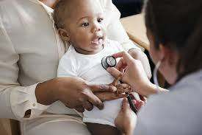
Background
Well-child visits are an essential part of preventative medicine
Current recommendation: 8 well-child appointments within the first 15 months of life
  3-5 days old, by 1 mo, 2 mo, 4 mo, 6 mo, 9 mo, 12 mo, 15 mo
Recommended schedule based on well children with no health or developmental concerns

Slide 3
Background
Components of a well-child exam
  Complete physical exam
  Lab work
  Development check – height, weight, milestones
  Immunizations
  Sight and hearing testing
  Overview of nutrition habits
  Child safety education
  Referrals
  Address any parental concerns

Slide 4
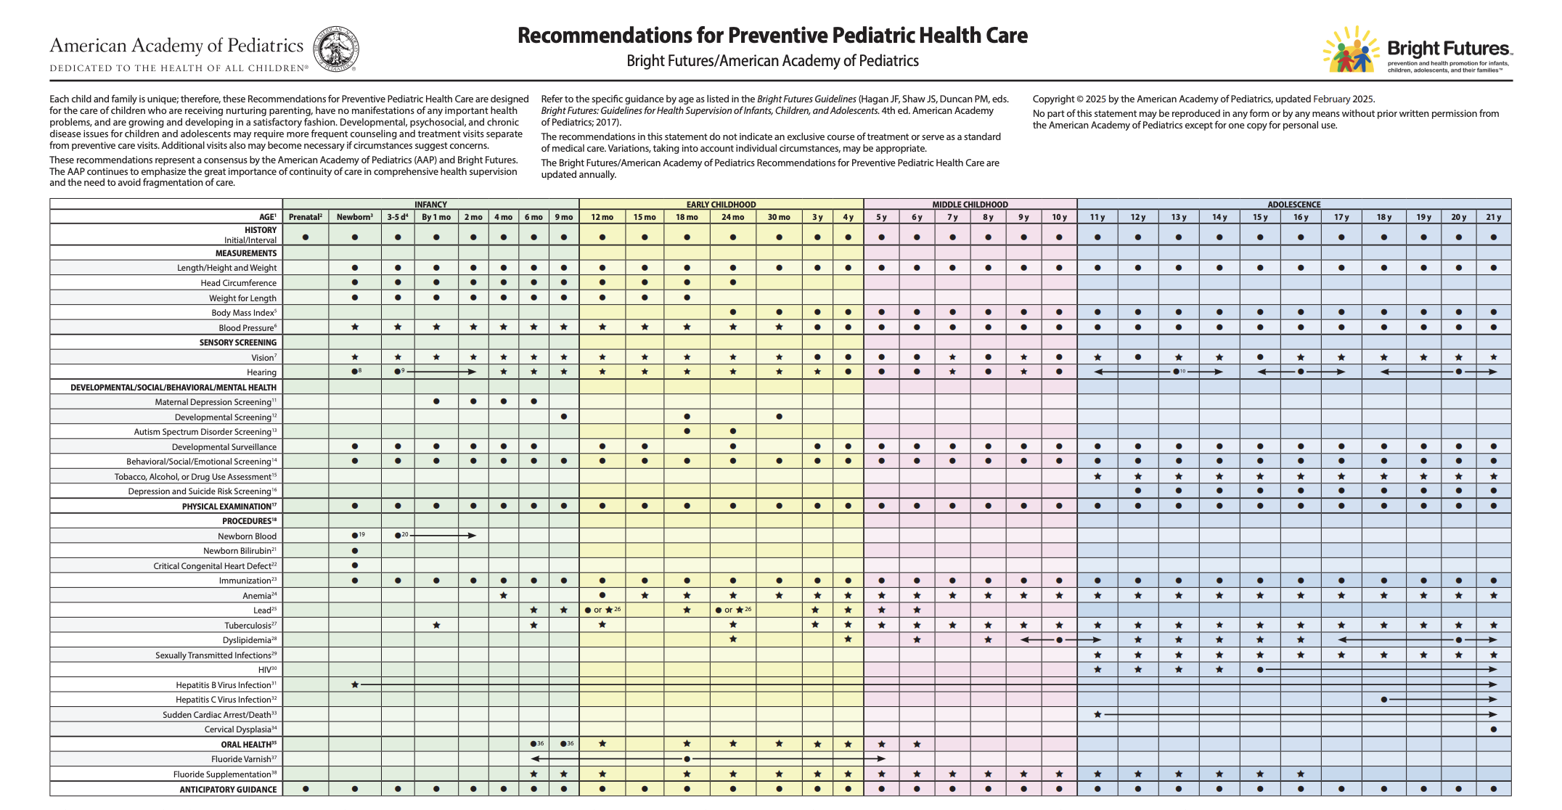

Slide 5
Barriers to the Well-Child visit
Lack of education on the purpose of well-child visit
Lack of trust in providers
Immunization distrust and/or refusal
Lack of childcare for other children
Difficulties with scheduling
  Guardian unable take off work
  Struggle securing consecutive appointments for families with multiple children
Lack of transportation

Slide 6
Current interventions
Mailers
Texting campaign
Social media posts
Gap in care reports
RROT outreach calls
Member outreach calls
Care Card incentives
Educational flyers
Newsletters
Notes:
Mailers – 4 month mailers
Originally went out to African American children only turning 4 mo old who are non-compliant with >3 well care visits
Expanded to all races in Feb 2026
Gap in care reports
Sent to PCPs for providers with high non-compliance numbers
RROT outreach calls – rapid response outreach team
black/African American members non compliant for 2 well child visits
Member outreach calls
Call members needing 1-2 more visits with ample time to outreach before 15 months
Care card incentives
$120 for 6 well child visits from birth to 15 months

Slide 7
ACLA Compliance data

Slide 8
Well Child Visits (W30/W15)
Compliance with well child visits in the first 30 months of life
  0-15 months: 6+ visits
  15-30 months: 2+ additional visits

Slide 9
Total W15 compliance: 2022-2025
Notes:
Improved total compliance in 2025 (66.7%) compared to 2022-2024 (26%, 65%, and 63%)
2024: n = 3384
2025: n = 2599

Slide 10
2025 W15 compliance: region
Notes:
Most Compliant
2024 – Region 4
2025 – Region 9
Least Compliant
2024 – Regions 5 and 8
2025 – Region 8
Great improvement in regions 2 and 9 between 2024 and 2025
2024: n = 3,368
2025: n = 2,587

Slide 11
2025 W15 compliance: parish
Notes:
Cutoff: n > 20 per parish
2024: n = 3,077
2025: n = 2,285
Most compliant parish: Vermillion (85.7%)
Least compliant parish: Franklin (20.8%)
Most compliant
2024: Saint Martin
2025: Vermillion (was 71% in 2024)
Least compliant
2024: Union
2025: Franklin (was 43% in 2024)

Slide 12
2024-2025 W15 Compliance: Geographic location
Notes:
Compliance increased in both groups from 2024-2025, but urban remains more compliant
2024: n = 3,368
urban: 2533
Rural: 835
2025: n = 2,587
urban: 1888
Rural: 699

Slide 13
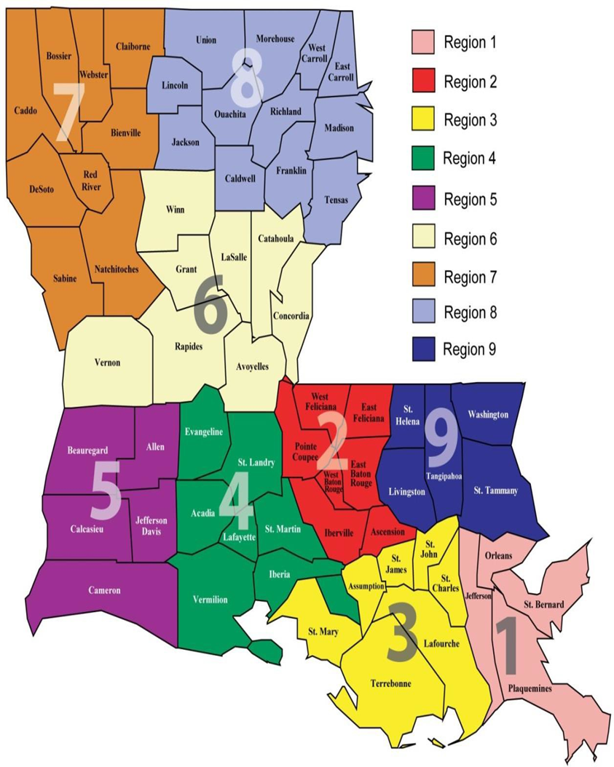
Conclusions
Region 8 and parishes within Region 8 (Union and Franklin) consistently have low compliance with well-child visits
Regions 2, 4, and 9 and parishes within those regions (Vermilion and Saint Martin) consistently have high compliance with well-child visits
Urban populations have better well-child follow up than rural populations, although both regions have improved compliance from last year

Slide 14
Recommendations
  Ensure resources are effectively provided to low-compliance regions
  Consider additional patient-level interventions to improve follow-up in these regions
    More frequent calls/texts
    Identifying trustworthy community members and educating them on the importance of well-child follow ups
  Identify which resources are most effective in high-compliance regions
  Identify the effective strategies used in both rural and urban populations
  Pilot new ides for provider-level interventions in low-compliance regions
    Provider financial incentives for well-child follow up
    Educational sessions for providers
    EMR Reminders

Slide 15
Thank you for listening!
Thank you to Dr. Randolph, Ms. Wells, and Ms. Smith!
Sources:
2022-2023 data from Kayla Woods and Bryce Arata
https://www.aap.org/en/practice-management/care-delivery-approaches/periodicity-schedule/?srsltid=AfmBOoqOVajmOBFi1d2IW7FpTgjctvgDJiYCDuXQi1QYdbC-AWGaaD4y
ACLA Data
https://pmc.ncbi.nlm.nih.gov/articles/PMC4727528/
Questions?

