Slide 1
Adherence to Antipsychotic Medications Among ACLA Members With Schizophrenia and Schizoaffective Disorder
By Kaden Knecht

Slide 2
BACKGROUND / PURPOSE
Schizophrenia requires continuous antipsychotic treatment to prevent relapse.
ACLA monitors adherence using the HEDIS SAA measure.
This project examines demographic patterns, LAI use, adherence, and care utilization outcomes.
Goal: Identify disparities and opportunities for targeted intervention.

Slide 3
Aim Statement
To identify key opportunities for intervention by improving the understanding of antipsychotic adherence patterns among ACLA members with schizophrenia and schizoaffective disorder by analyzing demographic factors, medication type, and acute care utilization.
Notes:
My aim was not to intervene clinically but to evaluate the current state of adherence. This gives ACLA actionable insight into where adherence drops and what factors may contribute.

Slide 4
Cohort Overview
Total members: 3245
Time Frame: 2023-2024
Diagnosis: Schizophrenia or Schizoaffective disorder
Geographic spread: All 9 Louisiana regions
Medication types captured: Oral antipsychotics and/or long acting injectables
Adherence defined using: SAA HEDIS metric (PDC ≥ 80%)
Notes:
“This is a large dataset with 3245 members across the state. All members had at least one antipsychotic prescription in 2023–2024.”

Slide 5
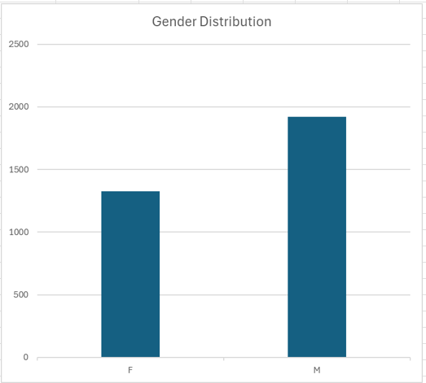
Cohort Characteristics

Slide 6
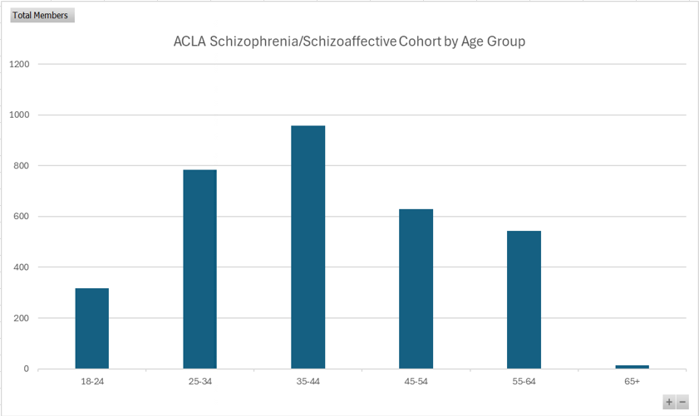
Cohort Characteristics
Notes:
The majority of members are concentrated between 35 and 54 years of age — the age range that typically carries the highest burden of chronic psychiatric illness.

Slide 7
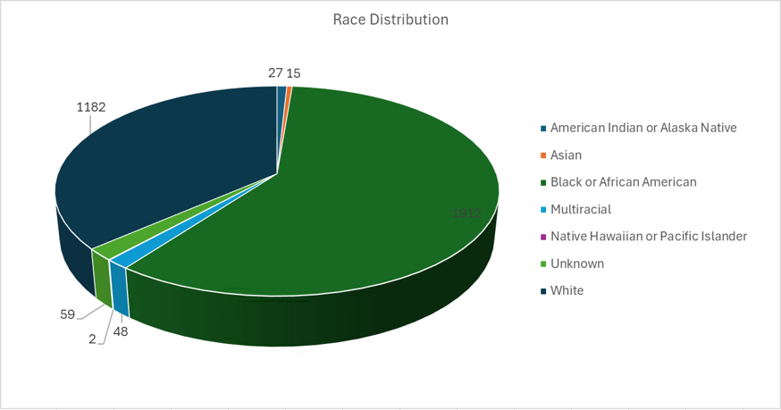
Cohort Characteristics
Notes:
Black members make up the majority of the cohort. This is important later when interpreting adherence disparities.

Slide 8
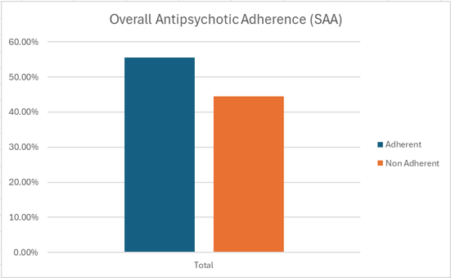
Overall Adherence
Notes:
~45% non-adherence is a very significant number of people without consistent adequate treatment. The adherence gap is a major risk factor for relapse and acute care use.

Slide 9
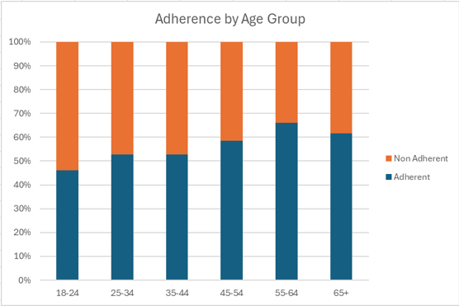
ADHERENCE BY AGE GROUP
Notes:
Adherence varies heavily by age, with older adults generally showing better adherence than younger adults. Though the trend begins to break down after the age of 65 due to possible factors like increased difficulties traveling to obtain medication (or even just standing up to get meds could be a chore), increased reliance on others, increased forgetfulness, etc.

Slide 10
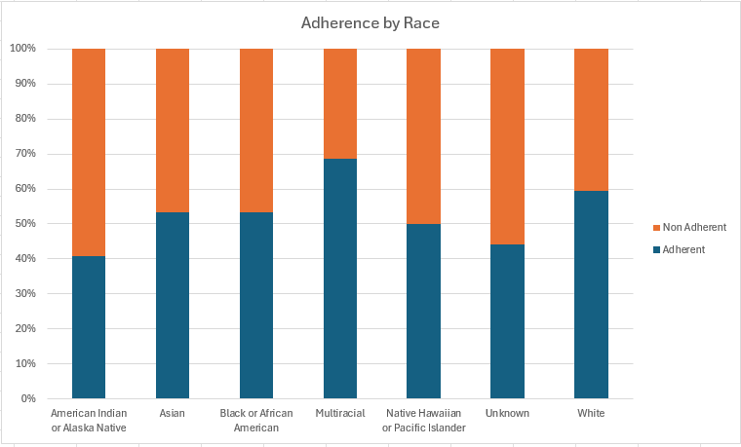
ADHERENCE BY RACE
Notes:
There is a measurable difference in adherence between white and Black members. Remember that the other Race categories are significantly fewer than that of white and African American Category. Kept all races in for sake of completion, but will focus on White vs AA comparison going forward as they make up the vast majority of the cohort.

Slide 11
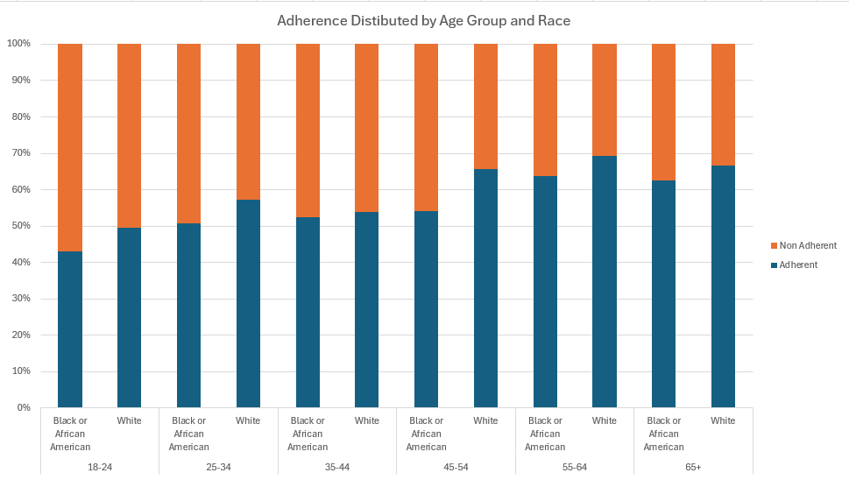
ADHERENCE BY RACE WITH AGE SUBGROUPS
Notes:
This deeper view shows which subgroups struggle the most.
Adherence amongst white population is higher in every single age group compared to AA population.
- What is causing this disparity? What is preventing the AA population from matching the adherence rate of their white counterparts across their lifetime? Younger Black males usually stand out — consistent with national patterns.

Slide 12
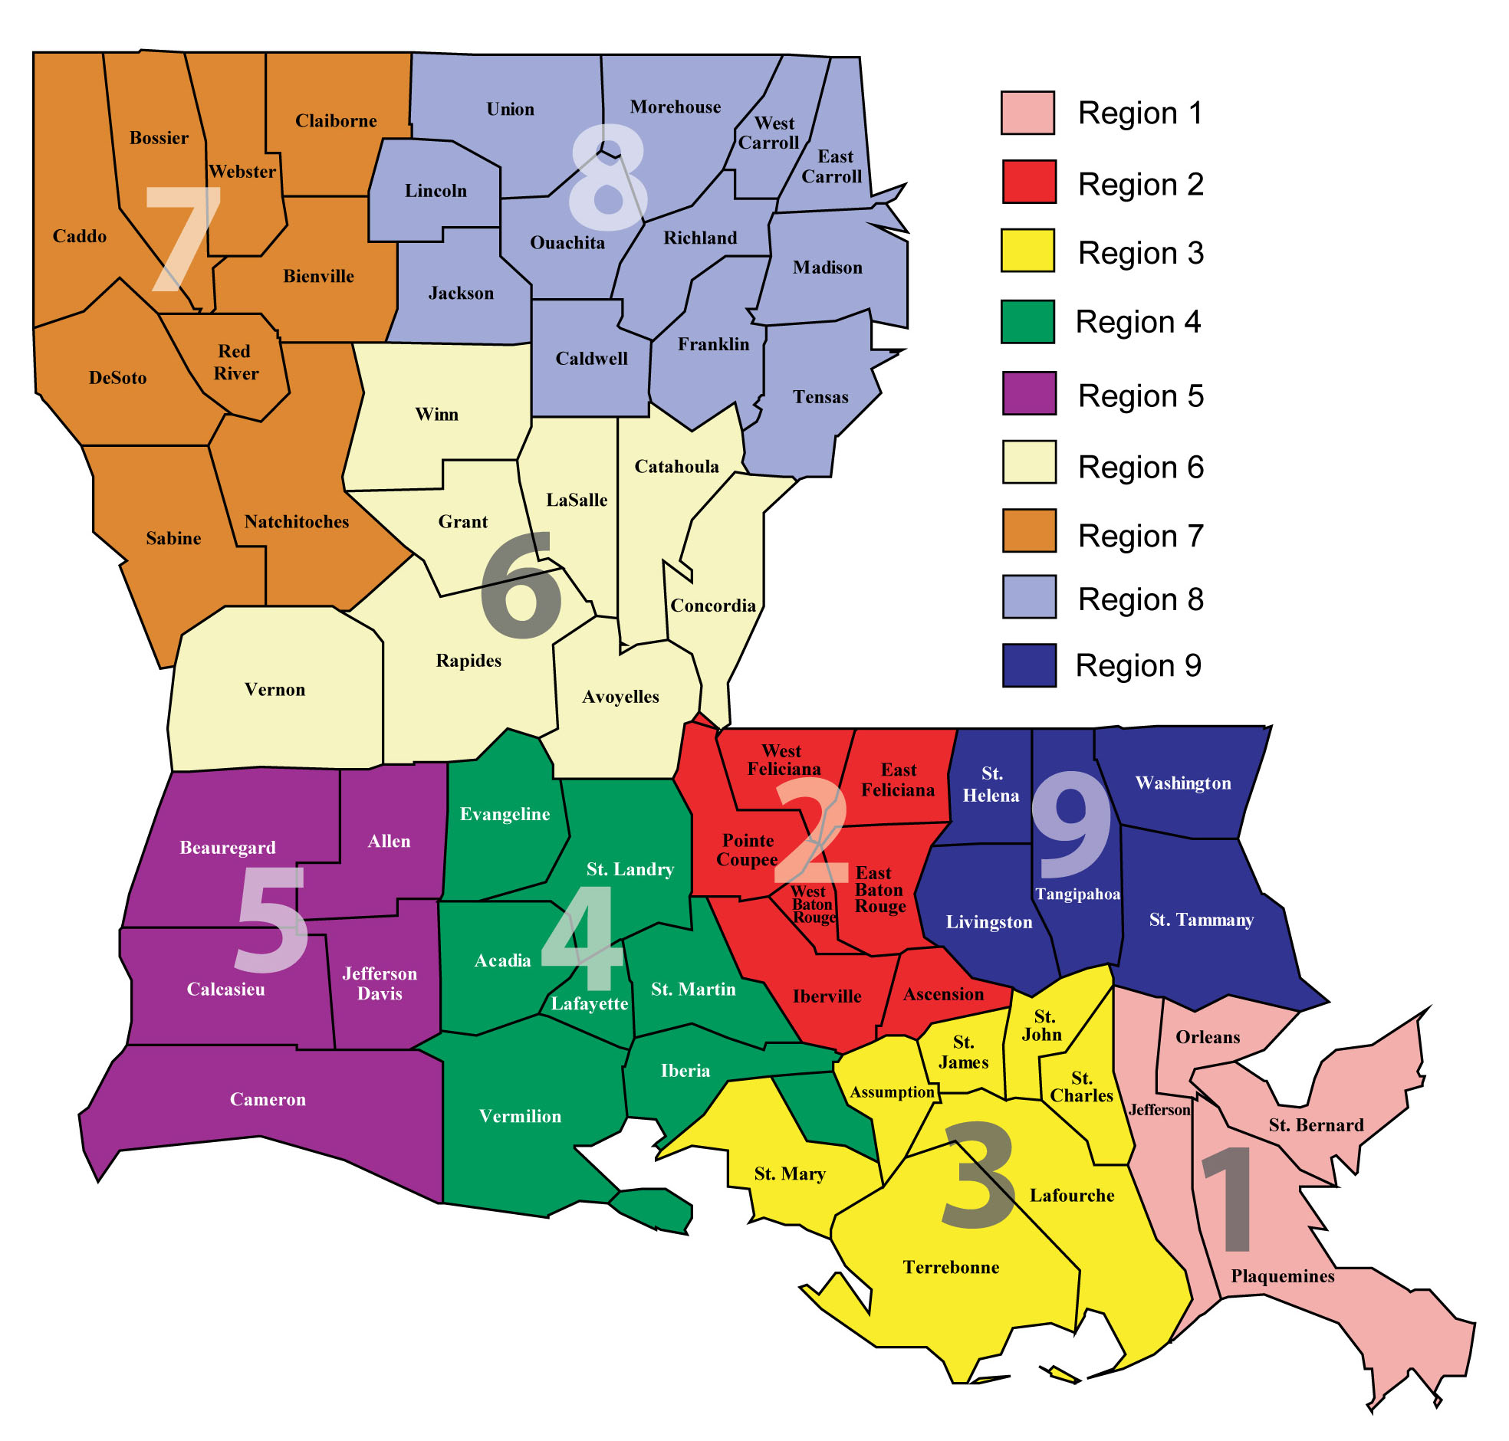
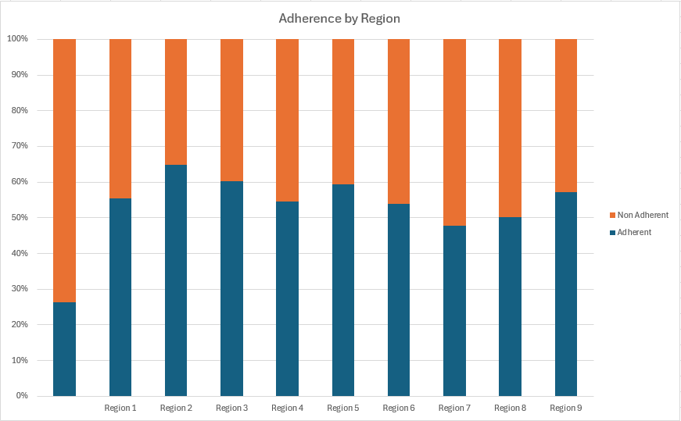
Adherence by Region
Notes:
Certain regions show significantly lower adherence and may benefit from targeted interventions (e.g., care management outreach, prescriber support).

Slide 13
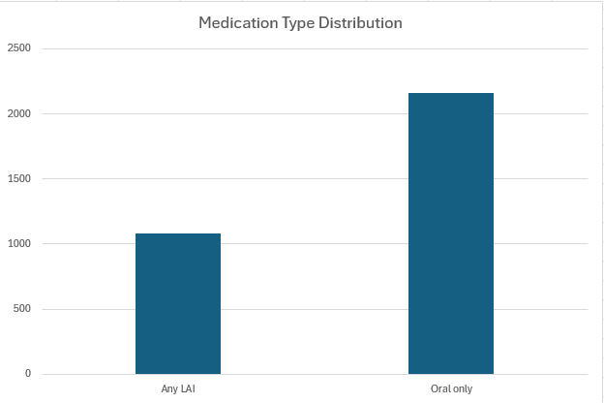
MEDICATION TYPE DISTRIBUTION
Notes:
About double the number of members have only ever utilized oral antipsychotics during their treatment when compared to those who have been on an LAI at least once during their treatment.

Slide 14
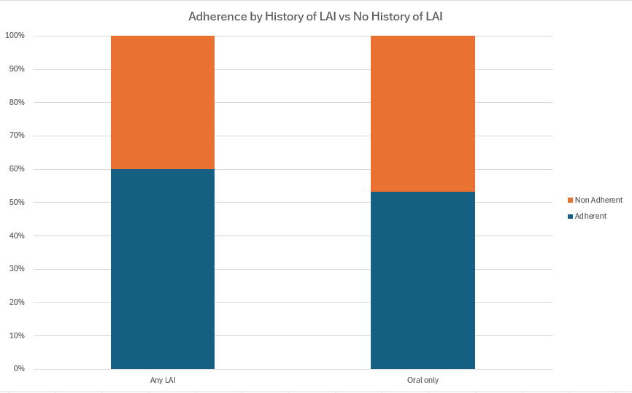
ADHERENCE: ORAL VS LAI
Notes:
Members with a history of LAI use show stronger adherence. This supports expanding LAI access in the ACLA population.

Slide 15
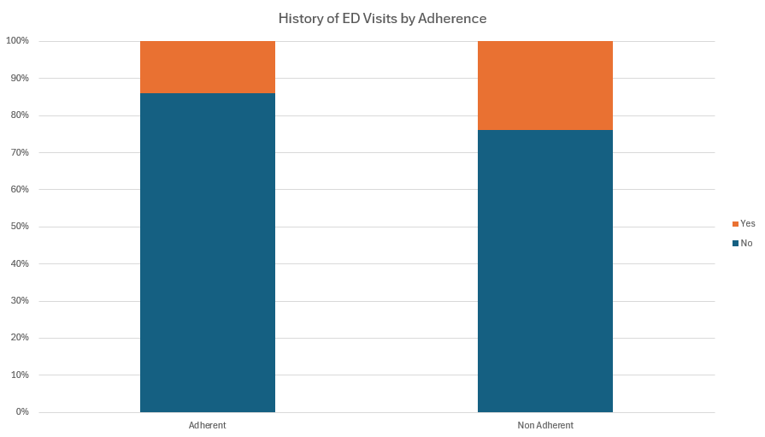
ED Visits And Adherence
Notes:
Members who are non adherent have higher levels of ED use. This aligns with what is expected clinically.

Slide 16
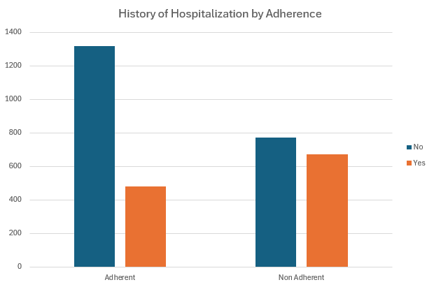
INPATIENT ADMISSIONS AND ADHERENCE
Notes:
Non adherent members are admitted at far higher rates. This is one of the most significant disparities found. Very obvious the effect that non-adherence has on the likelihood that a patient will be admitted to the hospital at some point in time SPECIFICALLY AS A RESULT OF THE SYMPTOMS CAUSED BY SAA. These are admissions with Primary diagnosis of SAA.

Slide 17
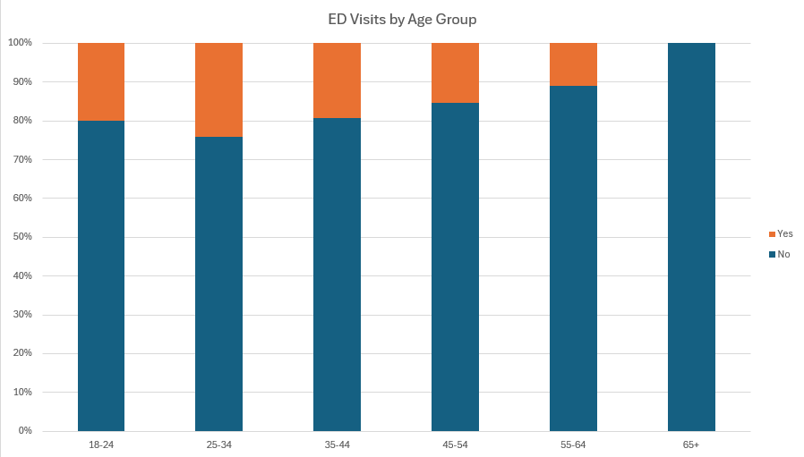
ED VISITS BY AGE
Notes:
Younger cohorts tend to use the ED more. This may reflect crisis driven patterns or inconsistent outpatient engagement.
Corresponds to the adherence rates across age groups.

Slide 18
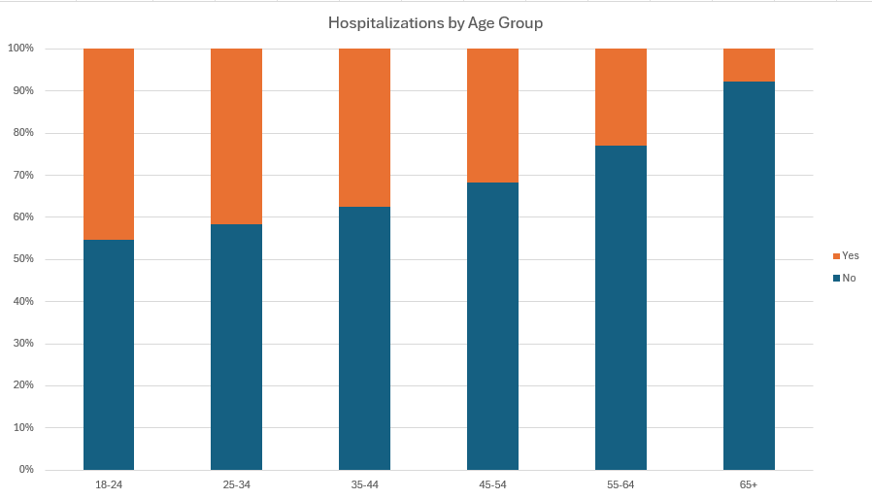
HOSPITALIZATIONS BY AGE
Notes:
Similar trend — older age groups appear more stable.
Corresponds to the adherence rates across age groups.

Slide 19
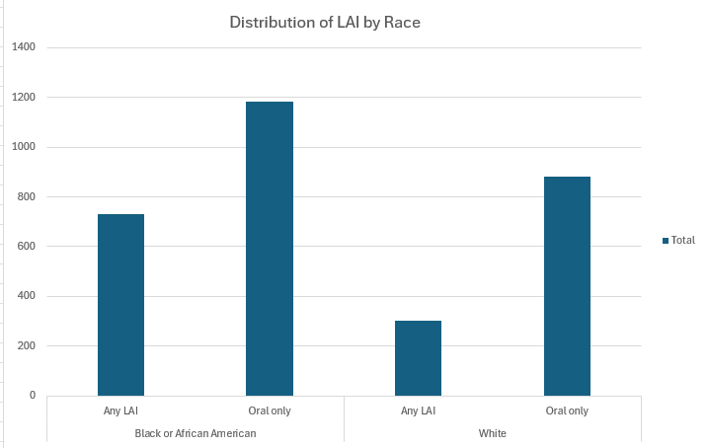
LAI USE BY RACE
Notes:
Black members were more likely than White members to have any history of LAI use, though both groups still relied mostly on oral medications.
This seems counterintuitive since we are saying LAI are protective yet AA population has increased care utilization/morbidity/less adherence and more LAI use. This could be due to a number of factors B. Higher LAI use among African American members may reflect:
Higher relapse risk noted historically by providers
Provider hesitancy to prescribe oral meds where there is risk of non-adherence
Systemic factors such as more frequent ED encounters
Improved continuity when an LAI is used This demographic pattern speaks to system-level practice trends, not clinical failure of LAIs.
C. LAIs are effective, but prescribing patterns are not uniform
The key point you want to communicate is:
“LAIs are beneficial, but the people who need them the most do not always receive them, and many people who receive them were selected because they were already struggling with adherence.”

Slide 20
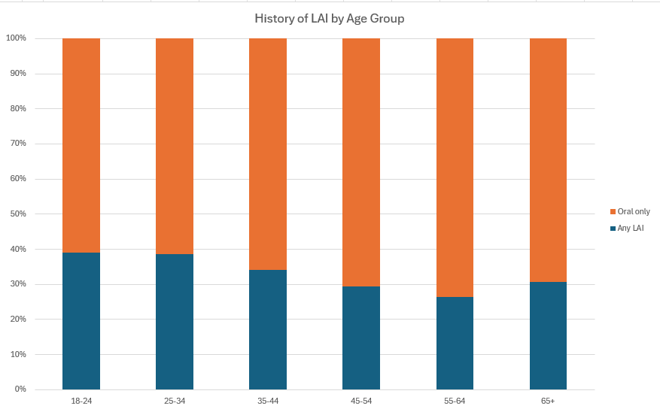
LAI USE BY AGE GROUP
Notes:
LAI use seems to fall amongst older population.
Why LAI Use Decreases in Older Age Groups
1. Older patients tend to be more stable and already adherent
As people age with chronic schizophrenia or schizoaffective disorder, many reach a more stable phase of illness. They often have:
consistent routines
established medication habits
long relationships with outpatient providers
Because of this, providers are less likely to escalate to an injectable if the patient is already reliable with oral meds.
2. Providers avoid LAIs in older adults due to medical complexity
Older patients are more likely to have:
cardiovascular disease
diabetes
movement disorders
polypharmacy issues
Some clinicians worry (sometimes overly so) about:
post injection complications
difficulty titrating doses
slower metabolism and increased side effects
So they default to oral meds where they feel they have more moment-to-moment control.
3. LAIs require transportation, support, and consistent clinic access
Older adults with schizophrenia are more likely to experience:
mobility limitations
lack of transportation
fewer social supports
This makes it harder to get to recurring injection appointments, leading providers to prefer orals that can be managed at home.
4. Historical prescribing patterns
Older patients often started treatment decades ago, before LAIs were as widely recommended or before the newer generations of LAIs existed.
Clinicians tend to follow the rule:
“If a patient has been stable on a regimen for years, do not change it.”
So they simply stay on older oral regimens.
6. Side effect sensitivity
LAIs remove the ability to:
stop the drug quickly
adjust daily doses
hold a dose during acute side effects
Older adults are more vulnerable to:
orthostasis
EPS
metabolic side effects
sedation
So prescribers may hesitate to use a medication that cannot be “turned off” for several weeks.
This suggests that even though LAI’s seem to be protective, they do not tell the whole story.

Slide 21
KEY FINDINGS (SUMMARY)
Adherence is significantly below the HEDIS standard.
Strong relationship between adherence and acute care use.
LAI use seems to be protective and associated with better adherence yet cannot explain the entire story as suggested by lower use rates use amongst older populations and higher use rates among AA population.
Disparities appear across age, race, and region.
Opportunities exist for targeted engagement and outreach.
Notes:
B. Higher LAI use among African American members may reflect:
Higher relapse risk noted historically by providers
Provider hesitancy to prescribe oral meds where there is risk of non-adherence
Systemic factors such as more frequent ED encounters
Improved continuity when an LAI is used This demographic pattern speaks to system-level practice trends, not clinical failure of LAIs.
C. LAIs are effective, but prescribing patterns are not uniform
The key point you want to communicate is:
“LAIs are beneficial, but the people who need them the most do not always receive them, and many people who receive them were selected because they were already struggling with adherence.”

Slide 22
CONCLUSION
Nonadherence plays a central role in avoidable acute care utilization.
LAIs may be one of the strongest levers for improving outcomes.
This project reveals actionable gaps that ACLA can address through focused population management strategies.
Notes:
LAI use isn’t just about the nature of the medicine, its administration, its pharmacokinetics, etc. It is also about the implications that go along with someone achieving PLANNED therapy with an LAI that plays a vital role in improving adherence and outcomes. The implications of planned LAI therapy are multifactorial and devising plans to achieve this level of therapy provides avenues that take advantage of a number of ”mechanisms” that all promote better adherence and better outcomes.

