Slide 1
ACLA Plan All-Cause Readmissions (PCR)
Humza Pirzadah

Slide 2
Background
PCR tracks unplanned acute readmissions within 30 days of discharge.
Readmissions (within 30 days) often reflect gaps in discharge planning, medication reconciliation, timely follow-up, and SDOH barriers.
Reducing readmissions improves quality performance and total cost of care for Medicaid populations.
Notes:
-HEDIS (Healthcare Effectiveness Data and Information Set) is a set of standardized performance measures for health plans, developed by the NCQA(national committee of quality insuracen) to evaluate the quality of care. These measures are used to compare health plans on various aspects like preventative care, chronic condition management, and customer satisfaction, helping employers, governments, and individuals assess and choose plans.
-Most preventable readmissions occur within 30 days, and evidence shows this window is strongly linked to hospital-related factors like discharge planning, medication reconciliation, and early follow-up.
-Early readmissions (especially within 7 days) are most often due to issues from the index hospitalization, while the rest of the 30-day window still captures events influenced by transitional care quality.
-Beyond 30 days, readmissions are less preventable and more driven by new illnesses, chronic disease progression, or community-level factors—making 30 days the most meaningful and actionable timeframe.

Slide 3
Objectives
Quantify overall 30-day readmission rates for 2023 and 2024.
Compare rates across Age, Gender, Region, diagnosis, DC dispo, CM involvement, and Race to detect inequities.
Highlight priority groups for targeted transitional care interventions.

Slide 4
Methods & Data
Source: Processed aggregate data (2023 & 2024).
Outcome: 30-day readmission rate.
Approach: Descriptive summaries, bar-chart visualizations, and comparative interpretation by stratifier.

Slide 5
Overall Readmission Rates
2023: 10.3%
2024: 10.1%
• National all-cause 30-day readmission rate: 14–15%
• Medicaid populations typically 15–18%
• ACLA overall rate (2023–2024): ~10.2%
• ACLA performing better than national trends
Notes:
Agency of Healthcare Research and Quality official website government database/website

Slide 6
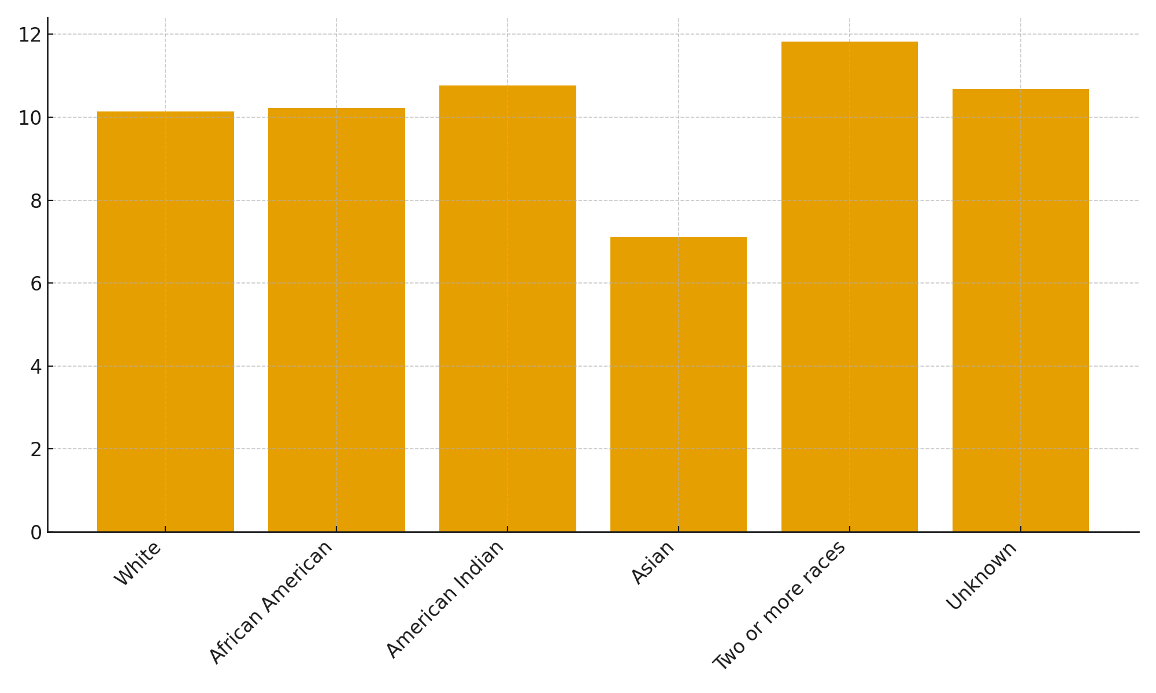
Race

Slide 7
Race Comparisons: ACLA vs National
National African American readmissions ≈ 16–17%
ACLA African American: 10.23%
National Asian: 11–12%; ACLA Asian: 7.12%
Racial disparities reduced within ACLA

Slide 8
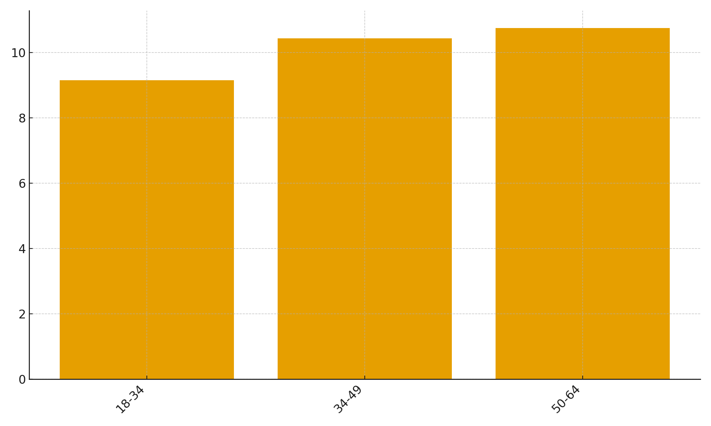
Age

Slide 9
Age Trends
National: Younger adults (8–10%), middle-aged (12–14%)
ACLA: 18–34 = 9.15%; 34–49 = 10.43%; 50–64 = 10.74%
ACLA shows consistently lower rates across most age groups

Slide 10
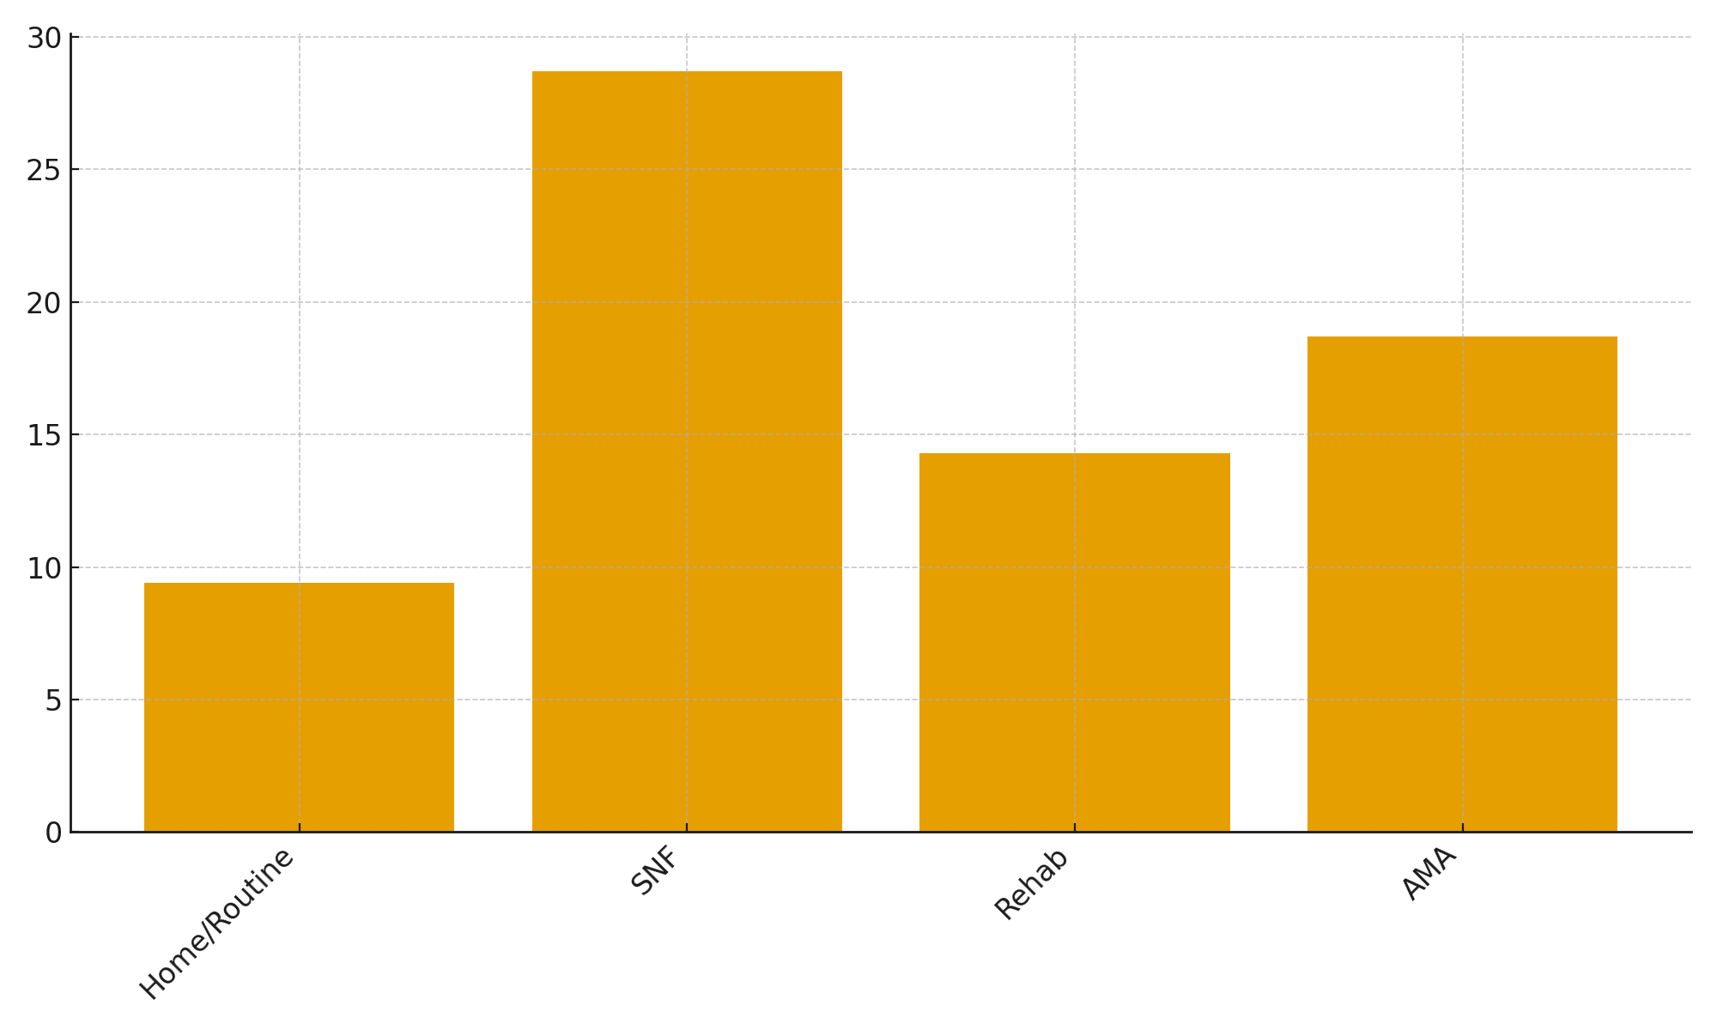
Discharge Dispositions

Slide 11
Discharge Dispositions
National SNF readmissions: 20–27%
ACLA SNF: 28.71% (consistent with national risk)
Home discharge nationally: 10–12%; ACLA: 9.41%
AMA nationally: 18–22%; ACLA AMA: 18.69%

Slide 12
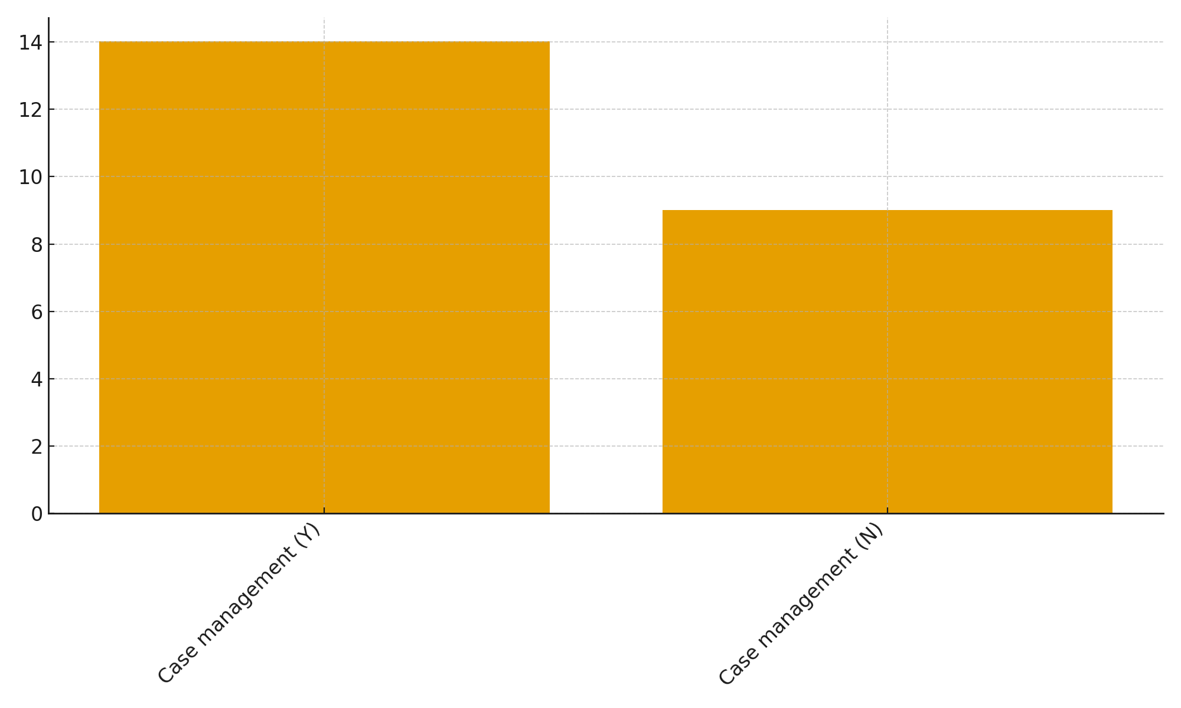
Case management

Slide 13
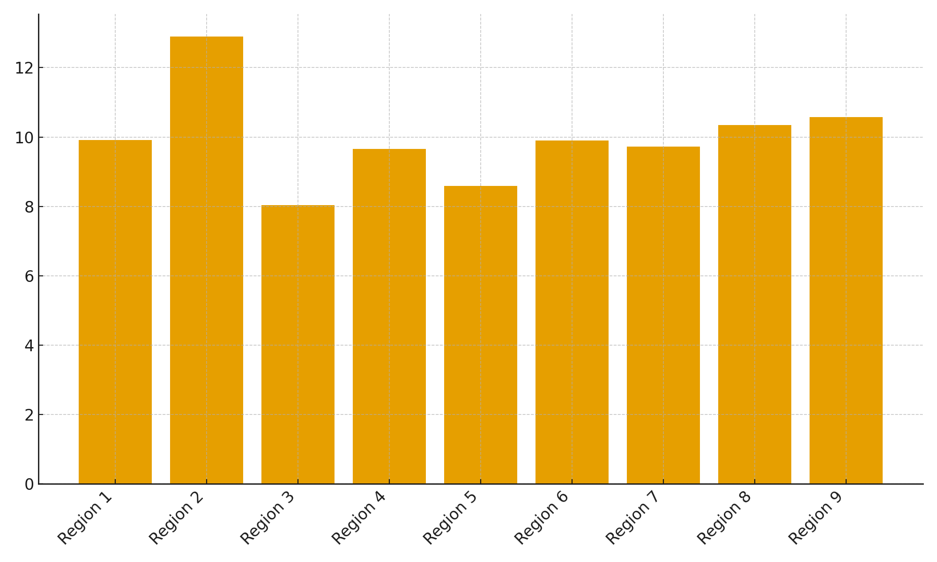
Region

Slide 14
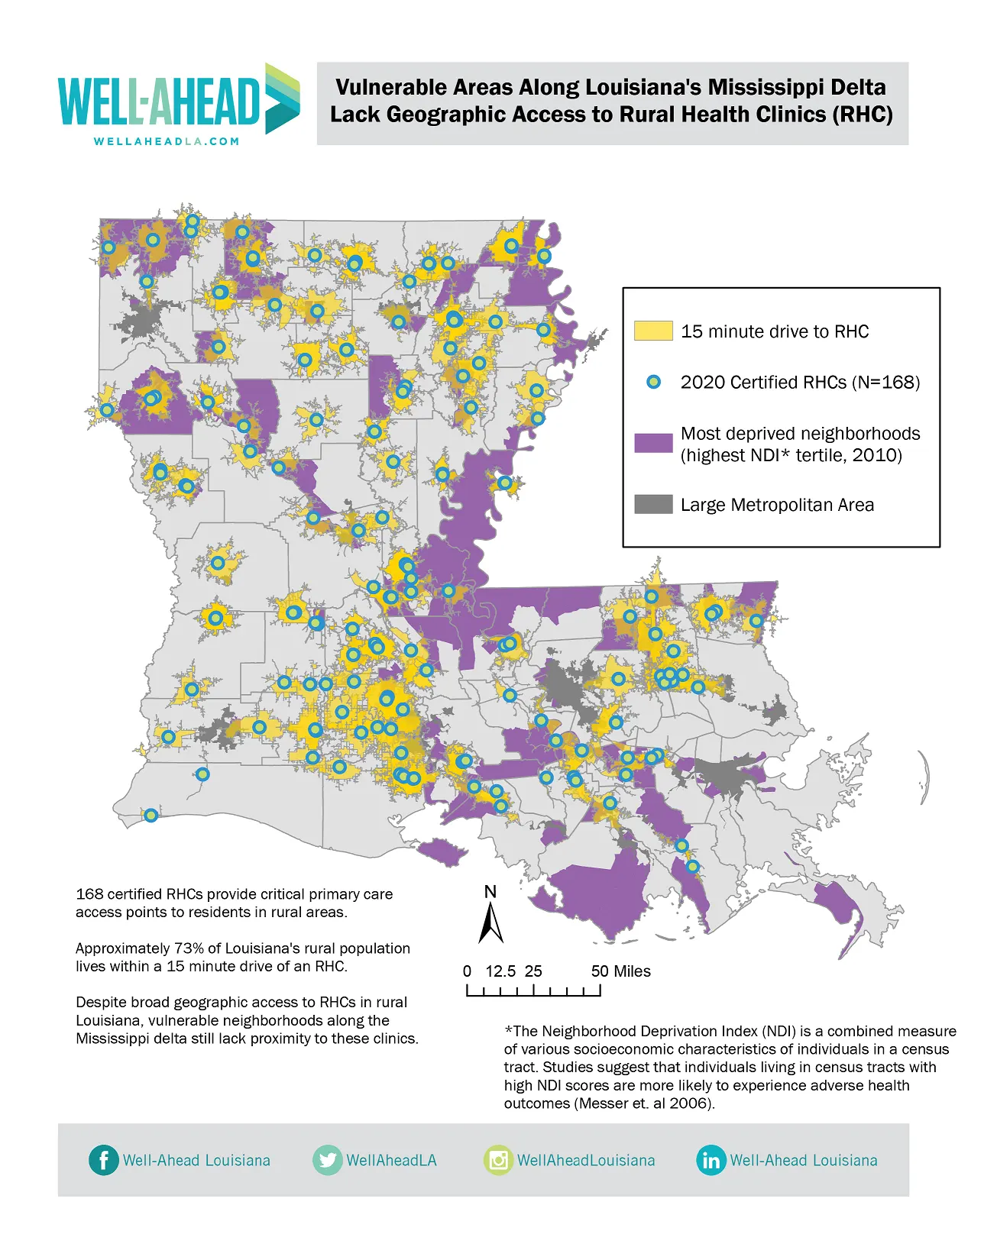
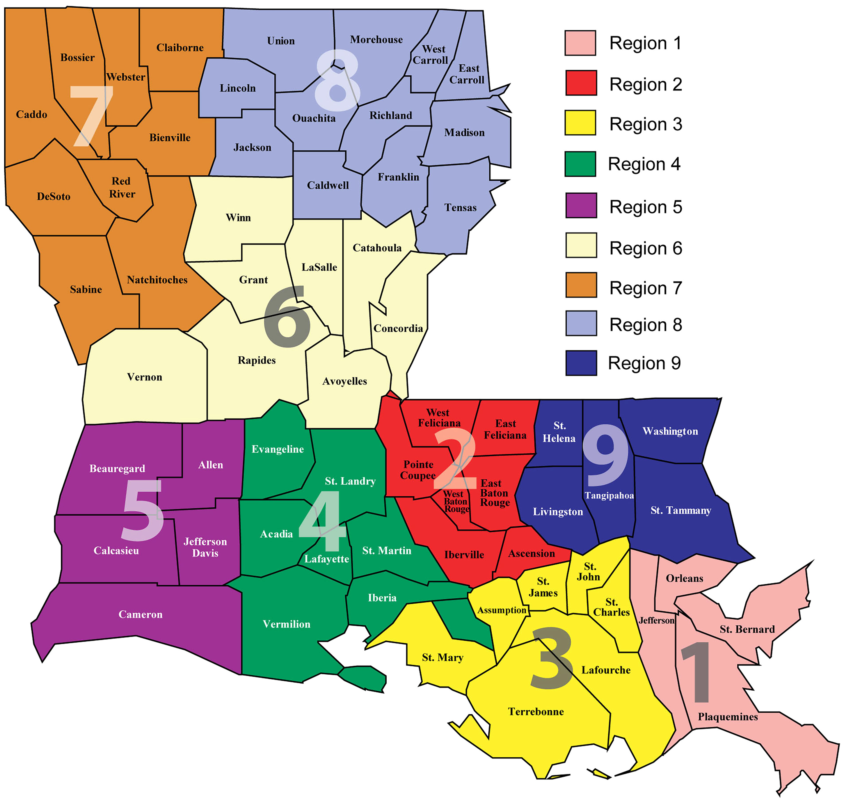

Slide 15
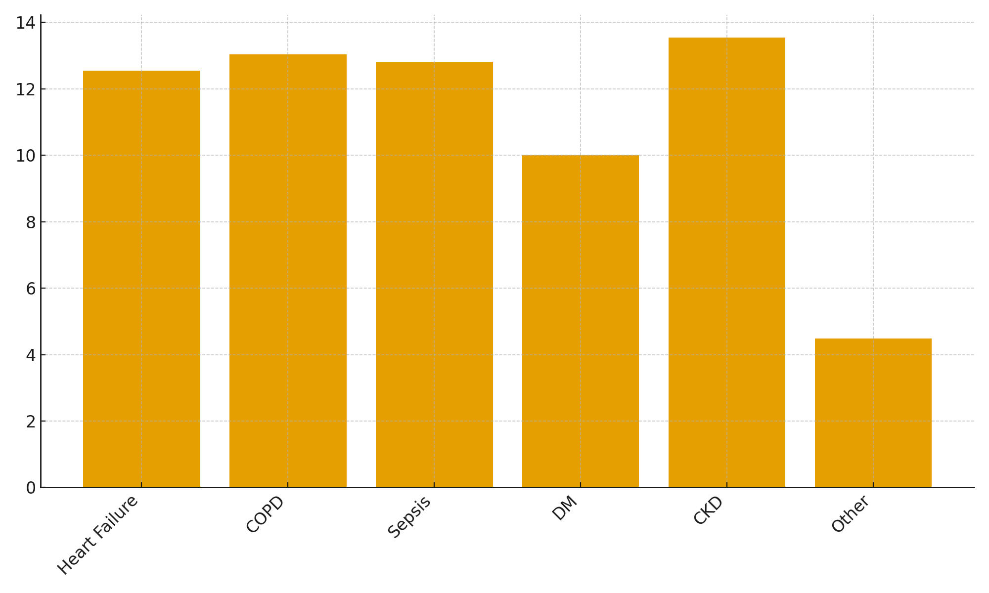
Diagnosis

Slide 16
Diagnosis Comparison
• National HF: 21–23%; ACLA HF: 12.54%
• National COPD: 18–20%; ACLA COPD: 13.03%
• National CKD: 17–19%; ACLA CKD: 13.55%
• ACLA outperforms national norms for chronic illnesses

Slide 17
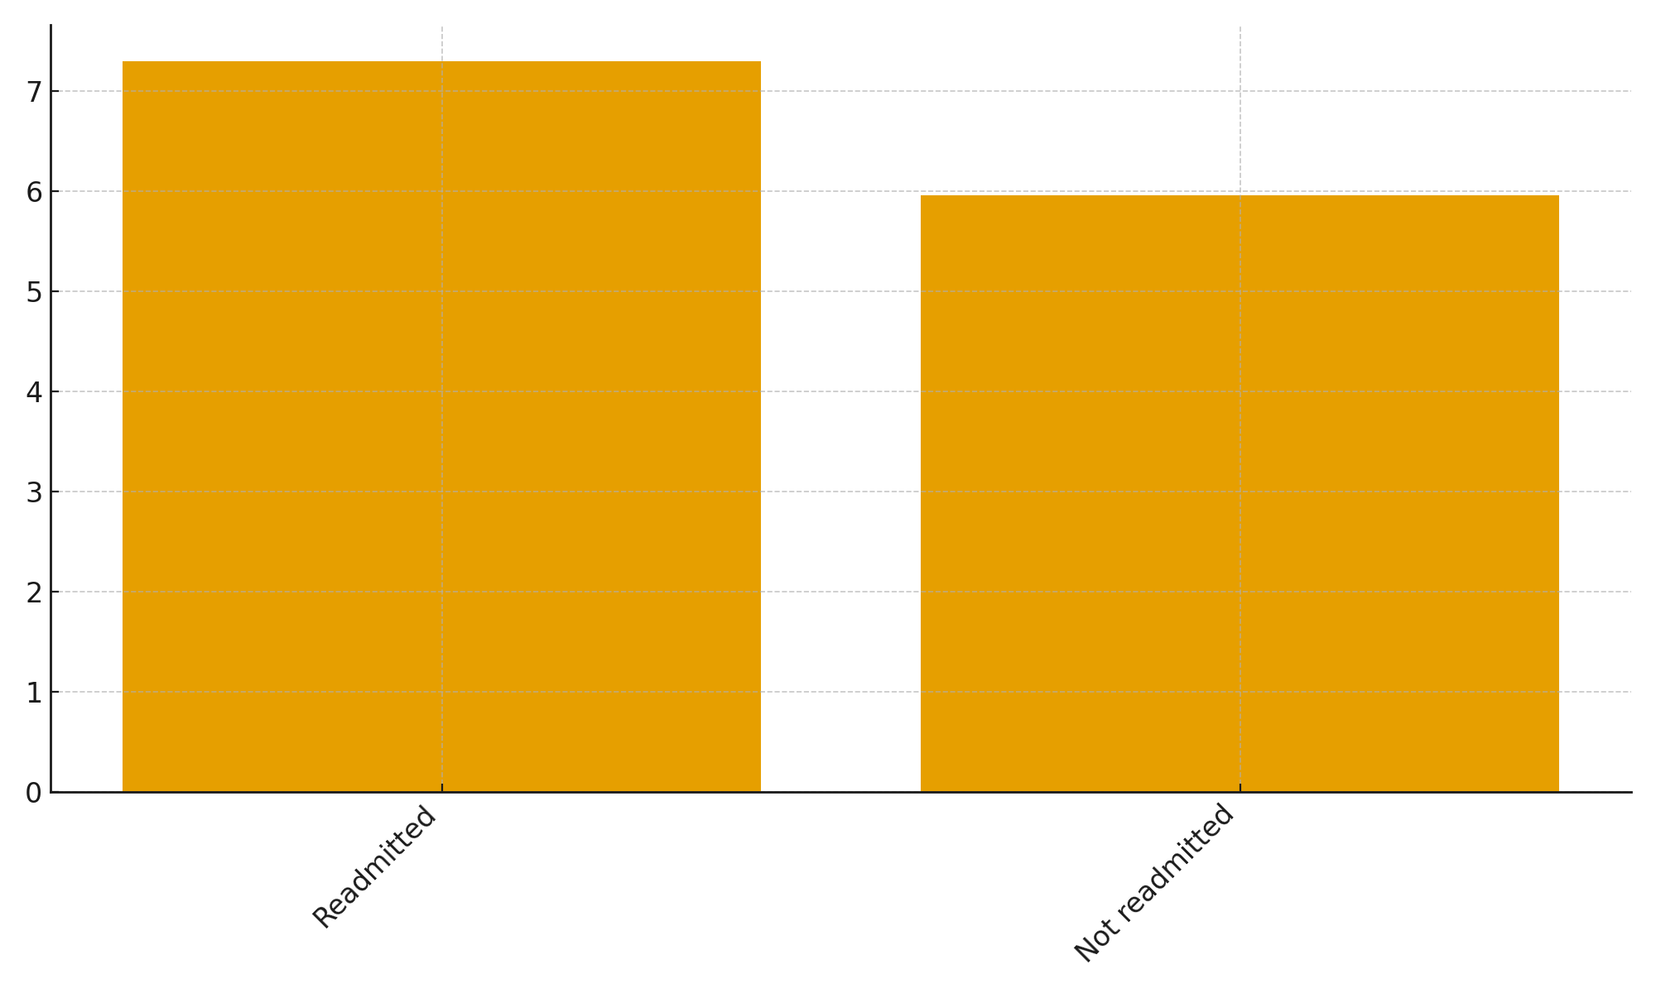
Index LOS

Slide 18
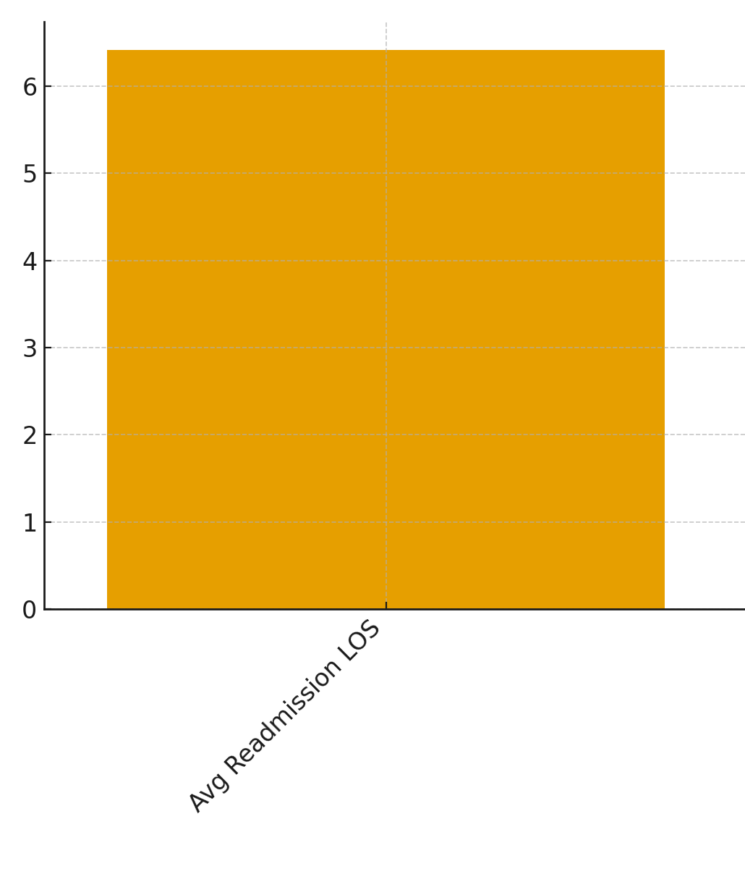
Readmission LOS

Slide 19
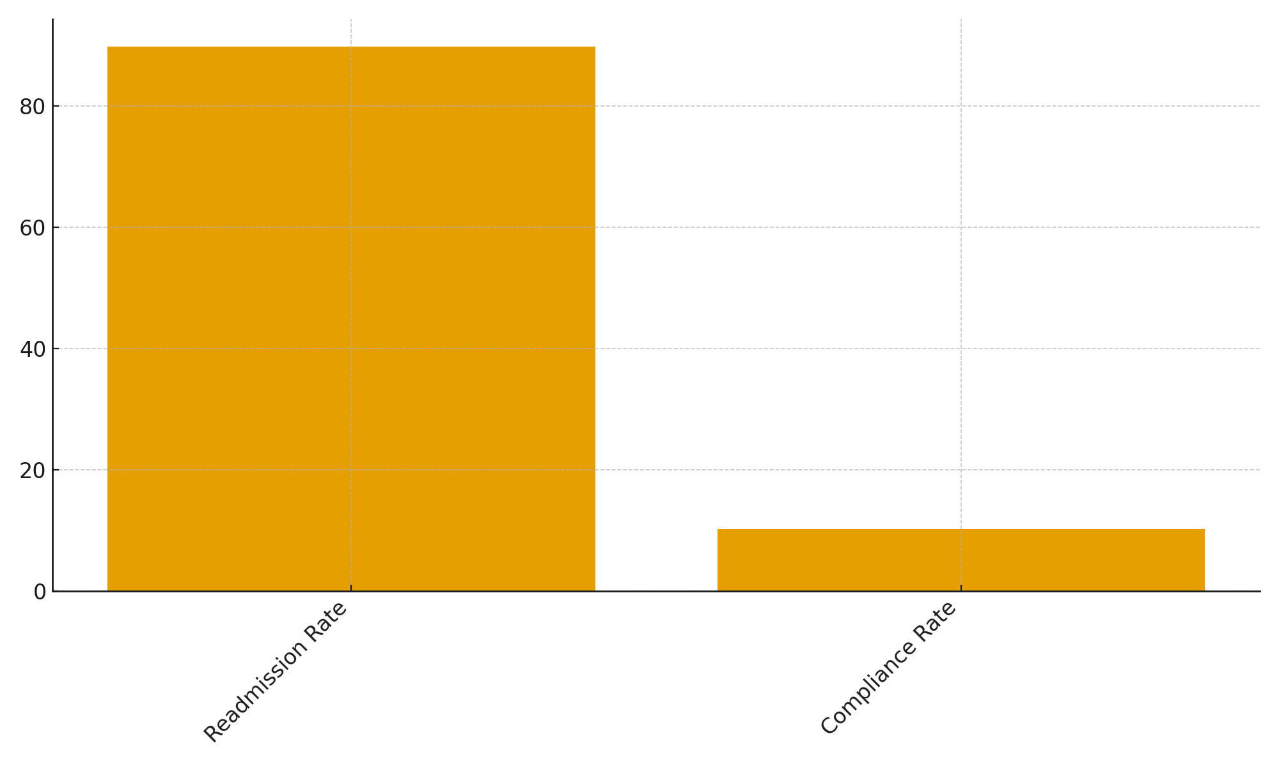
Compliance

Slide 20
How ACLA Can Cont. to Performs Better Than National Averages
• Strong transitional care management
• Robust case management enrollment (CM improves outcomes)
• Addressing SDOH: transportation, BH needs, housing
Notes:
HEDIS PCR = The national quality measure called Plan All-Cause Readmissions, which tracks how often adults are readmitted to the hospital within 30 days. Your project directly uses this same measure, so it aligns with national quality standards.
LDH PIP initiatives = The Louisiana Department of Health’s Performance Improvement Projects, which require Medicaid plans (like ACLA) to work on reducing preventable readmissions and improving transitions of care.

Slide 21
Recommendations
Prioritize Region 2: Address Socioeconomic & SDOH Burdens
Region 2 demonstrates a notably higher readmission rate, suggesting deeper structural and socioeconomic challenges.
Focused assessment of transportation barriers, housing instability, income limitations, health literacy, and access to follow-up care should guide targeted interventions.
Implement region-specific outreach: care coordination, community health worker engagement, and enhanced post-discharge follow-ups tailored to patients’ SDOH needs.
Use SDOH documentation tools to ensure patient needs are identified early and linked to resources before discharge.

Slide 22
Recommendations
Improve Medication & Care Plan Adherence
Non-adherent patients show dramatically elevated readmission rates, indicating a major opportunity for preventable readmissions.
Standardize adherence interventions: pharmacist reconciliation before discharge, teach-back education, and early post-discharge follow-ups (48–72 hrs).

Slide 23
Conclusions
Readmission rates vary
Patterns suggest contributions from clinical complexity, access to care, compliance, and SDOH barriers.
2024 overall rate shows modest change versus 2023; subgroup differences are small.
Focusing on the patterns identified can help ACLA improve even further beyond national average

Slide 24
Thank You!
Humza Pirzadah

Slide 25
Gender, Urban/Rural, LOS Findings
• National males readmit slightly more: matches ACLA (11.06% vs 9.40%)
• Rural slightly lower than urban nationally: matches ACLA (9.69% vs 10.26%)
• Longer index LOS predicts readmission nationally; reflected in ACLA data

Slide 26
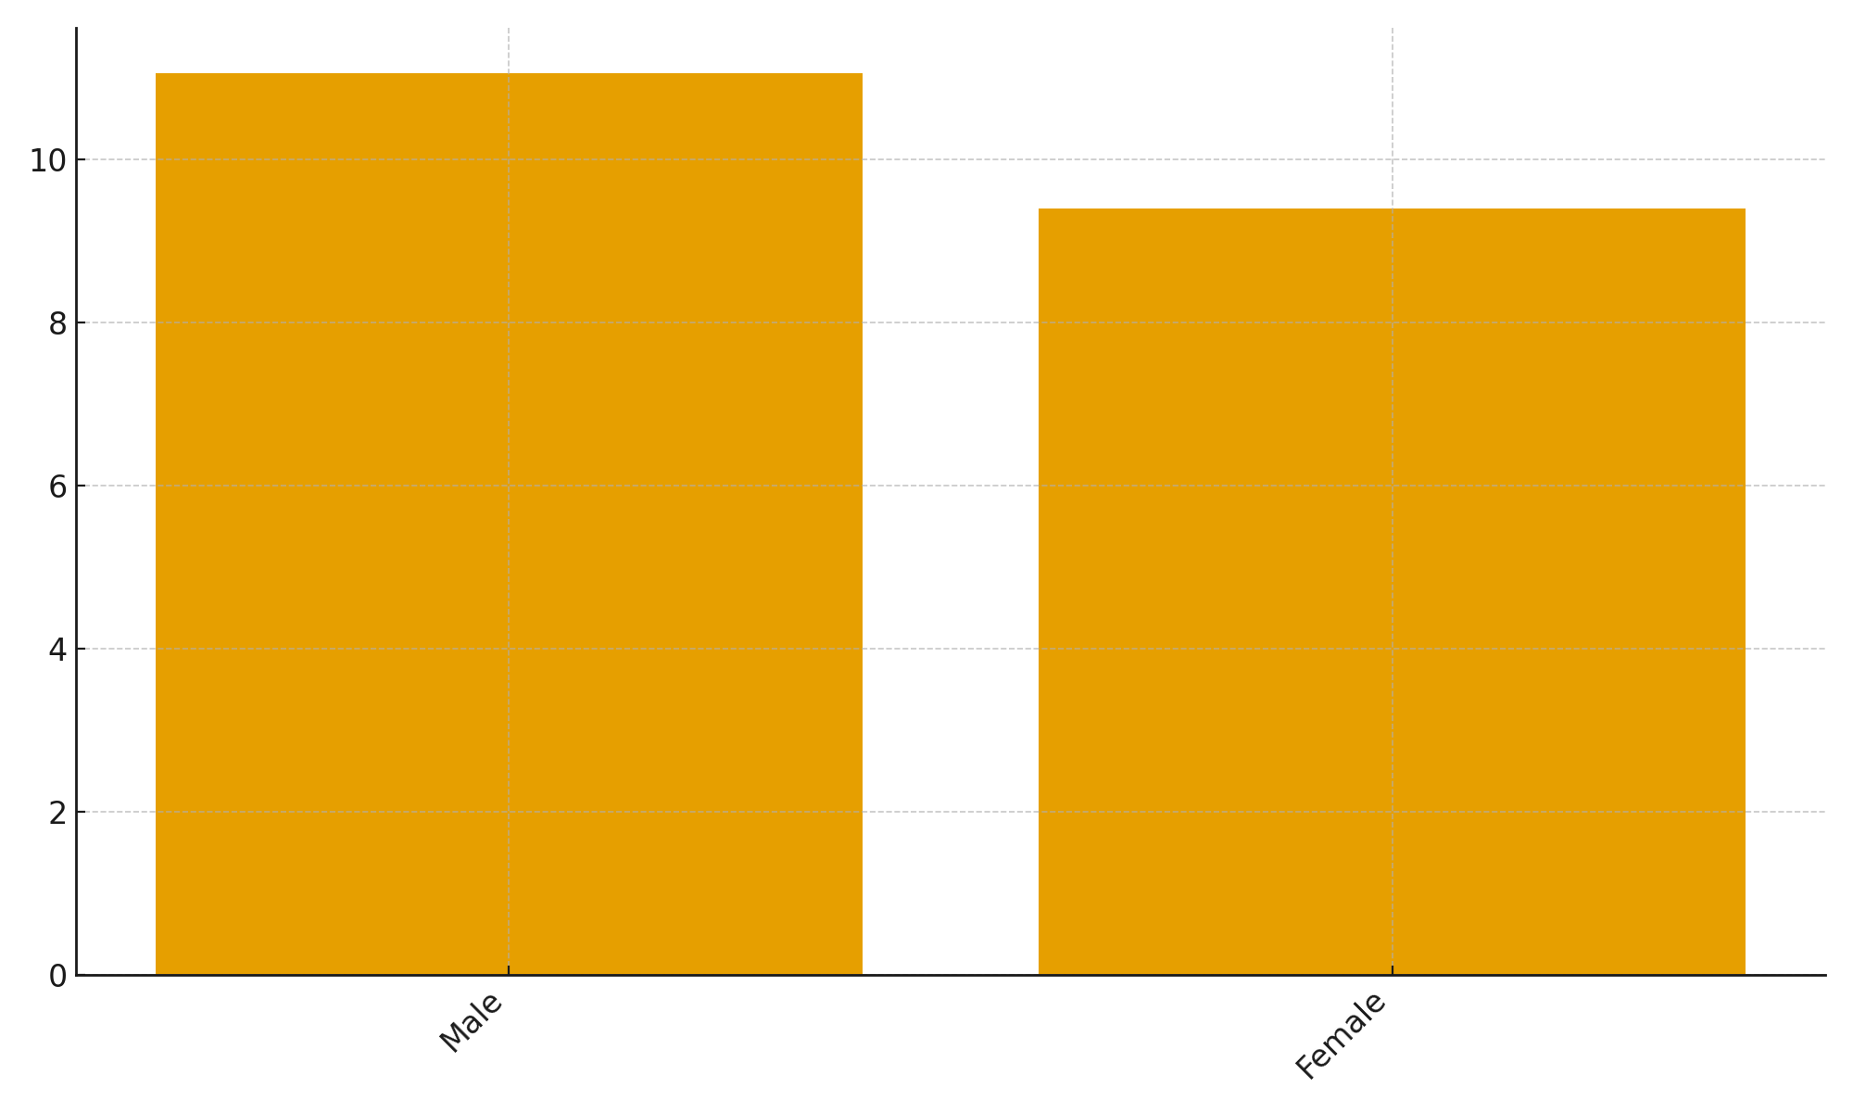
Gender

Slide 27
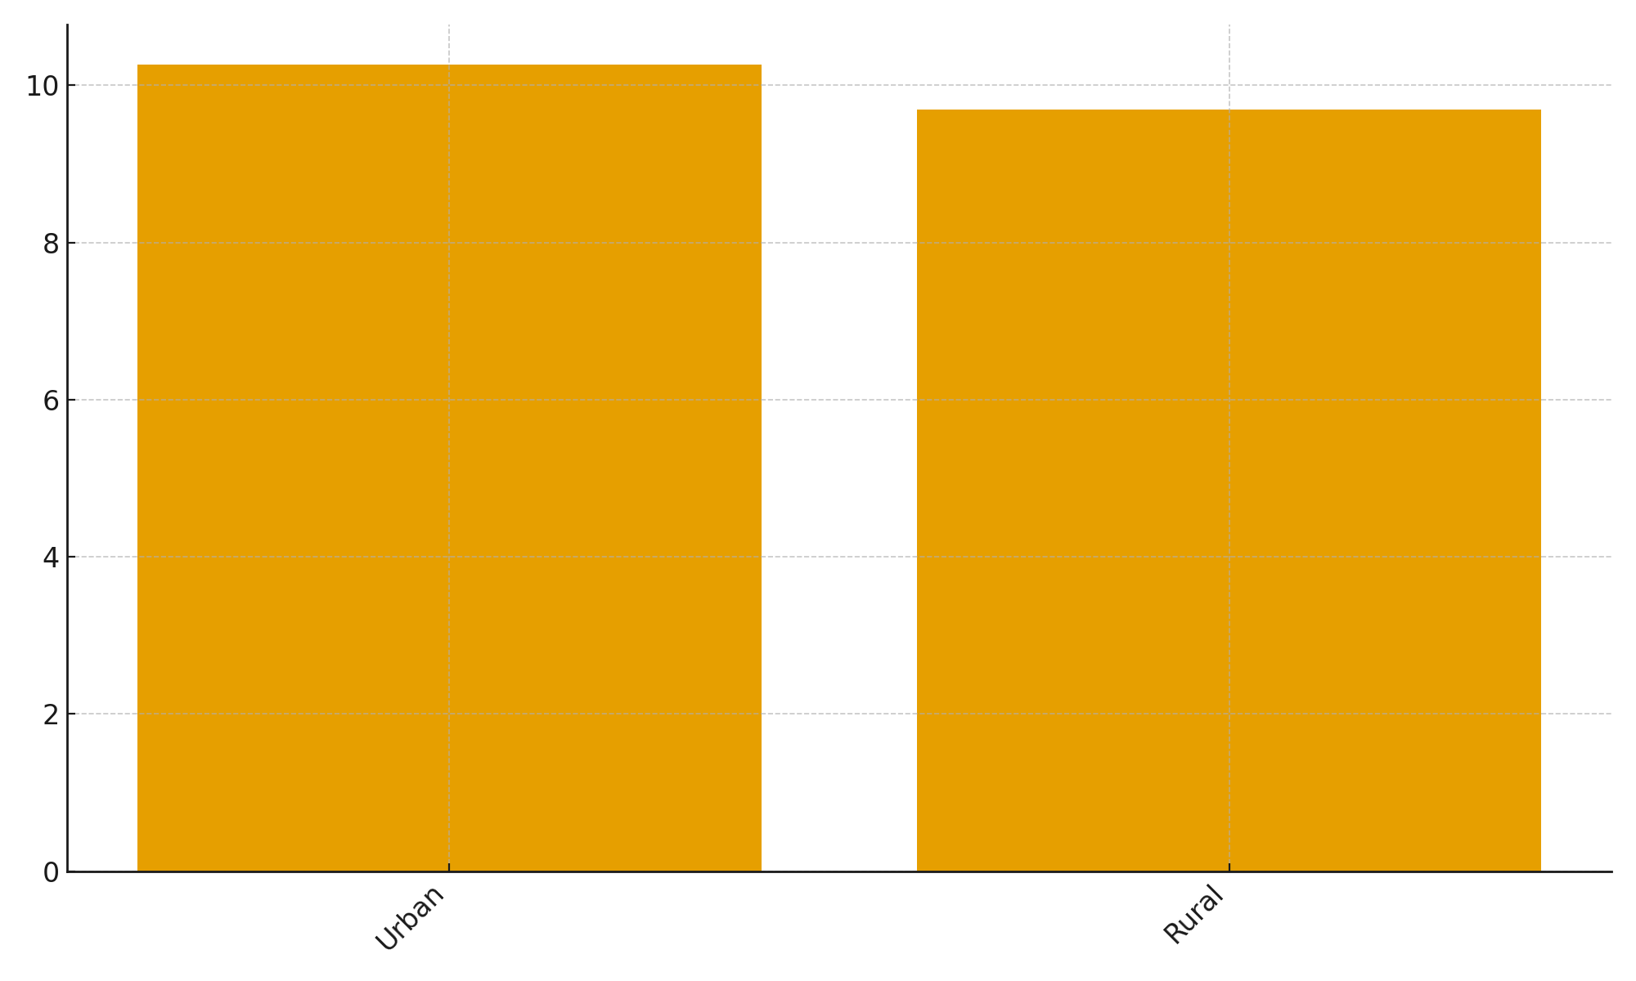
Urban vs Rural

