Slide 1
Adult Access to Preventive/Ambulatory Health Services
Priya Balamurugan
LSU New Orleans School of Medicine

Slide 2
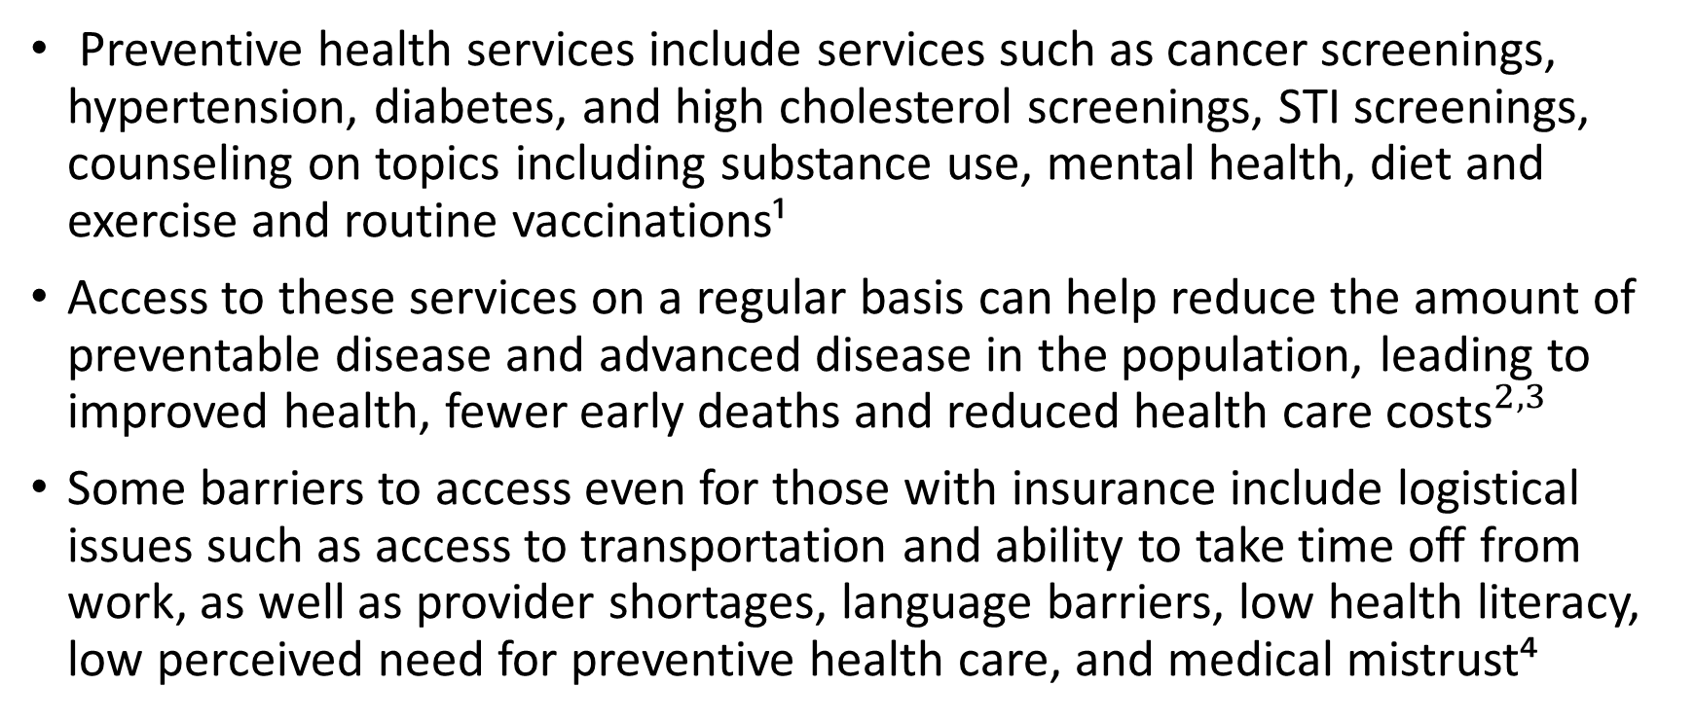
Background
Preventive health services include services such as cancer screenings, hypertension, diabetes, and high cholesterol screenings, STI screenings, counseling on topics including substance use, mental health, diet and exercise and routine vaccinations¹
Access to these services on a regular basis can help reduce the amount of preventable disease and advanced disease in the population, leading to improved health, fewer early deaths and reduced health care ${\text{costs}}^{2,3}$
Some barriers to access even for those with insurance include logistical issues such as access to transportation and ability to take time off from work, as well as provider shortages, language barriers, low health literacy, low perceived need for preventive health care, and medical mistrust⁴
Notes:
* Source for second and third point
More details about coverage for these services under Medicaid:
Most Medicaid expansion plans cover without copay or coinsurance services rated A or B by USPSTF if by in-network doctor

Slide 3
HEDIS Adult Access to Preventive/Ambulatory Health Services (AAP) measure
Measure that AmeriHealth Caritas LA (ACLA)has focused on more recently
Defined as percentage of persons 20 years of age and older who had ambulatory or preventive care visits (includes in-person and telehealth visits)
Compliance equals at least one preventive/ambulatory visit during the year
Excludes acute inpatient or ED visits.
Excludes patients who passed away during the measurement year as well as hospice patients

Slide 4
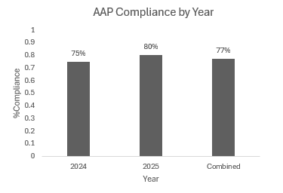
Overview of Project
Looked at ACLA member compliance with AAP measure for 2024-2025
N= 98,333 entries
Overall compliance: 77%
Trend of increase in compliance from 2024 to 2025
Also looked at Age, Sex, Race, Ethnicity, Language Spoken, Rural/Urban setting, Region, and Enrollment in Case Management

Slide 5
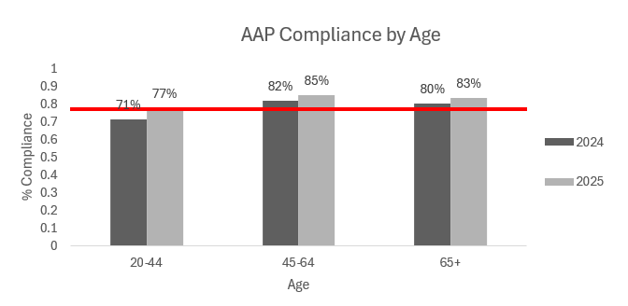
Age
Lowest Compliance amongst 20-44 age group
20-44 age group with 6% improvement from 2024-2025
Notes:
Possible barriers:
Lower perceived need
Logistical issues
Difficulty navigating health system, transitioning from pediatric care

Slide 6
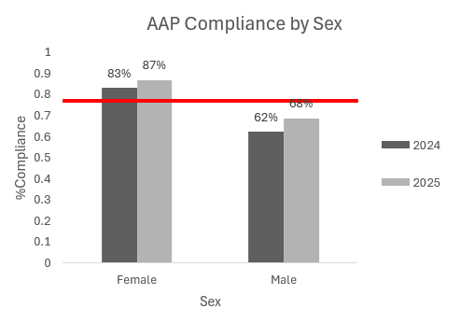
Sex
Notable difference with lower compliance among male members
Notes:
Men’s Health Month: Prioritizing Preventive Care and Wellness Strategies - BHM Healthcare Solutions
Men also at higher risk for certain chronic diseases such as heart disease, lung cancer and HIV and have unique health problems like prostate cancer

Slide 7
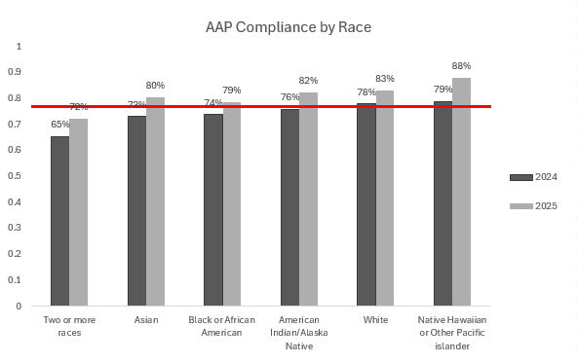
Race
Lowest compliance: two or more races, Asian, Black or African American
Highest compliance White and Native Hawaiian or Other Pacific Islander
Native Hawaiian or Other Pacific islander represented about 33-38 entries both years
#Entries for 2024 | 805 | 808 | 28,041 | 480 | 22,335 | 38
#Entries for 2025 | 622 | 679 | 21,846 | 379 | 17,572 | 33
Notes:
Order from lowest to highest

Slide 8
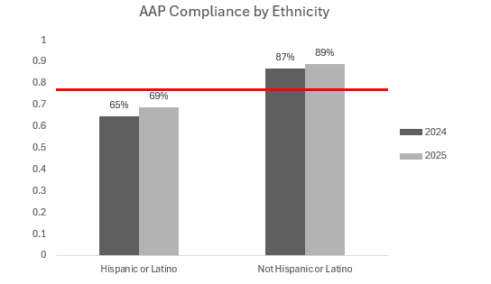
Ethnicity
Hispanic or Latino ethnicity with lower compliance compared to Non-Hispanic or Latino members

Slide 9
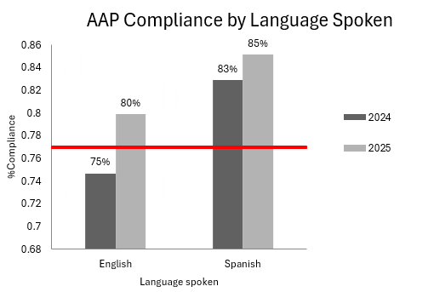
Language spoken
Interestingly, members who speak Spanish with better percent compliance than English-speaking members
Notes:
Roughlt 10% of number in Hispanic-Latino identifying members

Slide 10
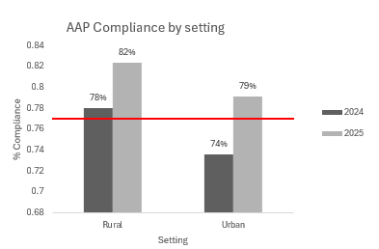
Setting
Interestingly, rural populations with higher percent compliance than urban settings

Slide 11
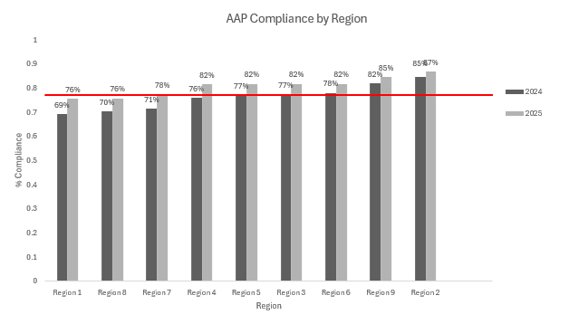
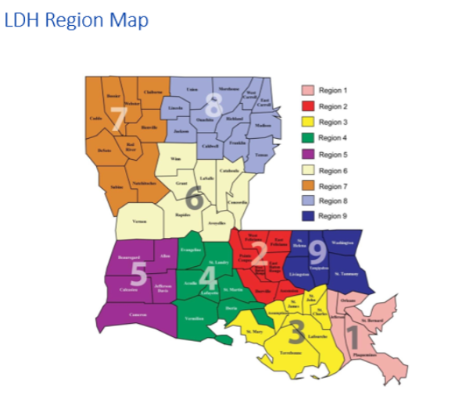
Region
Lowest Compliance: Region 1, 7, and 8
Highest Compliance: Region 2, Region 9
Notes:
Change graph so lowest to highest by height of graph
Can highlight lowest and highest in different colors

Slide 12
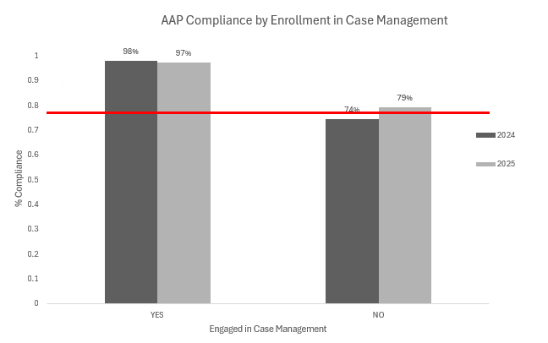
Enrolled in Case Management
Very high rates of compliance in those enrolled in case management

Slide 13
Summary
Key populations to target include 20-44 age group, male members, certain racial minorities, those of Hispanic/Latino ethnicity, and members in Regions 1,7 and 8
Rural populations and Spanish-speaking populations did not have lower comparative rates of compliance
Case Management enrollees with very high compliance
Notes:
Importance to provide physical and behavioral preventive health care
Continue and expand current initiatives

Slide 14

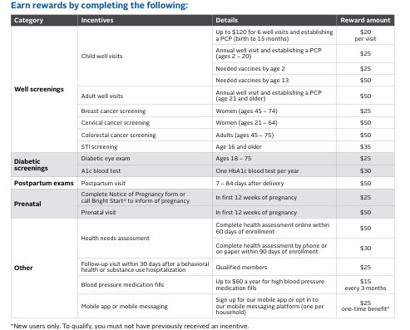

Current Interventions
Patient-centered:
Targeted mailers to let members know that they are past due for a wellness visit
Texting Campaign in 2025 and new campaign prepared for 2026
Social Media posts
Care Card- eligible members get rewards for completing recommended preventive health care
Notes:
care card program – amerihealth caritas louisiana
AmeriHealth Caritas Louisiana and Nest Health Value-Based Program Reduces Emergency Room Visits and Improves Outcomes for Families
Get more info about texting campaign and social media posts

Slide 15
Interventions continued
Health system-focused
ACLA Partnership with Nest Health in Dec 2023 to offer in-home primary care services to members in Greater New Orleans area
  Large reduction in Emergency room visits
  Vaccination rate double LDH target rate
  A 2:1 Return on Investment to AmeriHealth Caritas Louisiana over a 12-month period, based on its health care spending on participating members compared to what it paid Nest.

Slide 16
Recommendations
Continue and expand current ACLA Interventions | Other potential interventions and future directions
Positive trend of improvement in compliance from 2024 to 2025 Continue current interventions targeted at Non-utilizer list to remind members to complete annual wellness/preventive care visit Care Card targeting populations that might need extra incentive such as younger populations Continue/expand programs like partnership with Nest Health to address barriers to accessing care such as transportation | Provider focused interventions including incentives like Pay for performance programs for various preventive health care services and sharing gaps-in-care and performance feedback with providers Community-focused outreach by partnering with trusted community-based organizations and faith-based organizations to offer on-site screenings (how to track member utilization?) and information Future directions: - Looking at SDOH data like transportation - For those who are compliant with AAP, what recommended and covered preventive services are they accessing, differentiating between ambulatory and preventive visits, how many people with PCP

Slide 17
Sources
https://www.hhs.gov/healthcare/about-the-aca/preventive-care/index.html
https://www.ncqa.org/report-cards/health-plans/state-of-health-care-quality-report/adults-access-to-preventive-ambulatory-health-services-aap/
https://odphp.health.gov/healthypeople/objectives-and-data/browse-objectives/health-care-access-and-quality/increase-proportion-adults-who-get-recommended-evidence-based-preventive-health-care-ahs-08
https://www.beckerspayer.com/payer/how-to-close-the-gap-why-members-avoid-preventive-care/#:~:text=Rather%20than%20waiting%20for%20members,higher%20completion%20of%20needed%20care.
Luquis, R. R., & Kensinger, W. S. (2017). Perceptions of Health Care and Access to Preventive Services Among Young Adults. Journal of community health, 42(6), 1204–1212. https://doi.org/10.1007/s10900-017-0371-2
https://www.amerihealthcaritasla.com/about/news/062425-acla-nest-health-value-based-program
https://www.commonwealthfund.org/sites/default/files/documents/___media_files_publications_issue_brief_2013_apr_1687_silowcarroll_forging_community_partnerships_medicaid_managed_care_ib.pdf

Slide 18
Acknowledgements
Dr. Gregory Randolph, Dana Smith, Renee Wells, Shea Good, Allison Ladner, Rhonda Baird
THANK YOU!
Notes:
Anyone else to include?

