Slide 1
Use of First Line Psychosocial Care for Children and
Adolescents on Antipsychotics
Ally Spring, MS4
LSUHSC School of Medicine

Slide 2
Background
Antipsychotics are used to reduce aggression and irritability in children and adolescents.
  Autism, ADHD, behavioral disorders (eg, ODD), OCD, and Tourette’s
Side effects of APP include weight gain, metabolic effects, extrapyramidal side effects (eg, tardive dyskinesia and akathisia), cardiac effects, and neutropenia/agranulocytosis
In most cases, American Academy of Child and Adolescent Psychiatry (AACAP) recommends 12 weeks of psychosocial treatments prior to initiation of antipsychotics.
  Recommended to use psychosocial treatment alongside antipsychotic prescription as well
Studies showed that less than half of Medicaid-insured youth received psychosocial support before starting antipsychotics (Finnerty et al. 69)
  Identifies underutilization of first-line psychosocial interventions as opposed to antipsychotics in non-indicated conditions in youth
Notes:
Tardive dyskinesia:

Slide 3
Project aim and purpose
Among ACLA members ages 1-17 who receive a new antipsychotic prescription, which demographic, geographic, and age factors are associated with higher documentation of psychosocial care as first-line treatment?

Slide 4
Cohort Characteristics
Total members: 683
  2024: 340
  2025: 343
Time: 2024-2025
Geographic Regions: All 9 Louisiana Regions
Language: English
Ages: 4-17
*All graphs show percentage of members with new prescription of antipsychotics and have documentation of psychotherapy as first-line treatment prior to antipsychotic

Slide 5
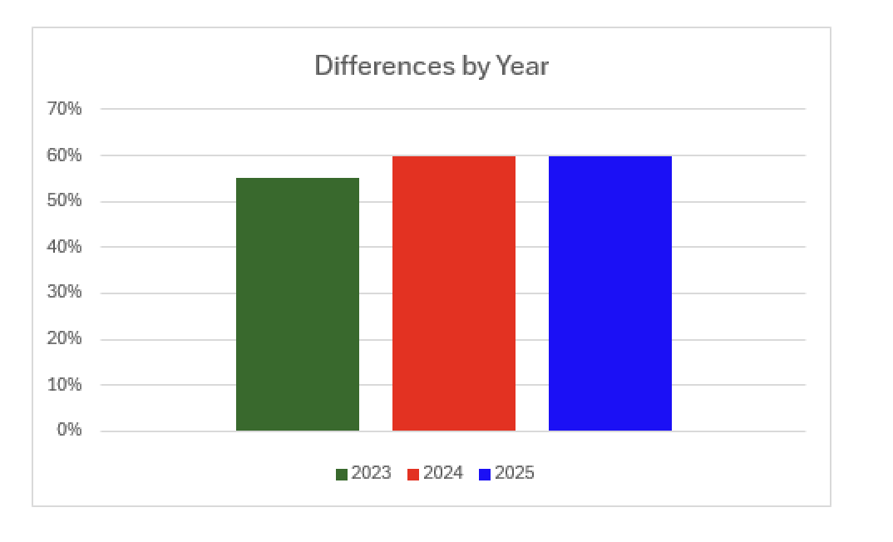
Year
Notes:
2023: 55%
2024 and 2025: 60%

Slide 6
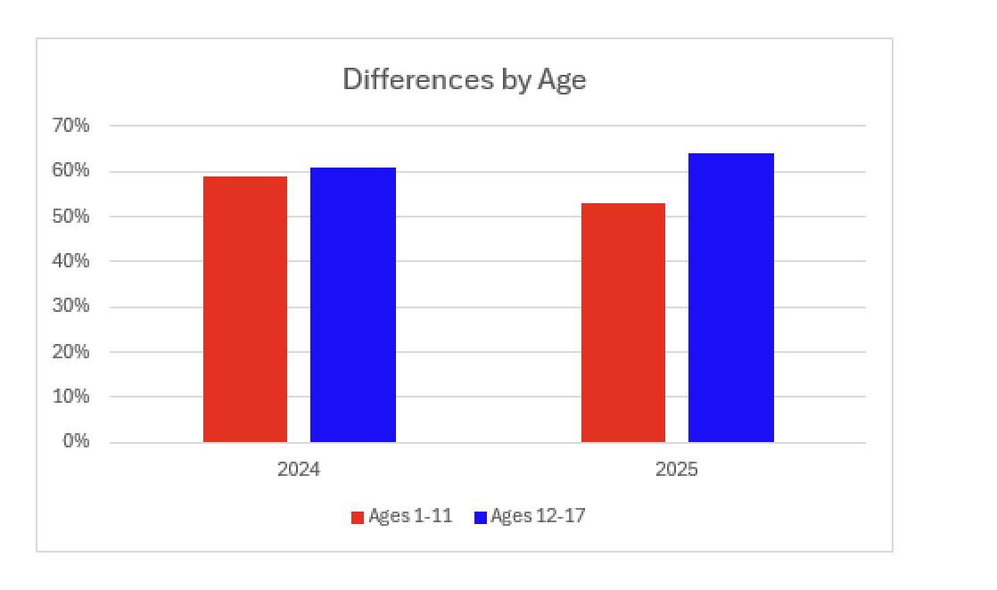
Age
Notes:
Ages 1-11: 59% (2024) and 53% (2025)
Ages 12-17: 61 (2024) and 64(2025)

Slide 7
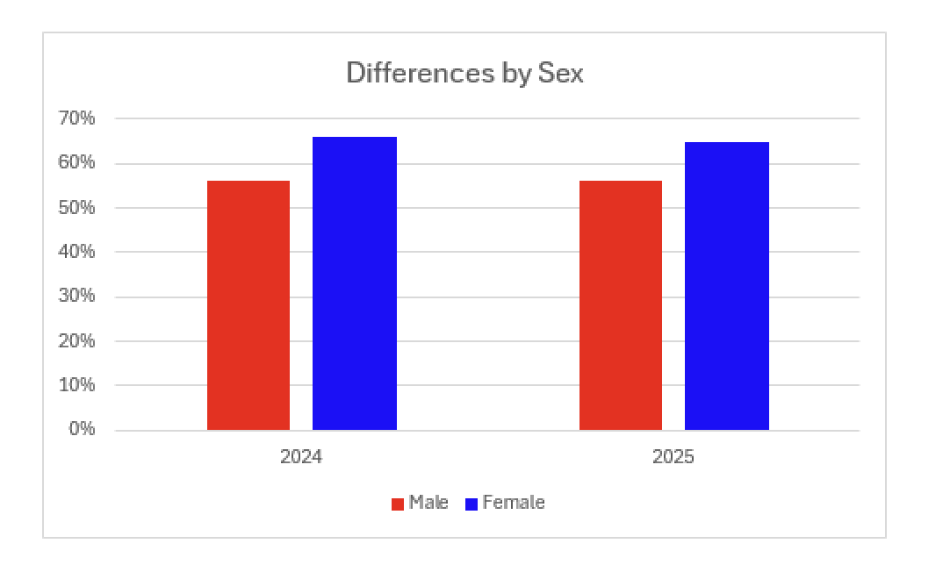
Sex
Notes:
Female had 10% higher documentation
Generally stable over both years

Slide 8
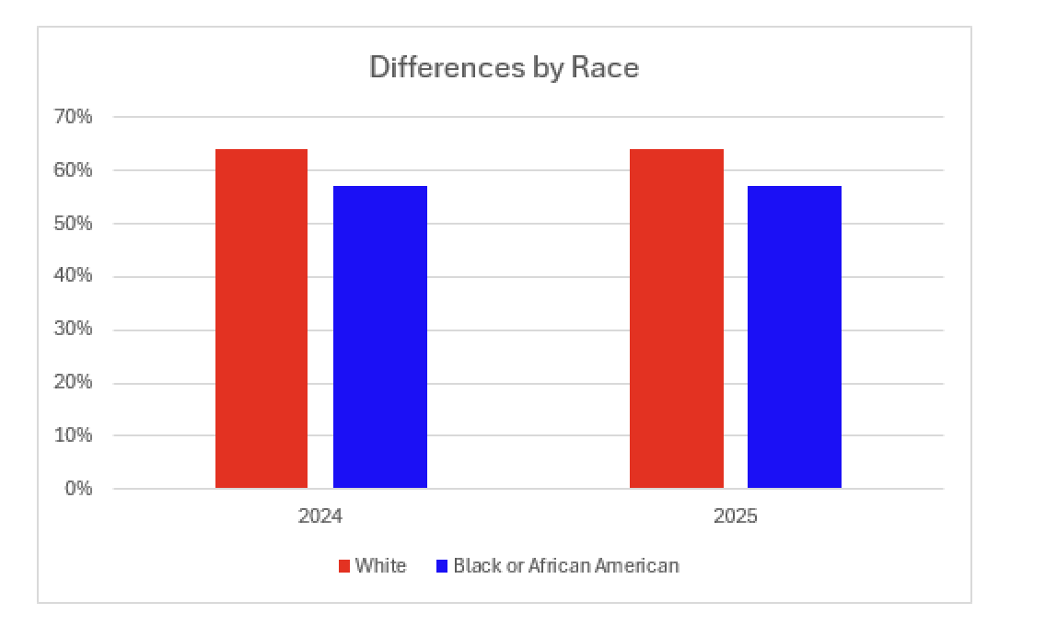
Race
Notes:
Several other races (American indian, Native hawaiian/Pacific islander, multiple races/unknown race) were included in the data however made up such a small proportion of the cohort that did not analyze the data
White: 64%
Black 57%

Slide 9
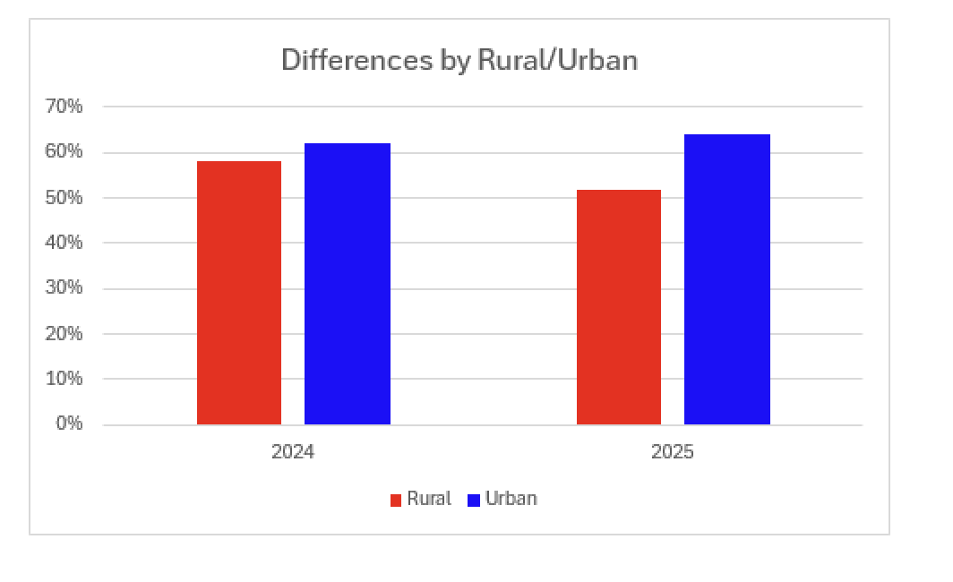
Rural/Urban
Notes:
Rural: 58 and 52
Urban: 62 and 64
Consistent

Slide 10
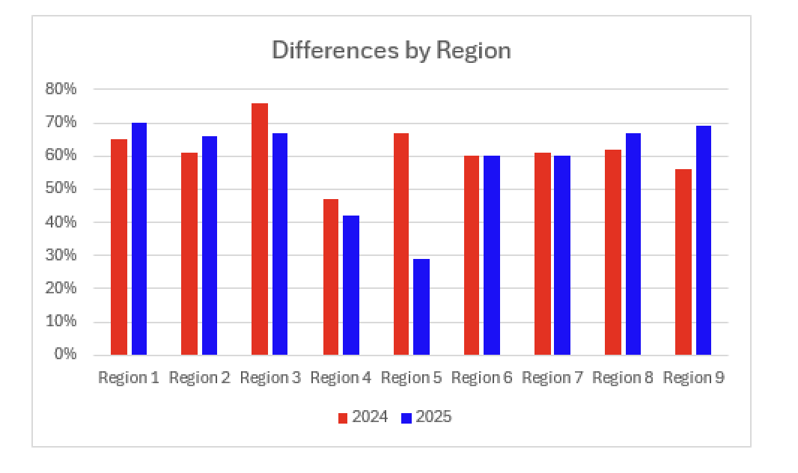
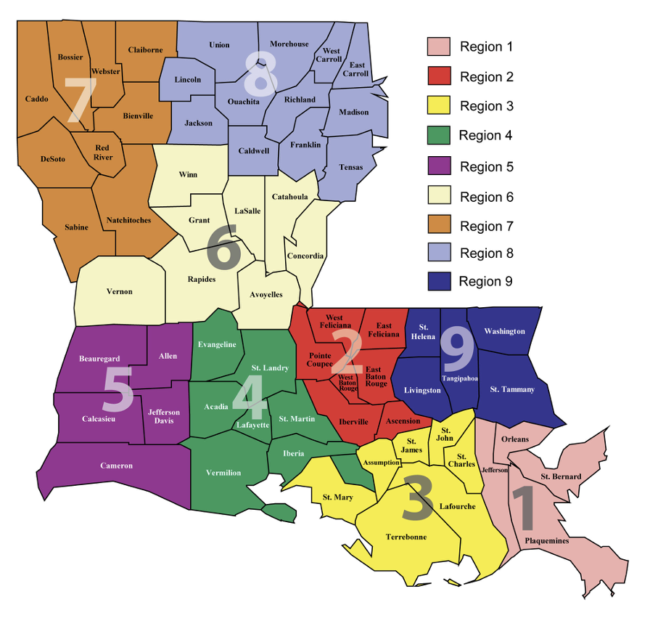
Region
Notes:
Region 3: 2024 has 76%--> Regions 1 and 5 high too
Region 5 with larger decrease in 2025***
Region 4 with lowest in general (47 then 42)

Slide 11
Key Points
Females had higher percentage of documentation of psychosocial as first-line treatment than males
White race had higher percentage of documented psychosocial therapy compared to Black or African American race
Higher percentage of psychosocial therapy as first-line treatment in 2024 and 2025 compared to 2023
Ages 1-11 had lower percentage of psychosocial therapy compared to ages 12-17
Urban areas had higher percentage of documented psychosocial therapy in comparison to rural areas
*Despite these findings, overall there are not large differences in comparison between the groups

Slide 12
Moving Forward
Identifying these specific groups and regions that are not receiving adequate first-line treatment of psychosocial therapy is important in order to create targeted management and population access to help close the gaps
ACLA posted a Provider Alert in October 2025 addressing this topic and providing recommendations to emphasize the importance of implementing psychosocial therapy as first-line treatment, when indicated, in children and adolescents prior to starting antipsychotics
Additionally, ACLA is in the process of creating a postcard on measuring and resources that can assist providers with scheduling counseling and treatment options
Further assessment should be done to uncover the reasoning that psychosocial therapy is not overall being used as first-line treatment in those with new antipsychotic prescriptions
It would be beneficial to collect and analyze newer data after the implementation of the ACLAs strategies to assess how these actions have affected patients and potentially further identify discrepancies between different groups

Slide 13
Sources
Correll, Christoph U. “Antipsychotic Use in Children and Adolescents: Minimizing Adverse Effects to Maximize Outcomes.” Focus, vol. 6, no. 3, 2008, pp. 368–382. American Psychiatric Association Publishing, https://doi.org/10.1176/foc.6.3.foc368
Finnerty, Molly, et al. “Access to Psychosocial Services Prior to Starting Antipsychotic Treatment Among Medicaid-Insured Youth.” PubMed, National Library of Medicine, 2016, https://pubmed.ncbi.nlm.nih.gov/26703912/
Miller, Caroline. “Children and Antipsychotic Medications.” Child Mind Institute, 24 June 2024, https://childmind.org/article/children-and-antipsychotic-medications-child-mind-institute/

