Slide 1
Reviewing relationships between hypertension and lipid levels
Schumann Chang, MS4
LSUHSC New Orleans School of Medicine

Slide 2
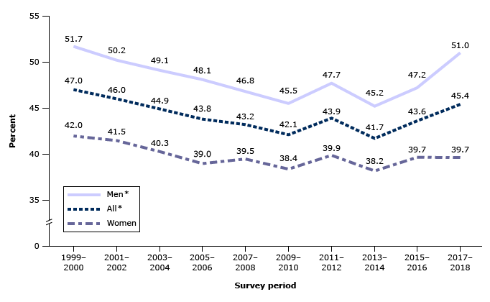
Background & Prevalence
Hypertension is a major risk factor for heart disease and stroke.
In the United States, the prevalence of hуреrtеnѕiоn is higher among males, older adults, Black adults, those with obesity, chronic kidney disease, diabetes, and those living in rural areas [3-9,12,13].
UpToDate, Connor RF (Ed), Wolters Kluwer.
Notes:
Burt VL, Whelton P, Roccella EJ, et al. Prevalence of hypertension in the US adult population. Results from the Third National Health and Nutrition Examination Survey, 1988-1991. Hypertension 1995; 25:305.
Hajjar I, Kotchen TA. Trends in prevalence, awareness, treatment, and control of hypertension in the United States, 1988-2000. JAMA 2003; 290:199.
Egan BM, Zhao Y, Axon RN. US trends in prevalence, awareness, treatment, and control of hypertension, 1988-2008. JAMA 2010; 303:2043.
Centers for Disease Control and Prevention (CDC). Vital signs: prevalence, treatment, and control of hypertension--United States, 1999-2002 and 2005-2008. MMWR Morb Mortal Wkly Rep 2011; 60:103.
Yoon SS, Carroll MD, Fryar CD. Hypertension Prevalence and Control Among Adults: United States, 2011-2014. NCHS Data Brief 2015; :1.
Egan BM, Li J, Hutchison FN, Ferdinand KC. Hypertension in the United States, 1999 to 2012: progress toward Healthy People 2020 goals. Circulation 2014; 130:1692.
Fryar CD, Ostchega Y, Hales CM, et al. Hypertension Prevalence and Control Among Adults: United States, 2015-2016. NCHS Data Brief 2017; :1.
Hypertension Prevalence Among Adults Aged 18 and Over: (Accessed on September 24, 2020).
Muntner P, Hardy ST, Fine LJ, et al. Trends in Blood Pressure Control Among US Adults With Hypertension, 1999-2000 to 2017-2018. JAMA 2020; 324:1190.
Ostchega Y, Fryar CD, Nwankwo T, Nguyen DT. Hypertension Prevalence Among Adults Aged 18 and Over: United States, 2017-2018. NCHS Data Brief 2020; :1.
Samanic CM, Barbour KE, Liu Y, et al. Prevalence of Self-Reported Hypertension and Antihypertensive Medication Use by County and Rural-Urban Classification - United States, 2017. MMWR Morb Mortal Wkly Rep 2020; 69:533.

Slide 3
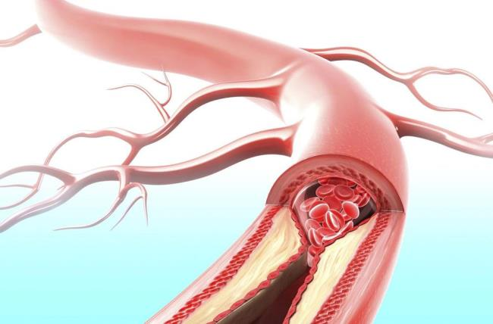
Lipids in Cardiovascular Health
Lipids, particularly, low-density lipoprotein (LDL) cholesterol has a big role in cardiovascular health
Elevated LDL cholesterol is a primary contributor to the development of atherosclerosis. LDL-c is the primary component that leads to the buildup of fatty deposits within the arterial walls, causing Atherosclerotic Cardiovascular Disease (ASCVD)
The cumulative exposure hypothesis posits that the risk of ASCVD is directly related to both the magnitude and duration of LDL exposure. This means that maintaining low LDL-C levels over time can significantly reduce the risk of cardiovascular events by slowing the progression of atherosclerosis and delaying the development of mature atherosclerotic plaques.
Notes:
Ference BA, Braunwald E, Catapano AL. The LDL cumulative exposure hypothesis: evidence and practical applications. Nat Rev Cardiol. 2024 Oct;21(10):701-716. doi: 10.1038/s41569-024-01039-5. Epub 2024 Jul 5. PMID: 38969749.
https://www.pennmedicine.org/for-patients-and-visitors/patient-information/conditions-treated-a-to-z/atherosclerosis

Slide 4
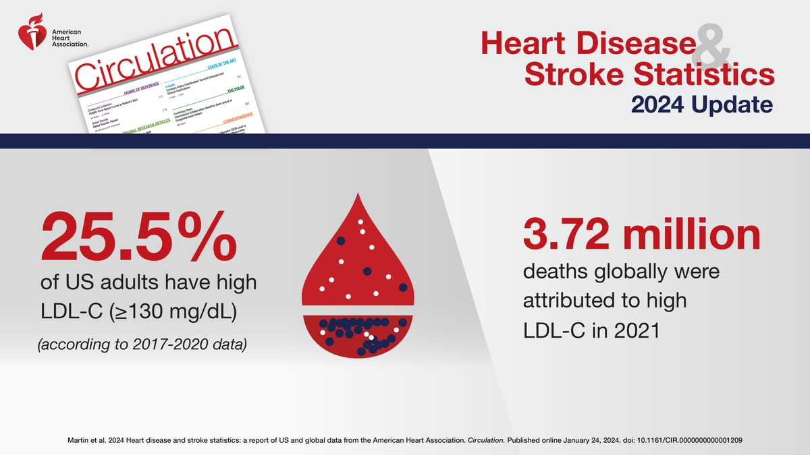
Notes:
Martin et. al. 2024 Heart disease and stroke statistics: a report of U.S. and global data from the American Heart Association. Circulation. Published online January 24, 2024. doi: 10.1161/CIR.0000000000001209
copyright American Heart Association 2024

Slide 5


Meanwhile in Louisiana
In 2022, about 40% of adults in Louisiana reported being diagnosed with hypertension. This is about 8% higher than the national average of 32%.
On American’s Health Rankings:
Notes:
https://ldh.la.gov/assets/oph/Center-EH/drywall/Hypertension.pdf
https://www.americashealthrankings.org/explore/measures/High_Chol/LA

Slide 6
Diagnosis of Hypertension
ACC/AHA definition of hypertension includes individuals taking antihypertensive medication OR SBP ≥130 and/or DBP ≥80
Normal BP = SBP <120 and DBP <80
Stage 1: Systolic 130 to 139 mmHg or diastolic 80 to 89 mmHg
Stage 2: Systolic at least 140 mmHg or diastolic at least 90 mmHg
Notes:
UpToDate, Connor RF (Ed), Wolters Kluwer.

Slide 7
Current ACLA initiatives
NEST Healthcare: offers in home visits, provider can treat the whole family. Good for patients who have children, work multiple jobs, lack of transportation
BP pocketguide for ACLA members: track bp, record prescription with nurse, also includes contraindications, precautions for medications
Make every calorie count program which provides support for patients with diabetes, obese, hypertension
this program now avail for every patient and offers free nutrition consult, referral to gym after 1 wellness visit and incentive payment to increase compliance for doing screenings at wellness visit

Slide 8
Population of interest
Members of the population turning 18-85 years of age who had a diagnosis of HTN within year 2023
Definition of compliance is BP adequately controlled (<140/90 mmHg)
What is the LDL levels of everyone within this population in association with other sub-groups?
Average LDL is 104
Notes:
Average LDL is 104

Slide 9
Compliance
Notes:
Compliant SD: 35.96 Non-compliant SD: 38.36

Slide 11
Women has higher average LDL compared to men
Standard deviation:
Male: 35.96
Female: 37.93

Slide 12
Urban lipid average greater than rural lipid average
Standard deviation:
Urban: 38.01
Rural: 34.22

Slide 13
Region 3 has highest LDL
Regions 1, 3, 9 are above average

Slide 14
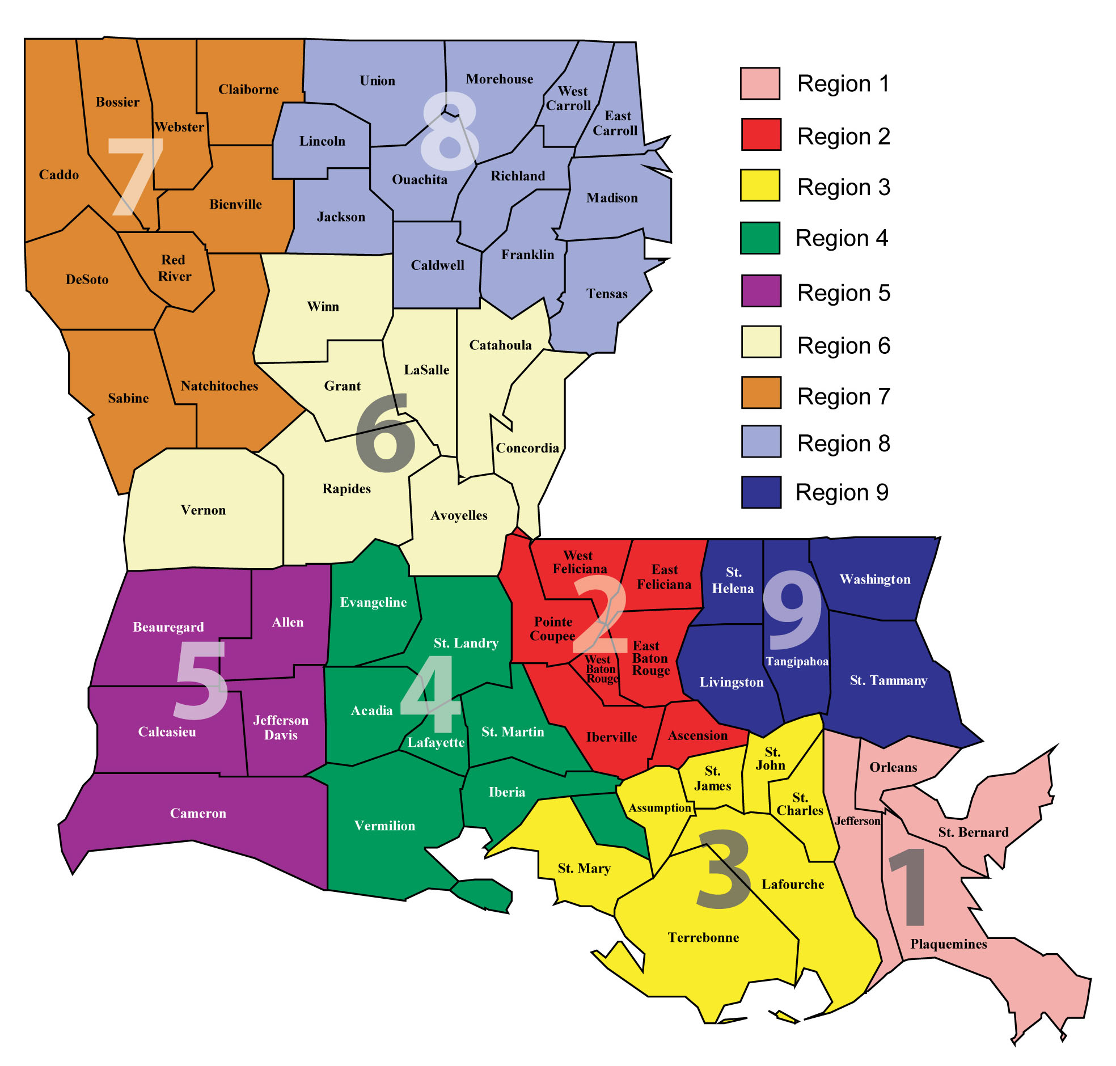
Notes:
https://ldh.la.gov/page/about-ldh

Slide 15
Obesity
Standard deviation
Obesity: 32.11
No obesity: 41.37

Slide 16
A1C is greater in patients who have hyperlipidemia
Standard deviation
No hyperlipidemia: 1.47
Hyperlipidemia: 1.58

Slide 17
Summary and Recommendations
It was interesting to see that 6% of hypertensive patients had a recorded LDL level
The ACC/AHA recommend that all adults, including those with hypertension, should have a fasting or non-fasting lipoprotein profile obtained at least every 5 years.[1]
Additionally, if therapy is initiated, the National Lipid Association (NLA) advises that lipid levels should be reassessed 6 weeks and again at 6-week intervals until the treatment goal. Then individuals should be tested at 6- to 12-month intervals
Notes:
1.2018 AHA/­ACC/­AACVPR/­AAPA/­ABC/­ACPM/­ADA/­AGS/­APhA/­ASPC/­NLA/­PCNA Guideline on the Management of Blood Cholesterol: A Report of the American College of Cardiology/­American Heart Association Task Force on Clinical Practice Guidelines.Grundy SM, Stone NJ, Bailey AL, et al.
Journal of the American College of Cardiology. 2019;73(24):e285-e350. doi:10.1016/j.jacc.2018.11.003.
2.National Lipid Association Annual Summary of Clinical Lipidology 2015.Bays HE, Jones PH, Brown WV, Jacobson TA.
Journal of Clinical Lipidology. 2014 Nov-Dec;8(6 Suppl):S1-36. doi:10.1016/j.jacl.2014.10.002.

Slide 18
More Summary
Lower lipid levels in compliant compared to non-compliant patients
women overall are more compliant but they have higher lipid levels.
Strongly correlated with obesity.
Higher lipids in urban, region 3 has highest with regions 1, 3, 6, 9 are above average
Patients with Hyperlipidemia also had a higher A1C average

Slide 19
Acknowledgement and thanks
Thank you Dr. Randolph, Ms. Dana Smith, Renee Wells, and Shea Good for their help with providing the data for this project
‌ACLA Clinical Quality Improvement Activity
ACLA Data

