Slide 1

Improving HIV Viral Load Suppression rates for AmeriHealth Caritas Louisiana Members
Holly Mayeux
LSU Health Sciences Center, New Orleans
School of Medicine Class of 2025
AmeriHealth Caritas Louisiana Medical Intern
March 5th 2025

Slide 2
Brief HIV Primer
Human Immunodeficiency Virus (HIV) attacks the body’s immune system, specifically CD4 T-Cells
HIV is transmitted primarily through contact with blood, unprotected sexual contact, and breast milk.
AIDS or Acquired Immunodeficiency Syndrome, is the latest and most severe stage of an HIV infection.
AIDS is marked by a CD4 T-Cell count of less than 200 cells/mm^3, or by the acquisition of certain opportunistic AIDS defining illnesses regardless of CD4 T-Cell count.
Without treatment most HIV patients will develop AIDS within 8-10 years
Undetectable = Untransmittable. HIV viral load suppression prevents transmission and allows patients an increased quality of life.

Slide 3
Background
HIV, particularly untreated HIV, was and is a deadly illness that affects anywhere from 36.1 to 44.6 million people worldwide.
HIV is now a treatable illness, with appropriate viral suppression allowing patients to live long and healthy lives comparable to their uninfected peers.
Treatment of HIV at the population level is crucial both to prevent transmission of the virus and to promote the health of our communities.
Early HIV treatment and subsequent viral suppression are both morally and financially incentivized, as both the human and financial costs of AIDS sequelae treatment are immense.
As of September 30, 2024, a total of 23,444 people were living with HIV (PLWH) in Louisiana; of these individuals, 11,017 people (47%) have an AIDS diagnosis.

Slide 4
Healthy Louisiana Medicaid Managed Care Program Performance Measures
Aim | Goal | Objective | Healthy Louisiana Measure | Measure Description | Incentive Based?
Healthier people, Healthier communities. Improve the health of Louisianians through evidence-based treatment and prevention strategies that address all barriers to healthcare | To address population health inequities and to delve further into the contributing factors to HIV viral load non-suppression | To improve HIV viral suppression in the population by gathering a deeper understanding of the underlying barriers to healthcare patients might face. | HIV Viral Load Suppression | Increase HIV Viral Load Suppression to the 2025 goal of 85.13% Compliant population: The percentage of members 18 or older with a diagnosis of HIV who had a viral load of less than 200copies/ml at the last HIV viral load test during the measurement year. Total population: Members 18 and up with HIV diagnosis | Yes, but NonHEDIS

Slide 5
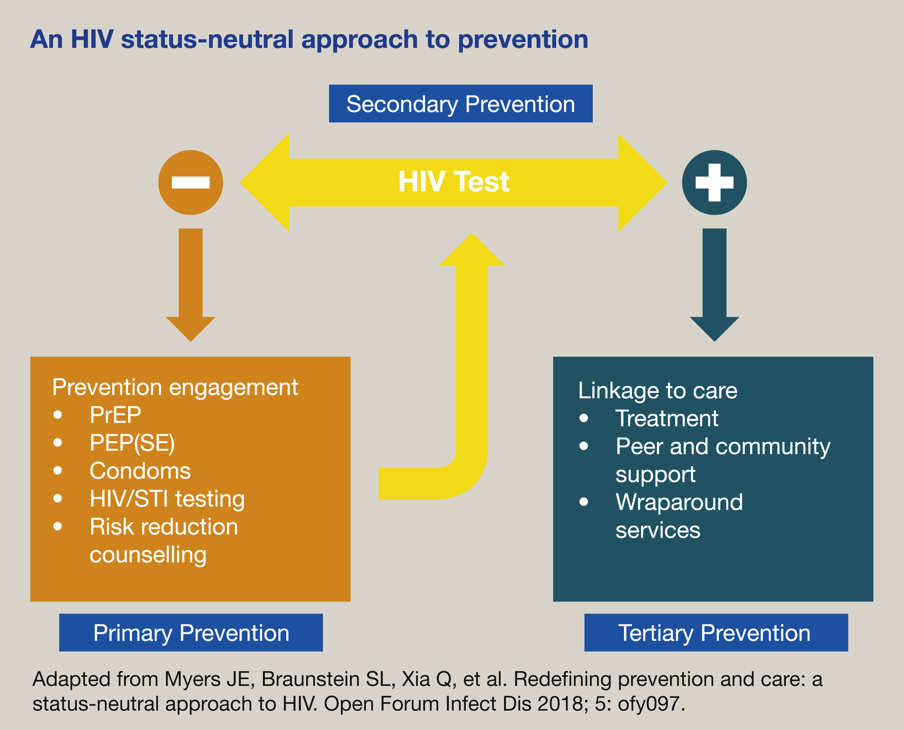
Current strategies for infection control
It is important to focus mostly on Tertiary Prevention, as our goal is to decrease the number of HIV positive people with an HIV Viral Load of greater than 200 copies/ml
This requires a better understanding of the population living with HIV and better linkage to care and community support.
Many of the measures ACLA already has in place do an excellent job of outreach to encourage follow-up.

Slide 6
Understanding the Population A cross- sectional look

Slide 7
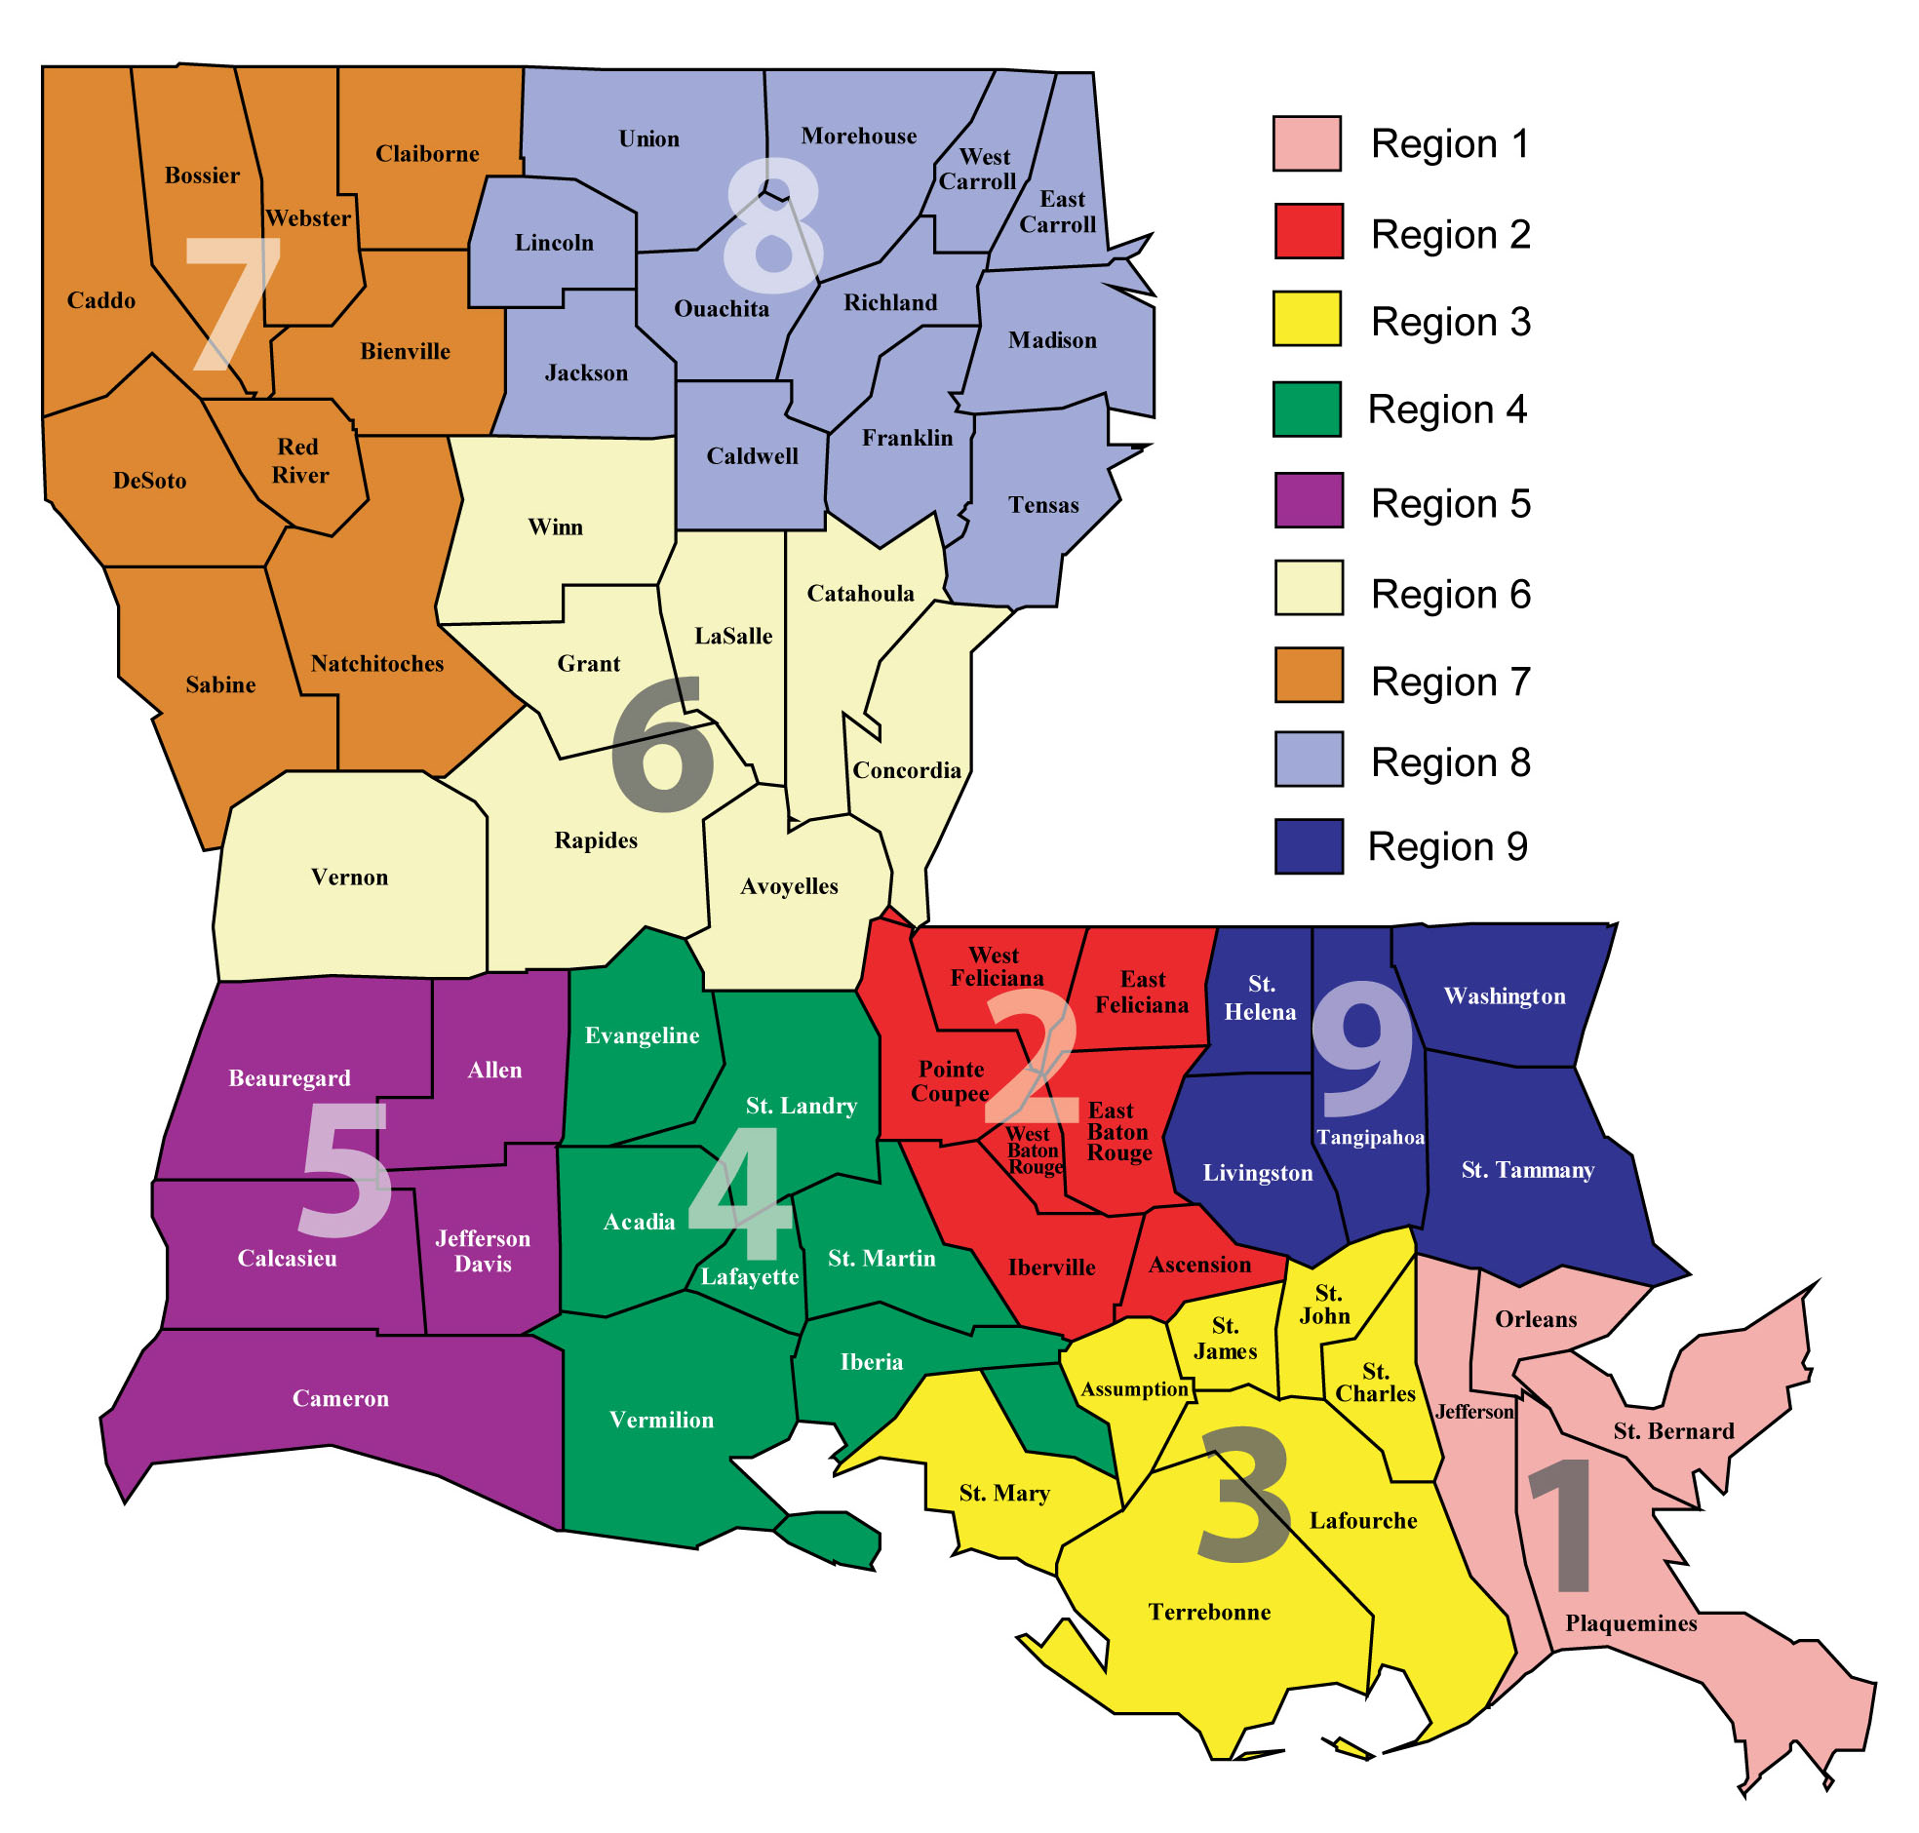
Region Level Data 2023
 | Suppressed | Percentage Suppressed | Unsuppressed | Percentage Unsuppressed | Unknown | Percentage Unknown
Region 1 | 244 | 67.40% | 40 | 11.05% | 78 | 21.55%
Region 2 | 128 | 77.58% | 24 | 14.55% | 13 | 7.88%
Region 3 | 36 | 66.67% | 5 | 9.26% | 13 | 24.07%
Region 4 | 58 | 77.33% | 8 | 10.67% | 9 | 12.00%
Region 5 | 24 | 61.54% | 6 | 15.38% | 9 | 23.08%
Region 6 | 43 | 72.88% | 8 | 13.56% | 8 | 13.56%
Region 7 | 84 | 58.74% | 24 | 16.78% | 35 | 24.48%
Region 8 | 39 | 61.90% | 8 | 12.70% | 16 | 25.40%
Region 9 | 46 | 79.31% | 5 | 8.62% | 7 | 12.07%
Unknown | 17 | 54.84% | 4 | 12.90% | 10 | 32.26%

Slide 8
Region Level Data 2024
 | Suppressed | Percentage Suppressed | Unsuppressed | Percentage Unsuppressed | Unknown | Percentage Unknown
Region 1 | 275 | 74.32% | 38 | 10.27% | 57 | 15.41%
Region 2 | 135 | 80.84% | 22 | 13.17% | 10 | 5.99%
Region 3 | 38 | 65.52% | 14 | 24.14% | 6 | 10.34%
Region 4 | 64 | 82.05% | 9 | 11.54% | 5 | 6.41%
Region 5 | 29 | 74.36% | 4 | 10.26% | 6 | 15.38%
Region 6 | 46 | 79.31% | 5 | 8.62% | 7 | 12.07%
Region 7 | 102 | 67.11% | 35 | 23.03% | 15 | 9.87%
Region 8 | 45 | 67.16% | 11 | 16.42% | 11 | 16.42%
Region 9 | 51 | 85.00% | 7 | 11.67% | 2 | 3.33%
Unknown | 17 | 56.67% | 4 | 13.33% | 9 | 30.00%

Slide 9
Region Level Data Trends

Slide 10
How does the number of provider visits effect suppression?
It is worth noting that none of these differences are statistically significant. All P-values were above an alpha of 0.05

Slide 11
How does housing status effect suppression?
Only about 20.4% of members answered the questionnaire, of those members the vast majority were well suppressed.
I looked, and there was no correlation with provider visit numbers either.
It may be good to do targeted outreach to the patients in the bottom 3 categories.
Suppressed + Unknown | 627 | 65.93%
Unsuppressed + Unknown | 130 | 13.67%
Suppressed + Stable | 148 | 15.56%
Unsuppressed + Stable | 15 | 1.58%
Suppressed + Vulnerable | 24 | 2.52%
Unsuppressed + Vulnerable | 3 | 0.32%
Suppressed + Crisis | 3 | 0.32%
Unsuppressed + Crisis | 1 | 0.11%

Slide 12
Data Summary
Population
  Suppressed patients went from 68% to 74% from 2023 to 2024
  Excluding unknowns Suppressed patients went from 85% to 84%
  The target for 2025 is 85.13%, the target for 2024 was met
Visit Frequency
  Visit frequency had no correlation to HIV viral load suppression across all categories including primary care, behavioral health, infectious disease, or combined.
  This may suggest that visit frequency should not be an improvement goal to reach the 2025 target
Substance use
  Substance use may affect HIV viral load suppression and visit frequency, but there was not enough quality data to make good conclusions.
  On one hand, however, very few of the HIV positive patients (~15) have ever been diagnosed with a substance use disorder of any kind.
Region
  Region 1, 7, and 2 & 8 showed the most improvement from 2023
  Region 9 is doing excellent in 2024, and may be good to model from
Housing
  Only 20% of members answered their questionnaire
  It may be good to do targeted outreach to the members in vulnerable and crisis categories regardless of suppression status

Slide 13
What are we doing about it?
ACLA has a case management team that reaches to all noncompliant members by phone for reminders and refills.
ACLA has a Community Health Navigators team that goes out into the field to try to find noncompliant members who cannot be reached by phone or other means.
ACLA has team members that fax providers information for patients who are non-adherent with medication refills.
ACLA sends letters to all noncompliant members. These letters have a QR code members can scan. 12/127 members scanned code last year.
ACLA sends text messages that go out to members non-adherent with medication refills
Last year ACLA did targeted outreach to Caddo, Orleans, and East Baton Rouge parishes, as they were noted to have the largest number of unsuppressed and unknown patients.
ACLA attempted to get a member incentive for getting viral load lab work done and for refilling medications but it did not get approved

Slide 14
References
Louisiana Dept Health HIV and Syphilis quarterly report https://ldh.la.gov/assets/oph/HIVSTD/HIV_Syphilis_Quarterly_Reports/Third-Quarter-2024-HIV-and-Syphilis-Report.pdf
CDC HIV fact sheet https://hivinfo.nih.gov/understanding-hiv/fact-sheets
Riddell J, Amico KR, Mayer KH. HIV Preexposure Prophylaxis: A Review. JAMA. 2018 Mar 27;319(12):1261-1268. [PubMed]
Engler K, Lènàrt A, Lessard D, Toupin I, Lebouché B. Barriers to antiretroviral therapy adherence in developed countries: a qualitative synthesis to develop a conceptual framework for a new patient-reported outcome measure. AIDS Care. 2018 Jan-Dec;30(sup1):17-28. [PubMed]
Myers JE, Braunstein SL, Xia Q, Scanlin K, Edelstein Z, Harriman G, Tsoi B, Andaluz A, Yu E, Daskalakis D. Redefining Prevention and Care: A Status-Neutral Approach to HIV. Open Forum Infect Dis. 2018 May 2;5(6):ofy097. doi: 10.1093/ofid/ofy097. PMID: 29977957; PMCID: PMC6016418.

Slide 15
Thank you!
Special thanks to:
Dr. Gregory Randolph, Dana Smith, Renee Wells, Carrie Blade, Lekitha Gregory, Rhona Baird, Jennifer Manuel, Shea Good
and anyone else who helped on this project that I may have forgotten.

