Slide 1

FOLLOW UP AFTER MENTAL ILLNESS ADMISSION
Yasmin Hammad
LSU Medical student
AmeriHealth Intern

Slide 2
Current Research on Follow-Up
A JAMA published research article in 2023 “Follow-Up Timing After Discharge and Suicide Risk Among Patients Hospitalized With Psychiatric Illness” notes that in this cohort study of patients with psychiatric illness, early follow-up outpatient care after discharge was associated with a lower risk of suicide.
A quick pubmed search was conducted to look for affect on readmission rates, while I did find some other studies, most were small and there isnt much consistent research on the topic

Slide 3
Despite this or maybe because of this
There are no CDC community guidelines or USPSTF recommendations addressing follow-up after mental health hospitalization

Slide 4
ACLA Barriers and Interventions
Barriers
Limited provider of awareness of members recent inpatient or Ed discharge.
Limited ADT / health information exchange for BH hospitals
member access to accessible aftercare appointments after discharge.
Dual diagnosis population
Homeless/ housing instability population.
Care coordination between medical and BH physicians.
Member knowledge of appointment necessity and health benefits to attending appointments
Interventions
  Enhance hospital to MCO workflow for notification of hospital emergency department admissions discharges and transfers
  Link members to aftercare with BH providers prior to discharge from hospital or ED
  Identify and address needs of subpopulation by stratifying data by member race/ethnicity, member region of residence, high-utilizers, SMI diagnosis, co-occurings disorders, age and if available LGBTQ
  Initiate broader interventions to facilitate follow up with members with an appropriate mental health provider e.g text messaging, letter to member and members PCP with list of follow up providers in members location.
  Assistance with care coordination services when BH member chooses to ‘opt out’ of participating in care management program.
  For offer provider incentives for members discharged who complete 30 day follow up appointments with the appropriate provider type
  offer member reward for FUM members discharged from emergency departments who complete 30 day follow up appointments with appropriate provider type
  pilot program with a high volume hospital to offer an outpatient/ telehealth bridge follow up follow up appointments in patient discharge.
  Partner with vendor to assist with additional outreaching of transition of care members in the FUH population.
  Utilize BH CM staff who hold licensure as LMHP to outreach members in the FH population to conduct a post discharge follow up assessment to close gaps internally

Slide 5
What are we studying?
The percentage of discharges after hospitalization for mental illness that receive follow-up within 30 days
The population:
  Members 6+ years of age on the date of discharge with a selected diagnosis of mental illness or intentional self-harm within the calendar year.

Slide 6
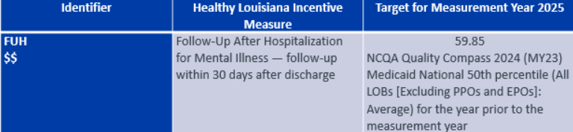
ACLA GOALS

Slide 7
Data showed …
Year | 30 day follow-up | 7 day follow up
2024 | 39% | 16%
2023 | 37% | 20%

Slide 8
Percent follow-up breakdown by race- 2023
 | 30 DAY | 7 DAY
WHITE | 38% | 20%
BLACK | 36% | 18%
AMERICAN NATIVE/ ALASKAN NATIVE | 43%* | 24%
ASIAN | 58%* | 42%
TWO OR MORE | 45%* | 17%
UNKNOWN | 28% | 17%
* = sample size less than 50
Notes:
Population size was less than 50 for astriks

Slide 9
Percent Follow-up by Race 2024
Race | 30 day | 7 day
White | 41% | 20%
Black or African America | 37% | 16%
American Native/ Alaskan Native | 56%* | 35%
Asian | 50%* | 33%
Two or More | 43%* | 15%
Unknown | 31% | 16%
* = sample size less than 50

Slide 10
Percent Follow-Up by Region 2023
Region | 30 day | 7 day
Region 1 | 32% | 16%
Region 2 | 41% | 25%
Region 3 | 47% | 21%
Region 4 | 37% | 17%
Region 5 | 35% | 21%
Region 6 | 46% | 22%
Region 7 | 35% | 20%
Region 8 | 32% | 18%
Region 9 | 38% | 17%

Slide 11
Percent Follow-up by Region 2024
Region | 30 day | 7 day
Region 1 | 32% | 14%
Region 2 | 42% | 18%
Region 3 | 50% | 21%
Region 4 | 42%* | 23%
Region 5 | 42%* | 21%
Region 6 | 42% | 23%
Region 7 | 37% | 16%
Region 8 | 33% | 17%
Region 9 | 44%* | 23%
Notes:
Asriks- increase in follow-up
Highlight consistently high- recommend seeing what is different here and implementing it across other regions

Slide 12
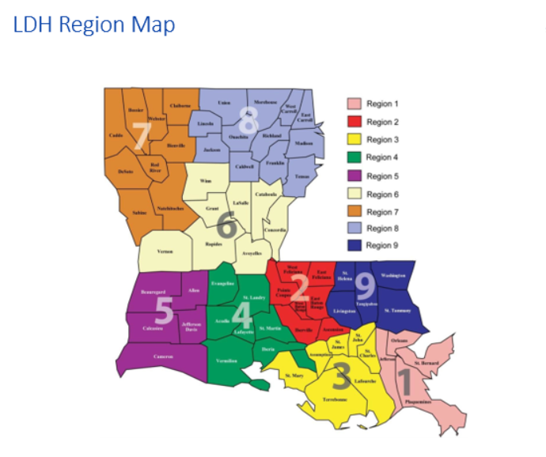

Slide 13
Housing status
2024
Housing status | 30 day | 7 day
Stable(N=771) | 49% | 24%
Vulnerable + Crisis (N=161) | 52% | 17%
2023
Housing status | 30 day | 7 day
Stable (N=891) | 41% | 31%
Vulnerable + Crisis (N=175) | 41% | 20%

Slide 14
Summery
In 2023 there was not much difference between black/ AA and white population follow-up rates, however in 2024 white population had an increase in follow-up
Regions 3 and 6 had consistently higher follow-up rates than other regions in 2023 and 2024. Region 1 was consistently the lowest across both years, region 8 was consistently low
There was not much difference in follow-up rates in stable vs unstable housing patients, however, the population size for the unhoused was significantly lower, and response rate to this was low in general

Slide 15
Recommendations based on data
Increased reporting on homeless/unhoused population to provide more accurate data
Study Region 3 and 6 population ( racial distribution, urban vs rural, access to BH follow-up, home stability/ access) and recognize the difference and what can be implemented in other regions
Consider more interventions in regions 1 and 8 and study of the population in the region to understand why follow-up rate was lower
Follow the difference between the black/AA community and white community (coincidence or more outreach to white communities)
Continue current interventions.

Slide 16
Sources
Che SE, Gwon YG, Kim K. Follow-Up Timing After Discharge and Suicide Risk Among Patients Hospitalized With Psychiatric Illness. JAMA Netw Open. 2023;6(10):e2336767. doi:10.1001/jamanetworkopen.2023.36767
The Guide to Community Preventive Services (The Community Guide)
Home page | United States Preventive Services Taskforce

