Slide 1
Colon and Rectal Cancer in Louisiana: Incidence, Mortality, Screening, and the Role of Primary Care Physicians
Rutger Fury, MS4
LSU School of Medicine – New Orleans
2/7/2025

Slide 2
Disclosure
I have applied to Family Medicine residency and have an interest in training in endoscopy.

Slide 3
Background Information
Colorectal cancer (CRC) is the 2nd leading cause of cancer-related death in the United States.
Louisiana has the 6th highest CRC mortality rate in the United States.
CRCs are the 4th most common types of cancer in Louisiana, with 2,419 cases diagnosed annually (on average).
On average, 861 people in Louisiana die from CRC annually.

Slide 4
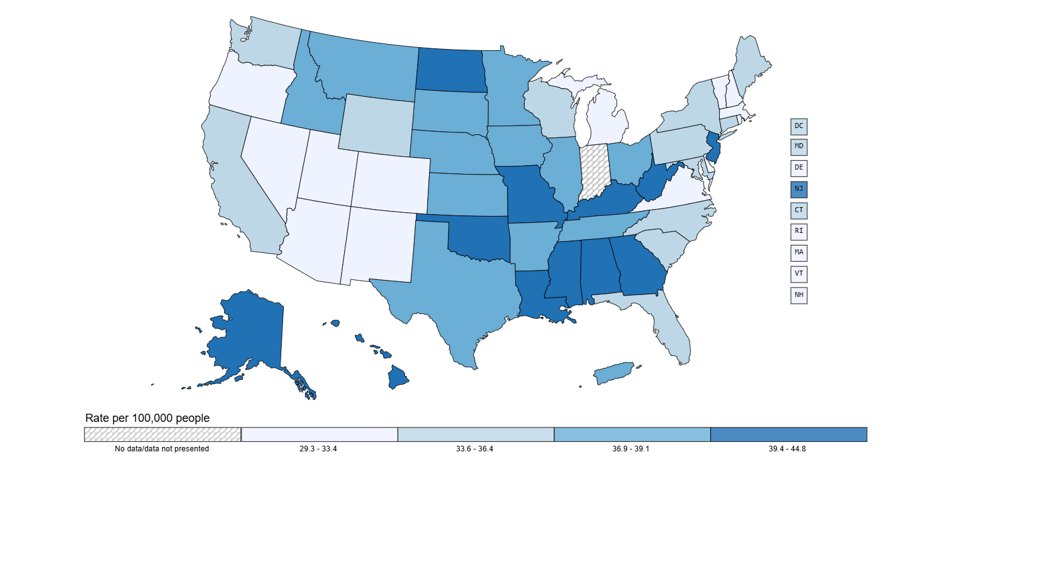
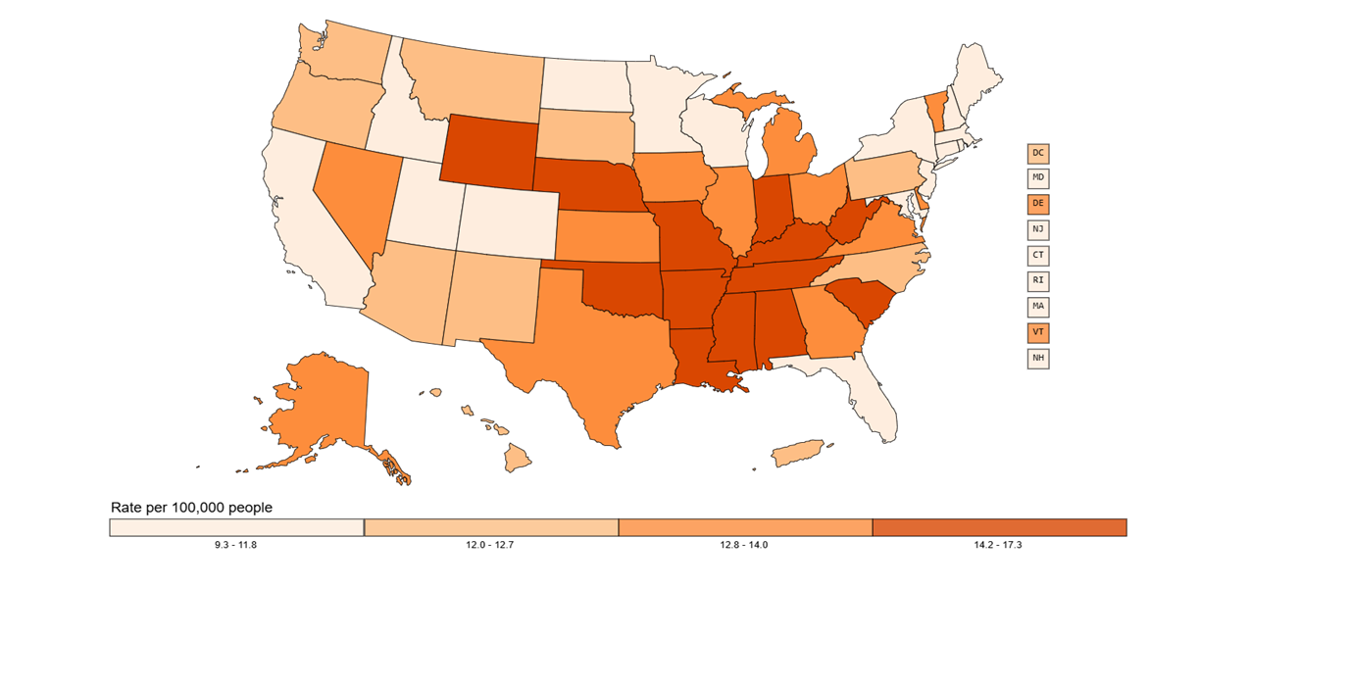
Colon and Rectum Cancer Rates and Deaths in the United States
Rate of New Cancers in the United States, 2021
Colon and Rectum, All Ages, All Races and Ethnicities, Male and Female
Rate of Cancer Deaths in the United States, 2022
Colon and Rectum, All Ages, All Races and Ethnicities, Male and Female
Source - U.S. Cancer Statistics Working Group. U.S. Cancer Statistics Data Visualizations Tool. U.S. Department of Health and Human Services, Centers for Disease Control and Prevention and National Cancer Institute; https://www.cdc.gov/cancer/dataviz, released in June 2024.
Source - U.S. Cancer Statistics Working Group. U.S. Cancer Statistics Data Visualizations Tool. U.S. Department of Health and Human Services, Centers for Disease Control and Prevention and National Cancer Institute; https://www.cdc.gov/cancer/dataviz, released in June 2024.

Slide 5
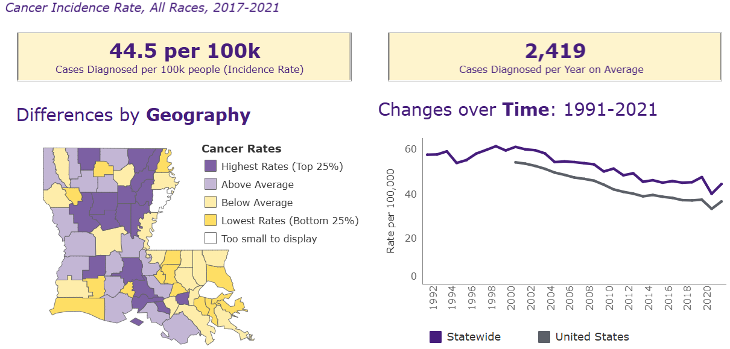
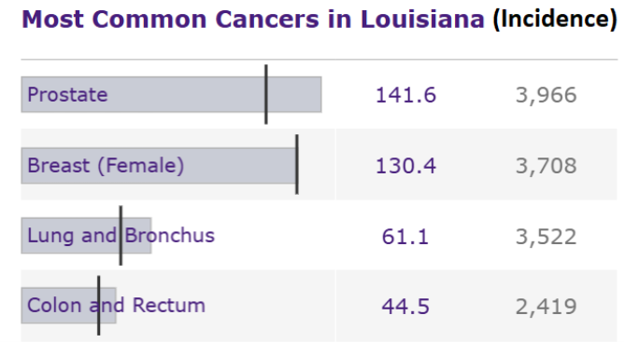
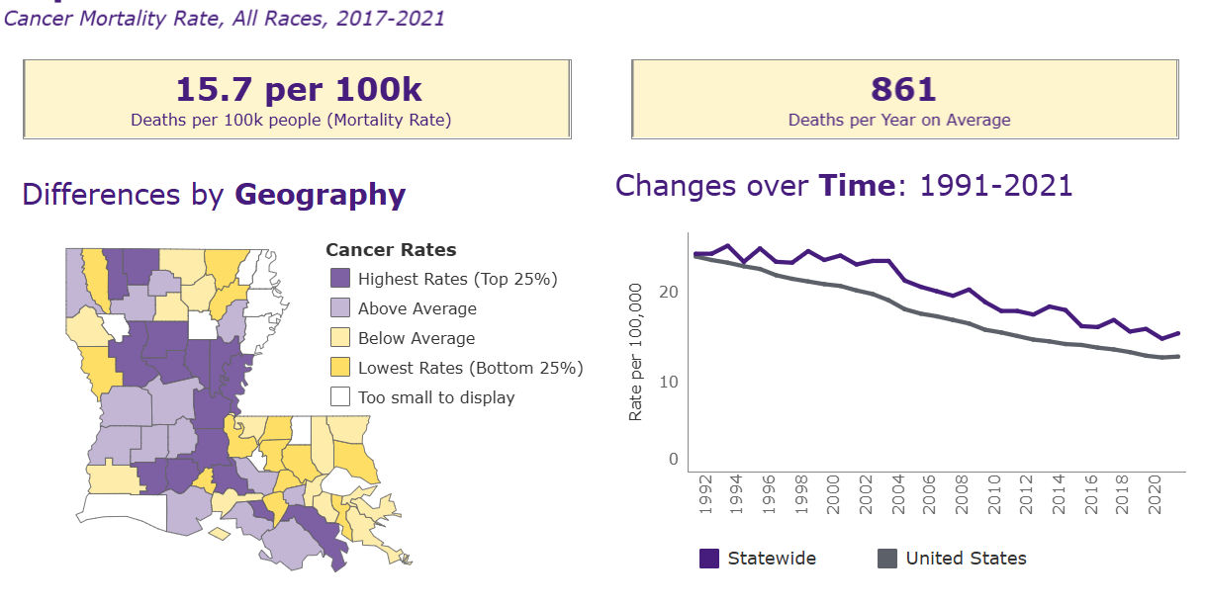
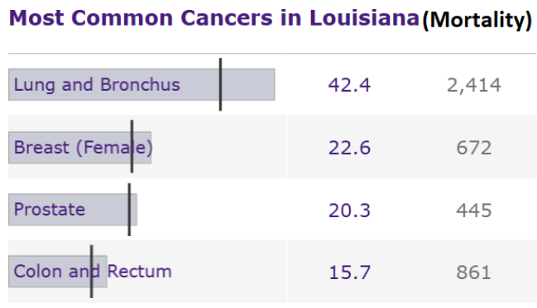
Colorectal Cancer in Louisiana: Incidence and Mortality (LSU Tumor Board Registry Data)
Louisiana Cancer Data Visualization, based on November 2023 submission data (2017-2021): Louisiana Tumor Registry; https://sph.lsuhsc.edu/louisiana-tumor-registry/data-usestatistics/louisiana-cancer-data-visualization-dashboard, December 2024.

Slide 6
Colorectal Cancer in Louisiana – Continued (LSU Tumor Board Registry Data)
Louisiana Cancer Data Visualization, based on November 2023 submission data (2017-2021): Louisiana Tumor Registry; https://sph.lsuhsc.edu/louisiana-tumor-registry/data-usestatistics/louisiana-cancer-data-visualization-dashboard, December 2024.

Slide 7
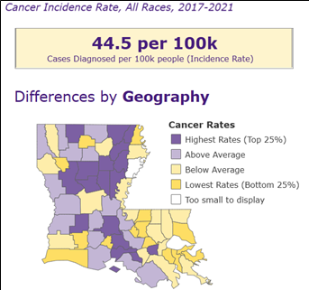
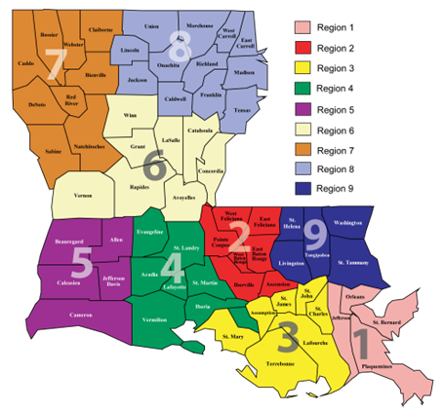
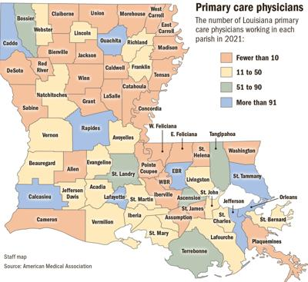
Colorectal Cancer in Louisiana & Primary Care Physicians
Data from State of Louisiana Board of Medical Examiners, 2023
https://www.nola.com/entertainment_life/louisiana_health/louisiana-health-primary-care-doctors/article_40ac3512-7510-11ef-b597-331131e58110.html

Slide 8
Screening Info & Methodology
USPTF recommends colorectal cancer screening for all adults ages 45-75.
Types of Screening
Stool Based
Guaiac-based fecal occult blood test (gFOBT) – yearly.
Fecal Immunochemical Test (FIT) – yearly.
Fit-DNA Test – every 3 years.
Flexible Sigmoidoscopy – every 5 years.
Colonoscopy – every 10 years.
CT Colonography – every 5 years.
https://www.cdc.gov/colorectal-cancer/screening/index.html

Slide 9
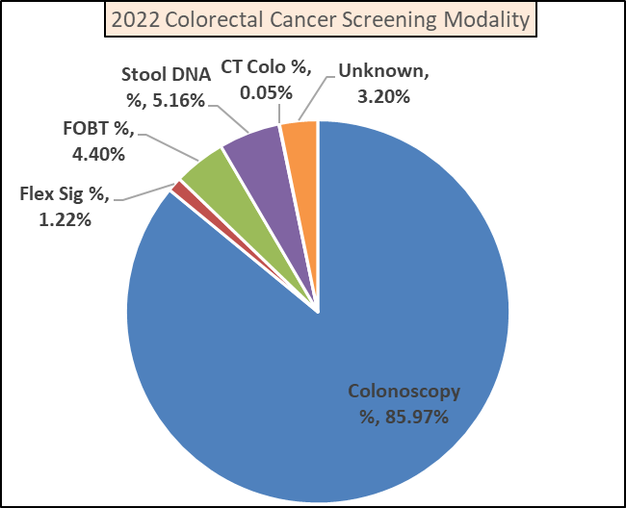
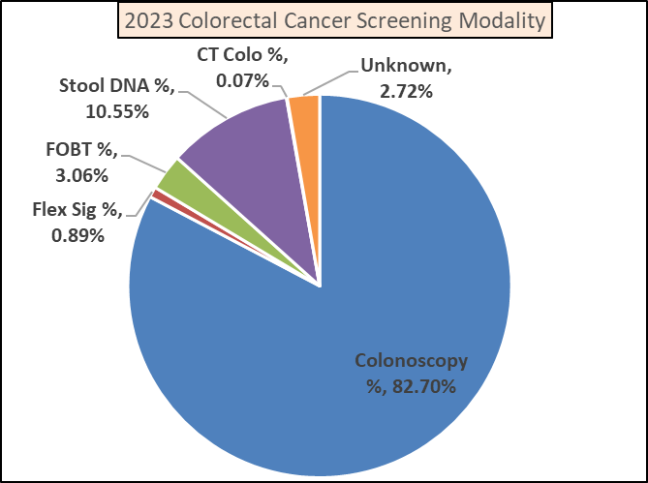
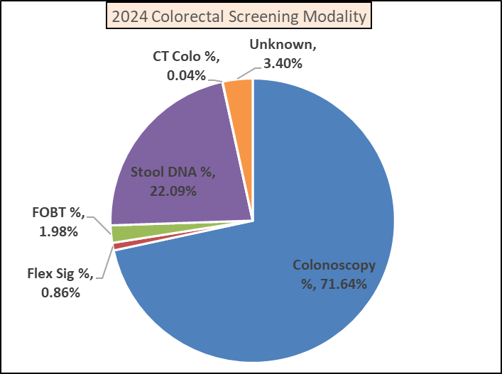
Louisiana Colorectal Cancer Screening Modality Trends 2022-2024 (ACLA Data)
Colonoscopy is the most common screening modality, although decreasing.
Stool DNA Screening has quadrupled since 2022.

Slide 10
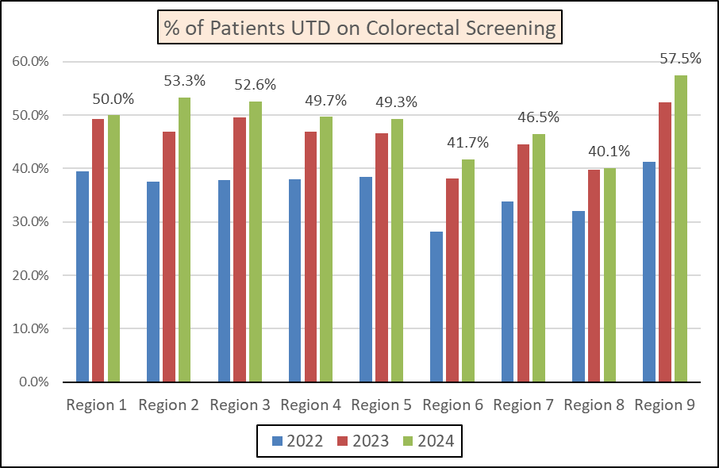
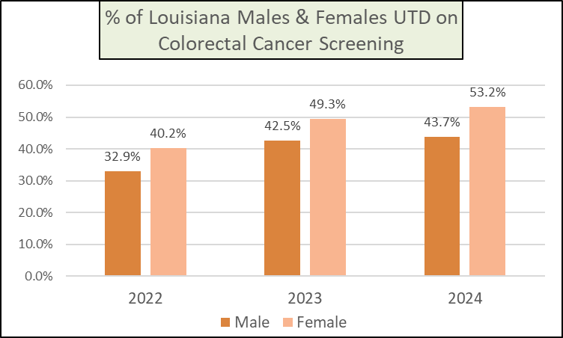
Current State of Louisiana Colorectal Cancer Screening Rates (ACLA Data)
The percent of patients UTD on colorectal cancer screening has been increasing over the past 3 years in ALL Regions.
Region 6 & 8 had the lowest % of patients UTD in 2024.
Females were more likely to be UTD in screening than males.
Females were more likely to have seen their PCP within the previous 3 years.

Slide 11

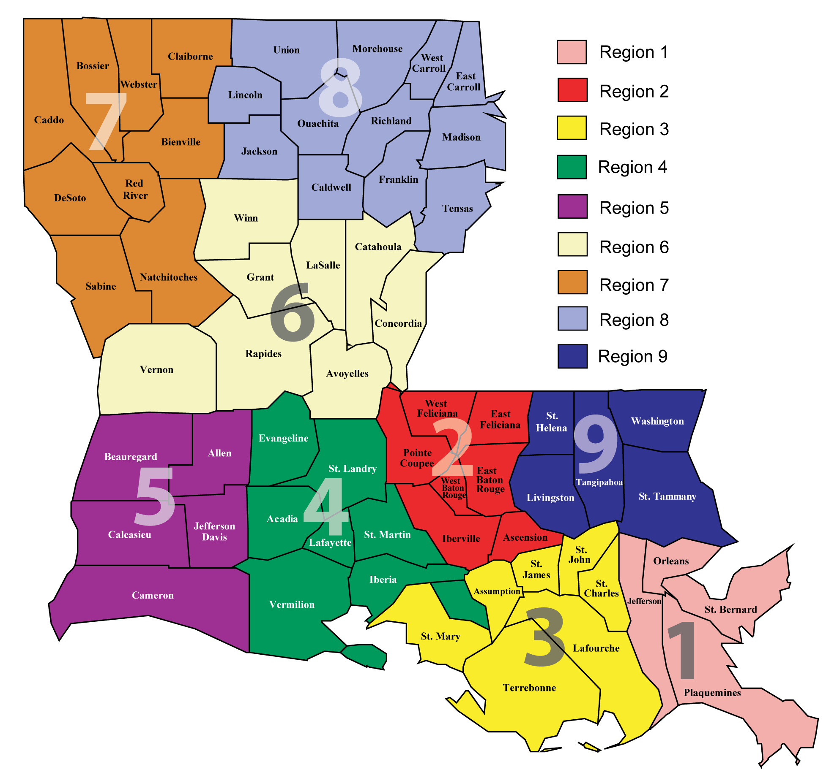
Current State of Louisiana Colorectal Cancer Screening Rates – Continued (ACLA DATA)

Slide 12
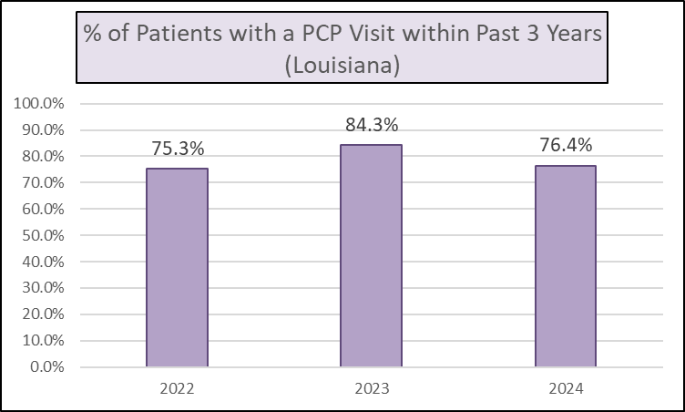
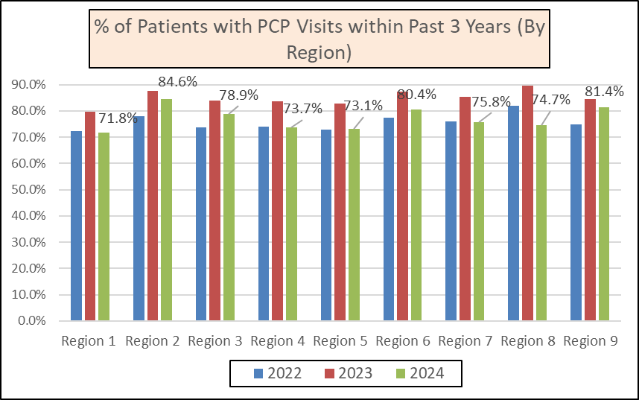
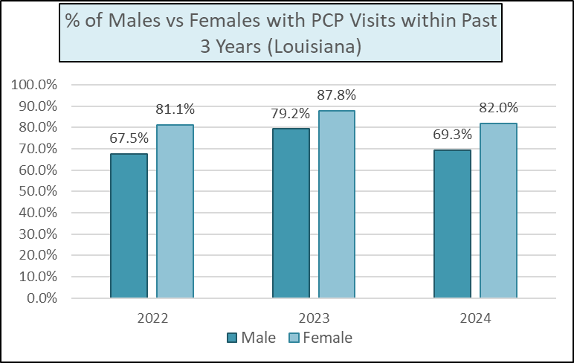
Louisiana Primary Care Physician Visits (ACLA Data)
In each year, a higher percentage of females had PCP visits than males.
Although region 6 & 8 had the lowest rate of UTD screening, they had some of the highest rates of PCP visits.

Slide 13
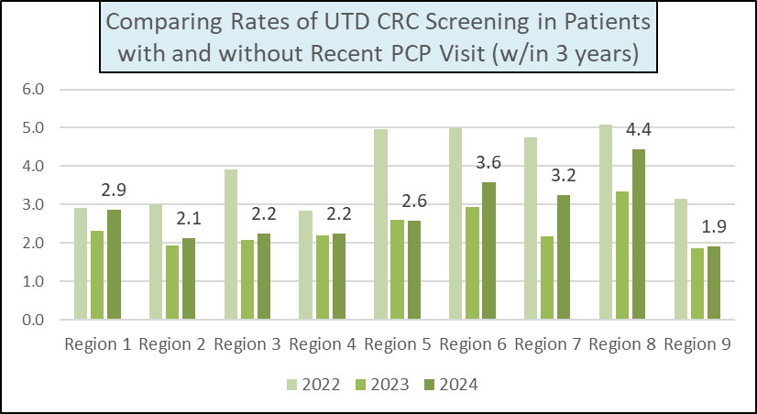
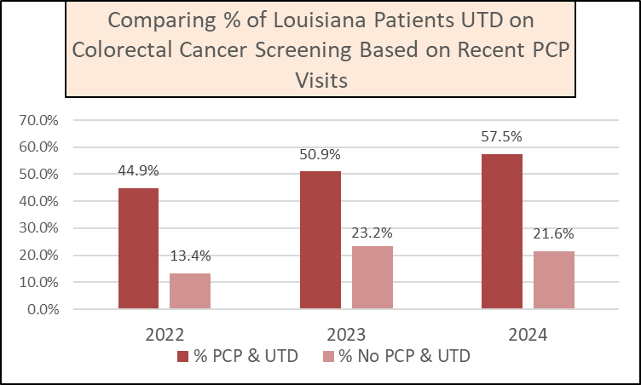
Colorectal Cancer Screening and PCP Visits (ACLA Data)
Summary
Over the 2022-2024 period, the rate of UTD CRC screening was (on average) 2.73x higher in patients who had seen their PCP within 3 years.
Differences between screening rates based on PCP visits was highest in Regions 6 & 8.
However, Regions 6 & 8 did not have the lowest rate of PCP visits.
(Percent of Patients who Saw Their PCP within 3 Years & were UTD for CRC Screening) ÷ (Percent of Patients who DID NOT See Their PCP within 3 Years & were UTD for CRC Screening)

Slide 14
Summary of Data
Louisiana exceeds the national average in both CRC incidence & mortality.
The % of ACLA patients UTD on CRC screening is improving in all LDH regions, and as of 2024 is meeting the LDH CRC screening goal.
Stool based DNA tests are increasing in popularity; however, colonoscopy remains the most common screening modality.
Women are more likely to be UTD on screening and are more likely to see their PCP.
Region 6 & 8 have the lowest % of patients UTD on CRC screening, they also seem to have low numbers of physicians.
Patients who saw their PCP within the previous 3 years had a 2.73x higher rate of being UTD on CRC screening, on average.
This modifier was even larger in Regions 6 & 8, where PCPs seem to scarcer.

Slide 15
Current ACLA Initiatives and Further Suggestions
Suggestions/Further Research
Further investigate why Region 6 and Region 8 have the lowest rate of UTD CRC screening, despite having similar rates of PCP visits.
Continue Exact Sciences Cologuard Project, potentially expand.
Create CRC screening initiative targeting men, given current disparity.
Given that Colonoscopies are still the major screening modality, consider increased utilization of primary care physicians trained in endoscopy.
  Recent data is limited, but multiple studies have shown PCPs having cecal intubation rate >95%, adenoma detection rate > than ASGE guidelines, and complication rate within accepted margins (1,4).
  Other studies have shown that gastroenterologists were significantly more effective at preventing CRC related death in patients who received colonoscopy than PCPs or Surgeons. However, PCPs outperformed surgeons in this metric (3).
  Numerous Louisiana/Texas/Alabama FM Residency programs training in endoscopy.
Current ACLA Initiatives
Exact Sciences Cologuard Project
Multidisciplinary Provider Education
Care Card Member Incentive
ACLA Provider Newsletter
TACL Flyer Distribution
mPulse Text Reminder Campaign
COL Disparity Project
ACLA Wellness Center Opportunities
And Many More!

Slide 16
Acknowledgements
Dana Smith
Dr. Gregory Randolph
Renee Wells
Rhonda Baird
Shea Good
Carrie Blades
Allison Caston
AmeriHealth Caritas LA

Slide 17
References
https://www.cdc.gov/colorectal-cancer/screening/index.html
Louisiana Cancer Data Visualization, based on November 2023 submission data (2017-2021): Louisiana Tumor Registry; https://sph.lsuhsc.edu/louisiana-tumor-registry/data-usestatistics/louisiana-cancer-data-visualization-dashboard, December 2024.
https://www.nola.com/entertainment_life/louisiana_health/louisiana-health-primary-care-doctors/article_40ac3512-7510-11ef-b597-331131e58110.html
https://www.ldi.la.gov/docs/default-source/documents/ldi-convention/2023-presentations/physician-shortage-in-la-culotta-and-fraiche.pdf?sfvrsn=7ece4752_0
Primary Care Physicians Performing Endoscopy
1.Kolber MR, Wong CKW, Fedorak RN, Rowe BH, on behalf of the APC-Endo Study Physicians (2013) Prospective Study of the Quality of Colonoscopies Performed by Primary Care Physicians: The Alberta Primary Care Endoscopy (APC-Endo) Study. PLOS ONE 8(6): e67017. https://doi.org/10.1371/journal.pone.0067017
2.Kolber, Michael, et al. "Outcomes of 1949 endoscopic procedures: performed by a Canadian rural family physician." Canadian Family Physician 55.2 (2009): 170-175.
3.Baxter, Nancy N., et al. "Association between colonoscopy and colorectal cancer mortality in a US cohort according to site of cancer and colonoscopist specialty." Journal of Clinical Oncology 30.21 (2012): 2664-2669.
4. McClellan, David A., et al. "Expanding access to colorectal cancer screening: benchmarking quality indicators in a primary care colonoscopy program." The Journal of the American Board of Family Medicine 28.6 (2015): 713-721.
5.“Colonoscopy (Position Paper).” AAFP, 12 Dec. 2019, www.aafp.org/about/policies/all/colonoscopy-position-paper.html.

