Slide 1
Cervical Cancer Screening
Caroline Neck
LSUHSC 4th Year Medical Student
AmeriHealth Caritas Louisiana Intern
March 5, 2025

Slide 2
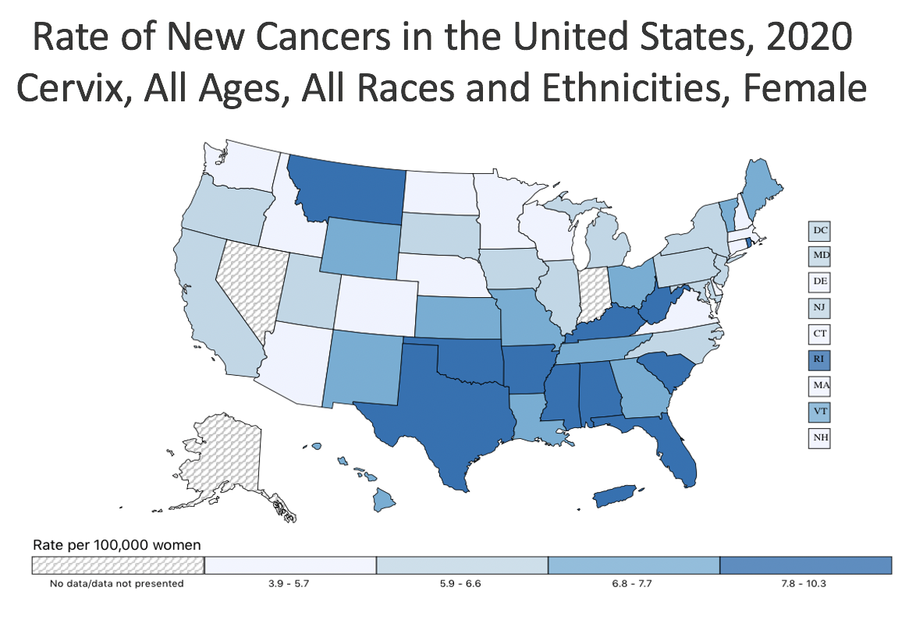
Background – What is cervical cancer?
Worldwide, cervical cancer is the 4th most common cancer among women. Louisiana has the 4th highest death rate for cervical cancer in the U.S.
As these strains of HPV are asymptomatic, regular screening for abnormally growing and/or HPV-containing cells in the cervix is paramount for the prevention (as well as the early detection and treatment of) cervical cancer.
Thanks to regular screenings (and, more recently, vaccination for HPV), cervical cancer is arguably the most preventable type of cancer.
Persistent infection with any high-risk strain of human papillomavirus (HPV) is the cause of cervical cancer.
Incidence rate of cervical cancer in the U.S., 2017-2021:
7.5 per 100,000 women per year
Incidence rate of cervical cancer in Louisiana, 2017-2021:
9.2 per 100,000 women per year

Slide 3
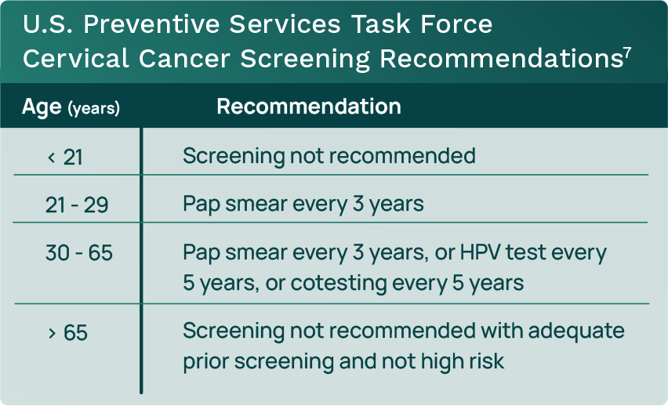

Guidelines for Cervical Cancer Screening (CCS)
Notes:
Goal: to find precancerous or cancerous cervical cells at the earliest possible stage, when easiest to eradicate from the body.

Slide 4

Program Goals
Increase cervical cancer screening rates among women aged 21-64 years.
1
Provide education on the the importance of early detection of cervical precancer and malignancy.
2
Reduce cervical cancer-associated morbidity and mortality in women aged 21-64 years by promoting early HPV vaccination and regular CCS.
3

Slide 5
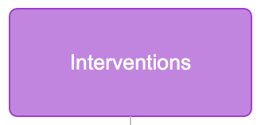
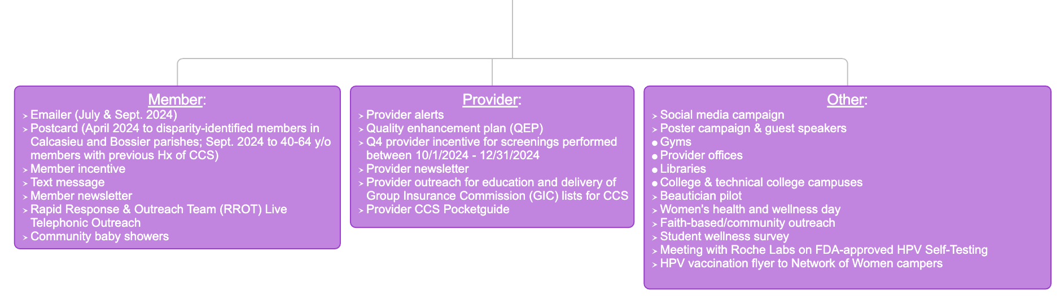
ACLA Interventions & Barriers
Barriers
Patient lack of knowledge & awareness
Economic constraints
Cultural & religious factors
Fear & embarrassment
Distrust in healthcare systems

Slide 6
CCS Rates by Age
Notes:
December 2023-December 2024

Slide 7
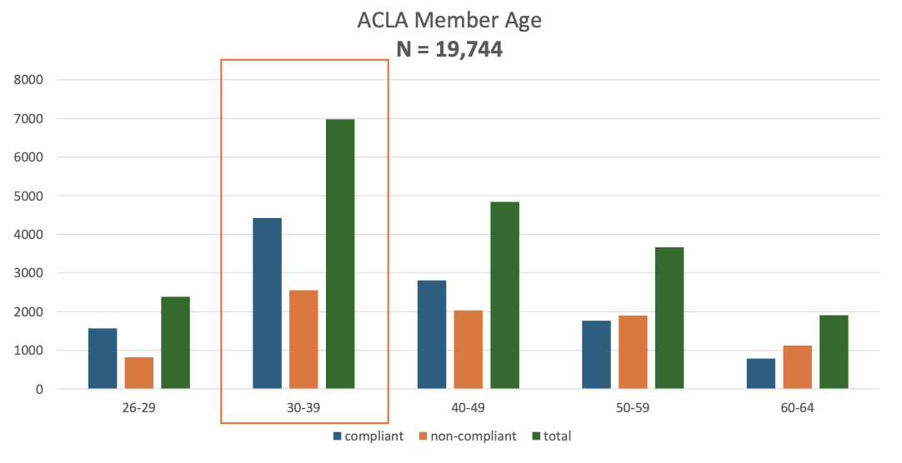
CCS Rates – 2024 vs. 2023
Notes:
December 2023-December 2024

Slide 8
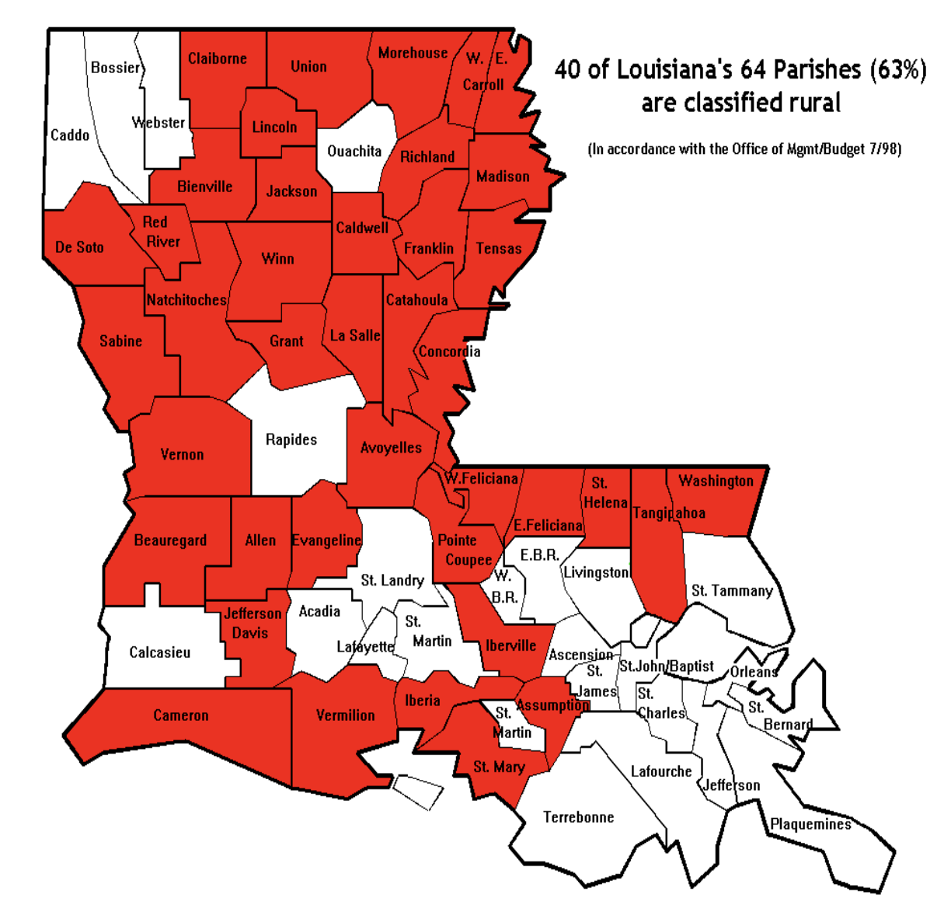
CCS Rates in Rural vs. Urban Parishes
 | Compliant | Non-Compliant | % Compliant
Urban | 10,095 | 8,221 | 55
Rural | 3,825 | 3,610 | 51
Total | 13,920 | 11,831 | 54
Notes:
Which region had lowest % of population compliant
Which region had highest % compliant

Slide 9
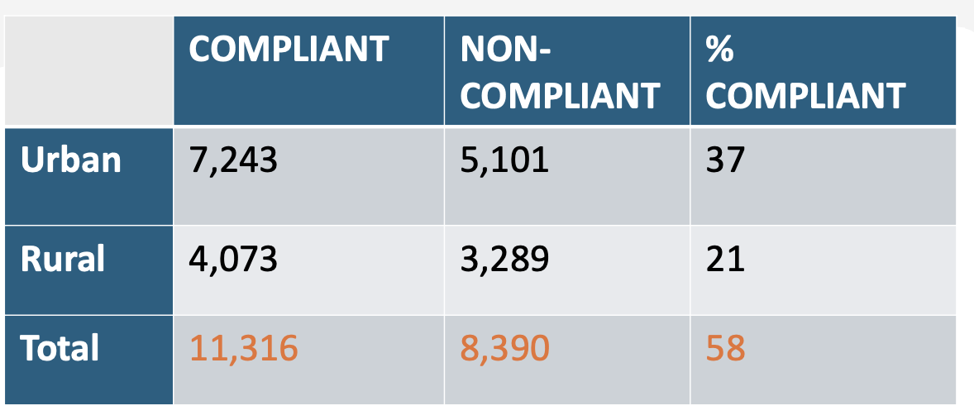
Rural & Urban CCS Rates – 2024 vs. 2023
 | Compliant | Non-Compliant | % Compliant
Urban | 10,095 | 8,221 | 55.1
Rural | 3,825 | 3,610 | 51.1
Total | 13,920 | 11,831 | 54
58.6
55.3

Slide 10
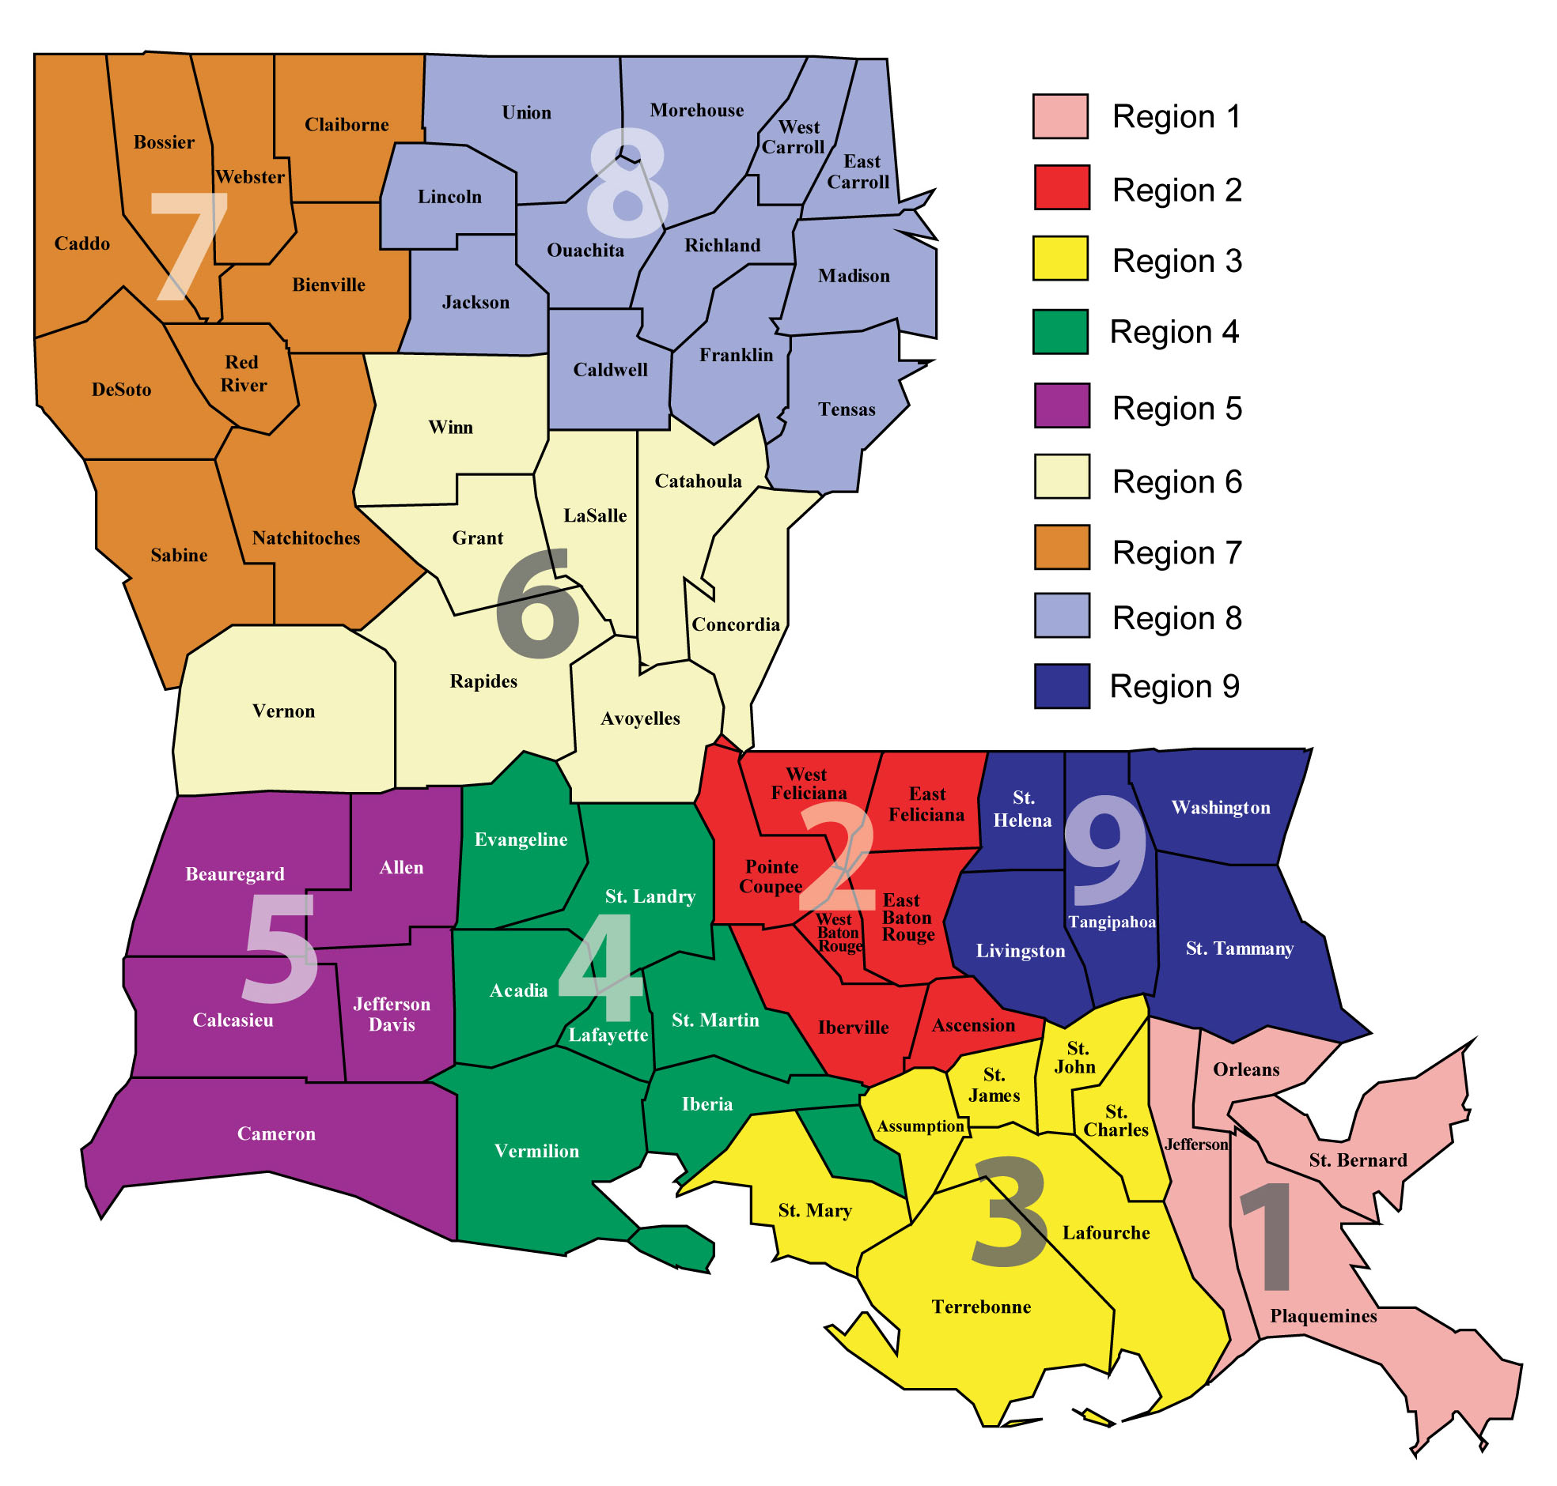
CCS Rates by Region
Region | % Compliant
Region 1 | 58.1%
Region 2 | 57.5%
Region 3 | 59.5%
Region 4 | 54.7%
Region 5 | 50.1%
Region 6 | 46.9%
Region 7 | 49.4%
Region 8 | 49.1%
Region 9 | 57.5%
Notes:
Which region had lowest % of population compliant
Which region had highest % compliant

Slide 11
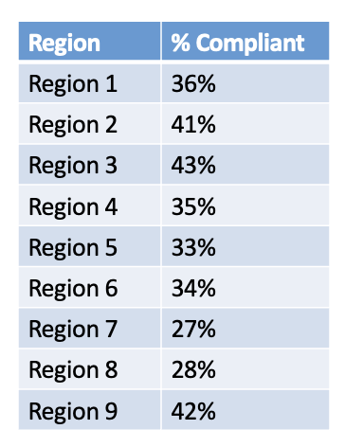
CCS Rates by Region – 2024 vs. 2023
Region | % Compliant
Region 1 | 58.1%
Region 2 | 57.5%
Region 3 | 59.5%
Region 4 | 54.7%
Region 5 | 50.1%
Region 6 | 46.9%
Region 7 | 49.4%
Region 8 | 49.1%
Region 9 | 57.5%
Notes:
2024 highest to lowest compliance regions: 3, 1, 2, 9, 4, 5, 7, 8, 6
2023 highest to lowest compliance regions: 3, 9, 2, 1, 4, 6, 5, 8, 7

Slide 12
Notes:
Top 5 regions both years: 3, 1, 5, 9, 4

Slide 13
CCS Rates by Race
Race | Compliant | Non-Compliant | % Compliant
White | 5,210 | 5,311 | 49.5
Black or African-American | 7,684 | 5,606 | 57.8
American Indian or Alaska Native | 139 | 101 | 57.9
Asian | 209 | 147 | 58.7
Native Hawaiian or Other Pacific Islander | 10 | 10 | 50.0
≥2 Races | 135 | 138 | 49.4
Unknown Race | 518 | 533 | 49.2
Total | 13,905 | 11,846 | 53.9

Slide 14
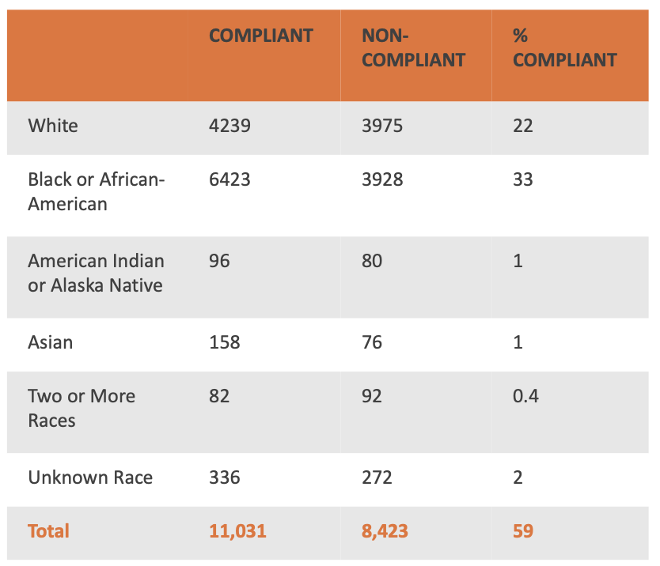
CCS Rates by Race – 2024 vs. 2023
Race | Compliant | Non-Compliant | % Compliant
White | 5,210 | 5,311 | 49.5
Black or African-American | 7,684 | 5,606 | 57.8
American Indian or Alaska Native | 139 | 101 | 57.9
Asian | 209 | 147 | 58.7
Native Hawaiian or Other Pacific Islander | 10 | 10 | 50.0
≥2 Races | 135 | 138 | 49.4
Unknown Race | 518 | 533 | 49.2
Total | 13,905 | 11,846 | 53.9
51.6
62.0
54.5
67.5
47.1
55.2

Slide 15
CCS Rates by Ethnicity
Ethnicity | Compliant | Non-Compliant | % Compliant
Hispanic or Latino | 1,390 | 1,467 | 48.6
Not Hispanic or Latino | 9,605 | 6,343 | 60.2
Unknown Ethnicity | 2,910 | 4,036 | 41.8
Total | 13,905 | 11,846 | 53.9

Slide 16
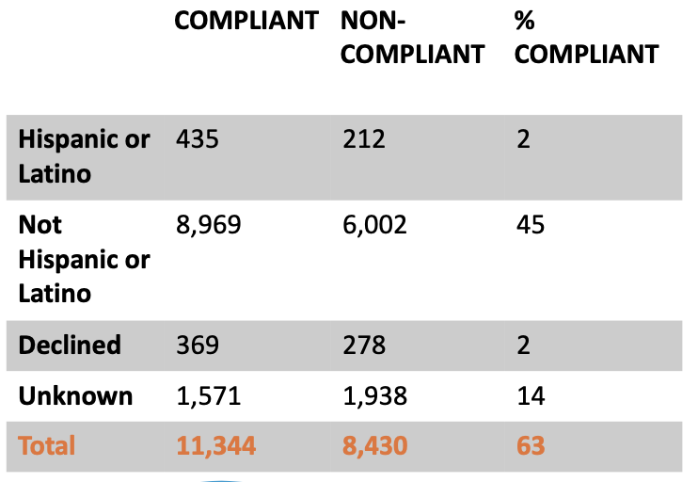
CCS Rates by Ethnicity – 2024 vs. 2023
Ethnicity | Compliant | Non-Compliant | % Compliant
Hispanic or Latino | 1,390 | 1,467 | 48.6
Not Hispanic or Latino | 9,605 | 6,343 | 60.2
Unknown Ethnicity | 2,910 | 4,036 | 41.8
Total | 13,905 | 11,846 | 53.9
67.2
59.9
57.0
44.7

Slide 17
Summary
No significant changes in CCS compliance trends from 2023 to 2024 by age or by rural vs. urban residence
5 most compliant regions (1, 2, 3, 5, 9) and 4 least compliant regions remain unchanged from 2023 to 2024
Significant decrease in CCS compliance in the Hispanic/Latino population from 2023 to 2024
Significant decrease in CCS compliance in both the Black/African-American and Asian populations from 2023 to 2024
  However, these populations remain the two most compliant with CCS of all the racial demographics

Slide 18

Recommendations
Continue current ACLA interventions
Target providers in areas of low compliance rates, particularly those in the rural parishes of regions 5, 6, 7, and 8
Education & promotion of Gardasil (HPV) vaccine, community vaccine fairs, etc.
Ideas for further analysis: Expand analyses at the parish level to investigate how access to providers differs

Slide 19


Thank you!
Dr. Gregory Randolph
Dana Smith
Renée Wells
Carrie Blades
Shea Good
Rhonda Baird
LSU School of Medicine
ACLA Quality Improvement Team
Questions?

Slide 20
References
Farajimakin, O. (2024). Barriers to Cervical Cancer Screening: A Systematic Review. Cureus, 16(7), e65555. https://doi.org/10.7759/cureus.65555
Fowler, J. R., Maani, E. V., Dunton, C. J., Gasalberti, D. P., & Jack, B. W. (2023). Cervical Cancer. StatPearls [Internet]. https://www.ncbi.nlm.nih.gov/books/NBK431093/
Futrell, K. (2023). Laboratory testing to support women’s health: How an LIS can assist with cervical cancer screening protocols [White paper]. Orchard Software. https://go.orchardsoft.com/l/975163/2023-06-06/4l5km/975163/1686060550qep23dDQ/OrchardSoftware_WomensHealthOEP_WhitePaper.pdf
Kitchen, F. L., & Cox, C. M. (2022). Papanicolaou Smear. StatPearls [Internet]. https://www.ncbi.nlm.nih.gov/books/NBK470165/

