Slide 1

Practice Experience
Information Session
Dr. Donna L. Williams, Associate Dean for Public Health Practice and Community Engagement
Yvette Merritt, Coordinator for Public Health Practice and Community Engagement

Slide 2

Defining Practice Experience
Planning
Procedures and Forms
Deadlines
Questions
Notes:
These are the objectives we are going to cover today.
Please keep in mind this is just the orientation on what you must complete to register for the course.

Slide 3

Notes:
These are the objectives we are going to cover today.
Please keep in mind this is just the orientation on what you must complete to register for the course.

Slide 4

Practice Experience
Practice-based Learning
  Bridge academic training and applied public health practice.
  Build a professional portfolio for use during and after MPH coursework.
  Practice Experience
  The MPH Practice Experience is a project or activity that immerses the student in one or more aspects of public health operations under the guidance of a preceptor. It gives the students an opportunity to apply what they are learning in a professional public health setting, while building skills, abilities and relationships.

Slide 5
Defining Practice Experience
Practice-based learning
  Bridge academic training and applied public health practice
  Build skills, abilities, and a professional network
  Inform career choices
CEPH requirement
Competency driven
Structured
  Planned
  Supervised/mentored by preceptor
  Evaluated
The MPH Practice Experience is a project or activity that immerses students in one or more aspects of public health operations under the guidance of a preceptor. It gives students an opportunity to apply what they are learning in a professional public health setting, while building skills, abilities and relationships.
Practice Experience is not administrative, shadowing, clinical, research, or an extension of a student worker position
Notes:
Your practice experience is a structured, competency driven, project or activity, that you complete at a public health based institution under the guidance of a preceptor whose has professional public health experience.
Why do we complete the practice experience?
Your MPH is a professional degree that is preparing you to work in the field as soon as you complete the program. It is different than an MS which is more research based. It is also a CEPH requirement.
Who knows what CEPH stands for? Council on Education for Public Health. CEPH is an independent agency recognized by the U.S. Department of Education to accredit schools of public health, and public health programs outside schools of public health. Similar to SACS
Competencies are measurable patterns of knowledge, skills and abilities, that are demonstrated through behaviors, which drives performance. In other words, the list of competencies that you see in you syllabus, the proposal, and school webpage are skills and abilities you will learn in class, apply during your practice experience and demonstrate your mastery through a deliverable. We will discuss deliverables more at a later part of the presentation.
Did anyone complete a practicum, internship, co-op, or fellowship prior to starting their MPH? If so, it is very similar however, it is more structured. You will be completing a proposal, keeping a work log, and you will be evaluated by your preceptor at the end of the semester. All of that information will be covered in the class on the first day.

Slide 6
Practice Experience Requirements
200 practice hours| 3 Credits | 1 semester Fall & Summer
1 | Plan
Discuss plans with advisor
2 | Identify
Identify site
Identify preceptor
3 | Develop
Work with preceptor to develop proposal
Speak with PE coordinator
Start early!
Get code from PE office to register for PUBH 6800
5 | Register
4 | Submit
Submit e-forms to PE office*
CITI & HIPAA Training
Proposal
MOU
Prerequisites
* Requirements for student starting prior to Fall 2024: At least 9 credit hours including BIOS 6100 (MPH core) OR EPID 6210 (MPH core); Program-specific core (ENHS 6238, BCHS 6212, or HPSM 6268)
* Requirements for student starting Fall 2024: At least 10 credit hours including PUBH 6120 plus 6 credit hours of program-required coursework.
* COVID Waiver
* SPH Code of Conduct
* Training
  -HIPAA
  -CITI
* * This course is a prerequisite for the PUBH 6600 Integrated Learning Experience

Slide 7
Practice Experience Planning
Start planning early (at least during prior semester)
Identify a site and preceptor
Develop your proposal
Submit documents to office for approval
  Proposal
  CITI & HIPAA Training
  SPH Code of Conduct
  Preceptor – Student Agreement
Register
  Registration code comes from Registrar’s Office each semester and is disseminated to students once their proposal has been approved by the Practice Office
The Public Health Practice Office is available to help you along the way.
The didactic portion of the course will be held simultaneously with the practice experience placement
Reach out with any questions at any time.
*If the site is new and/or preceptor, student must submit New Site Data Form and/or submit preceptor CV/resume
Notes:
Here is a short overview of what you should be thinking about in regards to you practice experience.
Plan early basically decide when you are going to do your practice experience because your proposal is due the semester prior to your practice experience. I send out reminders monthly but it is your responsibility to check your email. We do not give extensions pass the deadline and I have had to tell people to wait until the next semester. Delayed signatures or I did not know, are not acceptable excuses.
Identify a site. Start thinking about where you want to go and that site capacity. They may only take 2 students each semester, they may require an application, that is something to think about.
Once you found a site you need to develop your proposal. Figure out what you want to do, what you can do, and what is attainable. 8/10 students have to make changes to their proposal so you can send it in before hand for me to review.
Once you complete everything, send all of you signed and complete documents. Remember those deadlines are set so you want to get things in early. I suggest two weeks in the event you need to make changes.
After all that is complete. I send out registration codes with 2-3 weeks after the deadline.

Slide 8
Identifying a Site
Types of Placement Sites
How to Find a Site
Organization, center, or program
  Government
  Non-Profit
  Private companies (environmental)
Devoted to health of populations
  Prevention of disease
  Promotion of health
  Advocacy for healthcare programs/ delivery of service
Additional procedures/requirements for international sites
  Start international PE planning early
Networking
Advisor
Peers
Volunteering
Email blast
Approved site list on Practice Experience spreadsheet
New sites must be reviewed for approval before a student can proceed
New Site Data forms are on the PE webpage.
Notes:
When you are looking for a practice experience site, the question may be what am I looking for?
There is no one answer fits all to that. Sites can be an site that supports the general public health mission. Which is to preserve, promote, and improve the health and well being of populations, communities, and individuals.
That can be local, national, or international. I am not going to go into detail for international practice experience but it that is something you are considering, make an appointment with me because those requirements are a bit different.
There are a number of ways to find a site. SGA, Mrs. Cuccia, and my office promotes a lot of volunteer opportunities. That is one of the best ways to find a site because you can see how the site operates and network with employees. Our list has a number of sites students have been to in the past. I also send out a PDF form with opportunity announcements to students to check out as potential practice experiences.
In the event you do not see any on the list. You can find a site that you would like to use for a practice experience. It does require you to complete a new site data form, but it is just on page, and obtain the resume/CV of your potential preceptor.

Slide 9

Practice Experience Preceptors
Role of the Preceptor
Considerations for New Preceptors
Orient the student to specific project goals and operational requirements
Explain the structure and function of the agency
Invite the student to agency, interagency, and community meetings
Supervise the student
Provide a model of professional work habits and attitudes
Evaluate student performance on forms provided
If the preceptor has never served in this role before, they must submit CV/resume to be reviewed for approval by PE course director.
Must be an experienced, practicing public health professional
  MPH (or equivalent degree) plus 3 years professional public health experience
  Bachelor’s in related field plus 5 years of professional public health experience
Notes:
For our preceptors on the approved list, we have vetted that they meet our preceptor requirements and actively participate in the role expectations.
For new preceptors, we ask that students go over the roles with the preceptors. And when they submit their CV/resume those are the requirements we are looking for.
BA – 5 years of experience
MA – 3 years of experience (any degree is acceptable)

Slide 10

Competency-Driven Experiential Learning
MPH students are required to meet at least 5 competencies during their practice experience.
  3 of 5 MUST be foundational competencies
  2 of 5 MUST be program-specific competencies
Selected competencies must be submitted in the Practice Experience Proposal form.
Competencies must pair with a specific deliverable. Deliverables are concrete products produced during the practice experience
Students must submit at least 2 deliverables to demonstrate achievement of selected competencies by the end of the practice experience.

Slide 11
Foundational Competencies
Public Health & Health Care Systems
Compare the organization, structure and function of health care, public health and regulatory systems across national and international settings
Discuss the means by which structural bias, social inequities and racism undermine health and create challenges to achieving health equity at organizational, community and societal levels
Planning & Management to Promote Health
Assess population needs, assets and capacities that affect communities’ health
Apply awareness of cultural values and practices to the design or implementation of public health policies or programs
Design a population-based policy, program, project or intervention
Explain basic principles and tools of budget and resource management
Select methods to evaluate public health programs
Policy in Public Health
Discuss multiple dimensions of the policy-making process, including the roles of ethics and evidence
Propose strategies to identify stakeholders and build coalitions and partnerships for influencing public health outcomes
Advocate for political, social or economic policies and programs that will improve health in diverse populations
Evaluate policies for their impact on public health and health equity
Leadership
Apply principles of leadership, governance and management, which include creating a vision, empowering others, fostering collaboration and guiding decision making
Apply negotiation and mediation skills to address organizational or community challenges
Communication
Select communication strategies for different audiences and sectors
Communicate audience-appropriate public health content, both in writing and through oral presentation
Describe the importance of cultural competence in communicating public health content
Interprofessional Practice
Perform effectively on interprofessional teams
Systems Thinking
Apply systems thinking tools to a public health issue
3 of 5 selected competencies must be Foundational Competencies

Slide 12
Program Specific Competencies
(Starting Fall 2024)
Biostatistics and Data Science Competencies
Apply principles of inferential statistics and data science to analyze various types of health-related data and decision-making.
Apply hypothesis tests for public health and medical-related research questions, select appropriate statistical methods based on the study objectives and data type, and draw conclusions based on the testing results.
Evaluate public health and medical studies and design suitable power analysis and sample size calculations.
Apply software and programming skills for data acquisition, management, cleaning, visualization, and analysis.
Apply expertise to advise researchers and public health professionals on translating research questions into testable hypotheses to advance public health.
Develop skills in communication, interpretation, and presentation of research findings to collaborators or clients
(Prior to Fall 2024)
Biostatistics Competencies
Explain the role that probability and statistical distributions play in inferential statistics and decision-making.
Advise researchers and public health professionals on translating research questions into testable hypotheses to advance public health.
Prepare appropriate analytic approaches for public health research questions, use corresponding statistical methods to test null hypotheses, and draw conclusions based on the testing results
Selectively apply hypothesis tests for comparing treatment strategies and exposure groups appropriate to the type of response measurement (e.g., binary, ordinal, continuous)
Perform power analysis and sample size calculations to aid in the planning of public health studies.
Communicate to colleagues and clients the assumptions, limitations, and (dis)advantages of commonly used statistical methods and describe preferred methodological alternatives when assumptions are not met.
Use computer software for acquisition, management, analysis of data, and presentation of results.

Slide 13
Program Specific Competencies
(Starting Fall 2024)
Community Health Science and Policy Competencies
Identify and apply behavioral health theories, concepts and models to community health analyses and practice.
Analyze the impact of community practice interventions on public health, social justice, health promotion, and/or economic opportunity.
Demonstrate proficiency in planning, implementation and evaluation of ethical and culturally aligned public health programs, policies, and/or interventions.
Apply management practices to decision-making in public health.
Develop, analyze, and/or evaluate policies for improving the health status of populations.
Identify socio-ecological factors and potential solutions affecting the health of individuals and populations, including health disparities.
(Prior to Fall 2024)
Behavioral and Community Health Sciences Competencies
Prioritize individual, organizational and community concerns, assets, resources and deficits for social and behavioral science interventions and policy change.
Analyze the role of individual, social and community factors in both the onset and solution of public health problems through intervention or policy change.
Design, implement, and interpret program evaluation methods to assess and improve community health programs and/or policies
Understand and apply public health methods across multiple levels of influence, specifically using the Social Ecological Model
Translate research to public health practice and policy
Apply evidence-based public health approaches to examine and respond to behavioral and community health issues in Louisiana

Slide 14
Program Specific Competencies
(Starting Fall 2024)
Environmental Health, Climate and Sustainability Competencies
Identify and assess health impacts of environmental hazards.
Appraise and communicate the science on climate change and sustainable solutions.
Develop and evaluate policies to equitably address hazards and risks.
Analyze and interpret data related to hazards, risks and impacts.
Facilitate resilience and adaptation through geospatial planning to address vulnerabilities and risks.
(Prior to Fall 2024)
Environmental and Occupational Health Sciences Competencies
Collect, analyze, and interpret environmental and occupational health outcomes data.
Examine the direct and indirect human, ecological, and safety effects of environmental and occupational exposures in order to protect the health of workers and the public.
Evaluate biological, genetic, physiological, and psychological factors that affect human susceptibility to adverse health outcomes following exposures to environmental and occupational health hazards.
Select appropriate human health risk assessment methods for a variety environmental and occupational data.
Recommend corrective strategies for mitigating and preventing environmental and occupational exposures that pose human health and safety risks.
Apply knowledge of federal and state regulatory programs, guidelines, and authorities appropriate to environmental and occupational health and safety.

Slide 15
Program Specific Competencies
(Starting Fall 2024)
Epidemiology and Population Health Competencies
Critique the processes involved in the design, analysis and evaluation of an epidemiologic study.
Distinguish the major sources of bias in epidemiology research and literature and the ways to evaluate and reduce the bias.
Apply and perform epidemiologic analyses using linear, logistic, Cox and Poisson regression using a standard statistical package (e.g. SAS, R, or STATA).
Evaluate data for confounding and effect modification (interaction) applying the tools of causal inference in epidemiology.
Effectively communicate epidemiologic information to diverse audiences in diverse settings.
Apply evidence-based management practices and quality improvement concepts to address health care organization and delivery issues.
Analyze the impact of political, social, and economic policies on health systems at the local, state, national, and international levels and formulate solutions to key problems.
(Prior to Fall 2024)
Epidemiology Competencies
Critique the processes involved in the design, analysis and evaluation of an epidemiologic study.
Distinguish the major sources of bias in epidemiologic research and the ways to evaluate and reduce the bias.
Apply epidemiologic analyses using linear, logistic, Cox and Poisson regression.
Evaluate data for confounding and effect modification (interaction)
Apply the tools of causal inference in epidemiology (e.g., counterfactuals, directed acyclic graphs)
Appraise the strengths and weaknesses of epidemiologic literature
Effectively communicate epidemiologic information to diverse audiences in diverse settings.

Slide 16
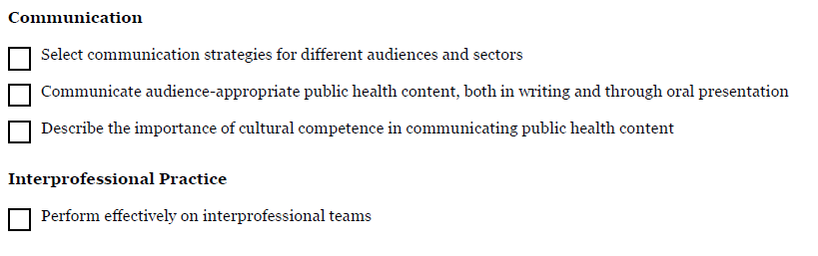
What if my competency contains the word “and?”
Notes:
Whenever the word “and” is used, it means you must do ALL of the things in the statement.
Example for “Communicate audience-appropriate public health content, both in writing and through oral presentation” the expectation would be some written document AND some evidence of an oral presentation (powerpoint, poster, etc.).
At a MINIMUM, the expectation would be a team list including roles and meeting minutes

Slide 17
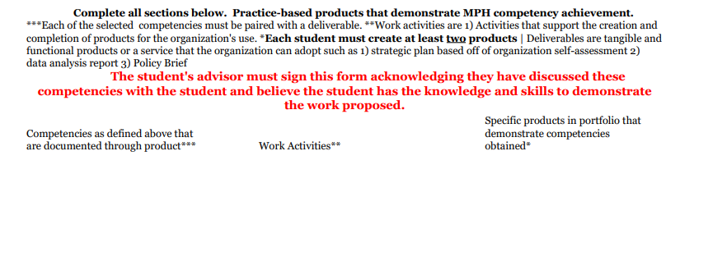
Deliverables “Products” Mapping
Deliverables "products" will be submitted at the end of the semester and added to student's portfolio.
Use competencies selected on pages 2-4
Activities that support the creation and completion of products for the organization's use
Deliverables are tangible and functional products or a service that the organization can adopt
Multiple competencies can be associated with one deliverable “product.”
Notes:
Once you selected the competencies you must complete the last page.

Slide 18
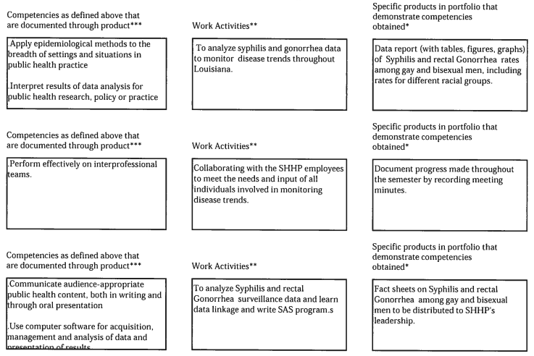
Deliverables Map Example
Notes:
Assess population needs, assets and capacities that affect communities’ health
Design a population-based policy, program, project or intervention
Propose policy development, analysis, and evaluation processes for improving the health status of populations.
Demonstrate leadership skills in public health and communicate health policy and management issues, using appropriate channels and technologies.
Select evidence-based principles, law and ethics to critical evaluation and decision- making in health care delivery
Design a population-based policy, program, project or intervention
Compare the organization, structure and function of health care, public health and regulatory systems across national and
international settings

Slide 19
Procedures and Forms
All Required Forms are due via Email to the PE Coordinator
Summer 2024 (due 3/26/2025), Fall 2024 (due 6/18/2025)
Proposal*
  Signed by student, preceptor, and PE course director
  Submit a draft proposal to the PE coordinator to review prior to obtaining a signature from your preceptor
  Meet with the PE office to discuss the proposal before approval
Preceptor – Student Agreement*
  Defines roles and responsibilities of student and preceptor
  Must be signed by the student and preceptor
New Site Data form for new sites*
  CV/resume for new preceptors
**No late forms accepted and no extensions permitted**
*Forms are on the PE webpage
**Accommodations are made for students awaiting formal internships
Notes:
The things that you need to turn in are your proposal, preceptor-student agreement, and new site information and resume/CV of a new preceptor if you need to.
I would suggest that you send a draft of your proposal to me at least two weeks in advance of the deadline. That way we can make needed changes without getting your preceptors signature twice. I do not accept late forms, even if it is a day late. You need to make sure your preceptor is not out of town and you get the forms in on time. The only exception to this rule is if you are waiting on a formal internship, at that point, I expect to see the formal announcement and information on the internship.

Slide 20
Integration with Culminating Experience (PUBH 6600)
Beginning in Summer 2025, The separate courses of the Practice Experience (PUBH 6800) and Culminating Experience (PUBH 6600) will be linked to provide continuation of service to our community partners by the students and provide more individualized experiences.
The primary shift in this process is with the Culminating Experience building on the work done during the Practice Experience.
The competency-based approach to both the Practice Experience and Culminating Experience courses:
  Practice Experience - students self-select at least five competencies, of which three must be foundational competencies
  Culminating Experience - students must demonstrate attainment of at least three competencies, one core competency is chosen by the Course Director
    Students must also choose at least one concentration competency to demonstrate.
      14. Advocate for political, social or economic policies and programs that will improve health in diverse populations
      15. Evaluate policies for their impact on public health and health equity
      22. Apply systems thinking tools to a public health issue
Deliverables for the Practice Experience should be developed with an eye for how they will be integrated into the final product for the Culminating Experience.
  The final paper and presentation for the Culminating Experience is expected to be built around the work done during the Practice Experience, specifically addressing the issues and population identified during that work.
  Preceptors will be also invited to the final presentations and receive a copy of the final paper of the student affiliated with their site at the conclusion of the Culminating Experience course.
Notes:
The things that you need to turn in are your proposal, preceptor-student agreement, and new site information and resume/CV of a new preceptor if you need to.
I would suggest that you send a draft of your proposal to me at least two weeks in advance of the deadline. That way we can make needed changes without getting your preceptors signature twice. I do not accept late forms, even if it is a day late. You need to make sure your preceptor is not out of town and you get the forms in on time. The only exception to this rule is if you are waiting on a formal internship, at that point, I expect to see the formal announcement and information on the internship.

Slide 21
Integration with Culminating Experience (PUBH 6600)
Upon successful completion of the Practice Experience, students will then be allowed to register for the Culminating Experience.
The course director for the Culminating Experience will be provided the list of qualifying students with their site location, preceptor and deliverables at the end of each semester the Practice Experience is offered.
Notes:
The things that you need to turn in are your proposal, preceptor-student agreement, and new site information and resume/CV of a new preceptor if you need to.
I would suggest that you send a draft of your proposal to me at least two weeks in advance of the deadline. That way we can make needed changes without getting your preceptors signature twice. I do not accept late forms, even if it is a day late. You need to make sure your preceptor is not out of town and you get the forms in on time. The only exception to this rule is if you are waiting on a formal internship, at that point, I expect to see the formal announcement and information on the internship.

Slide 22
Practice Experience Resources
http://sph.lsuhsc.edu/resources/student-resources/practice-experience/
Handbook
Active Placement Site List
Forms
Public Health Practice and Community Engagement Office
  Room 220
  Email publichealthpractice@lsuhsc.edu
  Phone 504-568-5874

