Slide 1
FUA The percentage of ED visits among members ages 13 years and older with a principal diagnosis of substance use disorder, or any diagnosis of overdose, for which there was follow-up within 30 days of the ED visit for 2022, 2023, and 2024.
Seema Morad
LSUHSC New Orleans, Population Health Management
September 17, 2024

Slide 2
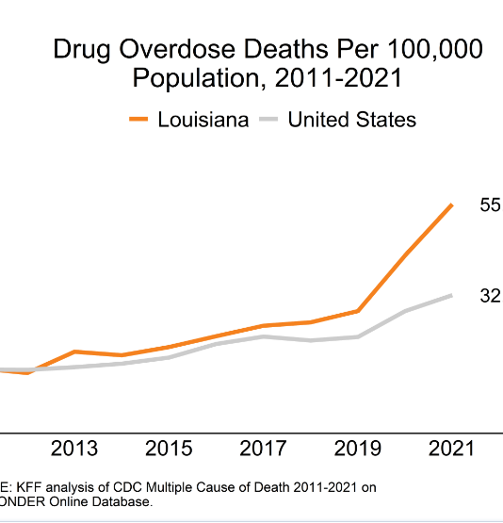
WHY?
In 2022, 48.7 million Americans over 12 years of age were classified as having a SUD.
Between 2018 and 2021, the use of ED services for substance use increased 39%, and the rate of ED visits related to substance use went up from 74.4 to 103.8 visits per 10,000 individuals.
People leaving the ED after a high-risk substance use event need coordinated care because they might be at a higher risk of losing touch with the health care system
Notes:
Opioid overdoses are the primary driver of increases in drug overdose deaths
“In 2021, there were over 106,600 deaths due to drug overdose in the U.S.– the highest on record. This marks a 51% increase in drug overdose deaths from prior to the pandemic (there were over 70,630 deaths in 2019).”
https://www.ncqa.org/hedis/measures/follow-up-after-emergency-department-visit-for-substance-use/

Slide 3
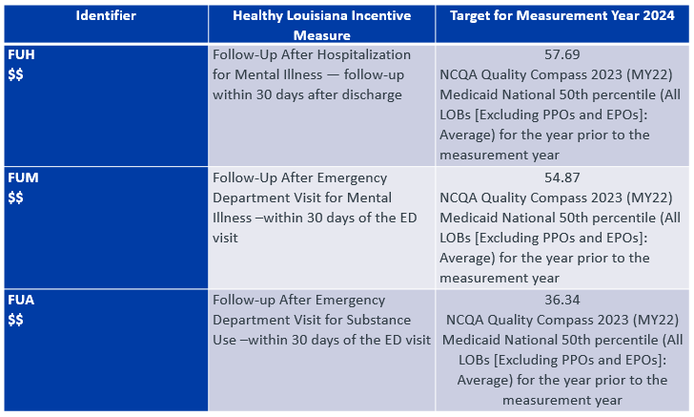


ACLA Withhold Measures
Notes:
According to HSAG’s latest LA My 2022 Report, all MCOs collectively met the target rate or improved by 2 percentage points for FUA measures.

Slide 4
Data Set (General Overview)
Total ED visits:
2022: 1,493
2023: 1,165
2024 YTD: 554
Followed up within 30 days:
2022: 433 (29%)
2023: 237 (20%)
2024 YTD: 127 (23%)
Except for one age group, the year 2023 consistently showed a drop in follow-up from 2022 for every factor.

Slide 5
Our Patient Population

Slide 6
Age
Notes:
Patients aged 13-18 have consistently poorer follow-up rates compared to those aged 19 and older. This could hint at a need for age-specific interventions and support for adolescents.

Slide 7
Gender
Notes:
Patient population consistently ~60% male compared to female, but no apparent difference in follow-up

Slide 8
Race
Notes:
Data provided ED visits for Hispanic or Latino, Asian, American Indian, and unknown patients, but they were excluded due to lack of sufficient data (less than 30 people).
“The uptick in substance use and deaths disproportionately affects many people of color. While white people continue to account for the largest share of deaths due to drug overdose per year, people of color are accounting for a growing share of these deaths over time.”

Slide 9
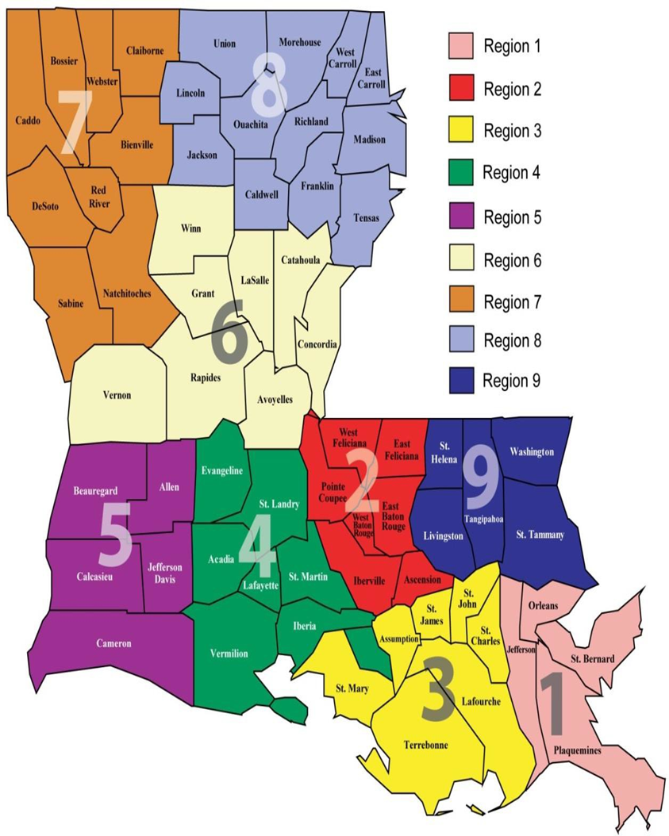
Regional Data

Slide 10
Drastic Fall in 2023: every LDH region experienced drop in 2023. Suggests systemic or region-wide factors influenced follow-up: policy or funding changes, access to care issues, regional variability.
Regional Recovery in 2024 for Regions 2, 3, 4, 5, and 9. Suggests successful regional interventions or a rebound in healthcare service provision in these areas.
Consistent decline in Region 1: Jefferson Parish specifically dropped from 28% in 2022 to 6% in 2024. The steady patient proportion with declining follow-up rate indicates worsening engagement or access to follow-up care services.
Small patient population in Region 8 makes follow-up rates sensitive to fluctuations. A few counties had very few patients completing follow-up in 2022, with many having 0 in 2023 and 2024, contributing to a dramatic drop in the region’s overall follow-up rate.
 | 2022 FUA | 2023 FUA | 2024 YTD FUA
Rural | 21% | 22% | 27%
Urban | 77% | 77% | 73%
Notes:
What is causing Region 1 to experience such decline?
-Jefferson Parish: 28% -> 16% -> 6%, yet maintaining same proportion of patient population
What caused 2023 to experience such a drop? Why were Regions 2, 3, 4, 5, & 9 able to recover but others unable?
Region 8 had small patient populations (<100), with many counties having just 1 patient following up in 2022 then 0 in 2023/2024, causing total regional follow-up rate to change drastically.
1 (U), 2(U), 3(U>R), 4(R>U), 5(U>R), 6(R>U), 7(R>U), 8(R>U), 9(U>R)

Slide 11
Administration of Pharmacotherapy within 15 days following ED visit
Data collected includes drugs administered for opioid use disorder or alcohol use disorder, with much larger proportion of prescriptions for opioid-use
Notes:
Patients who receive pharmacotherapy within 15 days of their ED visit show consistently higher follow-up rates. This highlights the importance of early pharmacotherapy intervention in improving follow-up.

Slide 12
Possible Benefits of Pharmacotherapy
Increased Engagement in Care: acts as an entry point into more comprehensive care. Typically require ongoing monitoring for side effects and prescription management.
Symptoms Management: reducing cravings/withdrawal improves patient’s ability to participate in care. Patients less likely to relapse or miss appointments due to substance use or associated complications.
Better Provider-Patient Relationships: creates trust and sense of accountability that encourages patients to adhere to follow-up schedules.
Improved Outcomes & Quality of Life: patients experiencing benefits of pharmacotherapy (eg, reduced substance use) might be more inclined to continue with follow-up care to maintain these benefits.

Slide 13
Patients with Prior ED Visits from Previous Year
Notes:
Last ED visit is a look back 1 year from the date of the ED visit (duplicates removed from data and most recent visit data point used)
While pts with 1-2 prior visits have lower follow-up rates, those with 6+ visits have shown better but decreasing follow-up rates. This could indicate that patients with more frequent ED visits are more engaged in follow-up care but may still require additional support.

Slide 14
More to Consider
Targeted interventions for Adolescents: an age-appropriate follow-up program for patients aged 13-18, such as school-based services or family support programs.
Address racial disparities: implement culturally tailored follow-up programs that address the specific needs of Black patients. Are patients of color experiencing worse patient interactions with providers compared to their White counterparts, leading to less desire to follow-up? Is there equitable access to follow-up care?
Enhance Pharmacotherapy Access: Increase the early use of pharmacotherapy for patients with substance use disorder or overdose. Streamline the process for initiating pharmacotherapy before ED discharge to ensure higher engagement in follow-up care.
Develop a high-risk registry for patients with recurrent ED visits: a dedicated care coordination team to provide follow-up support for patients with multiple ED visits.

Slide 15
References
https://ldh.la/gov/assets/Medicaid/HEDIS/LA_MY2022_HEDIS_PM_Results_AnalysisReport_F1.pdf
https://www.louisiana-demographics.com/counties_by_population
https://www.kff.org/statedata/mental-health-and-substance-use-state-fact-sheets/louisiana/
https://www.ncqa.org/hedis/measures/follow-up-after-emergency-department-visit-for-substance-use/

