Slide 1

Blood Pressure Control Across Subgroups with Diabetes
By Elizabeth Long
4th Year LSU Medical Student

Slide 2
Background
There is a rising prevalence of obesity and sedentary lifestyles in the United States, and both are major drivers of diabetes and HTN
Over 70% of individuals with diabetes 18 years of age or older have hypertension
The coexistence of HTN and diabetes in patients greatly increases their risk for cardiovascular disease, cerebrovascular accidents, retinopathy, nephropathy
Louisiana’s estimated percentage of adults with high BP ~40% of the total state population (vs US total percentage ~32%)
This estimate in Louisiana is also ~14% higher than it was 20 years ago

Slide 3
Background
Population of Interest:
Members of the population turning 18-85 years of age who had a diagnosis of HTN and diabetes
What percentage had their BP adequately controlled (<140/90 mmHg) across different subgroups?
2023 Prospective Rates for Controlling Blood Pressure Measure:
Total: 14,782 patients in the measure
Controlled: 5883
39.80%
Admin 2023 Final Rate: 60.80%
*after chart review

Slide 4
ACLA Current Interventions
Some examples of current ACLA interventions for those w/ diabetes/hypertension:
Care Card Member Incentive
$10 annually for completing all three: hemoglobin A1C (HbA1c) testing, dilated eye exam, and kidney screening
Population Health Disease Management Mailing to those newly diagnosed w/ diabetes
Collaborations with faith groups and/or local wellness centers with hosting eye clinics/nutritional counseling

Slide 5
The Population
Total Population of Interest: 9413
Controlled: 4038
Not Controlled: 5375
Sex
Male: 3243
Controlled: 1314
Not Controlled: 1929
Female: 6170
Controlled: 2724
Not Controlled: 3446

Slide 7
Notes:
Red line – 43% of overall population of diabetics with htn with controlled BP

Slide 8
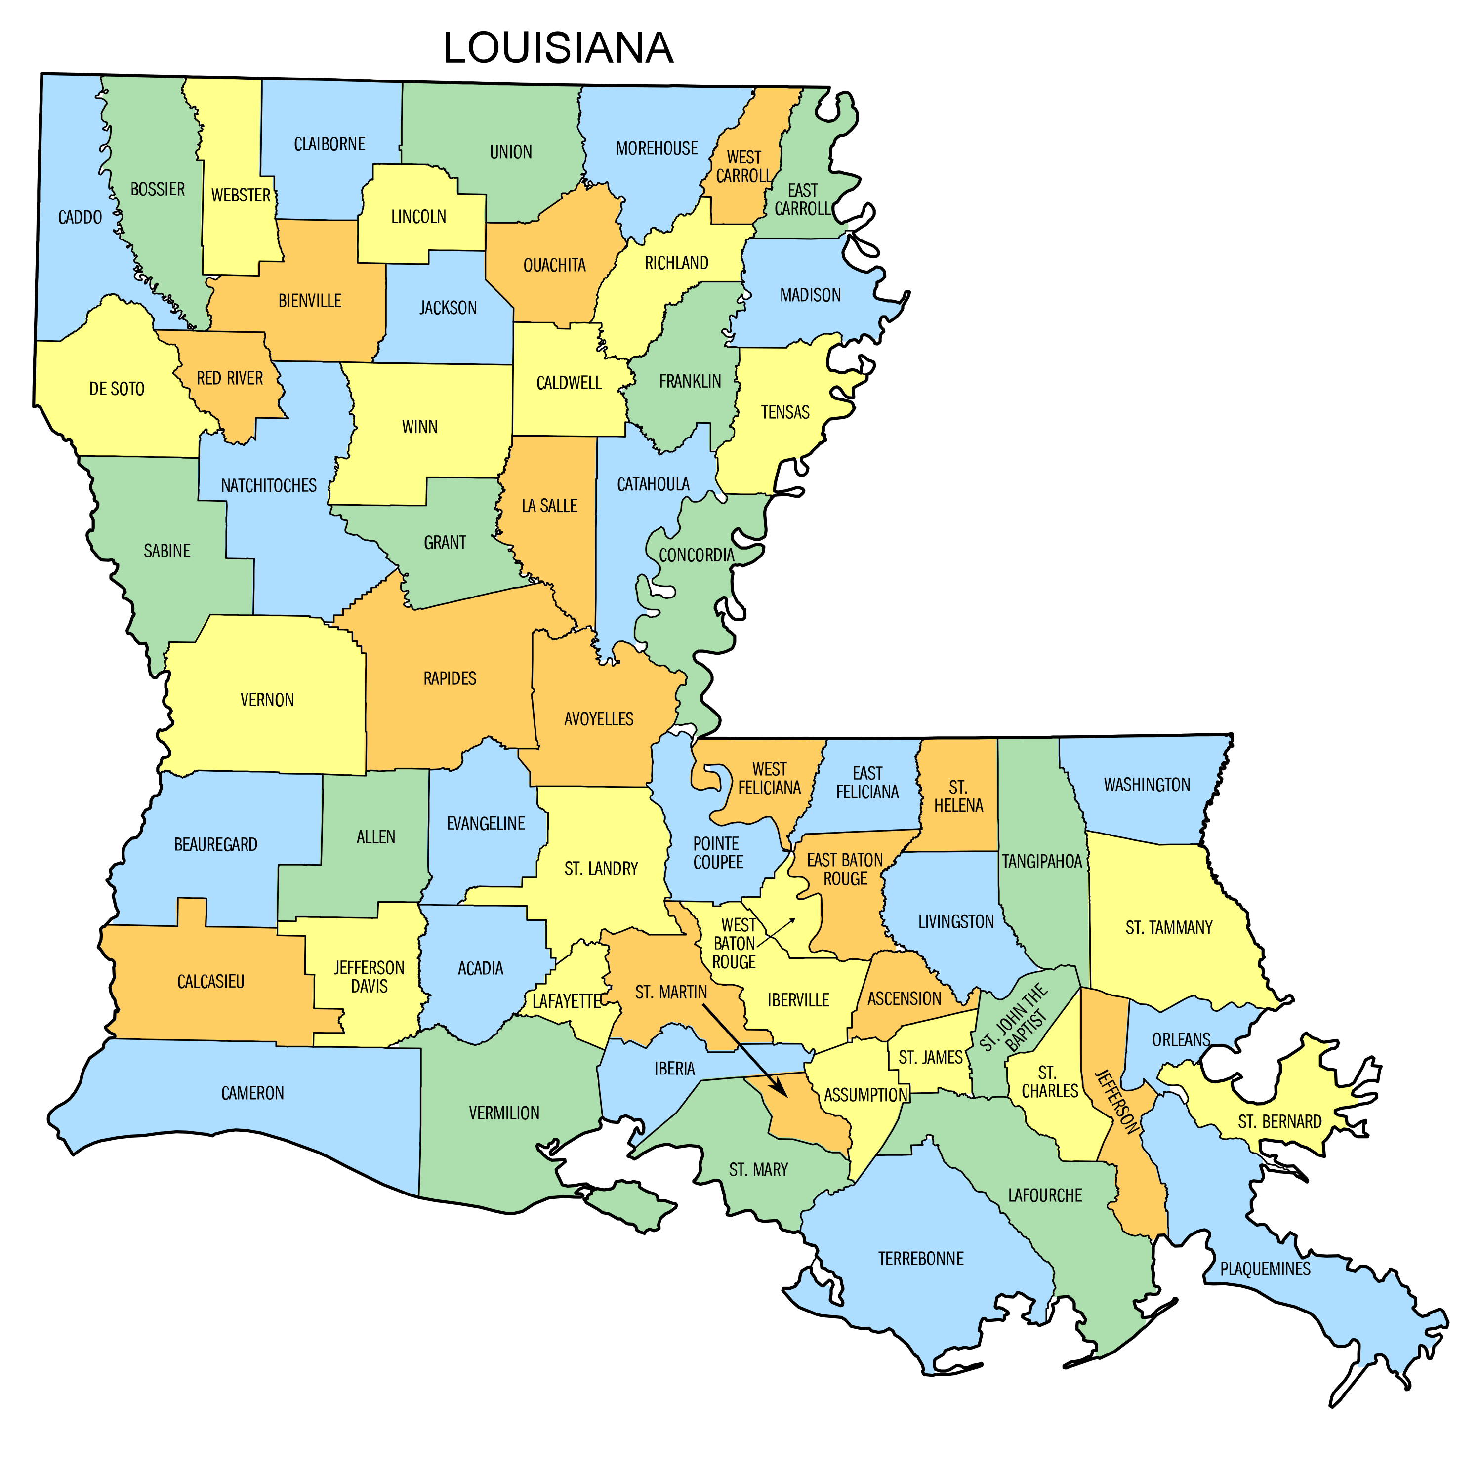
Across the State of Louisiana…
Urban Total Population: 6570
Controlled: 2984
Not Controlled: 3586
Rural Total Population: 2802
Controlled: 1038
Not Controlled: 1764

Slide 9
Notes:
Red line – 43% of overall population of diabetics with htn with controlled BP
Population with percent controlled <35 circled

Slide 10
Notes:
Parishes w/ less than 30 pts enrolled were omitted
Percent controlled of each parish w/ blood pressure controlled
Parishes with percent controlled <35 red circled
Green circles → >65% controlled
Red line – 43% of overall population of diabetics with htn with controlled BP

Slide 11
Notes:
Parishes w/ less than 30 pts enrolled were omitted
Percent controlled of each parish w/ blood pressure controlled
Parishes with percent controlled <35 red circled
Green circles → >50% controlled
Red line – 43% of overall population of diabetics with htn with controlled BP

Slide 12
Blood Pressure Control in Diabetics by Race
American Indian or Alaskan Native: 78
Controlled: 41
Not Controlled: 37
Unknown Race: 476
Controlled: 208
Not Controlled: 268
Two or More Races: 123
Controlled: 41
Not Controlled: 37
Black or African American: 5160
Controlled: 2140
Not Controlled: 3020
White: 3424
Controlled: 1502
Not Controlled: 1921
Asian: 145
Controlled: 80
Not Controlled: 65

Slide 13
Notes:
Race with percent controlled <35 circled
Red line – 43% of overall population of diabetics with htn with controlled BP
Native Hawaiian and other Pacific Islander Excluded bc n total = 8

Slide 14
Blood Pressure Control in Diabetics with other Co-Morbidities
Tobacco User: 3171
Those that responded “Yes” to tobacco use
Controlled: 1377
Not Controlled: 1749
Chronic Kidney Disease: 760
Controlled: 336
Not Controlled: 424
Atherosclerosis: 168
Controlled: 80
Not Controlled: 88

Slide 15
Notes:
Red line – 43% of overall population of diabetics with htn with controlled BP

Slide 16
Blood Pressure Control in Diabetics by Age
Age 18-24: 381
Controlled: 172
Not Controlled: 209
Age 25-34: 1010
Controlled: 436
Not Controlled: 574
Age 35-44: 1940
Controlled: 781
Not Controlled: 1159
Age 45-54: 2613
Controlled: 1086
Not Controlled: 1527
Age 55-64: 3373
Controlled: 1515
Not Controlled: 1858
Age 65-75: 95
Controlled: 47
Not Controlled: 48

Slide 17
Notes:
Red line – 43% of overall population of diabetics with htn with controlled BP

Slide 18
Summary & Recommendations
There is a greater number of “urban” parishes with percent controlled at or above 50% than “rural” parishes
Less optimal BP control seen in rural and/or Black/African American communities
ACLA currently has ongoing education campaign for those newly diagnosed with diabetes in rural areas, and is investigating root-cause barriers specific to African Americans
Continue to facilitate these campaigns, and also cater to those with HTN

Slide 19
Summary & Recommendations
Higher % BP control in those with atherosclerosis compared to other high-risk groups
Why are those with atherosclerosis more successful with controlling their BP?
Are those with CKD, for example, more prone to difficulty with BP control?
Out of the racial groups analyzed, Asians had the best percent control
Analyze what factors make this group successful
Younger age groups with diabetes tend to have lower % controlled HTN compared to older populations
Consider more social media campaigns to reach out to younger patients with diabetes

Slide 20
Acknowledgements & Sources
Special thanks to Dr. Randolph, Reneé Wells, Dana Smith, and Shea Good for all their help with drafting, data collections, and answering my many question!
Khangura DS, Waqar Salam M, Brietzke SA, Sowers JR. Hypertension in Diabetes. PubMed. Published August 7, 2021. https://www.ncbi.nlm.nih.gov/books/NBK279027/.
‌Hypertension | La Dept. of Health. La.gov. Published 2023. https://ldh.la.gov/page/hypertension
‌ACLA Clinical Quality Improvement Activity
ACLA Data

Slide 21
Questions?

Slide 22
Notes:
Parishes w/ less than 30 pts enrolled were omitted
Percent controlled of each parish w/ blood pressure controlled
Parishes with percent controlled <35 circled
Red line – 43% of overall population of diabetics with htn with controlled BP

Slide 23
Notes:
Parishes w/ less than 30 pts enrolled were omitted
Percent controlled of each parish w/ blood pressure controlled
Parishes with percent controlled <35 circled
Red line – 43% of overall population of diabetics with htn with controlled BP

