Slide 1

Analyzing the Connection Between Individual Characteristics and rates of Colorectal Cancer Screening
Tram Ngo, M4
LSUHSC New Orleans
Notes:
Hi everyone, my name is Tram Ngo and I am an MS4 at LSUHSC in New Orleans.
The project I am going to talk about today is a continuation of the project I did last month on colorectal cancer screening, but this time I am analyzing the connection between individual characteristics and it’s correlation to rates of colorectal cancer screening

Slide 2
Summary (from previous project)
Colorectal cancer screening (CCS) rates in urban vs rural Louisiana in 2023 were the same (44%)
CCS rates across different regions in Louisiana varied
Highest: region 1 and 3
Lowest: region 6 and 8
The parishes with highest screening rates were mainly in rural areas (St. Charles, St. James, St. Landry, and Acadia) apart from De Soto
The parishes with lowest screening rates were Allen and Madison, both of which are in rural areas
People in rural areas were more likely to have visited their PCP in 2023 than people in urban areas
Though there seems to be no disparity in colorectal cancer screening rates between the rural vs urban regions, access to primary care providers appears to positively influence colorectal cancer screening rates
Notes:
So here is a little refresher of the findings from my previous project looking at the correlation between geography and colorectal cancer screening rates in Louisiana in 2023
Colorectal cancer screening rate in urban vs rural Louisiana in 2023 were the same (at 44%)
CCS rates across different regions in Louisiana varied, with
region 1 and 3 having the highest rates
while region 6 and 8 had the lowest rates
The parishes with highest screening rates were:
Saint Charles
Saint James
De Soto
Saint Landry
Acadia
While the parishes with lowest screening rates were Allen and Madison
People in rural areas were more likely to have visited their PCP in 2023 than people in urban areas
And though there seems to be no disparity in colorectal cancer screening between the rural vs urban areas, access to primary care providers appears to positively influence colorectal cancer screening rates

Slide 3
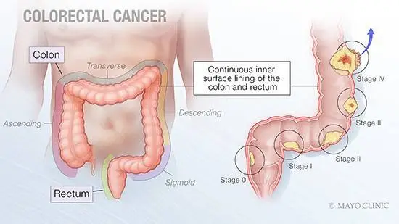
Background
Colorectal cancer (CRC) is 2nd greatest cause of cancer-related death in the United States
Colorectal cancer screening (CCS) can identify precancerous polyps, leading to prompt removal, thereby potentially preventing cancer from developing
The incidence and mortality rates of CRC have been declining in the United States, likely due to an increase in screening
Notes:
So, for a little background, colorectal cancer is 2nd greatest cause of cancer-related death in the United States
Colorectal cancer screening can identify precancerous polyps, leading to prompt removal, and thereby potentially preventing the cancer from developing
The incidence and mortality rates of CRC have been declining in the United States, likely due to an increase in screening

Slide 4
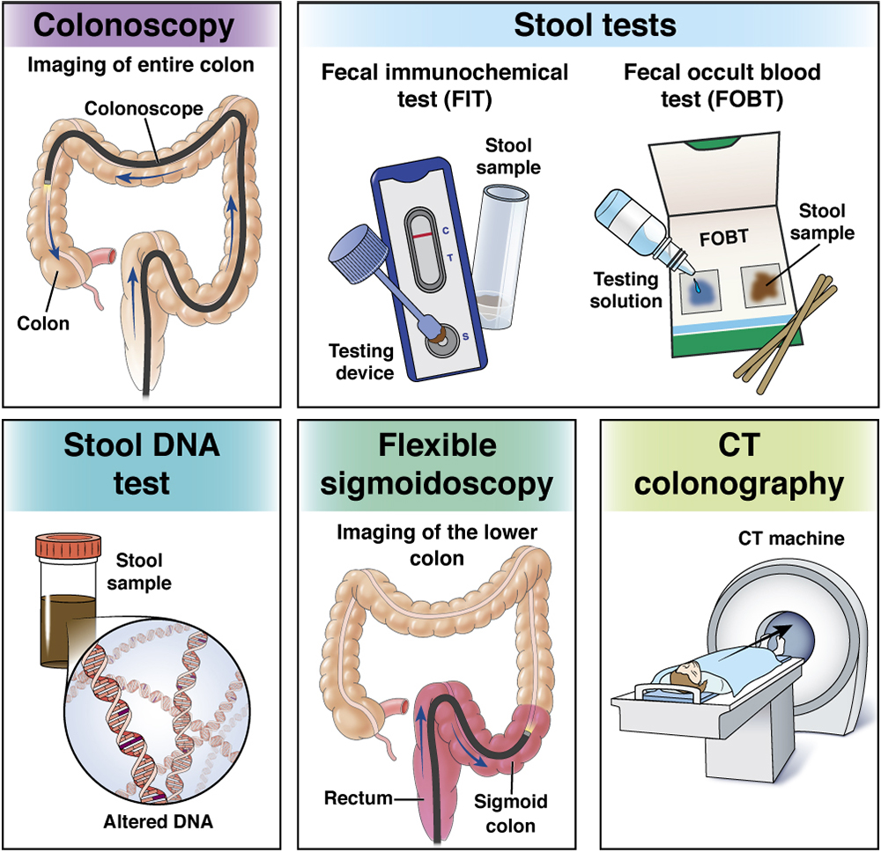
Types of Colorectal Cancer Screening
Stool-based tests
Highly sensitive fecal immunochemical test (FIT) every year
Highly sensitive guaiac-based fecal occult blood test (gFOBT) every year
Multi-targeted stool DNA test with fecal immunochemical testing (MT-sDNA or sDNA-FIT or FIT-DNA)) every 3 years
Visual (structural) exams of the colon and rectum
Colonoscopy every 10 years
Sigmoidoscopy every 5 years
CT colonography (virtual colonoscopy) every 5 years
Notes:
There are many ways to screen for colorectal cancer with either stool based or visual testing
Stool based tests includes:
fecal immunochemical test (repeat every year)
fecal occult blood test (repeat every year)
stool DNA test (repeat every 3 years)
Visual tests includes:
Colonoscopy (repeat every 10 years)
Flexible Sigmoidoscopy (repeat every 5 years)
CT colonography (repeat every 5 years)

Slide 5


Gender
Colorectal Cancer Screening Rates (2023):
Males: 3097/7184 (43%)
Females: 5384/10782 (50%)
Notes:
So when looking at gender and it’s correlation to CCS rates in 2023 in Louisiana, males had a lower compliance rate for colorectal cancer screening (at 43%) while females had a 50% compliance rate

Slide 6
Age
46-50: 1486/4561 (32.6%)
51-55: 1957/4211 (46.5%)
56-60: 2592/4887 (53.0%)
61-65: 2358/4130 (57.1%)
66-70: 67/135 (49.6%)
71-75: 21/42 (50.0%)*
*small sample size
Notes:
Here is the break down of the CCS rates in each age group
People ages 46-50 years old had the lowest screening rates at 32.6%
While people ages 61-65 years old had the highest screening rates at 57.1%
To note, age group 71-75 may be not be representative of the entire group because of the small sample size

Slide 7
Race/Ethnicity
American Indian/Alaska Native: 84/163 (51.5%)
Asian: 149/273 (54.6%)
Black/African American: 4007/8277 (48.4%)
White: 3763/7991 (47.1%)
Hispanic/Latino: 317/567 (55.9%)
Non-Hispanic/Latino: 6725/13159 (51.1%)
Notes:
This slide is looking at CCS rates in terms of race/ethnicity
Not every race/ethnicity is represented on this slide – those with less than 50 people were excluded
Hispanic and Latinos had the highest compliance rates for CCS at 55.9% while white people had the lowest compliance rates at 47.1%

Slide 8
Primary Languages
English: 8237/17531 (47.0%)
Spanish: 160/275 (58.2%)
Native Hawaiian: 80/137 (58.4%)
Notes:
Here we are looking at the primary languages spoken by the patients
Not every language is represented on this slide – those with less than 50 people were excluded
Interestingly, Native Hawaiian and Spanish speaking patients had a greater compliance rate for colorectal cancer screening (both at around 58%) than English speaking patients (which had a rate of 47%)

Slide 9
Type of screening
Colonoscopy: 6947/7325 (94.8%)
Fecal occult blood test: 293/7325 (4.0%)
Sigmoidoscopy: 79/7325 (1.1%)
CT colonography: 6/7325 (0.1%)
Notes:
When looking at what type of screening patients underwent, an overwhelming majority (94.8%) had a colonoscopy
While only 5.2% of the patients had either a fecal occult blood test, sigmoidoscopy, or a CT colonography

Slide 10
Screening Test: Colonoscopy vs. Other Tests
Notes:
I wanted to look further into the types of individuals who chose to do a colonoscopy vs. one of the other screening tests
So here is the breakdown in terms of gender and age
There seems to be no significant difference between the gender break down of the people who chose to do a colonoscopy vs. one of the other tests
And the same can be said about the ages – there seems to be no major differences there between these two groups as well when looking at age groups
CCS w/ colonoscopy: 6947/7325
Gender:
Male: 2571/6947 (0.37)
Female: 4376/6947 (0.63)
Age Groups
46-50: 1172/6947 (0.17)
51-55: 1561/6947 (0.22)
56-60: 2160/6947 (0.31)
61-65: 1974/6947 (0.28)
66-70: 63/6947 (0.01)
71-75: 17/6947 (0.0)
CCS w/o colonoscopy: 378/7325
Gender:
Male: 137/378 (0.36)
Female: 241/378 (0.64)
Age Groups
46-50: 59/378 (0.16)
51-55: 103/378 (0.27)
56-60: 105/378 (0.28)
61-65: 107/378 (0.28)
66-70: 3/378 (0.01)
71-75: 1/378 (0.0)

Slide 11
Screening Test: Colonoscopy vs. Other Tests
Notes:
Here we are comparing the race/ethnicity and primary languages between the group that did a colonoscopy vs the group that did one of the other tests
And again, similar to gender and age, there seems to be no significant difference between the race/ethnicity and primary languages of people who chose to do the colonoscopy vs one of the other screening methods
CCS w/ colonoscopy: 6947/7325
Race/Ethnicity
American Indian/Alaska Native: 65/6947 (0.01)
Asian: 115/6947 (0.02)
Black/African American: 3332/6947 (0.48)
White: 3062/6947 (0.44)
Hispanic/Latino: 252/6947 (0.04)
Non-Hispanic/Latino: 5554/6947 (0.80)
Primary language
English: 6743/6947 (0.97)
Spanish: 131/6947 (0.02)
Native Hawaiian: 71/6947 (0.01)
CCS w/o colonoscopy: 378/7325
Race/Ethnicity
American Indian/Alaska Native: 8/378 (0.02)
Asian: 3/378 (0.01)
Black/African American: 181/378 (0.48)
White: 161/378 (0.43)
Hispanic/Latino: 13/378 (0.03)
Non-Hispanic/Latino: 292/378 (0.77)
Primary language
English: 374/378 (0.99)
Spanish: 3/378 (0.01)
Native Hawaiian: 1/378 (0.0)

Slide 12
Summary
Women were more likely to undergo colorectal cancer screening (CCS) than men in Louisiana in 2023
Age group 45-50 had the lowest compliance rate for CCS
Age group 61-65 has the highest compliance rate for CCS
Hispanic/Latino was the race with the highest rates of CCS while White was the race with the lowest rates of CCS
People who speak Native Hawaiian or Spanish are more likely to get CCS
The majority of patients received a Colonoscopy as their screening test
Comparing patients who get colonoscopy vs other tests, there was no significant difference between the individual characteristics (gender, age, race/ethnicity, and primary language)
Notes:
So in summary, my study found that in Louisiana in 2023:
Women were more likely to undergo colorectal cancer screening than men
Age group 45-50 had the lowest compliance rate while the age group 61-65 has the highest compliance rate
Hispanic and Latinos was the race with the highest rates of CCS while White was the race with the lowest rates of CCS
People who speak Native Hawaiian or Spanish are more likely to get colorectal cancer screening than people who spoke English
The majority of patients received a Colonoscopy as their screening test
Comparing patients who got colonoscopy vs the other tests, there was no significant difference between the individual characteristics including gender, age, race/ethnicity, and primary language

Slide 13
Community Preventive Services Task Force (CPSTF) Recommendations
CPSTF recommends multicomponent interventions to increase screening for colorectal cancers
Multicomponent interventions consist of two or more intervention approaches reviewed by the CPSTF
Two or more intervention approaches from the following strategies:
Interventions to increase community demand: client reminders, client incentives, small media, mass media, group education, one-on-one education
Interventions to increase community access: reducing structural barriers, reducing client out-of-pocket costs
Interventions to increase provider delivery of screening services: provider assessment and feedback, provider incentives, provider reminders
The CPSTF recommendation is based on evidence from a systematic review of 88 studies (search period January 2004 - November 2013)
Compared with no intervention, multicomponent interventions increased colorectal cancer screening by a median of 15.4 percentage points
Notes:
Here are some recommendations by the Community Preventive Services Task Force for colorectal cancer screening
The CPSTF recommends multicomponent interventions to increase screening for colorectal cancers
The multicomponent interventions consist of 2 or more intervention approaches reviewed by the CPSTF
Combinations may include two or more interventions from the following strategies:
Interventions to increase community demand such as through client reminders, client incentives, small media, mass media, group education, and one-on-one education
Interventions to increase community access by reducing structural barriers and reducing client out-of-pocket costs
Interventions to increase provider delivery of screening services such as through provider assessment and feedback, provider incentives, and provider reminders
The CPSTF recommendation is based on evidence from a systematic review of 88 studies (search period January 2004 - November 2013)
Compared with no intervention, multicomponent interventions increased colorectal cancer screening by a median of 15.4 percentage points

Slide 14
AmeriHealth Current Initiatives
ACLA Participation in TACL (Taking Aim at Cancer in Louisiana)
Social Media Campaign to bring awareness to colorectal cancer screening
Distribution of Louisiana Department of Health Colorectal Cancer Fact Sheet and screening infographics
Faith-Based Organization Outreach and Education
Cancer Screening Saves Lives event at each Wellness and Opportunity Center to promote cancer screenings
$10 for completing colorectal cancer screening for current Care Card Member
Notes:
Listed on this slide is some of the ACLA colorectal cancer screening initiatives that are currently in place which includes:
ACLA participating in Taking Aim at Cancer in Louisiana
Social Media Campaigns to bring awareness to colorectal cancer screening
Distribution of LDH Colorectal Cancer Fact Sheet and screening infographics
Faith-Based Organization Outreach and Education
Cancer Screening Saves Lives event at each Wellness and Opportunity Center to promote cancer screenings
And current care card members can receive $10 for completing their colorectal cancer screening
Women's Health and Wellness Event on June 29,2023 at New Orleans Health and Wellness Center, included education on colorectal cancer screenings
Outreach to church communities in Region 5 for COL screening presentation; outreach and presentation to all Faith Based Organization that will allow presentation
Presented to Greenfield Baptist Church in Hammond Louisiana on 11/21/2023 to 70 attendees

Slide 15
Recommendations
Develop public awareness campaigns to emphasize the importance of colorectal cancer screening for both men and women, with tailored messaging to encourage screening among the 45-50 age group
Collaborate with community organizations serving populations with lower screening rates
Utilize mobile screening units to bring colorectal cancer screening services directly to underserved communities
Work with healthcare facilities across Louisiana to implement quality improvement initiatives aimed at increasing colorectal cancer screening rates and improving the overall quality of screening services.
Notes:
Lastly, here are some of my recommendations to improve colorectal cancer screening rates in Louisiana which includes:
Develop public awareness campaigns to emphasize the importance of colorectal cancer screening for both men and women, with tailored messaging to encourage screening among age group 45-50 years old
Collaborate with community organizations serving populations with lower screening rates
Utilize mobile screening units to bring colorectal cancer screening services directly to underserved communities
Work with healthcare facilities across Louisiana to implement quality improvement initiatives aimed at increasing colorectal cancer screening rates and improving the overall quality of screening services.

Slide 16


Thank you!
Dr. Gregory Randolph
Dana Smith
Renee Wells
Carrie Blades
Shea Good
Rhonda Baird
ACLA Quality Improvement Team

Slide 17
References
Sung H, Ferlay J, Siegel RL, et al. Global Cancer Statistics 2020: GLOBOCAN Estimates of Incidence and Mortality Worldwide for 36 Cancers in 185 Countries. CA Cancer J Clin. 2021;71(3):209-249. doi:10.3322/caac.21660
Cronin KA, Lake AJ, Scott S, et al. Annual Report to the Nation on the Status of Cancer, part I: National cancer statistics. Cancer. 2018;124(13):2785-2800. doi:10.1002/cncr.31551
Steele CB, Thomas CC, Henley SJ, et al. Vital Signs: Trends in Incidence of Cancers Associated with Overweight and Obesity - United States, 2005-2014. MMWR Morb Mortal Wkly Rep. 2017;66(39):1052-1058. Published 2017 Oct 3. doi:10.15585/mmwr.mm6639e1
Yang DX, Gross CP, Soulos PR, Yu JB. Estimating the magnitude of colorectal cancers prevented during the era of screening: 1976 to 2009. Cancer. 2014;120(18):2893-2901. doi:10.1002/cncr.28794
Colorectal cancer screening. Colorectal Cancer Screening. (n.d.).https://progressreport.cancer.gov/detection/ colorectal_cancer
Guide to Community Preventive Services. Cancer Screening: Multicomponent Interventions — Colorectal Cancer. https://www.thecommunityguide.org/findings/cancer-screening-multicomponent-interventions-colorectal-cancer.html. Page last updated: October 8, 2019.

