Slide 1



Compliance Rates in Continuation-Maintenance Visits for Pediatric AdhD members in louisiana during 2022-2023
By: Margaret Mena
LSU New Orleans School of Medicine
Population Health Elective

Slide 2
What is Attention Deficit Hyperactivity Disorder (ADHD)?
At its core, Attention Deficit Hyperactivity Disorder (ADHD) is a condition where there is inattention, hyperactivity, or a combination of the two in the patient.
In the United States, 6.1 million children aged 2-17 years were diagnosed with ADHD as of 2016.
Sixty-two percent, or 6 out of 10 children take medication for their ADHD, which is 1 of 20 of all US children.
Notes:
https://www.cdc.gov/ncbddd/adhd/diagnosis.html
https://www.cdc.gov/ncbddd/adhd/features/national-prevalence-adhd-and-treatment.html#:~:text=CDC%20scientists%20found%20that%2C%20as,is%20similar%20to%20previous%20estimates.

Slide 3
AmeriHealth Caritas Louisiana and ADHD
  Initiation Phase: Assesses children between 6 and 12 years of age who were diagnosed with ADHD and had one follow-up visit with a practitioner with prescribing authority within 30 days of their first prescription of ADHD medication.
  Continuation and Maintenance Phase: Assesses children between 6 and 12 years of age who had a prescription for ADHD medication and remained on the medication for at least 210 days, and had at least two follow-up visits with a practitioner in the 9 months after the Initiation Phase.
  All the data reviewed unless otherwise noted are compliant continuation and maintenance (CCM) patients.
Notes:
https://www.ncqa.org/hedis/measures/follow-up-care-for-children-prescribed-adhd-medication/

Slide 4

Age
Age (Years) | Total Members | Percentage
7 | 164 | 57%
8 | 122 | 54%
9 | 137 | 50%
10 | 110 | 58%
11 | 131 | 47%
12 | 100 | 45%
* Total Members = Total Continuation-Maintenance Members in Category
Findings: According to age, ten-year-olds had the highest compliance among continuation-
maintenance members whereas twelve-year-olds had lowest compliance among continuation-
maintenance members. There seems to be a big change at age 11 compared to the younger
members.
Notes:
Next step would be to do chi-square analysis.

Slide 5

Gender
Gender | Total Members | Percentage
Male | 503 | 52%
Female | 260 | 52%
* Total Members = Total Continuation-Maintenance Members in Category
Findings: The compliance rates between male and female continuation-maintenance members are similar.
Gender | TCI Members | Percentage
Male | 3403 | 65%
Female | 3403 | 35%
*TCI = Total Compliant Initiation; Members who were compliant with initiation in both categories
Findings: Females had significantly less initiations than males.
Notes:
Comments to be expressed on later:
- https://www.cdc.gov/ncbddd/adhd/data.html →

Slide 6
Member Region
Region | Total Members | Percentage
2 | 121 | 46%
8 | 55 | 47%
7 | 207 | 49%
3 | 19 | 53%
1 | 83 | 53%
6 | 77 | 55%
9 | 59 | 59%
4 | 99 | 61%
5 | 29 | 62%
* Total Members = Total Continuation-Maintenance Members in Category

Slide 7
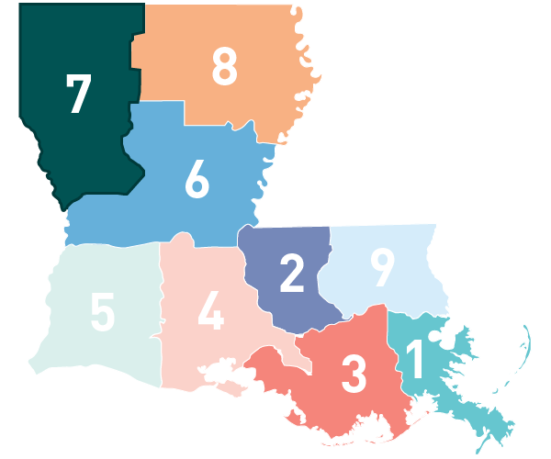
Member Regions Continued…
Findings: Region 2 had the lowest compliance rates for continuation-maintenance visits. Region 5 had the highest compliance rates for continuation-maintenance visits.

Slide 8
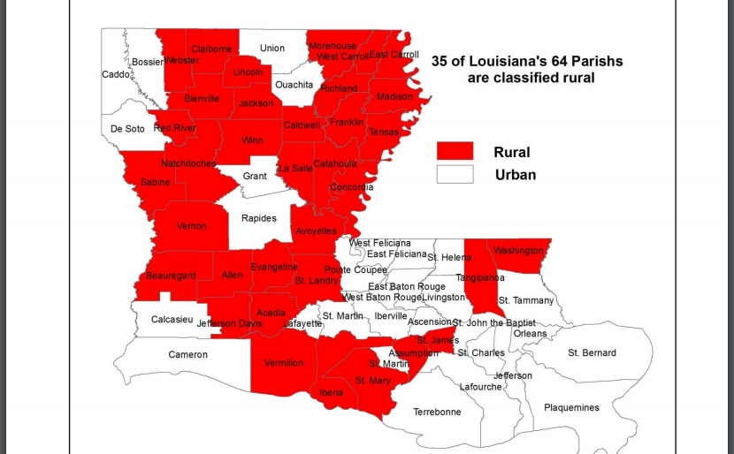
Rural Versus Urban
Status | Total Members | Percentage
Urban | 632 | 52%
Rural | 291 | 55%
Note: There were 14 unclassified.
*CCM = Compliant Continuation-Maintenance
** Total Members = Total Continuation-Maintenance Members in Category
Findings: The compliance rates between urban and rural continuation-maintenance members are similar.

Slide 9

Race
Race | Total Members | Percentage
White | 340 | 66%
Black or African American | 335 | 44%
*Total Members = Total Continuation-Maintenance Members in Category
Findings: The only significant findings could be concluded for the “White” and “Black or African American.” There was a notable difference between the two populations of 22%.
Note: Only “White” and “Black or African American” had a significant population amount.
Note: Primary language did not have enough data to draw accurate conclusions.

Slide 10

Ethnicity
Ethnicity | Total Members | Percentage
Hispanic/Latino | 59 | 64%
Not Hispanic/Latino | 476 | 51%
* Total Members = Total Continuation-Maintenance Members in Category
Findings: The Hispanic/Latino population had increased compliance rates compared to the other groups.

Slide 11
Discussion Points and Recommendations
Gender
  The compliance rates between males and females were similar, but the initiation rates were different (65% in males, 35% in females).
  Boys are more likely to be diagnosed with ADHD than girls (13% vs. 6%) in the United States.
  According to a 2023 systematic review, women are more likely to have inattentive type ADHD, making detection more difficult. Furthermore, women are more likely to be diagnosed with another condition before ADHD and treated with antidepressants.
  It would be interesting to see the subtypes of ADHD in Louisiana.
Member Region
  Region 2 had the lowest compliance rates for continuation-maintenance visits. Region 5 had the highest compliance rates for continuation-maintenance visits.
  What could be the reason for this? Good access to healthcare? Are there enough pediatricians in this area? Medication availability?
Notes:
https://www.cdc.gov/ncbddd/adhd/data.html
https://www.ncbi.nlm.nih.gov/pmc/articles/PMC10173330/#bibr38-10870547231161533

Slide 12
Discussion Points and Recommendations
Member Region Continued...
  We considered pediatrician to patient ratio as a possible reason for compliance differences in different regions. However, when evaluating this data, there was no correlation between compliance and pediatrician to patient ratio.
  There is a national shortage of ADHD medication. Having information about ADHD medication supply and region could be useful.
Race and Ethnicity
  There was a significant difference between compliance rates amongst different races and ethnicities. Overall, the Black and African American population experienced disparities in compliance rates. Interestingly, the Hispanic/Latino population was more compliant than their non-Latino counterparts.
  A National Study from 2022 found that a lack of access may be the cause of these disparities. However, in that study, there was also a disparity present for Latinos.
Notes:
https://www.medscape.com/viewarticle/no-end-sight-national-adhd-drug-shortage-2024a10004me?form=fpf
https://ps.psychiatryonline.org/doi/10.1176/appi.ps.202100578

Slide 13
References
Attoe DE, Climie EA. Miss. Diagnosis: A Systematic Review of ADHD in Adult Women. Journal of Attention Disorders. 2023;27(7):108705472311615. doi:https://doi.org/10.1177/10870547231161533
Centers for Disease Control and Prevention. Data and statistics about ADHD. Centers for Disease Control and Prevention. Published August 9, 2022. https://www.cdc.gov/ncbddd/adhd/data.html
Follow-Up Care for Children Prescribed ADHD Medication. NCQA. https://www.ncqa.org/hedis/measures/follow-up-care-for-children-prescribed-adhd-medication/
No End in Sight for National ADHD Drug Shortage. Medscape. https://www.medscape.com/viewarticle/no-end-sight-national-adhd-drug-shortage-2024a10004me?form=fpf
Yang KG, Flores MW, Carson NJ, Cook BL. Racial and Ethnic Disparities in Childhood ADHD Treatment Access and Utilization: Results From a National Study. Psychiatric Services. 2022;73(12). doi:https://doi.org/10.1176/appi.ps.202100578
Notes:
https://www.ncqa.org/hedis/measures/follow-up-care-for-children-prescribed-adhd-medication/
https://www.cdc.gov/ncbddd/adhd/data.html
https://www.ncbi.nlm.nih.gov/pmc/articles/PMC10173330/#bibr38-10870547231161533
https://www.medscape.com/viewarticle/no-end-sight-national-adhd-drug-shortage-2024a10004me?form=fpf
https://ps.psychiatryonline.org/doi/10.1176/appi.ps.202100578

Slide 14
Thank you for listening!

