Slide 1


Immunizations for Adolescents
Combo 2
A longitudinal analysis of vaccine compliance throughout the COVID pandemic
Population Health Management Clerkship - April 1, 2024
Logan Gold, MS-4

Slide 2
disclosure
No disclosures

Slide 3
outline
1. Combo 2 Vaccine Schedule
4. Compliance & Noncompliance
5. Barriers
2. Background & Methods
3. Patient Population, Demographics
6. Recommendations
7. Conclusions & Future Directions

Slide 4
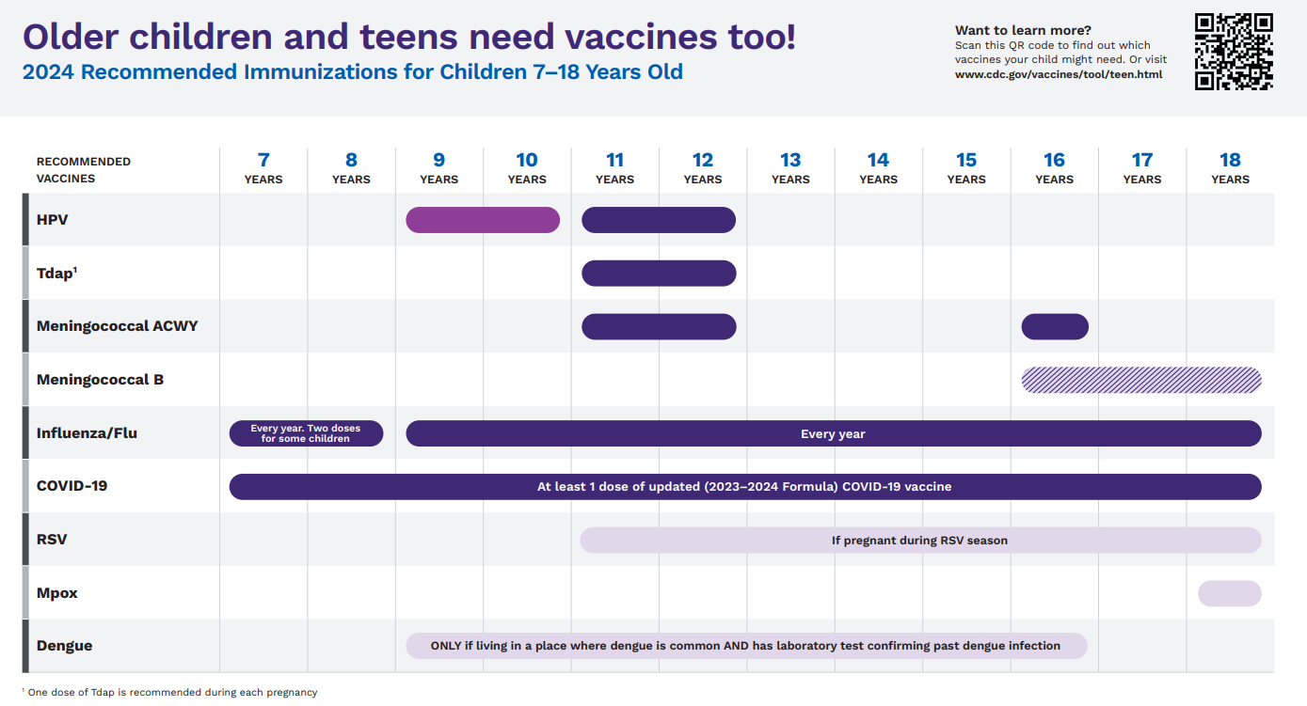


Slide 5



Patient population & goal
Compliant Population
Percentage of adolescents 13 years of age who have had
  One dose of Meningococcal & Tdap
  The complete HPV series
Total
Population
Adolescents turning 13 years of age in the calendar year
Target Measurement
2024 Target: 34.31% vaccine compliance*
  *NCQA Quality Compass 2023 (MY22) Medicaid National 50th Percentile (All LOBs [Excluding PPOs and EPOs]: Average) for the year prior to measurement

Slide 6
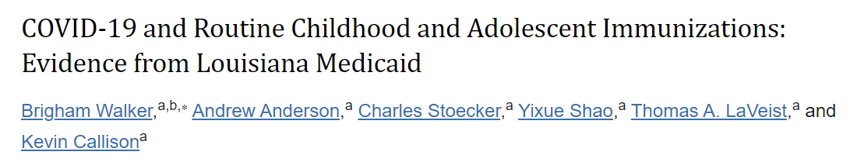
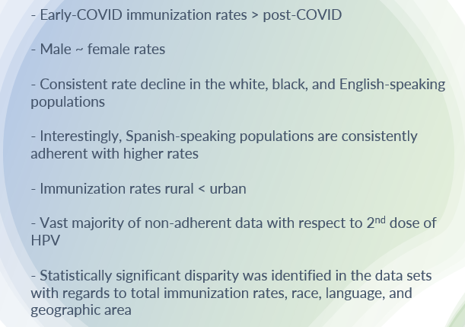
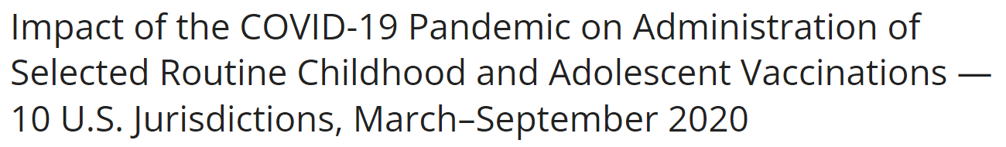

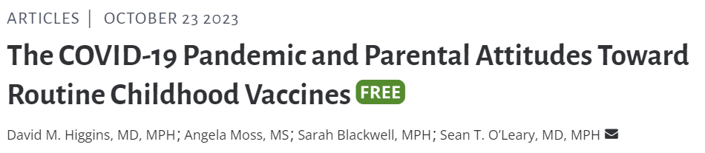
background

Slide 7

Compliance throughout covid
2020
2021
2022
2023
“Pre-COVID”
“During COVID”
“Post-COVID”
45.5%
40.2%
38.0%
Last year’s data: through Sept. 2023

Slide 8
Patient demographics
 | 2020 N=4461 | 2021 N=4695 | 2022 N=4679 | 2023 N=2252 | P-Value
Gender N, (%) |  |  |  |  | 0.6405
Male | 2268 (50.8) | 2328 (49.6) | 2368 (50.6) | 1138 (50.5)
Female | 2193 (49.2) | 2367 (50.4) | 2311 (49.4) | 1114 (49.5)
Race N, (%) |  |  |  |  | -
White | 1337 (30.0) | 1471 (33.0) | 1538 (32.9) | 778 (34.5)
Black or African American | 2605 (58.4) | 2705 (57.6) | 2618 (56.0) | 1265 (56.2)
American Indian or Alaska Native | 29 (0.650) | 30 (0.639) | 39 (0.834) | 19 (0.844)
Asian | 53 (1.12) | 56 (1.19) | 44 (0.940) | 21 (0.933)
Native Hawaiian or Pacific Islander | 3 (0.0672) | 0 | 4 (0.0563) | 2 (0.0888)
Two or More Races | 57 (1.13) | 52 (1.11) | 53 (1.13) | 42 (1.87)
Unknown | 377 (8.45) | 381 (8.12) | 383 (8.19) | 125 (5.55)
Ethnicity N, (%) |  |  |  |  | <0.00001
Hispanic or Latino | 276 (6.19) | 369 (7.86) | 563 (12.0) | 155 (6.88)
Not Hispanic or Latino | 2128 (47.7) | 2043 (43.5) | 2345 (50.1) | 1150 (51.1)
Unknown | 2057 (46.1) | 2283 (48.6) | 1771 (37.8) | 947 (42.1)

Slide 9
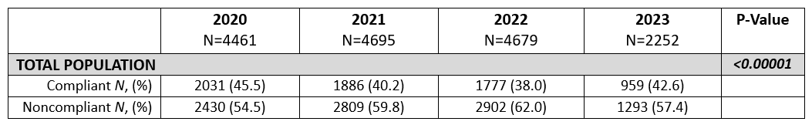

Overall compliance
2020
2021
2022
2023
“Pre-COVID”
“During COVID”
“Post-COVID”
42.6%

Slide 10
P<0.00001

Slide 11
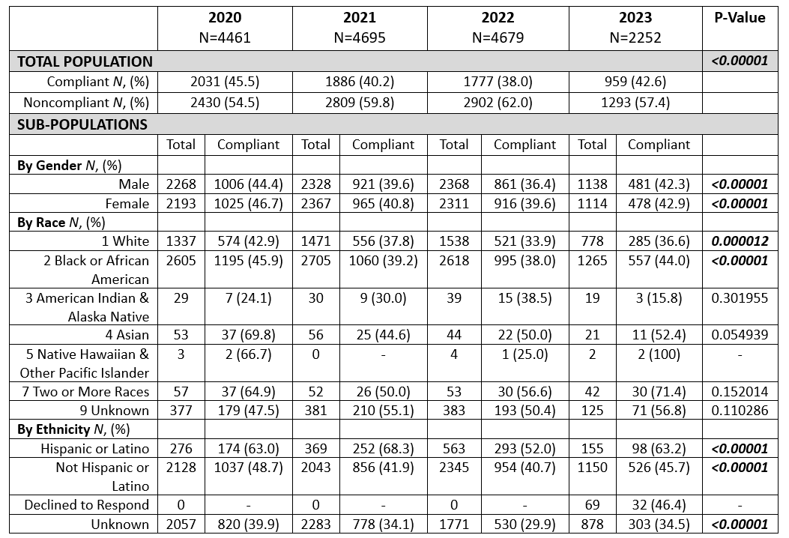
Compliance by gender, race, ethnicity

Slide 12
P<0.00001

Slide 13
P<0.00001

Slide 16
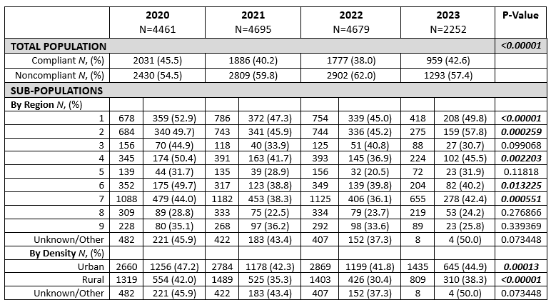
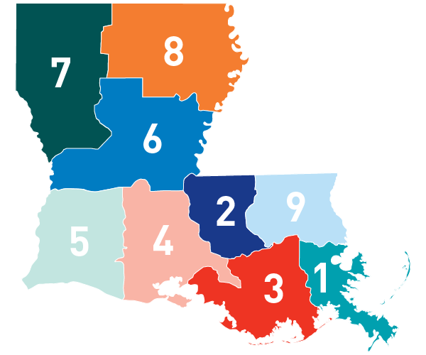

Regional compliance
Urban > Rural

Slide 17
NONCOMPLIANCE STRATIFIED BY VACCINE TYPE
 | 2020 N=2430 | 2021 N=2809 | 2022 N=2902 | 2023 N=1293 | P-Value
Vaccine |  |  |  |  | <0.00001
HPV N, (%) | 2391 (98.4) | 2776 (98.8) | 2892 (99.7) | 1277 (98.8) | 0.00006
Meningitis N, (%) | 551 (22.7) | 831 (29.6) | 908 (31.3) | 342 (26.5) | <0.00001
TDAP N, (%) | 546 (22.5) | 780 (27.8) | 888 (30.6) | 324 (25.1) | <0.00001

Slide 18
Noncompliant patients with refusal codes documented
 | 2020 | 2021 | 2022 | 2023 | P-Value
NONCOMPLIANT PATIENTS | N=2430 | N=2809 | N=2902 | N=1293 | -
Refusal Code Documented N, (%) | 14 (0.576) | 18 (0.641) | 8 (0.276) | 3 (0.232) | 0.093827
Caregiver or patient refusal, N (%) | 5 (35.7) | 5 (27.8) | 0 | 3 (100) | 0.014611
Under immunization status, N (%) | 9 (64.3) | 12 (66.7) | 1 (12.5) | 0 | 0.012847
Other or unspecified reason, N (%) | 0 | 1 (5.56) | 7 (87.5) | 0 | <0.00001
Type of Missing Vaccination, N (%)
HPV, N (%) | 14 (100) | 18 (100) | 8 (100) | 3 (100) | 1
HPV Only, N (%) | 13 (92.9) | 12 (66.7) | 7 (87.5) | 1 (33.3) | 0.071154
All (HPV + Men + TDAP), N (%) | 1 (7.14) | 6 (33.3) | 1 (12.5) | 2 (66.7) | 0.071154

Slide 19
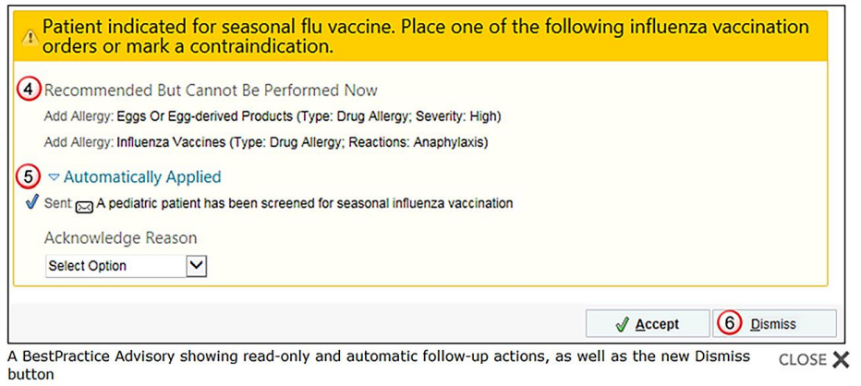
Barriers & recommendations
Information Gap
Patient & provider education
Inadequate Documentation
Document reasons for refusal
Access
AmeriHealth Caritas LA transportation resources
Reactive Medicine
EMR “alerts” for patients with missing vaccines

Slide 20
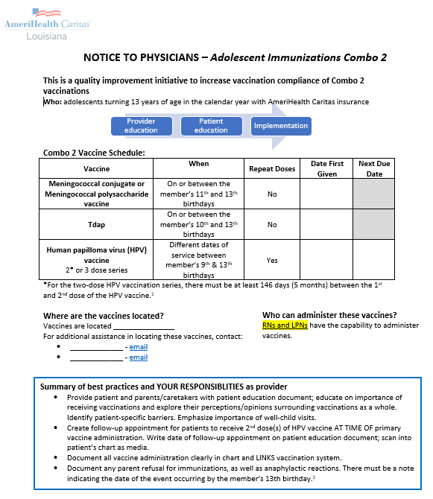
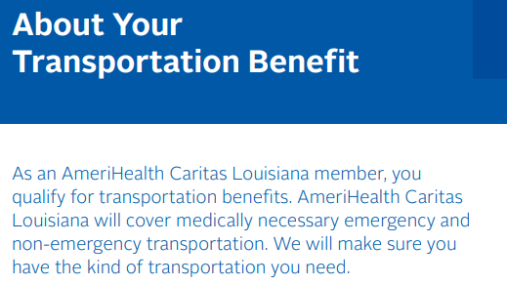
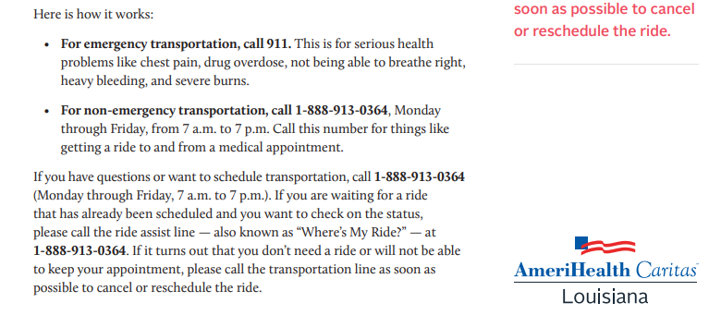

Slide 21








Conclusions + Future directions
Vaccine compliance rebound post-COVID
documentation to sample size
Urban > rural
Patient & provider education
HPV accounts for >92% noncompliance
Tip sheets, EMR alerts
High compliance among Spanish-speaking population
Transportation services

Slide 22



Acknowledgements
Dr. Gregory Randolph
Dana Smith
Renee Wells
Shea Good
Rhonda Baird
Lekitha Gregory
Danielle McGill

