Slide 1

School of Public Health
Faculty On-Boarding
Amee Barattini, MBA
Assistant Dean for Finance and Administration

Slide 2

Mission
To advance health equity through evidenced-based education, research, and practice for populations in the context of a changing climate.
Vision
A healthier Louisiana population with a workforce addressing the structural and emergent issues affecting public health.
Values
Collaborative Creative Culturally Adept Globally Engaged
Innovative Transformative
Notes:
Again, welcome to the LSU School of Public Health. Our Mission is to advance the public’s health and well-being through education, research and service with a focus on issues affecting Louisiana. In this ceremony, we have a number of awards to present to graduating students who have distinguished themselves in the classroom, in extra-curricular activities and in the practice of public health.

Slide 4
Faculty Handbook
The faculty handbook is a primary source of guidance for variety of information.
It includes the following sections: general information, definition of faculty, faculty appointments, recruitment, appointment and orientation, faculty personnel files, faculty evaluations, promotion, tenure, separation, faculty rights, duties and responsibilities, faculty development, and outside employment.
The annual review process currently takes place annually on a calendar year basis with faculty evaluations due March 1st each year.

Slide 5

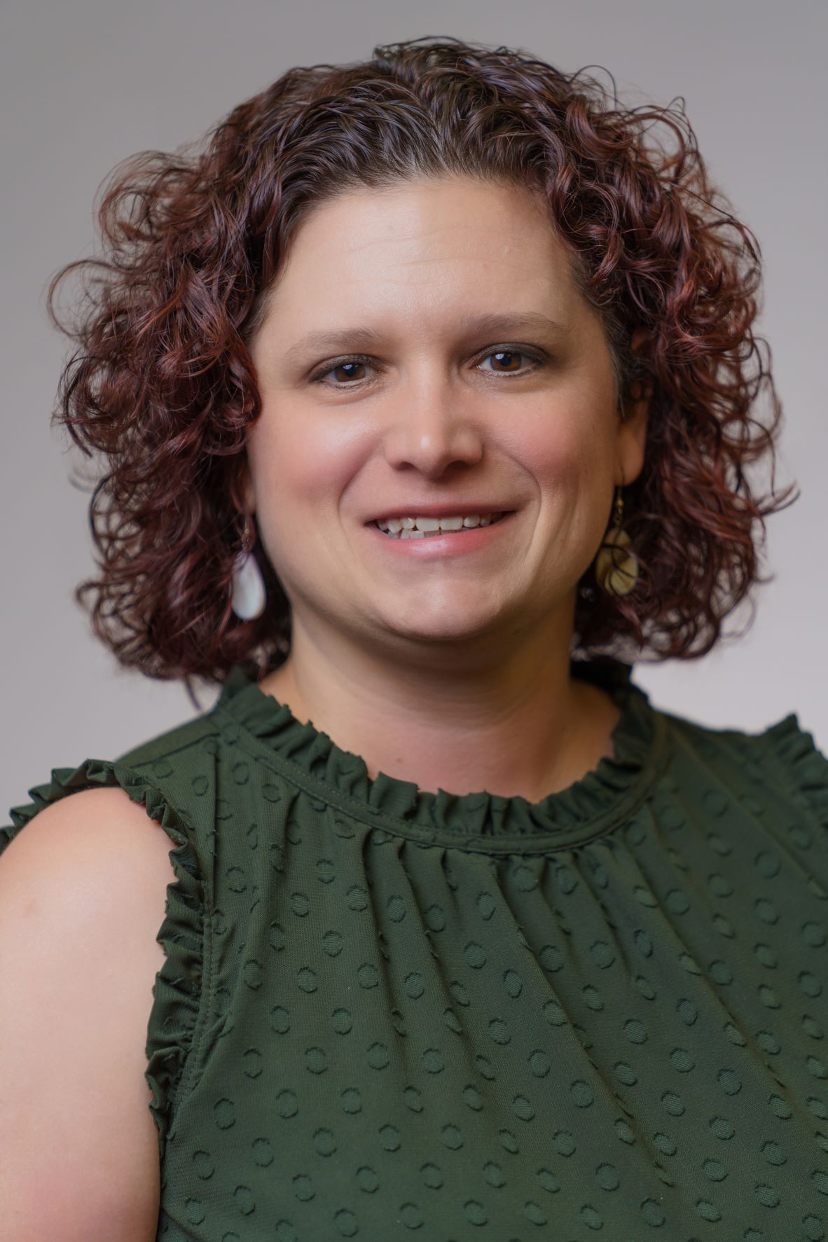
Finance and Administration
Amee Barattini, MBA
Assistant Dean for Finance and Administration
abarat@lsuhsc.edu
504.568.5922

Slide 6
School of Public Health Finance & Administration
Fiscal Staff
Dean’s Office
Laura Eller, MBA
Senior Business Operations Manager
leller@lsuhsc.edu
504-568-5770
Clarence Osteen, MA
Assistant Business Manager
costee@lsuhsc.edu
504-568-5720
Vacant
Program Coordinator of Contracts & Administration
504-568-5733
Program Areas
H. Betty Gonzales-Cardona, MBA
Business Manager
Louisiana Tumor Registry (LTR)
Toya Shanklin, MBA
Business Manager and Assistant Business Manager
Louisiana Cancer Prevention and Control Program (LCP)
Denise Fontenberry
Assistant Business Manager
STD/HIV/Hep C Program
Link to resources: Business Office Resources

Slide 7
Leave Policy and Employee Self-Service
PM-20 Leave Policy
Annual and sick leave are earned on a monthly basis.
PM-5 Holiday Schedule
There are 14 paid Holidays per year.
Employee Self Service
Requesting leave, approving leave, viewing paychecks
Requesting Leave Training Module
Payroll
Faculty are paid on a monthly basis on the last business day of the month.

Slide 8
Staff Hiring Process Overview
Link to more detailed information:
Hiring Process Presentation

Slide 9
Travel
All travel requires prior approval forms and reimbursement forms. Original receipts are required for travel to be paid.
  Note: International Travel requires committee approval prior to submission of an abstract. Allow a minimum of one month for approval.
All flights must be booked through the state’s travel agency
Meal and hotel expenses are paid per diem based on the federal GSA rates. Approval for conference hotel requires proper documentation in order to be paid at a higher rate.
Link for more detailed information and forms: https://sph.lsuhsc.edu/resources/business-office-resources/

Slide 10

Purchasing Requests
Office supply requests: submit requests to the Dean’s Office Administrative Assistant, Lezel Gaas
IT related purchases: submit requests to IT Staff List Serv
Other purchases: submit requests to Assistant Dean for Finance and Administration, Amee Barattini or to the business staff assigned to your funded projects
Note: Any food related purchase requires a business meal prior.

Slide 11
Grant Proposals
Pre-Award
Before starting your grant, please consult with Patricia Arteaga, Research Office Coordinator (SPH Research Office). She will help you route the proposal through central administration’s Office of Research Services (ORS) for approval by the Vice Chancellor or Academic Affairs (VCAA). She also assists with IRB approvals.
Routing is submitted via Kuali a minimum of 10 business days prior to the proposal due date.
Only the VCAA has the authority to approve and submit grant proposals on behalf of the University

Slide 12
Grants – Post Award
The fiscal staff member assigned to managing your budget will assist you with any post-award routing of budgets and documents in conjunction with Patricia Arteaga, Research Office Coordinator.
Routing is submitted via Kuali a minimum of 10 business days prior to the due date for any documents requiring routing.
Only the VCAA has the authority to approve documents on behalf of the University
Funded grants may be eligible for Research Incentive Compensation

Slide 13
Revenue Contracts
Revenue contracts for non-grant related work are routed through central administration’s Contracts Office. Only the Chancellor or the Chancellor’s designee is authorized to sign contracts.
Revenue contracts may require budget negotiations before routing and faculty should keep business staff involved in the process to ensure everything is budgeted accordingly

Slide 14
Expenditure Contracts
Expenditure contracts are routed through central administration’s Contracts Office. Only the Chancellor or the Chancellor’s designee is authorized to sign contracts.
Expenditure contracts that are federal subcontracts require additional steps due to subrecipient monitoring requirements.
Expenditure contracts are often a lengthy process due to negotiations of scope of work, budgets, and legal language.
Expenditure contracts cannot be initiated without a valid, active funding source.
More information on the process can be found here.

Slide 15
Compliance Training
New Hires are required to complete initial compliance training within 90 days of hire date
Existing employees are required to complete renewal and new trainings within 30 days of the date of notification
Emails with the required training information will be received from Frank Wasser noreply@bridgeapp.com and link to: Compliance Training - Bridge App.
Direct contact information:
Frank Wasser, JD, Compliance and Privacy Officer
Fwasse@lsuhsc.edu
504-568-4816

Slide 16
School of Public Health Finance & Administration
Information Technology Staff
Dean’s Office
Carl Kluttz
IT Analyst IV
ckluttz@lsuhsc.edu
504-568-5885
Room 335
Jason Armand
IT Analyst III
Jarman@lsuhsc.edu
504-568-5963
Room 305
Joseph Gautier
IT Analyst II
jgauti@lsushc.edu
504-568-5730
Program Areas
Brent Mumphrey
Project Coordinator
Louisiana Tumor Registry

Slide 17
IT Support and Resources
Submit IT help desk tickets via: https://solutions.lsuhsc.edu
Public Health IT Support email contact list serv: publichealthitsupport@lsuhsc.edu
Computer support reference materials are located Here and includes information such as how to reset a password, mapping network drives, using webmail, etc…

Slide 18
Frequently Used SPH List Servs
Name | Email | Purpose
Public Health Deans and Directors | publichealthdeansanddirectors@lsuhsc.edu | To send an email to the Dean, Associate/Assistant Deans, and Program Directors
Public Health, School of | sph@lsuhsc.edu | Published email address for the School
Public Health Conference Rooms and Events | sphconfrooms@lsuhsc.edu | To request a conference room reservation
Public Health Business Managers | publichealthbusinessmanagers@lsushc.edu | To email the Assistant Dean, Business Managers, and Associate/Assistant Business Managers
Public Health IT Support | publichealthitsupport@lsuhsc.edu | To send an email to IT support for any IT related needs
Public Health Maintenance | publichealthmaintenance@lsushc.edu | To send an email for any maintenance related request
Public Health Student Workers Deans Office | phswdo@lsuhsc.edu | To send a request to the students at the front reception desk
Public Health Webmaster | phwebmaster@lsuhsc.edu | To send an email to the webmaster for any website concerns or requests
Note: Program Directors will provide additional list serv information specific to an individual faculty member's department.

Slide 19

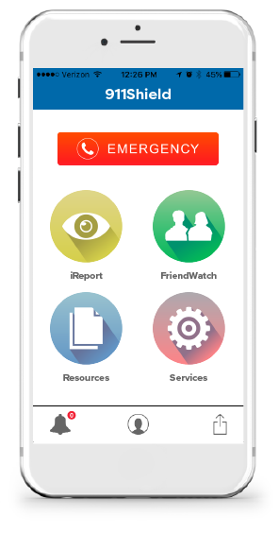
Campus Police
IN CASE OF AN EMERGENCY
► Call 568-8999
(Downtown Campus / After Hours –
Florida Avenue Campus)
► Call 941-8100
(6 am to 6 pm - Florida Avenue Campus)
TO SEND A TIP
TEXT 79516 and begin your message with LSUHSC followed by a space
  University Police will not be notified if your text does not begin with LSUHSC followed by a space
You will receive a text to notify you that the text has been received by uTip
https://911.lsuhsc.edu/report/lsushield.aspx

Slide 20
Emergency Alerts
In the event of an emergency situation, LSU Health Sciences Center—New Orleans administration has the capability to transmit pertinent information through the mediums of websites, phone trees, e-mail, text messaging, and digital signage to the entire spectrum of students, faculty and staff.
Alert Signup!
  https://911.lsuhsc.edu/EAS/default.aspx
  Once your cell phone number is registered, you will receive potential alert notifications related to dangerous or threatening situations or conditions (occurring or anticipated) in facilities owned by LSUHSC-NO on the downtown and Dental School academic campuses.

Slide 21
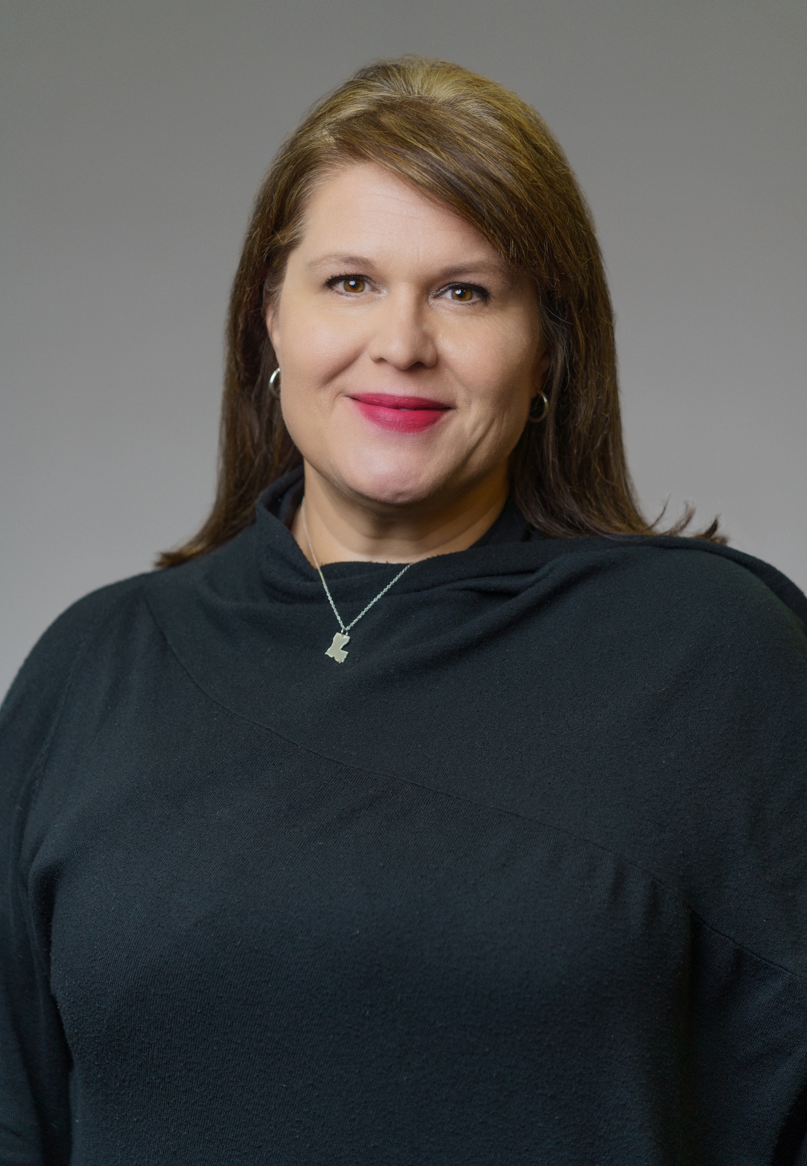
Academic Affairs
Kari Fitzmorris Brisolara, ScD, MSPH
Associate Dean for Academic Affairs
Professor, ENHS
kbriso@lsuhsc.edu
504.568.5725 (office)
504.250.1999 (cell)

Slide 22
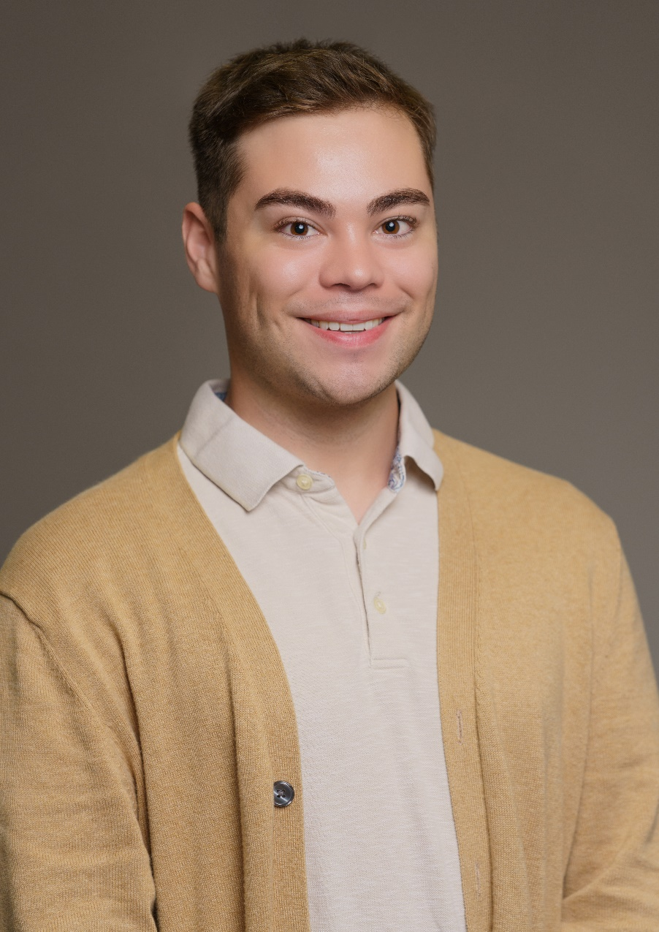
Academic Affairs
The Data Specialist for Academic Affairs is
John Fruge MEd
Please contact John for any systems needs including:
  Faculty Success (Digital Measures)
  Moodle LMS
  MyCourseEval
  PeopleSoft
  Faculty advising sheet reference materials

Slide 23
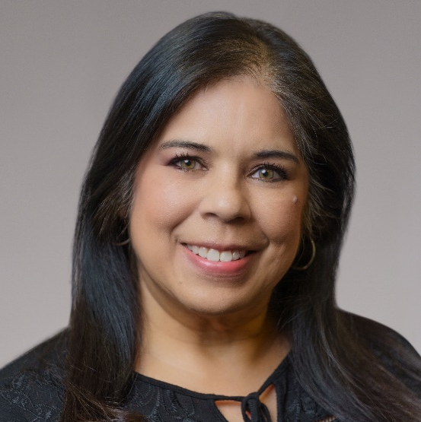
Isabel M. Billiot, MEd ibilli@lsuhsc.edu
504.568.5773
Withdrawals and deferred enrollment
Change in anticipated graduation date
Change of concentration
Change of advisor
Degree verifications
Verify enrollment for employment
Prepare I-20 application/documents
Compliance & HIPAA training notice
Commencement - logistics
Academic Calendar
Admissions:
SOPHAS application process
Deferred acceptance
Re-admits
International student assistance
Orientation – Student Affairs
Registration:
Overall troubleshooting
Auditing classes
Assign/Remove student blocks

Slide 24
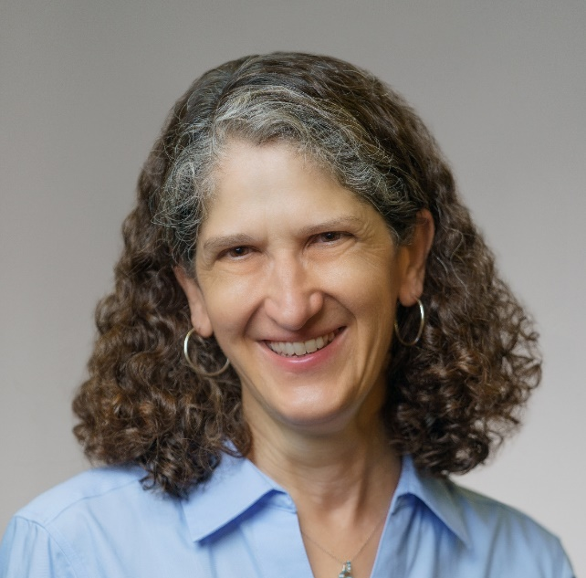
Martha L. Cuccia, MPH, MCHES mcucci@lsuhsc.edu
504.568.5789
Resumes, cover letters
Job/Fellowship/Student worker announcements
Internships (outside of Practice Experience)
Transcript/degree audit for commencement
Transfer credits
Academic probation
Thesis/Dissertation process
Commencement – checklist for graduation
National Public Health Week
Delta Omega coordination
Admissions:
Orientation – Academic Affairs
Registration:
Course permission number requests
Exam Only
Independent study
Course schedule

Slide 25
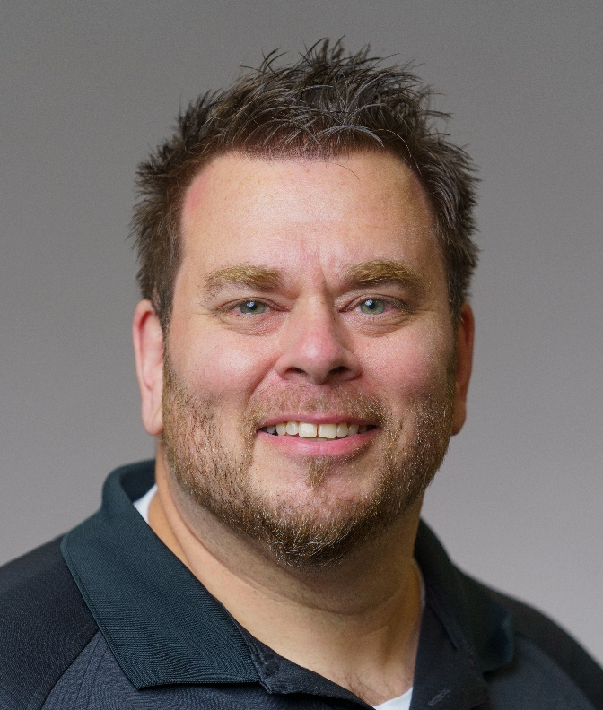
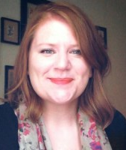
Courtney Martin
cmartin@lsuhsc.edu
504.568.5746
Recruiting
Marketing
Jason Armand, MBA
phmoodle@lsuhsc.edu
504.568.5963
Moodle Support

Slide 26
Program Directors

Slide 27
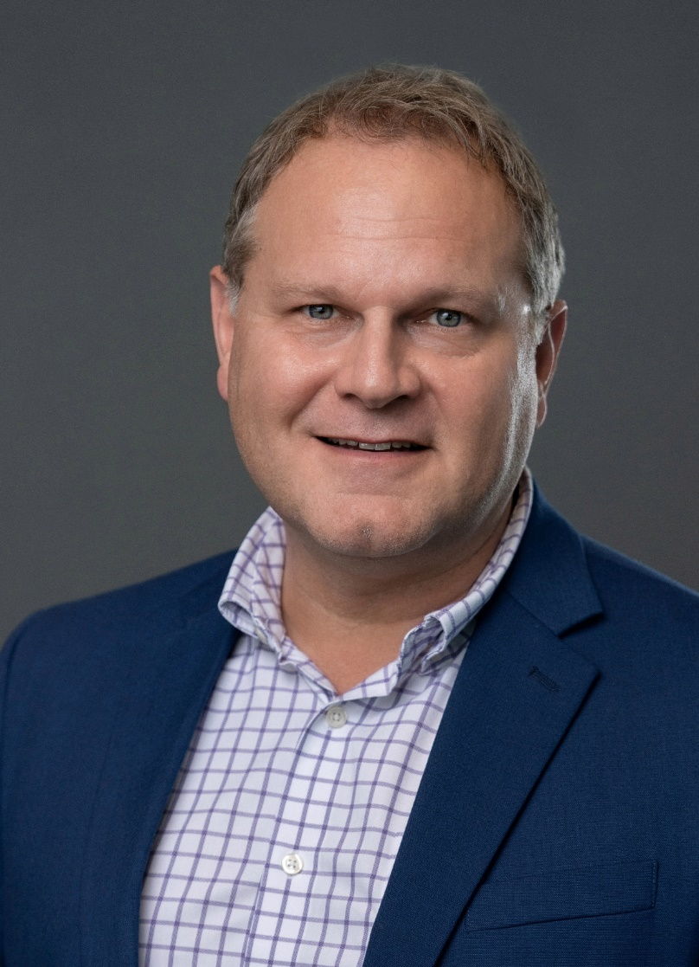
Community Health Science and Policy (CHSP) previously
Behavioral & Community Health Sciences
(BCHS)
Stephen Phillippi, Jr., PhD, LCSW, CCFC
Notes:
The Program Director will be presenting the graduating students from their program. The First is …

Slide 28
Research and Service Programs
Louisiana Cancer Prevention and Control Programs (LCP)
Principal Investigator: Donna Williams, DrPH
Fiscal Contact: Toya Shanklin, MBA
The program’s goals include eliminating suffering and death for cancers that are preventable or able to be detected early for treatment. Cancer focuses include breast, cervical and HPV, colorectal, lung and other tobacco-related cancers.
The program is primary funded by the Centers for Disease Control and Prevention. (CDC)

Slide 29
Research and Service Programs
Center for Evidence to Practice (EBP)
Principal Investigator: Stephen Phillippi, PhD
Fiscal Contact(s): Clarence Osteen, MA
The program supports agencies, organizations, communities, and providers in selecting and implementing research-driven behavioral health interventions.
The program is primary funded by the Louisiana Department of Health. LDH)

Slide 30
Research and Service Programs
Tobacco Control Initiative (TCI)
Principal Investigator: Michael Celestin, PhD
Fiscal Contact(s): Laura Eller, MBA and Clarence Osteen, MA
The program promotes multi-level, translational, and transdisciplinary approaches to cessation services and research.
The program is primary funded by the Louisiana Cancer Research and Consortium. (LCRC)

Slide 31
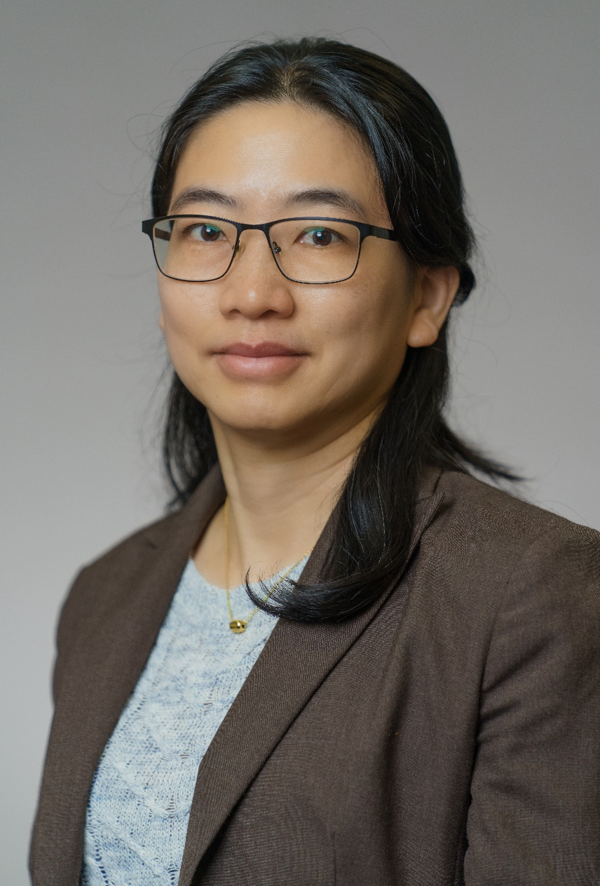
Biostatistics and Data Science
(BSDS) previously
Biostatistics
(BIOS)
Hui-Yi Lin, PhD (Interim)
Notes:
Dean Introduces Zhide

Slide 32
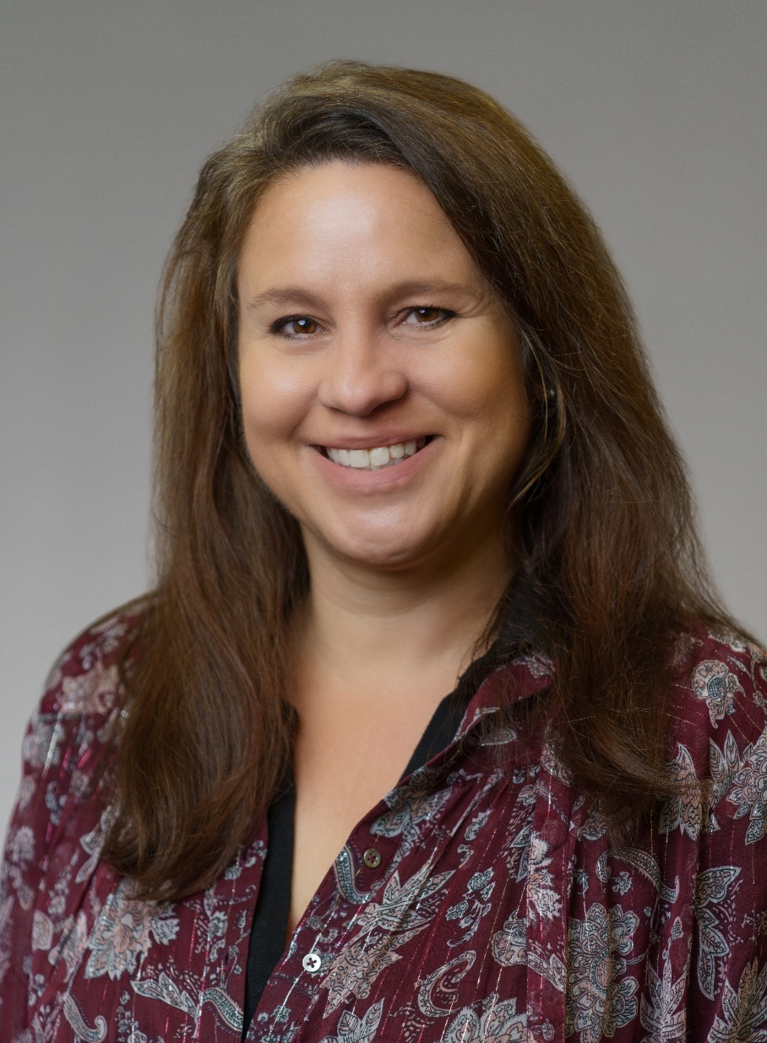
Environment, Health, Climate, and Sustainability
(EHCS) previously
Environmental and Occupational Health Sciences
(ENHS)
Adrienne Katner, DEnv, MS
Notes:
Dean introduces Jim

Slide 33
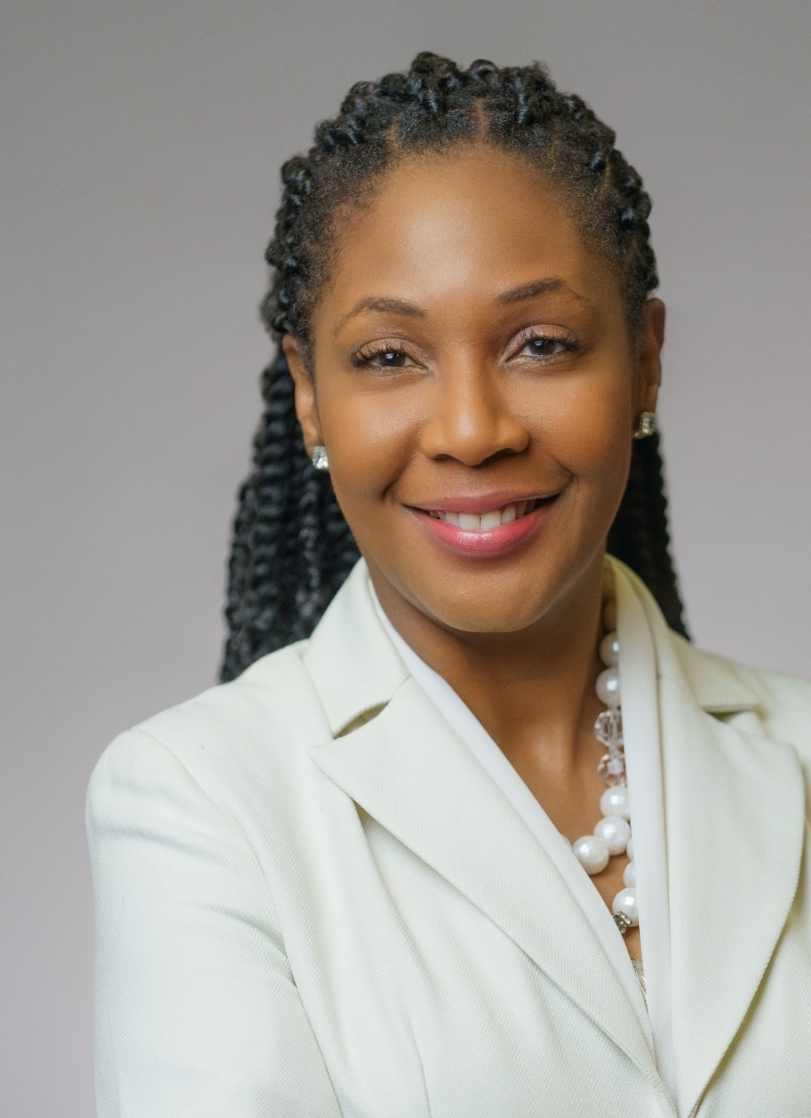
Epidemiology and Population Health (EPPH) previously
Epidemiology
(EPID)
Tekeda Ferguson, MPH, MSPH, CHES, PhD
Notes:
Dean Introduces Ed

Slide 34
Research and Service Programs
STD/HIV/Hepatitis Program (SHHP)
Principal Investigator: Deborah Wendell, PhD, MPH
Fiscal Contact: Denise Fontenberry, MSA
Administers statewide evidence-based public health services and interventions intended to prevent the transmission of STDs, HIV, and viral Hepatitis, and to ensure timely access to quality medical/treatment and supportive social services for those diagnosed with an STD, HIV, or Hepatitis.
Funded via a contract with Louisiana Department of Health (LDH) and partners with Southeast Louisiana Area Health Education Center (SEAHEC), Acadiana Cares, and the Centers for Disease Control and Prevention (CDC)

Slide 35
Research and Service Programs
Louisiana Tumor Registry (LTR)
Principal Investigator: Xiaocheng Wu, PhD
Fiscal Contact: Betty Gonzales, MBA
Collects and reports on population-based cancer data in Louisiana to support cancer research, control, and prevention.
It’s Surveillance, Epidemiology, and End Results (SEER) Program is funded by the National Institute of Health (NIH), National Cancer Institute (NCI). The registry also receives funding support from several other agencies include the Centers for Disease Control and Prevention. (CDC)

Slide 36
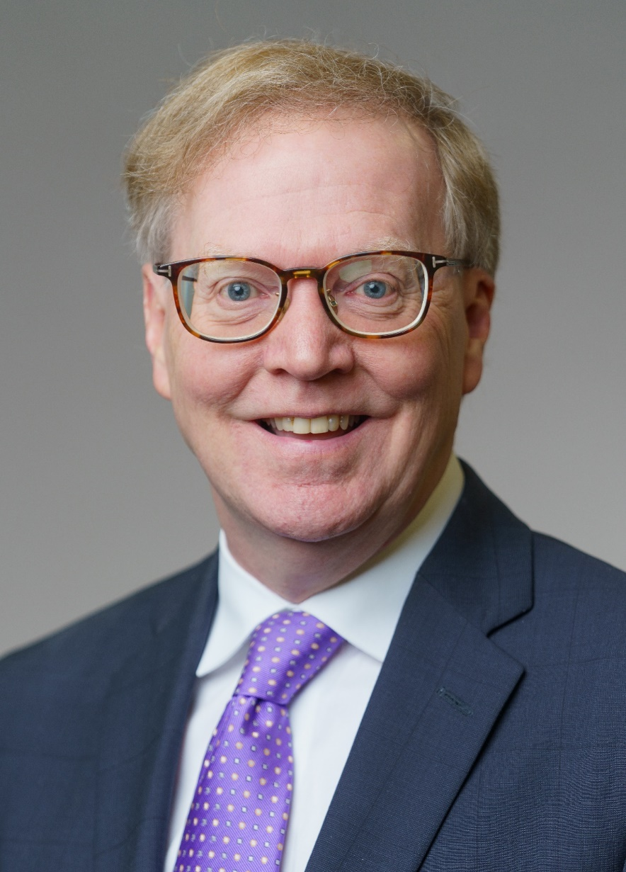
Health Policy and Systems Management
(HPSM)
Dean Smith, PhD (interim)
Notes:
Dean Introduces Dick

Slide 37
Academic Resources
SPH Faculty Development Page
  Resource in Moodle as a course – this page has information on advising, student forms, syllabus template, student handbook and various instructions and updates from Academic Affairs
  General teaching and faculty development resources are also housed here. For example, a modules on AI in the classroom and online teaching.
  https://moodle.lsuhsc.edu/course/view.php?id=5541
Additional faculty resources are available on the SPH website: https://sph.lsuhsc.edu/people/faculty/faculty-resources/

Slide 38
Accommodations
Upon acceptance to the School of Public Health, students are required to work with the Office of Disability Services to submit a Student Intake Form to their office if accommodations are needed.
Once the final documentation has been approved, it is the responsibility of the student to notify the course directors of the approved accommodations as noted by the Office of Disability Services.
Faculty members are to make reasonable course-related accommodations for qualified persons as prescribed by the appropriate healthcare provider and certified by the Office of Disability Services.
Office of Disability Services
Leigh Smith-Vaniz, Director
ods@lsuhsc.edu /504-568-2211
https://www.lsuhsc.edu/administration/academic/ods/

Slide 39
Catalog and Official Documents
https://sph.lsuhsc.edu/resources/sph-handbook-and-catalog/
  http://catalog.lsuhsc.edu/
https://sph.lsuhsc.edu/resources/course-schedule/
https://sph.lsuhsc.edu/resources/academic-calendar/
Additional information:
https://sph.lsuhsc.edu/resources/student-resources/

Slide 40
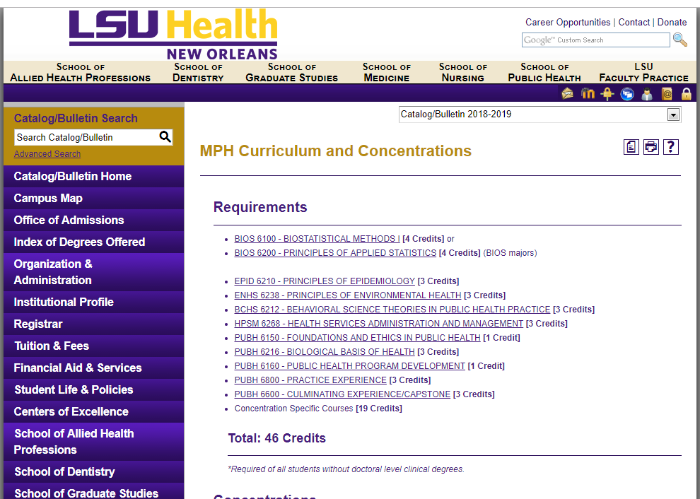
Curricula
Print program sheet: http://catalog.lsuhsc.edu/content.php?catoid=9&navoid=1845

Slide 41
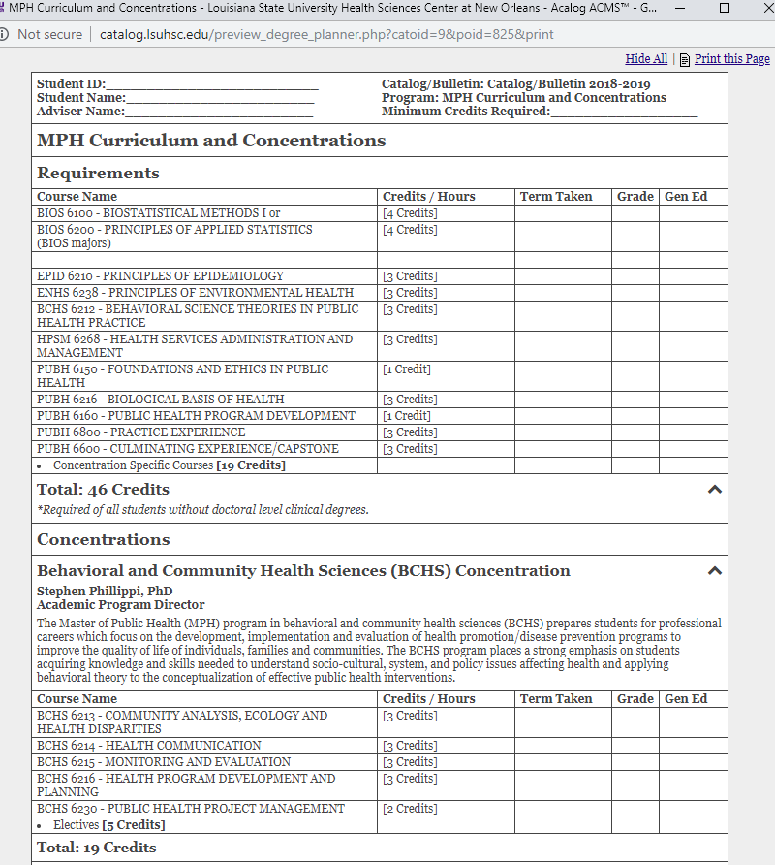
Degree Planner via Catalog
This is the checklist we use to determine eligibility for graduation.
Each student is responsible for using the correct catalog year!

Slide 42
Registration and Drop/Add
Registration Process
STUDENTS MUST CONSULT WITH THEIR ADVISOR before course selection and registration as your faculty advisor is the only one who can release the advisor approval hold on your account.
Student Self-Service Support
To access the online registration system: Academic Self-Serve using student LSUHSC login and password
Dates/deadlines regarding registration and adding/dropping courses are found on the Academic Calendar
Students must complete the process by the deadline noted on the academic calendar. Meeting the deadline helps to ensure disbursement of financial aid and secure enrollment for electives.
Drop/Add Process
Students consult with the course director, and then their academic advisor. The deadlines regarding withdrawing and grades are noted on the Academic Calendar
Students follow Student Self-Service to access instructions for Enrollment: Add Classes, Enrollment: Drop Classes.

Slide 43
Independent Study
Students may take a maximum of six (6) credit hours designated as “Independent Study.”
The procedure for the registration of these courses begins with discussion with your academic advisor.
The Independent Study Form should be initiated once a faculty member has agreed to participate.
The completed form must be submitted to the Office of Academic Affairs by the deadline indicated on the academic calendar.

Slide 44
Auditing Courses and Change of Advisor
Auditing Courses
Students may audit courses with the SPH, however it should be noted that once a course has been audited, students will not be allowed take it for academic credit in the future. To register to audit a course, students should contact Isabel Billiot ibilli@lsuhsc.edu for the necessary form after discussion with their academic advisor. The same tuition and fees will be charged for audited courses as for those courses taken for credit.
Change of Advisor
Students wanting to change advisors must complete the top section of the Change of Advisor Form, then have the current and proposed advisors sign the form. Students then submit the form to the Office of Academic Affairs for the Associate Dean’s signature.

Slide 45
Expectations
LSUHSC Standards: See Student Responsibilities and Rights (CM-56)
Exhibit the highest standard of personal, academic professional and ethical behavior.
Treat faculty, staff, peers, clients, patients, and others with dignity and respect.
Perform professional duties as best as possible.
The School of Public Health’s professional standards include the mandate that each student must: See School of Public Health Code of Conduct
Demonstrate respect for all people, inclusive of all ethnic backgrounds, religions, ages, sexual orientations, and gender.
Acknowledge and accept constructive criticism.
Deal responsibly and civilly with conflict.

Slide 46
Ways to Provide Feedback
SPH Evaluation Committee Feedback Form:
https://sph.lsuhsc.edu/resources/evaluation-committee/
Provide completely anonymous comments, tips, and suggestions on how we can make your educational experience better.
LSU Ethics & Integrity Hotline:
https://secure.ethicspoint.com/domain/media/en/gui/40897/index.html
Third-party/outside system managed that is securely configured to protect the identity of the reporter, if they wish to remain anonymous. It provides a formal mechanism for investigation, and communication between the investigator and the reporter during the follow-up, and response. Report suspected fraudulent or unethical behavior, such as:
  Financial irregularities Fraud Abuse Misconduct

Slide 47
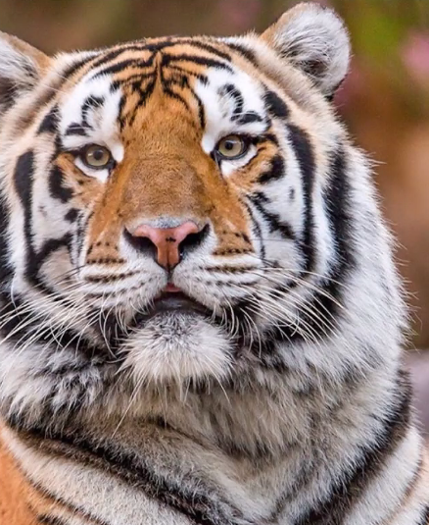
Questions?
GEAUX TIGERS

