Slide 1
Analyzing GLP-1 RA Usage and Demographics of Diabetic AmeriHealth Caritas Louisiana Members
Theresa Cao
Louisiana State University Health Sciences Center – New Orleans, LA
School of Medicine, Class of 2024
AmeriHealth Caritas Louisiana Medical Intern
April 1, 2024

Slide 2
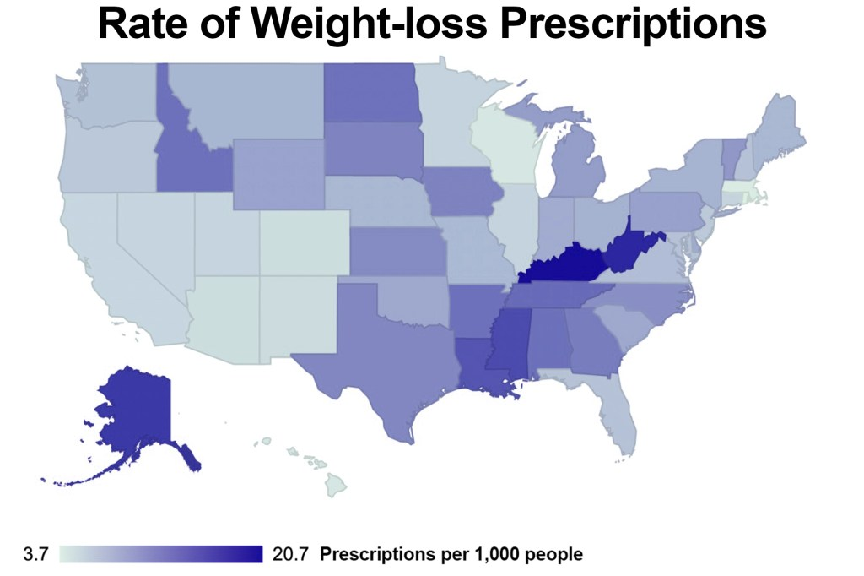

15
Notes:
According to New York Post, Louisiana – one of top 5 highest rates of prescriptions; 15 per 1000 people

Slide 3
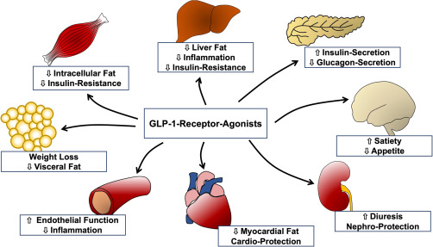
GLP-1-RAs: What Do They Do?
Notes:
GLP-1-RA - glucagon-like peptide-1 receptor agonists
-treat T2DM and obesity
-MOA: mimic the hormone glucagon-like peptide 1 that is normally produced by the body
-the GLP-1 helps body produce more insulin after eating, helps the brain feel more full and slows down food from stomach into small intestine
-also affects other organs such as heart contractility, decreasing glucose production in liver, increasing glucose uptake in muscle, etc.

Slide 4
GLP-1-RAs: Pros and Cons
Most Common Side Effects:
Nausea
Vomiting
Diarrhea
Possible low blood sugar (with other blood sugar lowering drugs)
According to the American Diabetes Association, consider in patients:
HbA1c greater than 1.5% over target
Cannot reach their target HbA1c in 3 months
Obese patients
Co-morbidities of atherosclerosis, heart failure, or chronic kidney disease (lowers BP & cholesterol)
NOT recommended for:
Pregnant women
Severe gastroparesis or IBD
Family hx of medullary thyroid CA or MEN
Hx of pancreatitis
Notes:
MEN – multiple endocrine neoplasia

Slide 5
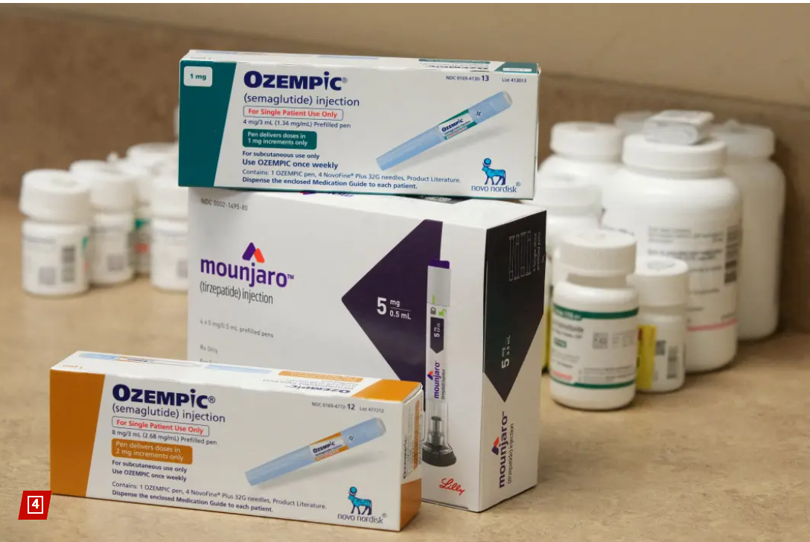
GLP-1-RAs: Examples
Lixisenatide (Adlyxin – daily)
Liraglutide (Victoza, Saxenda – daily)
Exenatide (Byetta – twice daily; Bydureon bcise – weekly)
Semaglutide (Rybelsus – oral daily; Ozempic – weekly)
Dulaglutide (Trulicity - weekly)
Albiglutide

Slide 6
Healthy Louisiana Medicaid Program Goals
Improve diabetes measure rates at least 2% annually
Expand efforts on social determinants of health and diabetes by working to identify, address, and monitor health disparities and close care gaps for improved health outcomes
Reinforce the importance of annual visits and routine screenings
Decrease avoidable urgent care visits, emergency room visits and hospitalizations among diabetic population

Slide 7
Data Analysis
Total population: Data obtained from 19,256 diagnosed diabetics aged 18 – 75 years old ACLA members during year 2023
Adequate Control HbA1c Population: Members with most recent HbA1c level < 8.0% | Poor Control HbA1c Population: Members with most recent HbA1c level > 9.0% or identified as 0, indicating HbA1c test is missing or was not done during 2023
< 8.0% : 3740 | > 9.0%: 636 Missing or not tested HbA1c: 14470
Included other data corresponding to: LDH Region of Residence Gender Age Race Language Spoken
Notes:
No differentiation between Type 1 or Type 2 DM
<8.0%: 3740
Total >9.0%: 636+14470 = 15,106

Slide 8
Demographic Characteristic | Proportion of Members in Region with Adequate Control |  | Proportion of Members in Region with Poor Control |  | Region Ranking
 | Count | % within each region | Count | % within each region
Region
Region 1 | 702 | 20% | 2812 | 80%
Region 2 | 716 | 28% | 1836 | 72%
Region 3 | 110 | 13% | 742 | 87% | 1st
Region 4 | 308 | 20% | 1258 | 80%
Region 5 | 212 | 22% | 758 | 78%
Region 6 | 360 | 25% | 1068 | 75%
Region 7 | 732 | 16% | 3980 | 84% | 3rd
Region 8 | 268 | 14% | 1612 | 86% | 2nd
Region 9 | 316 | 24% | 1000 | 76%
Unknown | 16 | 29% | 40 | 71%
Total | 3740 |  | 15106
Notes:
Region 3 – Houma
Region 8 - Monroe
Region 7 – Shreveport
<8.0%: 3740
Total >9.0%+NC: 636+14470 = 15,106

Slide 9
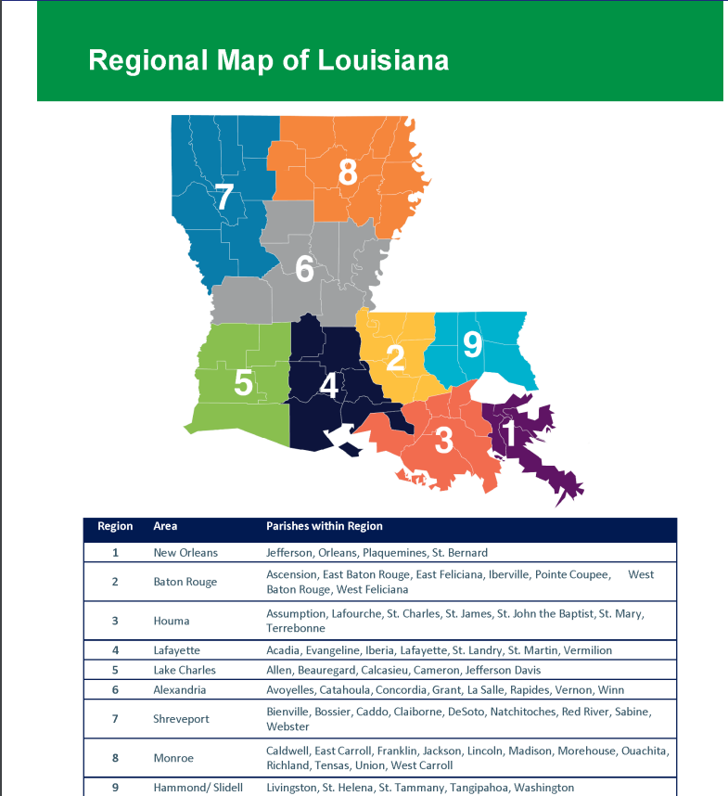
Louisiana Department of Health Regional Map

Slide 10
Gender Distribution
Age Groups Distribution
Notes:
Includes all diabetics, even those between HbA1c 8-9

Slide 11
Demographic Characteristic | Proportion of Members in Group with Adequate Control |  | Proportion of Members in Group with Poor Control |  | Ranking
 | Count | % within each group | Count | % within each group
Gender
Men | 1210 | 19% | 5158 | 81%
Women | 2530 | 20% | 9948 | 80%
Age Groups
< 30 | 232 | 15% | 1352 | 85%
30 - 39 | 554 | 17% | 2626 | 83%
40 - 49 | 916 | 20% | 3698 | 80%
50 - 60 | 1426 | 22% | 5088 | 78%
> 60 | 612 | 21% | 2342 | 79%
Total | 3740 |  | 15106
Notes:
Men and women had relatively same proportions
Trend of younger age groups being more poorly controlled than older age groups; as age increased, proportion of adequate control also increased
<8.0%: 3740
Total >9.0%+NC: 636+14470 = 15,106

Slide 12
Demographic Characteristic | Proportion of Members in Group with Adequate Control |  | Proportion of Members in Group with Poor Control |  | Ranking
 | Count | % within each group | Count | % within each group
Race
White | 1366 | 20% | 5534 | 80%
Black / African American | 1998 | 19% | 8314 | 81%
Asian or Pacific Islander | 94 | 31% | 206 | 69%
American Indian / Alaskan Native | 34 | 22% | 122 | 78%
Unknown | 248 | 21% | 930 | 79%
Total | 3740 |  | 15106
Language Spoken
English | 3628 | 20% | 14780 | 80%
Spanish | 64 | 21% | 240 | 79%
Total | 3692 |  | 15020
*Due to total groups of n < 20, subgroups of race (such as Hispanic, Native Hawaiian, Asian Indian, Guamania or Chamorro, Samoan) and language spoken (Vietnamese, French, Cambodian, Portuguese, Unknown) were not included in chart analysis
Notes:
All Groups relatively the same
Asian/Pacific Islander the most controlled
RACE
<8.0%: 3740
Total >9.0%+NC: 636+14470 = 15,106
Key:
White (1)
Black / African American (2, 10)
Asian or Pacific Islander (4)
American Indian / Alaskan Native (3)
Unknown (9)
Other (including Hispanic, Native Hawaiian, Asian Indian, Guamania or Chamorro, Samoan) (5, 6, 11, 12, 13, 7, 8)
Language Spoken
<8.0%: 3740
Total >9.0%+NC: 636+14470 = 15,106
Other including Vietnamese, French, Cambodian, Portuguese, Unknown

Slide 13
General Diabetic Member Data Summary for 2023
Region of Residence
Region 3, 8, 7 (Houma, Monroe, Shreveport) had the most % of poorly controlled members
Gender
Men had similar control compared to women
Age
Trend of younger age groups being more poorly controlled than older age groups; as age increased, proportion of adequate control also increased
Race
All racial groups had relatively similar control except Asian/Pacific Islander with the most proportion of adequate control
Language Spoken
English speaking group had similar control compared to Spanish speaking

Slide 14
GLP-1 RA Current Usage
Members Who Filled a GLP-1 RA Script in 2023: 8098 (42%)
Total GLP-1 RA Fill Count in 2023: 29,358
Notes:
Most filled are 9 and n=2
42% of all diabetic members
Less than 10 members currently on:
Soliqua
Xultophy
Bydureon
Byetta

Slide 15
GLP-1 RA Profile
Notes:
Most common ones: Ozempic, Trulicity, Mounjaro

Slide 16
Demographic Characteristics of Members who Fill GLP-1 RA | Proportion of Members in Region with Adequate Control |  | Proportion of Members in Region with Poor Control |  | Region Ranking
 | Count | % within each region | Count | % within each region
Region
Region 1 | 304 | 21% | 1172 | 79%
Region 2 | 318 | 28% | 830 | 72%
Region 3 | 58 | 16% | 300 | 84% | 2nd
Region 4 | 110 | 19% | 476 | 81%
Region 5 | 98 | 20% | 398 | 80%
Region 6 | 170 | 28% | 444 | 72%
Region 7 | 332 | 18% | 1470 | 82% | 3rd
Region 8 | 124 | 15% | 702 | 85% | 1st
Region 9 | 162 | 28% | 420 | 72%
Unknown | 6 | 25% | 18 | 75%
Total | 1682 |  | 6230
Notes:
Region 3 – Houma
Region 8 - Monroe
Region 7 – Shreveport
Similar to general data results
<8.0%: 1682
Total >9.0% = 6230

Slide 17
Gender Distribution
Age Groups Distribution
Notes:
Includes all diabetics, even those between HbA1c 8-9

Slide 18

Demographic Characteristics of Members who Fill GLP-1 RA | Proportion of Members in Group with Adequate Control |  | Proportion of Members in Group with Poor Control
 | Count | % within each group | Count | % within each group
Gender
Men | 378 | 20% | 1542 | 80%
Women | 1304 | 22% | 4688 | 78%
Age Groups
< 30 | 126 | 22% | 440 | 78%
30 - 39 | 256 | 17% | 1292 | 83%
40 - 49 | 508 | 23% | 1670 | 77%
50 - 60 | 592 | 21% | 2168 | 79%
> 60 | 200 | 23% | 660 | 77%
Total | 1682 |  | 6230
Notes:
Men and women had relatively same proportions
Usually general DM data: Trend of younger age groups being more poorly controlled than older age groups; as age increased, proportion of adequate control also increased
GLP-1RA data: age group 30-39 y/o has higher proportionate in poor control than other groups
<8.0%: 1682
Total >9.0% = 6230

Slide 19
Demographic Characteristics of Members who Fill GLP-1 RA | Proportion of Members in Group with Adequate Control |  | Proportion of Members in Group with Poor Control
 | Count | % within each group | Count | % within each group
Race
White | 638 | 20% | 2480 | 80%
Black / African American | 920 | 22% | 3354 | 78%
Asian or Pacific Islander | 18 | 28% | 46 | 72%
American Indian / Alaskan Native | 18 | 23% | 62 | 78%
Unknown | 88 | 23% | 288 | 77%
Total | 1682 |  | 6230
Language Spoken
English | 1654 | 21% | 6126 | 79%
Spanish | 14 | 58% | 10 | 42%
Total | 1668 |  | 6136
*Due to total groups of n < 20, subgroups of race (such as Hispanic, Native Hawaiian, Asian Indian, Guamania or Chamorro, Samoan) and language spoken (Vietnamese, French, Cambodian, Portuguese, Unknown) were not included in chart analysis
Notes:
All Groups relatively the same
Asian/Pacific Islander the most controlled
Language spoken Spanish not as helpful because n = <20
RACE
<8.0%: 1682
Total >9.0% = 6230
Key:
White (1)
Black / African American (2, 10)
Asian or Pacific Islander (4)
American Indian / Alaskan Native (3)
Unknown (9)
Other (including Hispanic, Native Hawaiian, Asian Indian, Guamania or Chamorro, Samoan) (5, 6, 11, 12, 13, 7, 8)
Language Spoken
<8.0%: 1682
Total >9.0% =
Other including Vietnamese, French, Cambodian, Portuguese, Unknown

Slide 20
GLP-1 RA Usage and ER Visits
Diabetic Members on GLP-1 RA Who Visited ER: 307
Included Diagnoses:
1. Diarrhea NOS – R19.7
2. Functional Diarrhea- K59.1
3. Infectious gastroenteritis and colitis NOS- A09
4. Nausea- R11.0
5. Nausea with vomiting- R11.2
6. Vomiting- R11.10 and R11.14
7. Unspecified adverse effect of drug or medicament- T88.7
8. Adverse effect of multiple unspecified drugs, medications, and biological substances- T50.915A
Notes:
Higher doses have more risk of admissions and ER visits?
Admits = only 5 distinct patients, too little of a group
Not included:
Bydureon = 1
Rybelsus = 3
ER Visits = 307 members
members who are diabetic using a GLP-1 and had a visit or readmit for below:
i. Diagnosis:
Diarrhea NOS – R19.7
Functional Diarrhea- K59.1
Infectious gastroenteritis and colitis NOS- A09
Nausea- R11.0
Nausea with vomiting- R11.2
Vomiting- R11.10 and R11.14
Unspecified adverse effect of drug or medicament- T88.7
Adverse effect of multiple unspecified drugs, medications, and biological substances- T50.915A

Slide 21
GLP-1 RA Dosage and ER Visits
Notes:
Higher doses have more risk of admissions and ER visits?
Admits = only 5 distinct patients, too little of a group
Not included:
Bydureon = 1
Rybelsus = 3
ER Visits = 307 members
members who are diabetic using a GLP-1 and had a visit or readmit for below:
i. Diagnosis:
Diarrhea NOS – R19.7
Functional Diarrhea- K59.1
Infectious gastroenteritis and colitis NOS- A09
Nausea- R11.0
Nausea with vomiting- R11.2
Vomiting- R11.10 and R11.14
Unspecified adverse effect of drug or medicament- T88.7
Adverse effect of multiple unspecified drugs, medications, and biological substances- T50.915A

Slide 22
Recommendations?
Group-specific | General
Emphasizing current interventions specifically in regions of Shreveport, Houma, and Monroe | Providing incentive to provider and members of yearly clinic visits and HbA1c testing
Providing more infographics appealing to younger audiences | Increasing awareness of established ACLA programs and incentives to both members and providers
Increasing texting alerts, reminders and diabetes educational facts to younger members | Providing ACLA providers with monthly reports of poorly controlled and non-compliant diabetic members
Encouraging provider discussions on health equity, implicit and explicit bias with non-White groups | Providing more flyers and infographics to all diabetic members at every office visit and in community settings

Slide 23


Acknowledgments
Renee Wells
Dr. Gregory Randolph
Dana Smith
Shea Good
Agnes Robinson
Lekitha Gregory
Carrie Blades
Rhonda Baird
Thank you!

Slide 24
References
Centers for Disease Control and Prevention. National Diabetes Statistics Report website. https://www.cdc.gov/diabetes/data/statistics-report/appendix.html.
Centers for Disease Control and Prevention. Diabetes State Burden Toolkit website. https://nccd.cdc.gov/Toolkit/DiabetesBurden/Prevalence
Centers for Disease Control and Prevention. United States Diabetes Surveillance System. Division of Diabetes Translation. https://gis.cdc.gov/grasp/diabetes/diabetesatlas-surveillance.html
American Diabetes Association. The Burden of Diabetes in Louisiana. https://diabetes.org/sites/default/files/2021-10/ADV_2021_State_Fact_sheets_Louisiana.pdf
The Community Guide. CPSTF Findings for Diabetes. Interventions to Prevent or Manage Diabetes. https://www.thecommunityguide.org/pages/task-force-findings-diabetes.html
Senn, J and S Fischli (2023). Visceral and Ectopic Fat. https://www.sciencedirect.com/topics/medicine-and-dentistry/glucagon-like-peptide-1-agonist
Castro, R. “GLP-1 agonists: Diabetes drugs and weight loss.” https://www.mayoclinic.org/diseases-conditions/type-2-diabetes/expert-answers/byetta/faq-20057955
Collins, L and R. A. Costello (2023). “Glucagon-Like Peptide-1 Receptor Agonists.” https://www.ncbi.nlm.nih.gov/books/NBK551568/
Steinberg, B (2024). “States with the most people on weight-loss drugs like Ozempic, Wegovy revealed.” New York Post. https://nypost.com/2024/01/19/lifestyle/states-with-most-people-on-ozempic-wegovy-for-weight-loss/

Slide 25
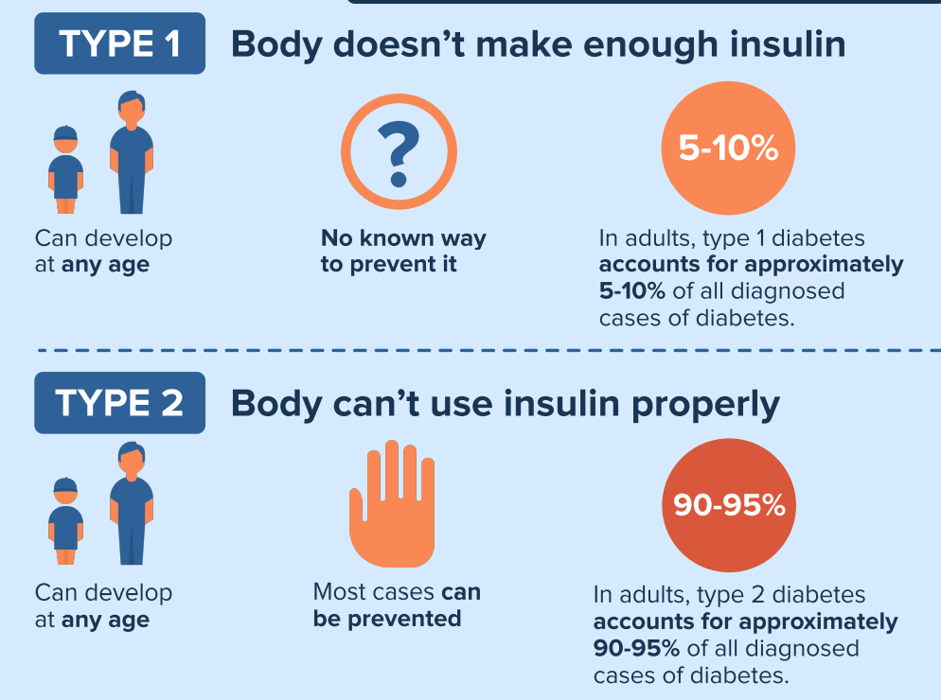
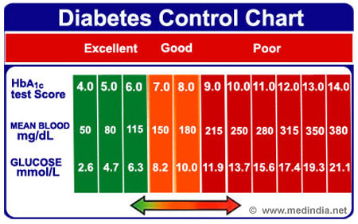
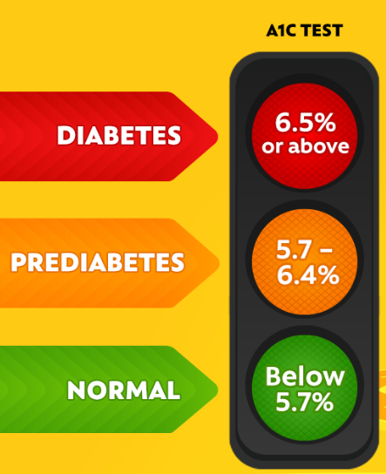
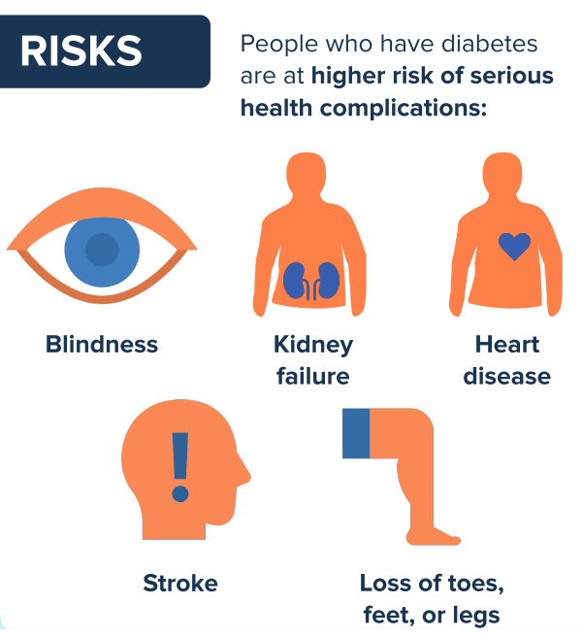

DIABETES
Combined diet and physical activity programs
Counseling, coaching, individualized guidance
Engaging community health workers for diabetes prevention and management
Mobile phone apps for self-management (Type 2 Diabetes)
Team-Based Care
Notes:
Diabetes – chronic health condition when there is not enough insulin (in type 1 DM) or insulin not be used well (in type 2 DM), causing too much sugar in bloodstream
Higher risk of health complications such as blindness, kidney failure, heart disease, stroke, loss of limbs
Measurement to help diagnose DM is HbA1c – which measures the average blood sugar level over the past 2 or 3 months. An A1C below 5.7% is normal, between 5.7 and 6.4% is prediabetes, and 6.5% or higher is diabetes.
Within Diabetes, there is good control as well as poor control, good control is considered an HbA1c <8.0% and poor control is considered >9.0%
Current strategies recommended to prevent and manage DM according to the Community Guide are…

