Slide 1

HIV Trends in LA During and Post Pandemic
How Can Louisiana Improve?
Eva Mace
Louisiana State University Health Sciences Center – New Orleans
AmeriHealth Caritas Louisiana

Slide 2
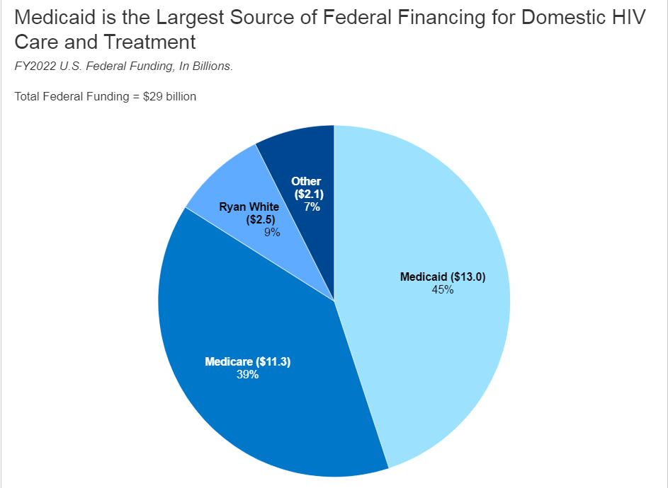
Background
Patients with HIV rely heavily on Medicaid
HIV rates in LA are some of the highest in the nation although Medicaid expansion has been implemented
HIV is preventable and treatment is available to reduce morbidity and mortality as well as decrease transmission
Notes:
Patients with HIV rely heavily on Medicaid from this graph, you can see that 45% of HIV care and tx nationally is covered my Medicaid
HIV is rates in LA are some of the highest in the nation despite the fact Medicaid expansion has been implemented
HIV is preventable and treatment is available to reduce morbidity and mortality as well as decrease transmission

Slide 3
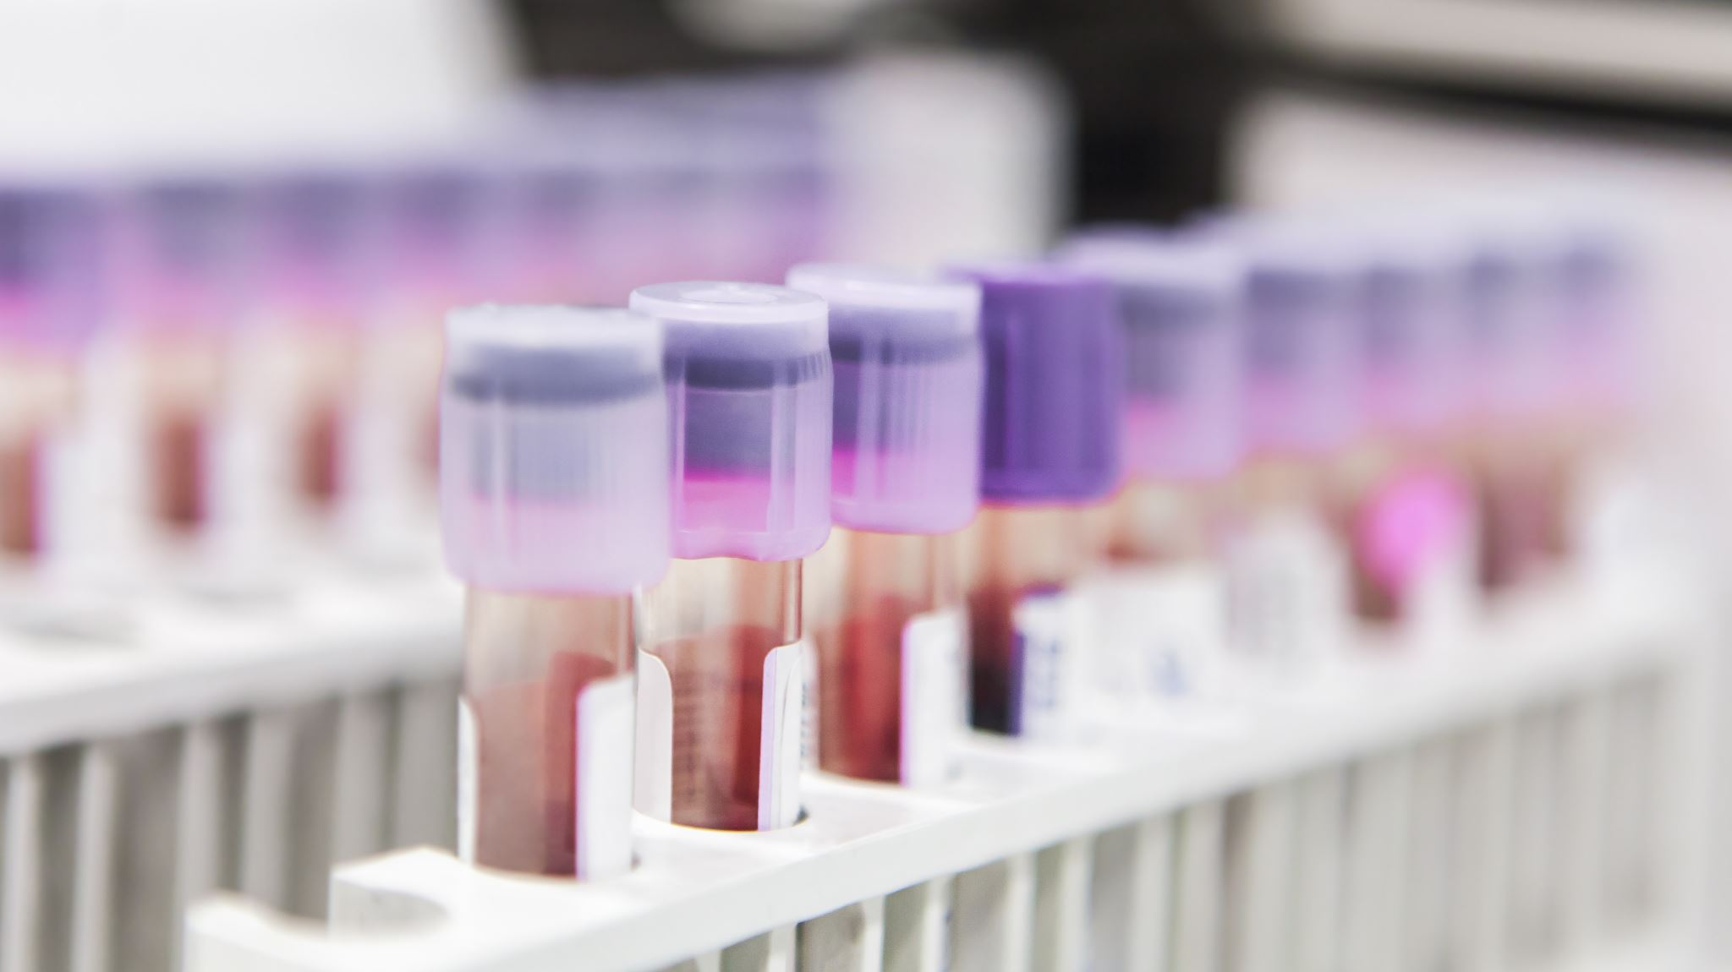
Medicaid’s Goal
81.65% of patients with HIV to be within the compliant population
Compliant Population
  The percentage of members ages 18 and older with a diagnosis of Human Immunodeficiency Virus (HIV) who had a HIV viral load less than 200 copies/mL at last HIV viral load test during the measurement year.
  < 200 copies/mL is the clinical threshold for PWH to be considered undetectable
  Undetectable= Untransmittable!!!
Notes:
Medicaid’s Goal
81.65% of patients with HIV to be within the compliant population
Compliant Population
The percentage of members ages 18 and older with a diagnosis of Human Immunodeficiency Virus (HIV) who had a HIV viral load less than 200 copies/mL at last HIV viral load test during the measurement year.
< 200 copies/mL is the clinical threshold for PWH to be considered undetectable
Undetectable= Untransmittable!!!

Slide 4
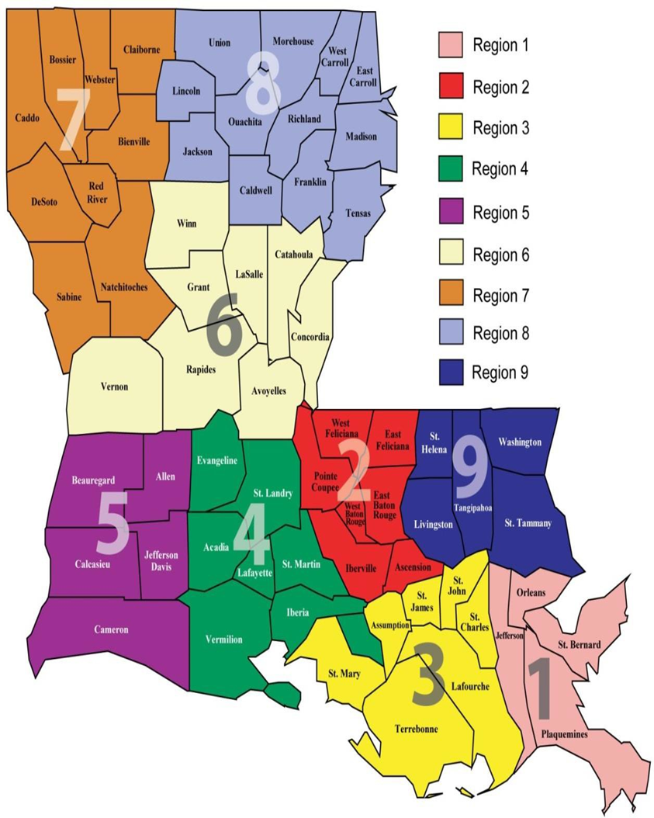
Pre pandemic Statistics for Louisiana
HIV diagnosis by Region¹
 | 2017 | 2018 | 2019
Region 1 | 29% | 29% | 28%
Region 2 | 21% | 22% | 21%
Region 3 | 4% | 5% | 5%
Region 4 | 11% | 13% | 11%
Region 5 | 5% | 4% | 5%
Region 6 | 5% | 7% | 6%
Region 7 | 12% | 9% | 13%
Region 8 | 6% | 5% | 5%
Region 9 | 7% | 6% | 7%
Notes:
-Here I am showing some regional prepandemic statistic for LA from 2017-2019. This is percentage of new HIV diagnosis by region.
-Throughout this period it remained steady with region 1 consistently the highest with apx 29% of new cases and baton rouge at second
-Something else that I found interesting was during this time period approximately 69% of new cases were in black people while they only account for 32% of LA population

Slide 5
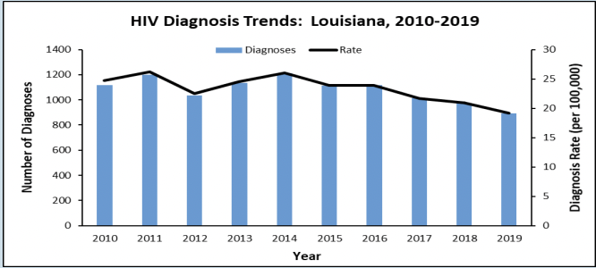
Pre pandemic Statistics for Louisiana
In 2018 Louisiana ranked 4th worse for HIV diagnosis rate and 4th for AID rates in US ¹
Notes:
-These are some additional prepandemic statistic
-in 2019 the rate of HIV diagnosis was 19.2 per 100,000 which was an 8% decrease from 2018.
-Although this was a promising trend, In 2018 Louisiana was ranked 4th worse for HIV diagnosis rate and 4th for AID rates in US

Slide 6
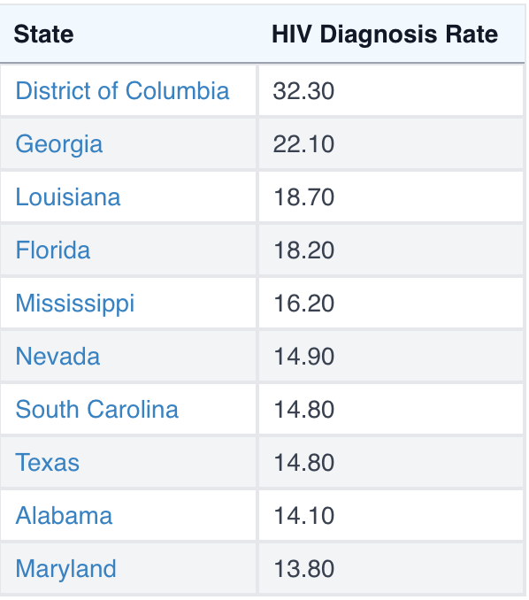
Where is Louisiana Today?
Louisiana ranks 3rd highest in the nation in HIV incidence rate (per 100,000) in 2024 ²
Notes:
Where is Louisiana today in 2024
Louisiana ranks 3rd highest in the nation in HIV incidence rate (per 100,000) in 2024 ²

Slide 7

Data from ACLA from 2021-2023
Notes:
For my discussion I used data about the patients with HIV in LA on Medicaid from 2021-2023 provided for me from ACLA. With the intent to capture the patient population during and post pandemic
Throughout this talk we will first get into general HIV statistics broken down by region and urban/rural. Then we will look at compliance rates as well as utilization of physician visits.
Lastly we will discuss what the ACLA is currently doing for HIV prevention in LA and what other states with better outcomes are doing

Slide 8
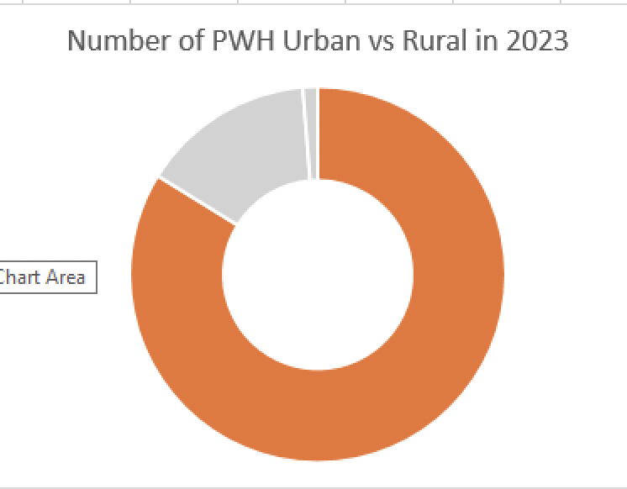
HIV Prevalence by Region
 | 2021 | 2022 | 2023
Region 1 | 33% | 33% | 35%
Region 2 | 20% | 19% | 15%
Region 3 | 5% | 5% | 5%
Region 4 | 6% | 6% | 7%
Region 5 | 3% | 3% | 3%
Region 6 | 6% | 6% | 5%
Region 7 | 14% | 14% | 14%
Region 8 | 4% | 5% | 7%
Region 9 | 8% | 8% | 6%
Notes:
This is the percentage of HIV prevalence by region from 2021-2023
You can see consistency in region 1 New Orleans being the leader of HIV prevalence and region 2 baton rouge following as close second
Based off of the data in the chart it is not surprising that the majority of pwh are in urban areas which is shown in the chart in the bottom right where the orange is urban and grey is rural

Slide 9
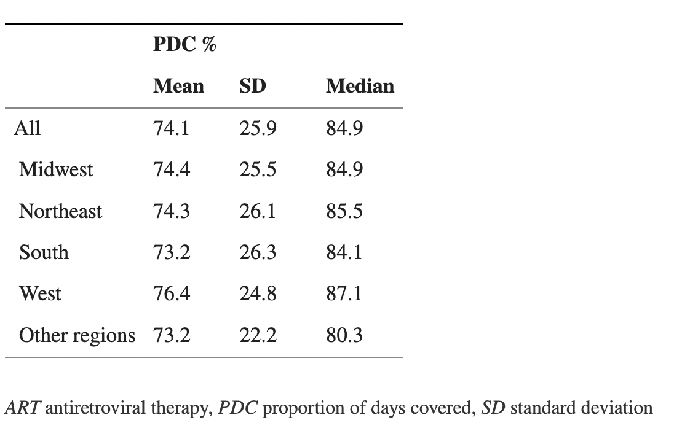
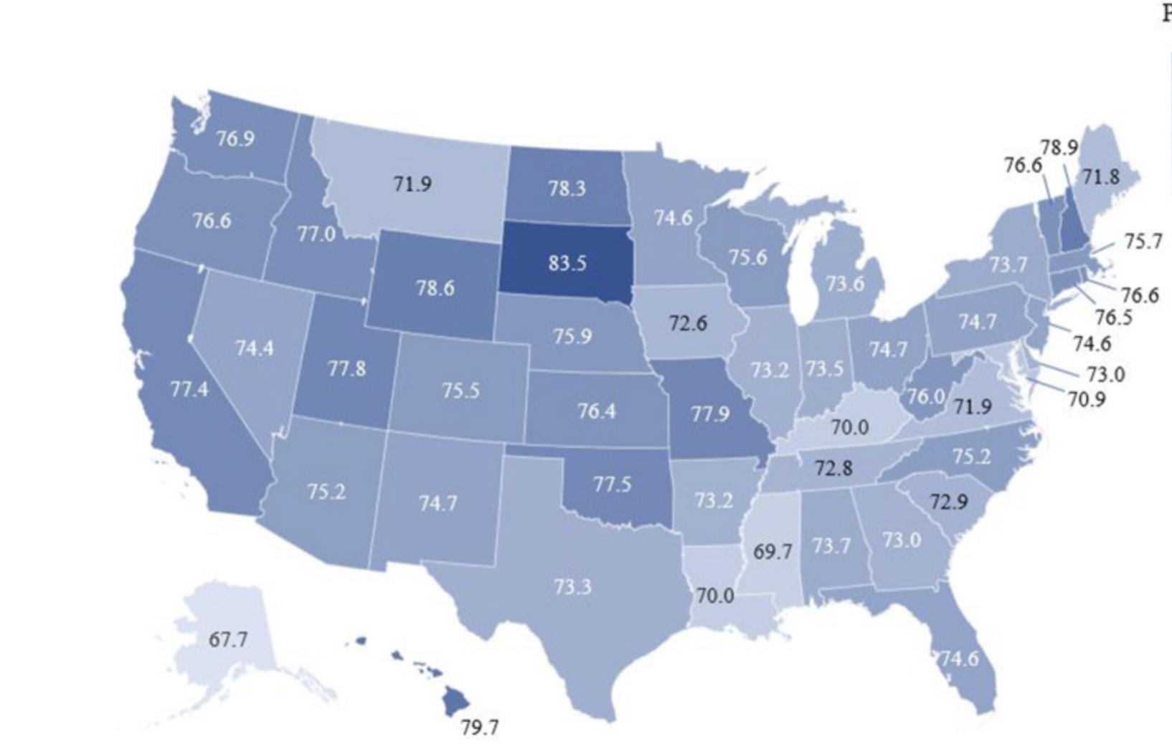
Compliance Distribution in US from 2017-2019³
Notes:
I looked at retrospective observational study using the Symphony Health Solution Integrated Dataverse database. It looked atover 200,000 Patients ≥ 18 years of age who had a diagnosis of HIV-1 and were treated with ART from 2017-2019.
It found that the national average for adherence was 74% with the south having the lowest at 73%. Louisiana in particular only had a compliance of 70%

Slide 10
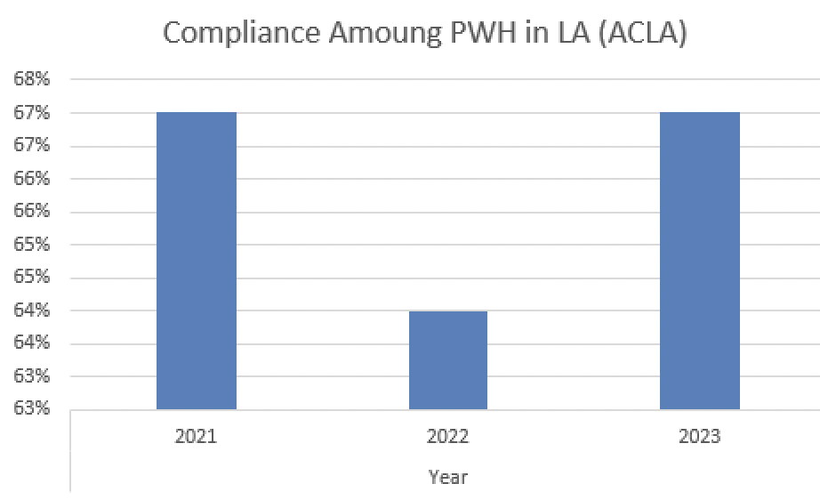
Notes:
This is a graphic representation of compliance data of PWH in LA from ACLA.
It shows in 2021 67% compliance, in 2022 64% compliance, and in 2023 67% compliance
Furthermore, these rate are even lower than what found in the previous national study from 2017-2019 indicating that the pandemic may have had an effect on compliance that has not yet recovered in 2023

Slide 11
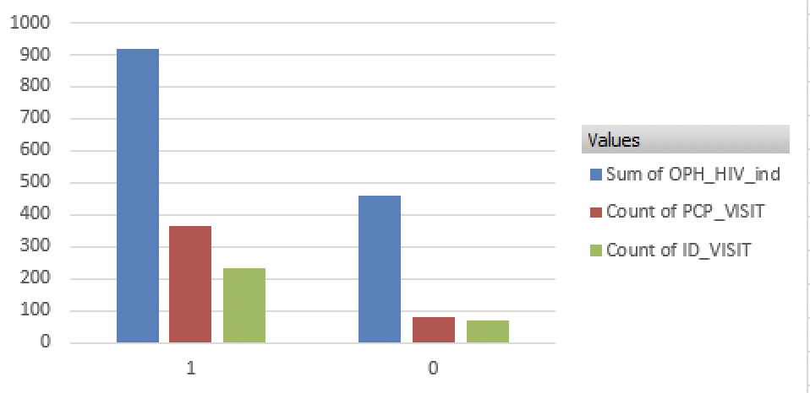
Number of Compliant vs Noncompliant PWH in 2021 (ACLA)
Notes:
This is showing number of compliant vs non compliants patients in 2021 in blue. compliant is labeled as 1 and noncompliant at 0. The red column is the number of patients that went to at least one PCP apt and the green is number of patients that attended at least one infectious disease apt.
In 2021 during the pandemic we can see 33% of pwh in LA were non compliant. Additinoally noncompliant patients only attended an apt with a physician (either PCP or ID) 33% of the time whereas compliant patietns had a 65% chance of seeing either healthcare professional
Of note, if the patient saw a physician outside of network it would not be account for in this data which could introduce a small margin of error

Slide 12
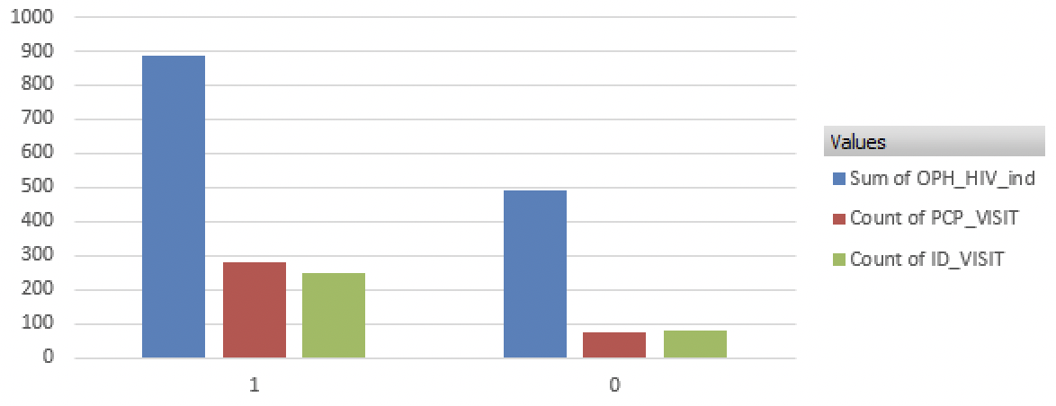
Number of Compliant vs Noncompliant PWH in 2022 (ACLA)
Notes:
In 2022 at the later part of the pandemic, the compliance worsened with 35.6% of non compliant PWH.
We also continue a decrease in the number of PCP and ID visits for both compliant and noncompliant patients which is interesting as youd presume that towards the end of the pandemic patients would have better access to healthcare professional

Slide 13
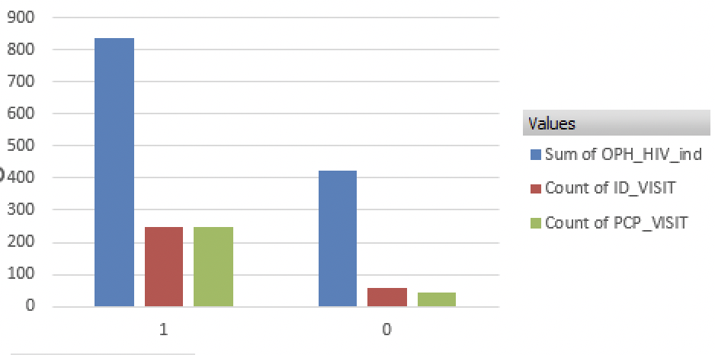
Number of Compliant vs Noncompliant PWH in 2023 (ACLA)
Notes:
In 2023 at the after the pandemic we see a noncompliance rate of 33.7% which is similar to the compliance in 2021 during the pandemic. This is a compliance rate of about 66%.
We continue to see the trend of non compliant patients infrequently going to physicians with only 23% attending apts

Slide 14
Summary
Region 1 (New Orleans) has the highest prevalence of HIV cases in the state
The data from ACLA of PWH on Medicaid shows that during and after the pandemic from the years of 2021-2023 the compliance rate was between 64-66%
Noncompliant patients were far less likely to attend appointments with PCP and/or ID than compliant
Notes:
In summary
-Region 1 (New Orleans) has the highest prevalence of HIV cases in the state
-The data from ACLA of PWH on Medicaid shows that during and after the pandemic from the years of 2021-2023 the compliance rate was between 64-66% which was lower than the prepandemic rate
Noncompliant patients were far less likely to attend appointments with PCP and/or ID than compliant

Slide 15
What are Current Strategies LA is using to Prevent and Treat HIV?
ACLA Strategies:
  CM outreach, offer education, PCP referral
  HIV screening for pregnant women
  Transportation to appointments
  Care coordination for at risk members
  Care card incentives
Notes:
What are Current Strategies LA is using to Prevent and Treat HIV?
ACLA Strategies:
CM outreach, offer education, PCP referral
HIV screening for pregnant women
Transportation to appointments
Care coordination for at risk members
Care card incentives

Slide 16

What are other states doing?
In 2016 Oregon launched End HIV Oregon to offer support for early detection, prevention, and treatment.
  Easy access to free local testing
  CAREAssist
  Oregon Health Plan
  Healthier Oregon
Notes:
What are other states doing?
Oregons HIV prevalence is 205 per 100,000 where as LA is 559 per 100,000
In 2016 Oregon launched End HIV Oregon to offer support for early detection, prevention, and treatment.
It offers all of this information on a user friendly website as well as Instagram
It offers info on locations to get free testing
Oregon’s AIDS Drug Assistance Program, called CAREAssist, provides financial help for people living with HIV by paying for medications and insurance co-pays. As well as additional support from case managers
The Oregon Health Plan (OHP) covers PrEP and all services related to PrEP at no cost for people who are eligible. Healthier Oregon, a program created by an Oregon law passed in November 2021, expands health coverage through OHP to adults who are eligible

Slide 17
Recommendation
Screen for HIV in people age 15-65; pregnant individuals
  USPSTF Grade A
Prescribe Pre-exposure Prophylaxis (PrEP) for those at high risk for acquiring HIV
  USPSTF Grade A
Behavior Counselling for sexually active individuals
  USPSTF Grade B
User friendly website similar to End HIV Oregon with amply healthcare information and resources.
Future analysis of Prep utilization in LA broken down by demographics
Notes:
Recommendations going forward
Screen for HIV in people age 15-65; pregnant individuals
USPSTF Grade A
Prescribe Pre-exposure Prophylaxis (PrEP) for those at high risk for acquiring HIV
USPSTF Grade A
Behaviour Counselling for sexually active individuals
USPSTF Grade B
I think this is particularly difficult in the South were we have the lowest rates of sexual education
User friendly website similar to End HIV Oregon with amply healthcare information and resources.
Future analysis of Prep utilization in LA broken down by demographics

Slide 18
References
1. Louisiana-HIV-STD-Update_2017_2019.pdf [Internet]. [cited 2024 Feb 27]. Available from: https://ldh.la.gov/assets/oph/HIVSTD/STDHIV_FactSheets/Louisiana-HIV- STD-Update_2017_2019.pdf
2. https://worldpopulationreview.com/state-rankings/hiv-statistics-by-state
3. McComsey GA, Lingohr-Smith M, Rogers R, Lin J, Donga P. Real-World Adherence to Antiretroviral Therapy Among HIV-1 Patients Across the United States. Adv Ther. 2021 Sep;38(9):4961-4974.
4. https://www.endhivoregon.org/

