Slide 1

HIV Viral Load Medication Adherence
Nabil M. Essajee
Louisiana State University Health Sciences Center – New Orleans
AmeriHealth Caritas Louisiana

Slide 2
Background
Louisiana ranks 3rd highest in the nation in HIV incidence rate (per 100,000) ¹
5th in deaths (per 100,000)
6th in prevalence per 100,000
13th in overall prevalence
  25th in U.S. by population size

Slide 3
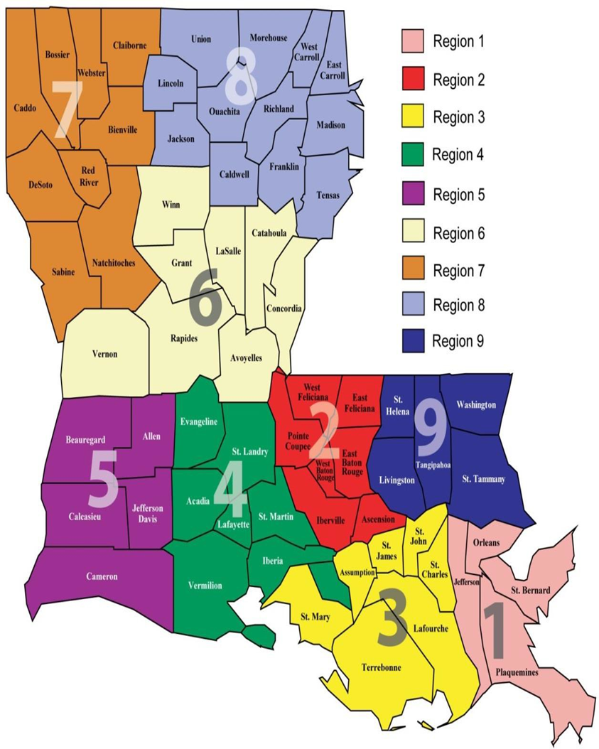
Background
Louisiana: 22,000 people with HIV (PWH)
  11,000 (1/2) have a diagnosis of AIDS^{2,3}
Region 1 (New Orleans): 34% HIV& AIDS prevalence in state and 27% of new HIV diagnoses⁴
  2nd in U.S. for HIV case rates; 5th in U.S. for AIDS case rates⁵
Region 2 (Baton Rouge): 23% HIV & AIDS prevalence in state

Slide 4
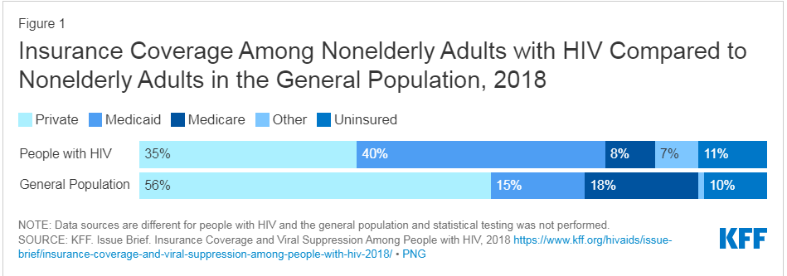
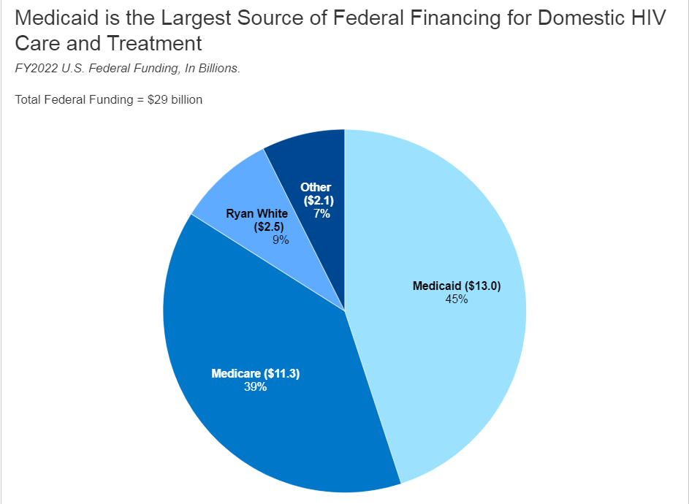
HIV & Medicaid
Medicaid is the largest source of federal funding for HIV care
PWH rely more heavily on Medicaid than the general population⁶

Slide 5
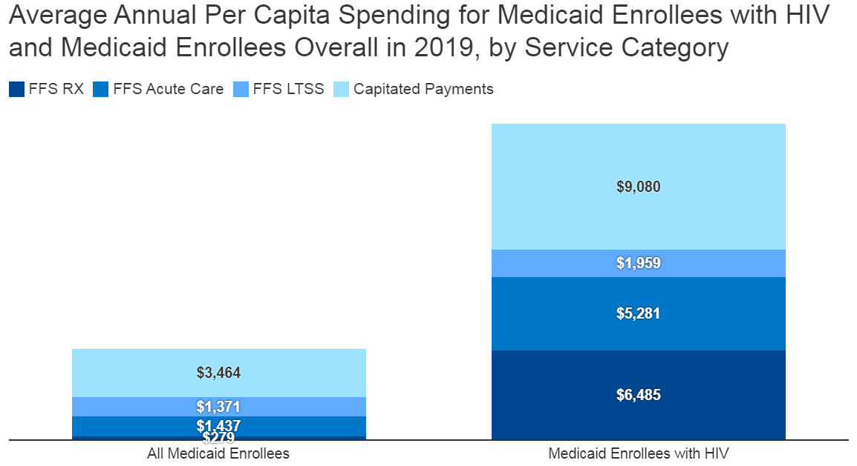
HIV & Medicaid

Slide 6
Importance
High reliance on Medicaid by PWH
PWH can live healthy lives with proper treatment & monitoring
Prevent further spread of HIV

Slide 7
Medicaid Goals
Compliant Population: Louisiana Medicaid members >18 years of age, with diagnosis of HIV and Viral Load (VL) < 200 copies/mL
  VL target based on clinical threshold for PWH to be considered to have undetected amount of virus
  Undetectable=untransmittable
Target Percent: 81.65%

Slide 8
Aims
Assess ACLA Medicaid population in Louisiana
Relationship between medication adherence and viral suppression

Slide 9
Population Demographics
Number of patients | 989
# > 18 years old | 983

Slide 10
Race

Slide 11
Regional Data

Slide 12
PCP & ID Provider Utilization
# of patients to see both PCP and ID provider | # at goal
20 | 19 (95%)
# of patients to have seen either PCP or ID Provider
326

Slide 13
Provider utilization by region

Slide 14
Antiretroviral Therapy Fill Data

Slide 15
Antiretroviral Therapy Fill Data

Slide 16
Social Factors
Data mostly unavailable or not reported

Slide 17
Summary
Region 1
  Highest prevalence of HIV in Louisiana
  Most # of people not at target VL
  Lowest % of people not at target VL
PCP and ID provider use associated with greater % at goal
ART medication usage associated with higher % at goal

Slide 18
Current ACLA Strategy
CM outreach, offer education, PCP referral
HIV screening for pregnant women
Transportation to appointments
Care coordination for at risk members
Care card incentives

Slide 19
Recommendations
Screen for HIV in people age 15-65; pregnant individuals
  USPSTF Grade A
Prescribe Pre-exposure Prophylaxis (PrEP) for those at high risk for acquiring HIV
  USPSTF Grade A
Behaviour Counselling for sexually active individuals
  USPSTF Grade B
Further investigate social factors that may be affecting healthcare utilization; medication adherence
Focus on the large population not at goal in Region 1
  Likely SDH has a role in Region 1 outcome

Slide 20
References
HIV Statistics by State 2024 (worldpopulationreview.com)
ThirdQuarter-2022-HIV-Syphilis-Report_final.pdf [Internet]. [cited 2023 Jan 30]. Available from: https://ldh.la.gov/assets/oph/HIVSTD/2022-reports/ThirdQuarter-2022-HIV-Syphilis-Report_final.pdf
Louisiana-HIV-STD-Update_2017_2019.pdf [Internet]. [cited 2023 Jan 30]. Available from: https://ldh.la.gov/assets/oph/HIVSTD/STDHIV_FactSheets/Louisiana-HIV-STD-Update_2017_2019.pdf
Louisiana_DataTables-2021_updated.pdf [Internet]. [cited 2023 Apr 11]. Available from: https://ldh.la.gov/assets/oph/HIVSTD/Tables-Profiles/data/Louisiana_DataTables-2021_updated.pdf
https://www.cdc.gov/hiv/pdf/research/demonstration/executive_summaries/cdc-hiv-pride-Louisiana.pdf
Medicaid and People with HIV | KFF

