Slide 1


Strategic Analysis of Combo 2 Adolescent Immunization Rates: A Comparative Study of Early- and Post-COVID Eras in Louisiana
David Nguyen, MS4 LSUHSC – New Orleans 12.12.23

Slide 2
Disclosure
I have no financial disclosure or conflicts of interest with the presented material in this presentation

Slide 3
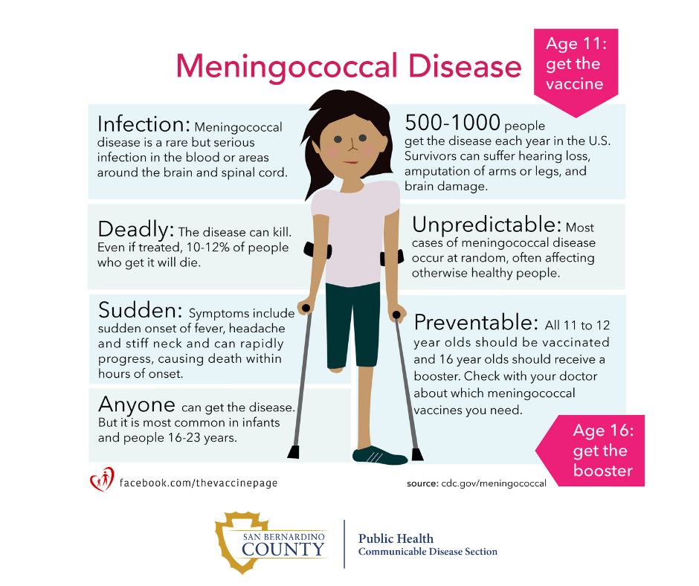
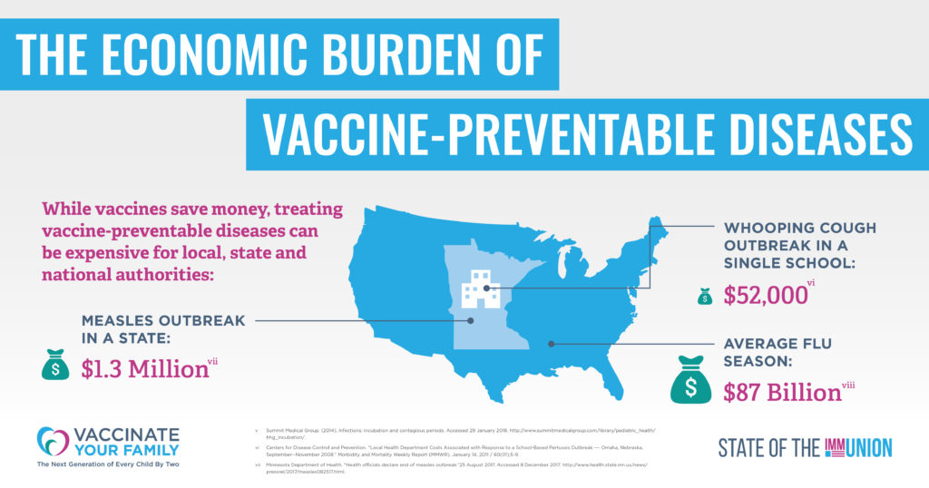
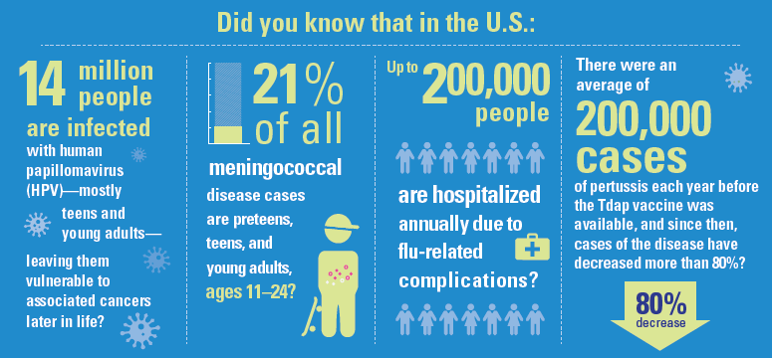
- Vaccines are a safe and effective way to protect adolescents against potential deadly diseases. - Serious diseases that can cause breathing difficulties, heart problems, nerve damage, pneumonia, seizures, cancer—and even death.

Slide 4
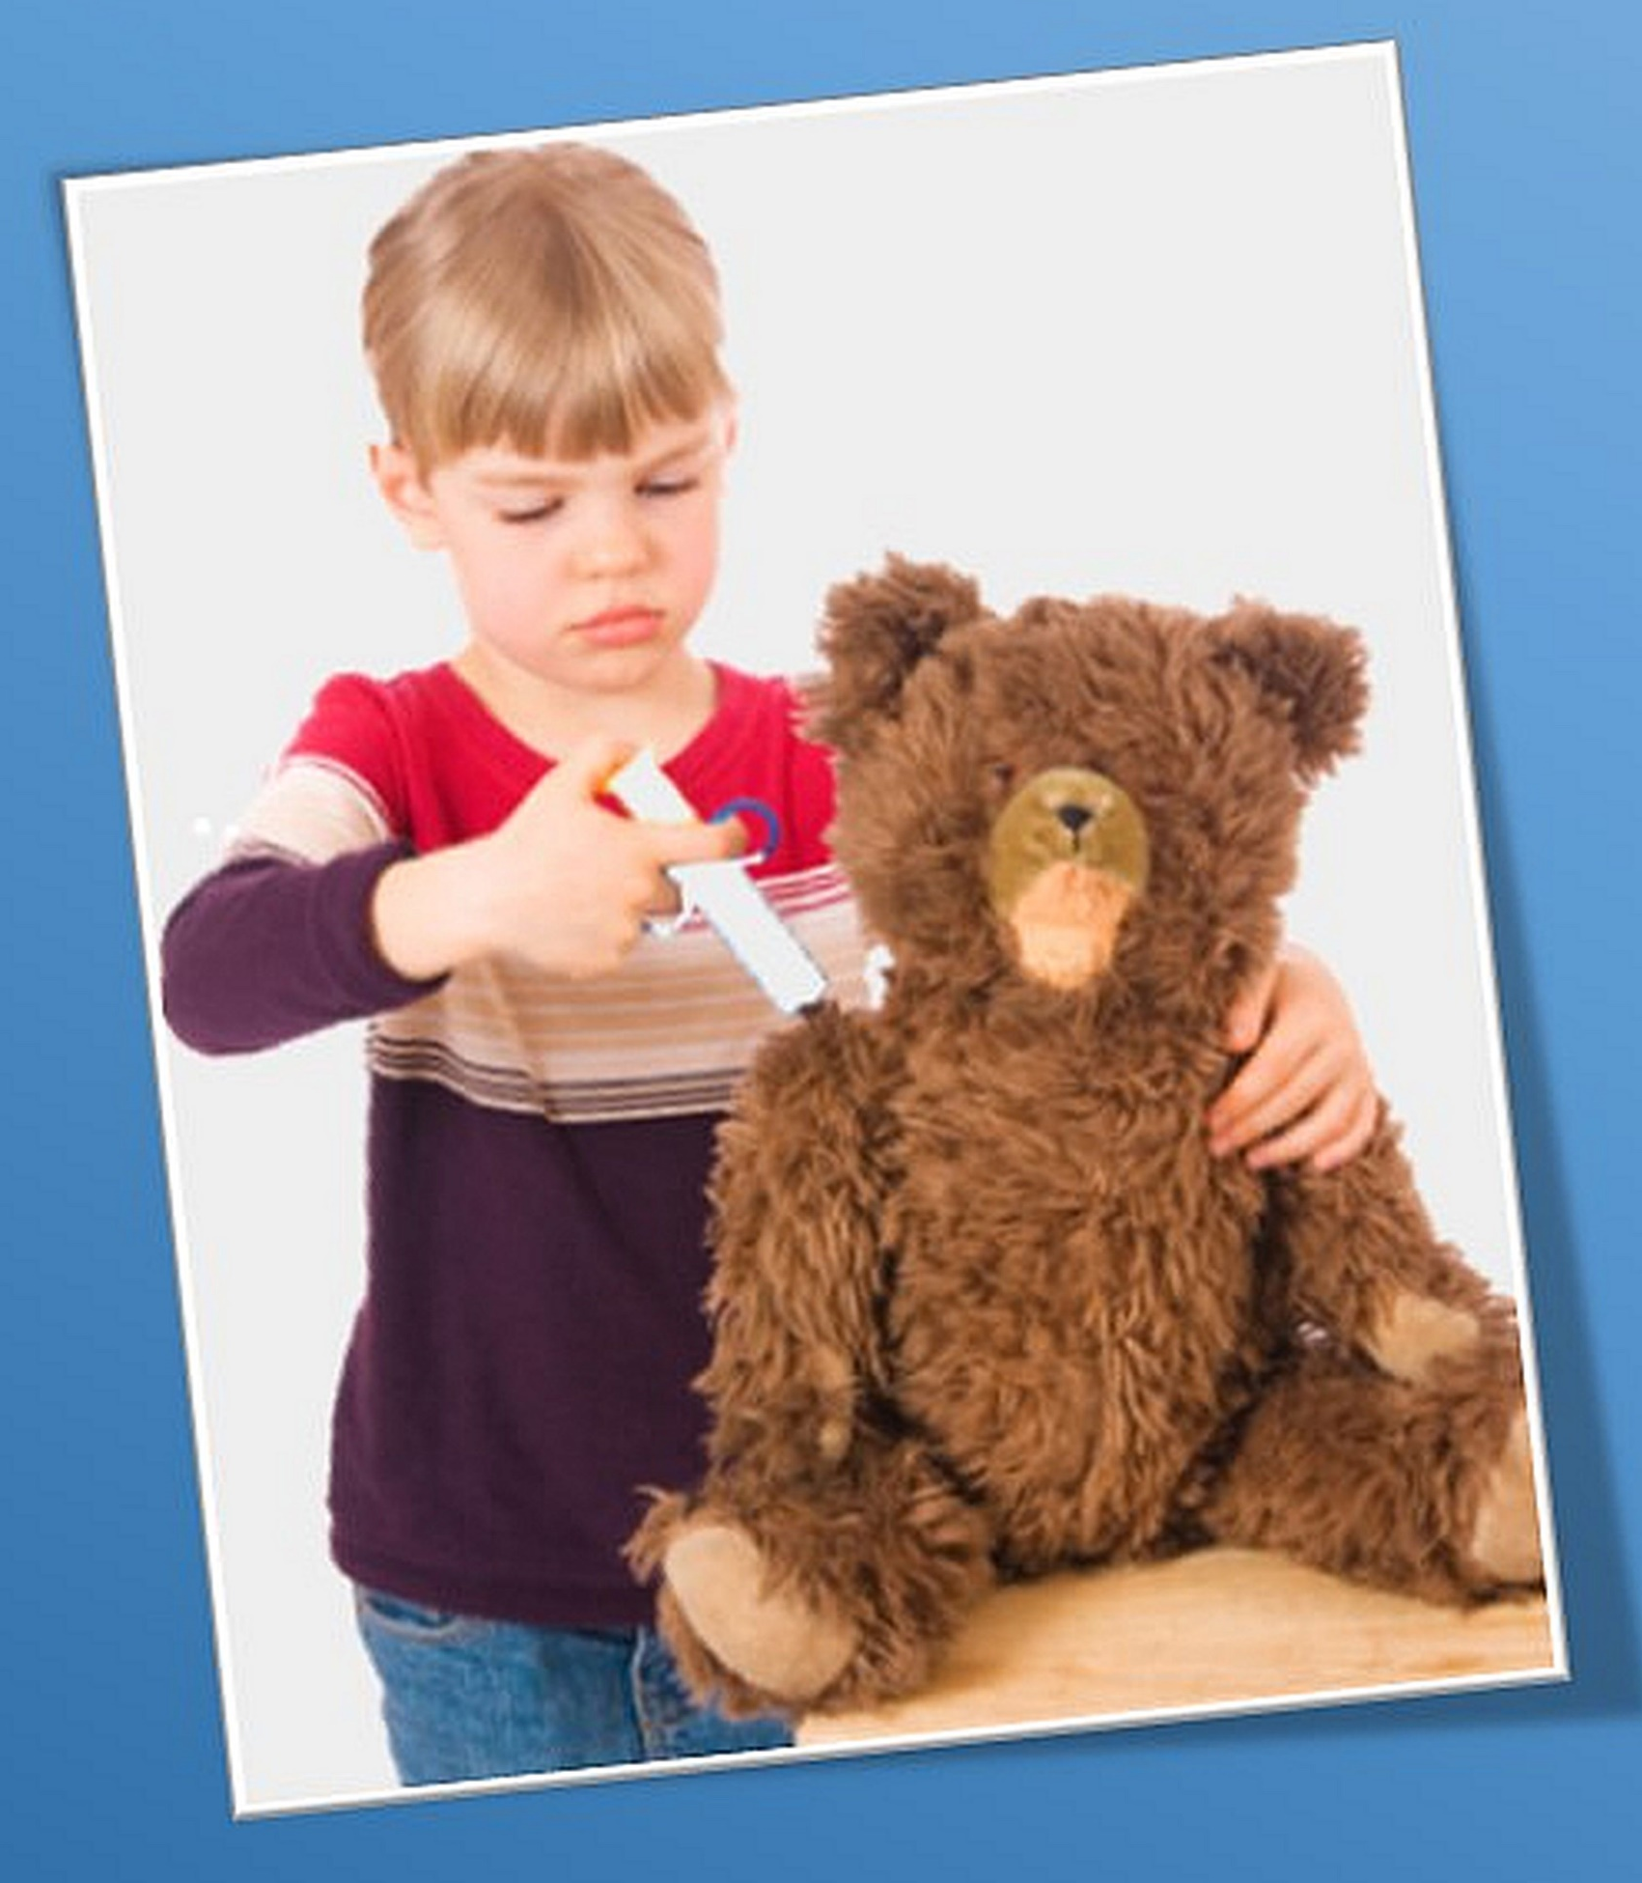
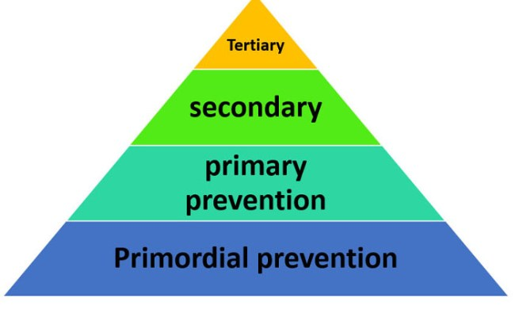
Preventive medicine
Notes:
Preventive medicine is the branch of medicine that deals not only with preventing disease from occurring, but also with halting disease progression and averting complications after disease onset. Disease prevention occurs on five levels, with measures ranging from health policies that affect the general population to specific treatments for particular patient groups: primordial prevention (actions that address environmental, socioeconomic, behavioral risk factors; e.g., smoking cessation campaigns), primary prevention (actions that inhibit the occurrence of specific diseases; e.g., immunization), secondary prevention (actions that inhibit the progress of specific diseases at an early stage to prevent or limit complications; e.g., screening), tertiary prevention (actions that inhibit the progress of specific diseases at an advanced stage to prevent or limit complications; e.g., blood pressure management in patients with hypertension), and quartenary prevention (actions that prevent over-medicalization and offer ethically acceptable interventions; e.g., pursuing nonaddictive strategies to managing chronic pain rather than prescribing opioids)

Slide 5
IMA COMBO 2 - Assesses adolescents 13 years of age who had one dose of meningococcal vaccine, one Tdap vaccine and the complete human papillomavirus vaccine series by their 13th birthday in the calendar year - Program targets *Increase rates for IMA Combo 2
*Increase the provision of and timeliness of Early Periodic Screening, Diagnosis, and Treatment (EPSDT)
*Reinforce the importance of immunizations and their role in disease prevention
*Decrease avoidable hospitalizations
*Work to ensure programs are equitably supporting wellness of all, with an emphasis on the most vulnerable people, populations, and communities
- Data from 2020 – 2022
*Early-COVID versus Post-COVID rates
*Social determinants of health
Notes:
National Committee for Quality Assurance (NCQA)

Slide 6
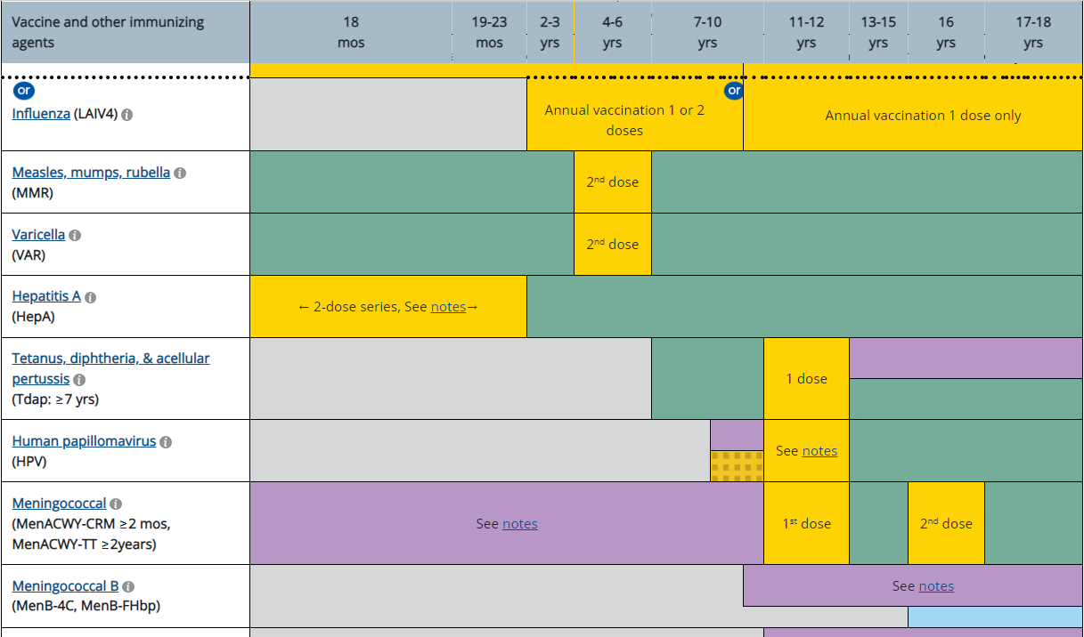
CDC Immunization Schedule

Slide 7
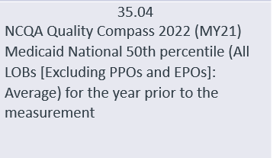
Overall Adherent Immunization Rates by Year
Year | Total Adherent | Total Non-adherent | Total adolescents | Immunization rates
2020 | 2031 | 2429 | 4460 | 45.5%
2021 | 1886 | 2808 | 4694 | 40.2%
2022 | 1777 | 2902 | 4679 | 38.0%
HEDIS MY 2023 Interim Data 1/1/2023-09/30/23 42.12%
P < 0.0001
Notes:
>95% cases due to missing 2nd dose of HPV
The final IMA Combo 2 demonstrated a 2.92% decrease for the year 2022. THE ACLA Plan Goal of 2% increase above is not met. The 50th percentile 2021 Quality Compass goal of 36.74% is met.

Slide 8
Adherent Immunization Rates by Language
Year | English | Spanish
2020 | 44.5% | 66.9%
2021 | 38.5% | 68.9%
2022 | 36.5% | 61.9%
P < 0.0001
Notes:
ESCNU
Total population
Spanish: 180 – 250
Other: <30
English : >4000
Statistically significant disparity was identified in the data set
2020: Male – 44.4%, Female – 46.7%
2021: Male – 40.1%, Female – 39.6%
2022: Male – 39.6%, Female – 36.4%

Slide 9
Adherent Immunization Rates by Race
Year | White | Black | Unknown
2020 | 42.9% | 45.9% | 47.5%
2021 | 37.8% | 39.2% | 55.1%
2022 | 33.9% | 28.1% | 50.4%
Total patient number (2020) | 574 | 1195 | 179
LA Population 2022 estimate: 4,590,241
White: 62.5%, Black: 32.8%
P < 0.0001
Notes:
Statistically significant disparity was identified in the data set
- => no recorded person for that population that year
Total population
White: 1337 – 1500
Black: 2600 – 3400
Indian: <40
Asian: <50
Pacific Islander: <5
US Census data

Slide 10
Adherent Immunization Rates by Geographic Area
Year | Urban | Rural
2020 | 47.7% | 38.4%
2021 | 42.0% | 34.4%
2022 | 41.2% | 28.8%
P < 0.0013
Notes:
ESCNU

Slide 11
Adherent Immunization Rates for Top 3 Largest Parishes
Year | East Baton Rouge | Orleans | Jefferson
2020 | 47.8% | 46.6% | 57.6%
2021 | 41.4% | 40.5% | 52.4%
2022 | 40.2% | 35.5% | 50.8%
P < 0.0001
Notes:
ESCNU

Slide 12
Summary
- Early-COVID immunization rates > post-COVID - Male ~ female rates - Consistent rate decline in the white, black, and English-speaking populations - Interestingly, Spanish-speaking populations are consistently adherent with higher rates - Immunization rates rural < urban
- Vast majority of non-adherent data with respect to 2nd dose of HPV - Caveats to the data - Statistically significant disparity was identified in the data sets with regards to total immunization rates, race, language, and geographic area
Notes:
Caveats:
The data reveals a decline in immunization rates without providing insights into the underlying causes or reasons for the decrease.
A built-in data delay factor exists; for instance, when a child undergoes immunization, it may take 4-6 weeks before the system registers it as either compliant or non-compliant.
If someone for example, received 2nd dose HPV after age of 13, they will still count towards the non-adherent category

Slide 13
Barriers - Knowledge and Misunderstanding - Motivation and Engagement - Healthcare Utilization Patterns - Education and Documentation - Provider Awareness and Appointment Availability - Administrative Challenges - Logistical Barriers
Current ACLA Barriers & Interventions
Interventions
- LIVE Member Outreach Calls/ Texting Campaign/ Social Media Posts
- Member Newsletter/ Member Reassignment Policy
- Multidisciplinary Provider education/training
- Member (Care Card)/provider incentives
- SAFELINK WIRELESS offers for the LifeLine program
- Provider Alert (Immunizations as part of EPSDT visit)
- Provider Alerts, Newsletter, and Website Updates
- Southeast Trans (Verida)
Notes:
Knowledge and Misunderstanding:
Lack of awareness about EPSDT schedules and preventive care importance.
Misunderstanding vaccine facts vs. myths.
Motivation and Engagement:
Parents' low motivation for EPSDT and preventive health screenings.
Auto-assignment to unfamiliar PCPs.
Lack of reliable phone numbers for appointment reminders.
Healthcare Utilization Patterns:
Continued preference for telehealth for well-checks.
Reactive healthcare approach, visiting doctors only when the child is sick.
Education and Documentation:
Inadequate member vaccine education.
Providers' failure to document vaccinations in LINKS.
Provider Awareness and Appointment Availability:
Providers unaware vaccinations can be given at sick visits.
Doctor's offices unaware of assigned members.
Limited appointment availability with PCPs.
Administrative Challenges:
Lengthy internal approval processes for member materials.
Logistical Barriers:
Transportation challenges affecting appointment attendance.
Outdated member contact information

Slide 14
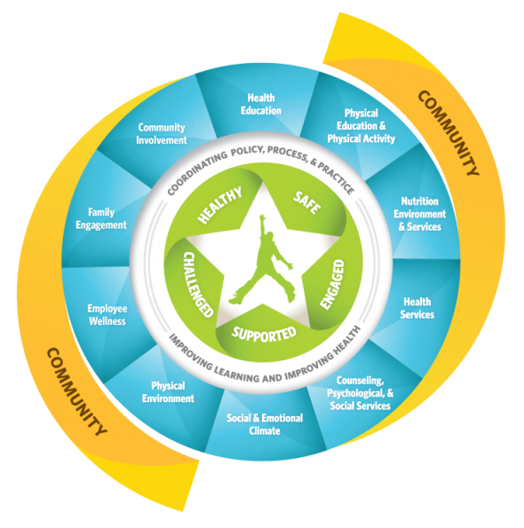
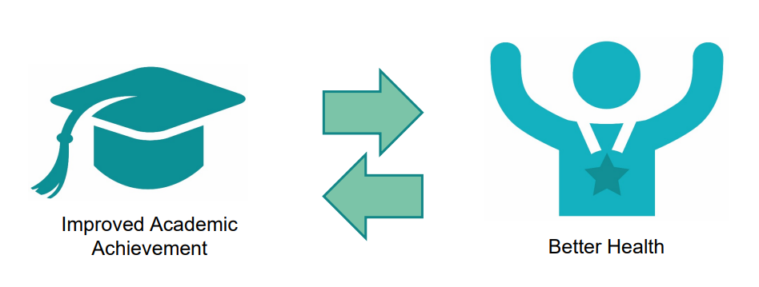
Whole School, Whole Community, Whole Child (WSCC)
Notes:
WSCC model seen in West Baton Rouge Parish and St. Mary Parish (2020). Unsure if model is still being utilized post-COVID.
The education, public health, and school health sectors have each called for greater alignment that includes, integration and collaboration between education leaders and health sectors to improve each child’s cognitive, physical, social, and emotional development. Public health and education serve the same children, often in the same settings. The Whole School Whole Community, Whole Child (WSCC) model focuses on the child to align the common goals of both sectors to put into action a whole child approach to education.

Slide 15
Recommendations
Implement surveys and feedback mechanisms to gather insights from healthcare providers, parents, and adolescents
Organize focus groups to delve deeper into community perceptions and beliefs about vaccinations
Consider school-community based collaborations such as:
Local health departments, schools
Partner with schools to facilitate vaccination clinics on-site, making it convenient for adolescents to receive vaccines
Non-profit organizations, businesses
Social service agencies, Parks & Recreation
Law enforcement, faith-based organization
Consider outreach programs, mobile clinics, and extended clinic hours to accommodate diverse schedules

Slide 16

THANK YOU!
Dr. Gregory Randolph
Dana Smith
Renee Wells
Shea Good
Rhonda Baird
Lekitha Gregory
Danielle McGill
Jana Blaylock

Slide 17
Sources
https://www.ncqa.org/hedis/measures/immunizations-for-adolescents/
https://ldh.la.gov/page/hpv-vaccination-coverage-by-age-13
https://dphhs.mt.gov/publichealth/immunization/adolescentvaccines
https://vaccinateyourfamily.org/
https://www.cdc.gov/vaccines/schedules/hcp/imz/child-adolescent.html#note-hpv
https://louisianabelieves.com/docs/default-source/2020-teacher-leader-summit/2020_a100_implementing-a-whole-child-approach-to-education.pdf?sfvrsn=a9a9981f_2

