Slide 1
Accessible Nutrition Improve Health Outcomes
Presented by
Xena Zheng, MD Candidate LSUHSC
5/3/2023

Slide 2

Appropriate nutrition remains an unmet need.
Luckily, this is a modifiable health issue.
Individuals living with severe, chronic illnesses can have unique nutritional and dietary needs
Proper dietary regimen improve outcomes in chronic conditions such as diabetes mellitus, cardiovascular disease, and renal failure
Patients often struggle to meet dietary needs
Exacerbated by:
Disabilities in feeding related ADL and IADL
Older age
Food insecurity
Reference: CDC 2022 (image)

Slide 3
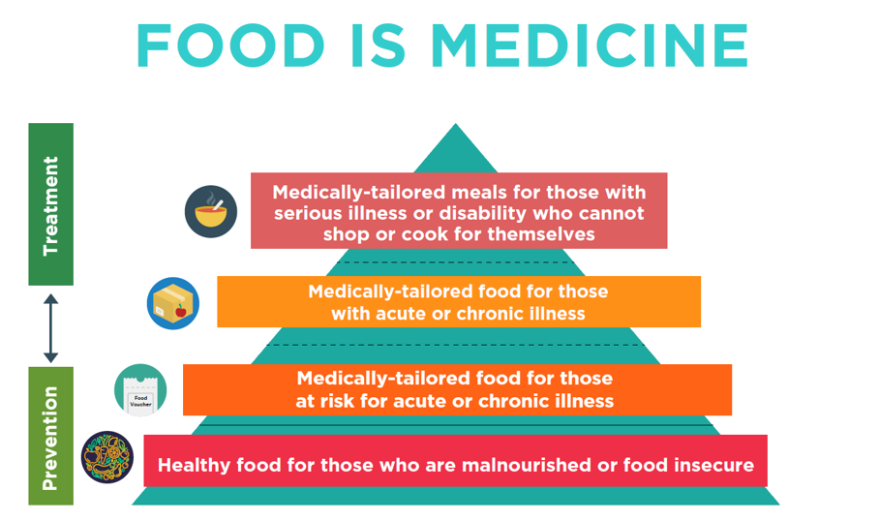
Medically Tailored Meals improve access to nutrition.
ACLA Mom’s Meals is a MTM community partner.
Medically tailored meals (MTM) program participation is prescribed for patients with severe, chronic illness and nutritional needs
Menus are designed to meet individual medical and nutritional needs
Community partner prepares and delivers meals
Reference: Food is Medicine Coalition (image)

Slide 4

Overview of Mom’s Meals.
Home delivered meals for members who meet eligibility criteria:
Chronic Care Meals (28 days)
Post Discharge Meals (7 days)
Physical Health UM
Behavioral Health uM
COVID19 Meals (7 days)
Emergency Meals (7 days)
2 meals a day
Care manager determines eligibility criteria
Reference: Mom’s Meals 2021 (image)

Slide 5
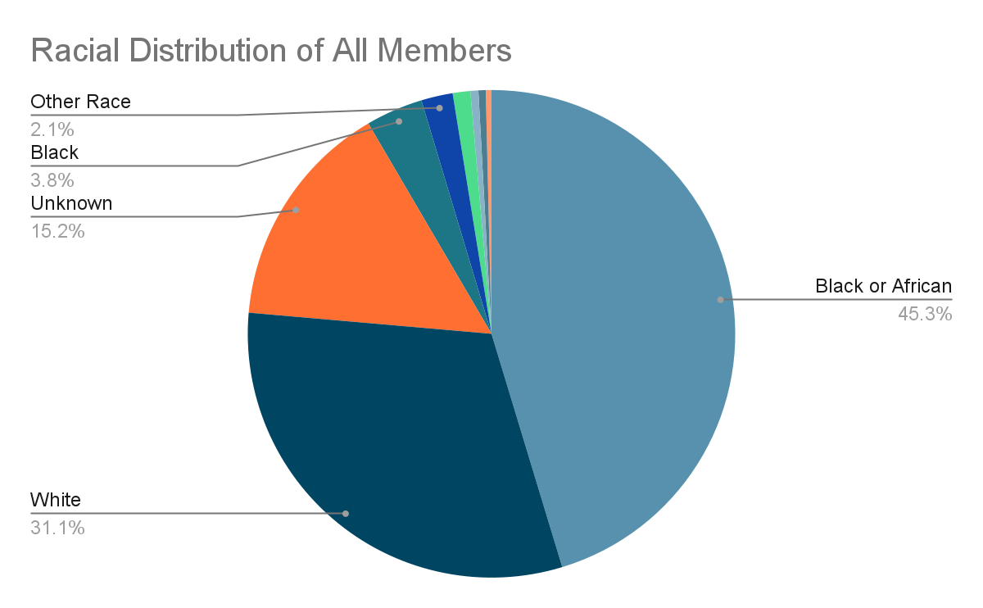
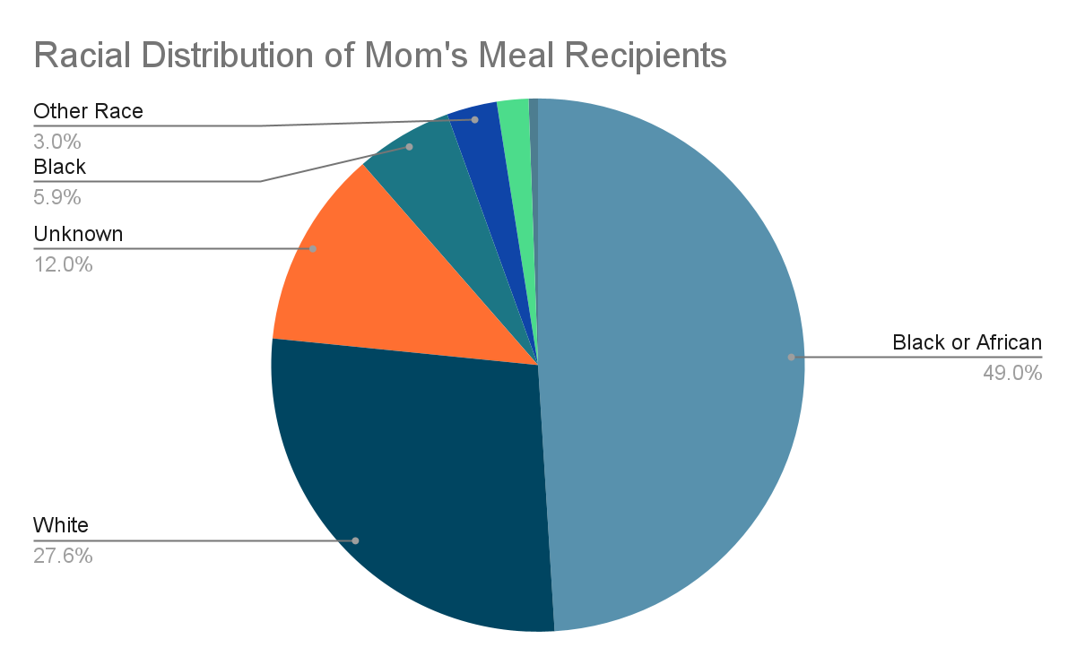
Demographics of Mom’s Meals Recipients: Race.
Focusing on Diabetes Mellitus & Congestive Heart Failure

Slide 6
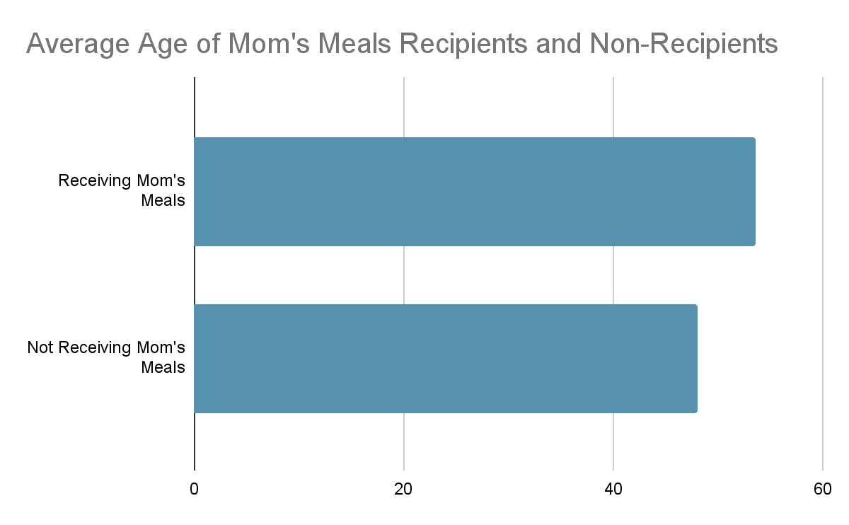
Demographics of Mom’s Meals Recipients: Age.
Recipients are more likely to be older.

Slide 7
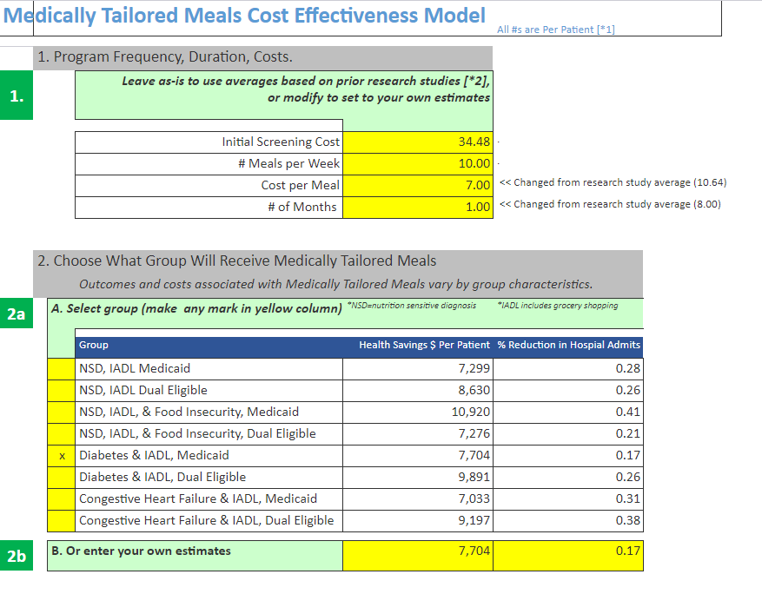
MTM Cost Effectiveness Model can estimate impacts.
Defaults based on studies can be changed to ACLA #s.
Model built by Dr. Patrick Bernet

Slide 8
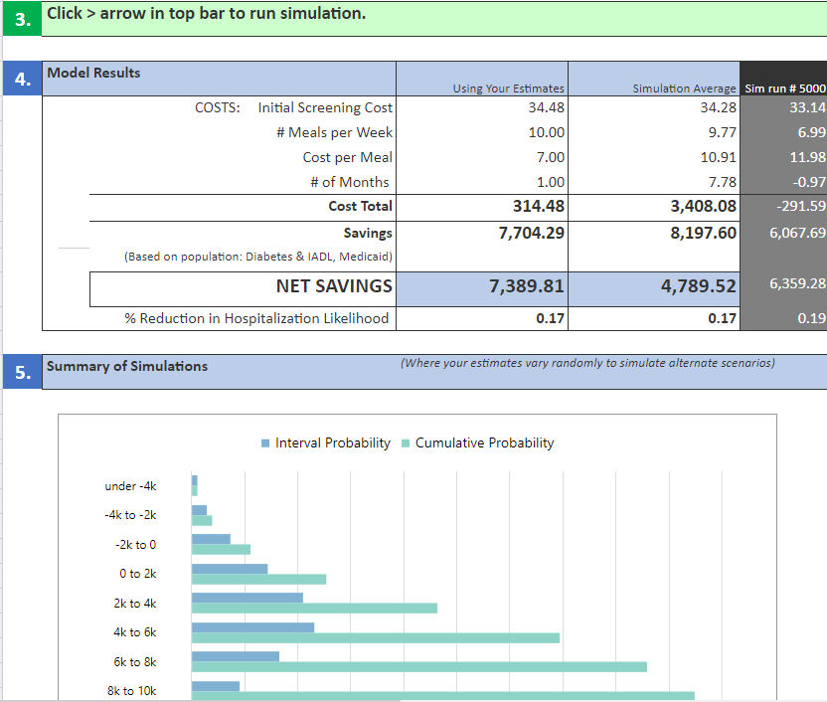
Model runs Monte Carlo simulation to calculate impact.
Limitation: skewed by longer length of program in studies.

Slide 9
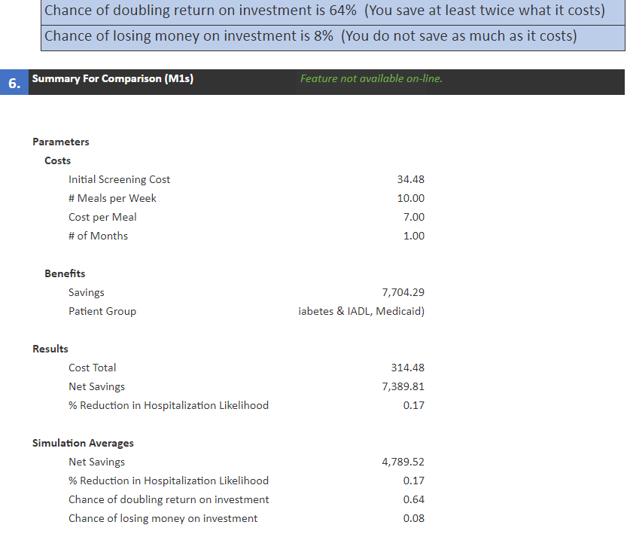
Overall chance of $ return on investment is estimated.

Slide 10
Estimated economic impact for ACLA is significant.
Caveat is lack of ACLA specific utilization data.
1410 Mom’s Meals Recipients (over 5 years)
X
~$7000 Net Savings Per Patient
=
~$10 Million Total Saved

Slide 11
Recommendations for further analysis.
Assess Mom’s Meals impact on health outcomes (e.g., ED visits and inpatient hospitalizations)
Compare time frames Pre- and Post- participation
Compare participants vs. matched cohort
Determine impact of participation length and diet type
Analyze impact on total health care costs
Calculate cost of optimal program participation time
Quantify direct health-related cost savings
Explore indirect economic benefits

Slide 12


Acknowledgments
Thank you so much!
Renee Wells
Dr. Gregory Randolph
Shea Good
Analytics team
Rhonda Baird
Dr. Rodney Wise
ACLA
Dr. Peggy Honore and Dana Smith
Dr. Patrick Bernet

