Slide 1

Controlling Hypertension
Sarah Corley
LSU New Orleans School of Medicine
Notes:
Looking at data from 2022, specifically with members 18–85 years of age who had a diagnosis of HTN and adequate control/controlled (<140/90 mm Hg) during the measurement year
18-65

Slide 2
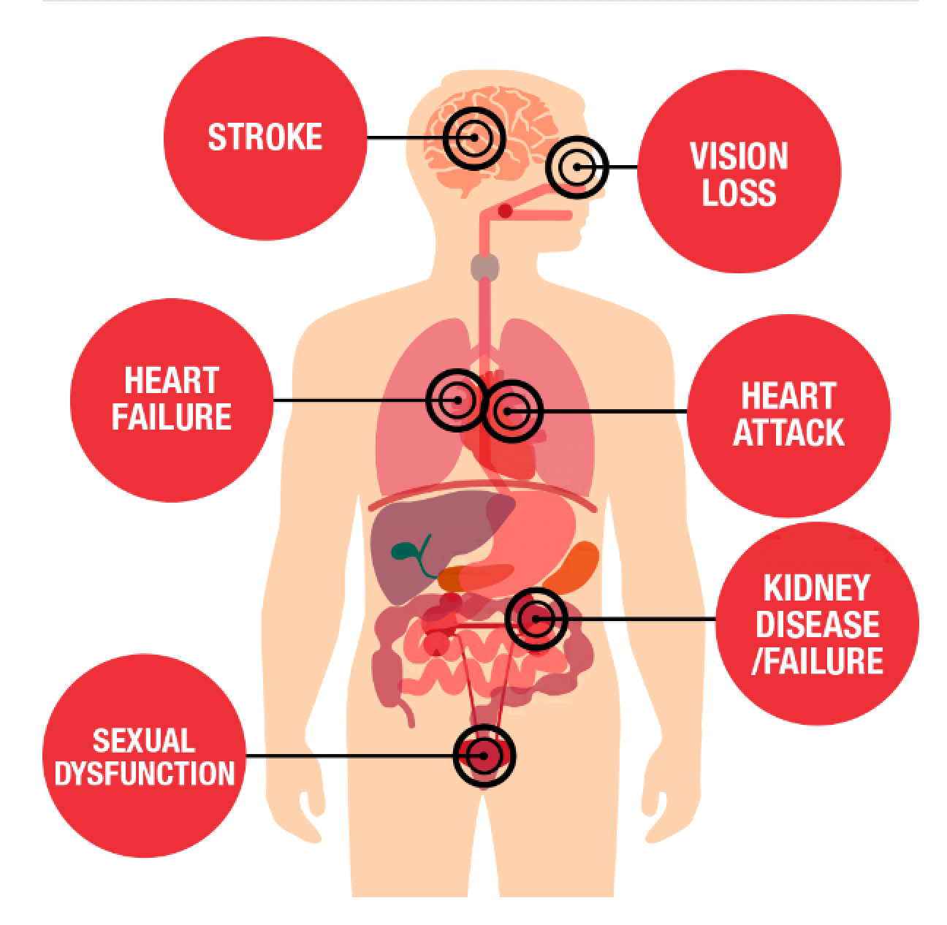
Hypertension significance
Many increased long-term risks
Stage 1: ≥ 130/80
Stage 2: ≥ 140/90
Controlled/resolved means <140/90 within one year
HTN in LA: ~40% (32% U.S.)

Slide 3
Associations with various factors
Associations with Primary Hypertension

Slide 4
Association with Obesity and Diabetes
All Patients Total pt number: 15,363 Controlled: 4771 (31.1%) Not controlled: 10,592 (68.9%) Average Number of Visits If controlled: 3.3 If not controlled: 3.1 | Obesity Total pt number: 587 Controlled: 184 (31.3%) Not controlled: 403 (68.7%) Average Number of Visits If controlled: 3.4 If not controlled: 2.8 | Type 2 Diabetes Total pt number: 2586 Controlled: 936 (36.2%) Not controlled: 1650 (63.8%) Average Number of Visits: If controlled: 2.8 If not controlled: 2.9
Notes:
Total:
Obesity associated = 587. 184 controlled (168 without recorded BP). 403 Not controlled with 392 of those not having any recorded BP.
Diabetes associated: 2586. controlled 936 (855 not recorded). Not controlled 1650 with 1614 not having recorded.
Diabetes
controlled = 2.824. Not controlled average = 2.928.
Total: 2.89046
If recorded, avg is 3.289
Obesity
controlled = 3.377. Not controlled average = 2.818
Total: 2.994
If recorded, avg is 2.863

Slide 5
Association with Age
18 to 24
  93 controlled, 273 not controlled
  % Controlled: 25.4%
  Number of visits 2.8
25 to 34
  361 controlled, 1158 not controlled
  % Controlled: 23.8%
  Number of visits: 3.0
35 to 44
  965 controlled, 2495 not controlled
  % Controlled: 27.9%
  Number of visits 3.1
45 to 54
  1460 controlled, 3086 not controlled
  % Controlled: 32.1%
  Number of visits 3.2
55 to 64
  1892 controlled, 3580 not controlled
  % Controlled: 34.6%
  Number of visits: 3.3

Slide 6
Association with Gender
  Male:
    Total number 5690
    Controlled 1665, not controlled 4025
    Controlled %: 29.3%
    Average number of visits 3.2
  Female:
    Total number 9673
    Controlled 3106, not controlled 6567
    Controlled %: 32.1%
    Average number of visits 3.2
Notes:
Gender:
M: controlled 1665, not controlled 4025. 264 recorded last BP
Average number of visits 3.195
Total number 5690
F: controlled 3106, not controlled 6567. 450 recorded last BP
Average number of visits 3.156
Total number 9673

Slide 7

Association with Race

Slide 8
Provider Type
Association with Provider Type
MD or DO
  Not controlled: 5871, controlled: 2717.
  % controlled: 31.6%
  Average number of visits: 3.2
NP or PA
  Not controlled: 4680, controlled: 2026
  % controlled: 30.2%
  Average number of visits: 3.0

Slide 9
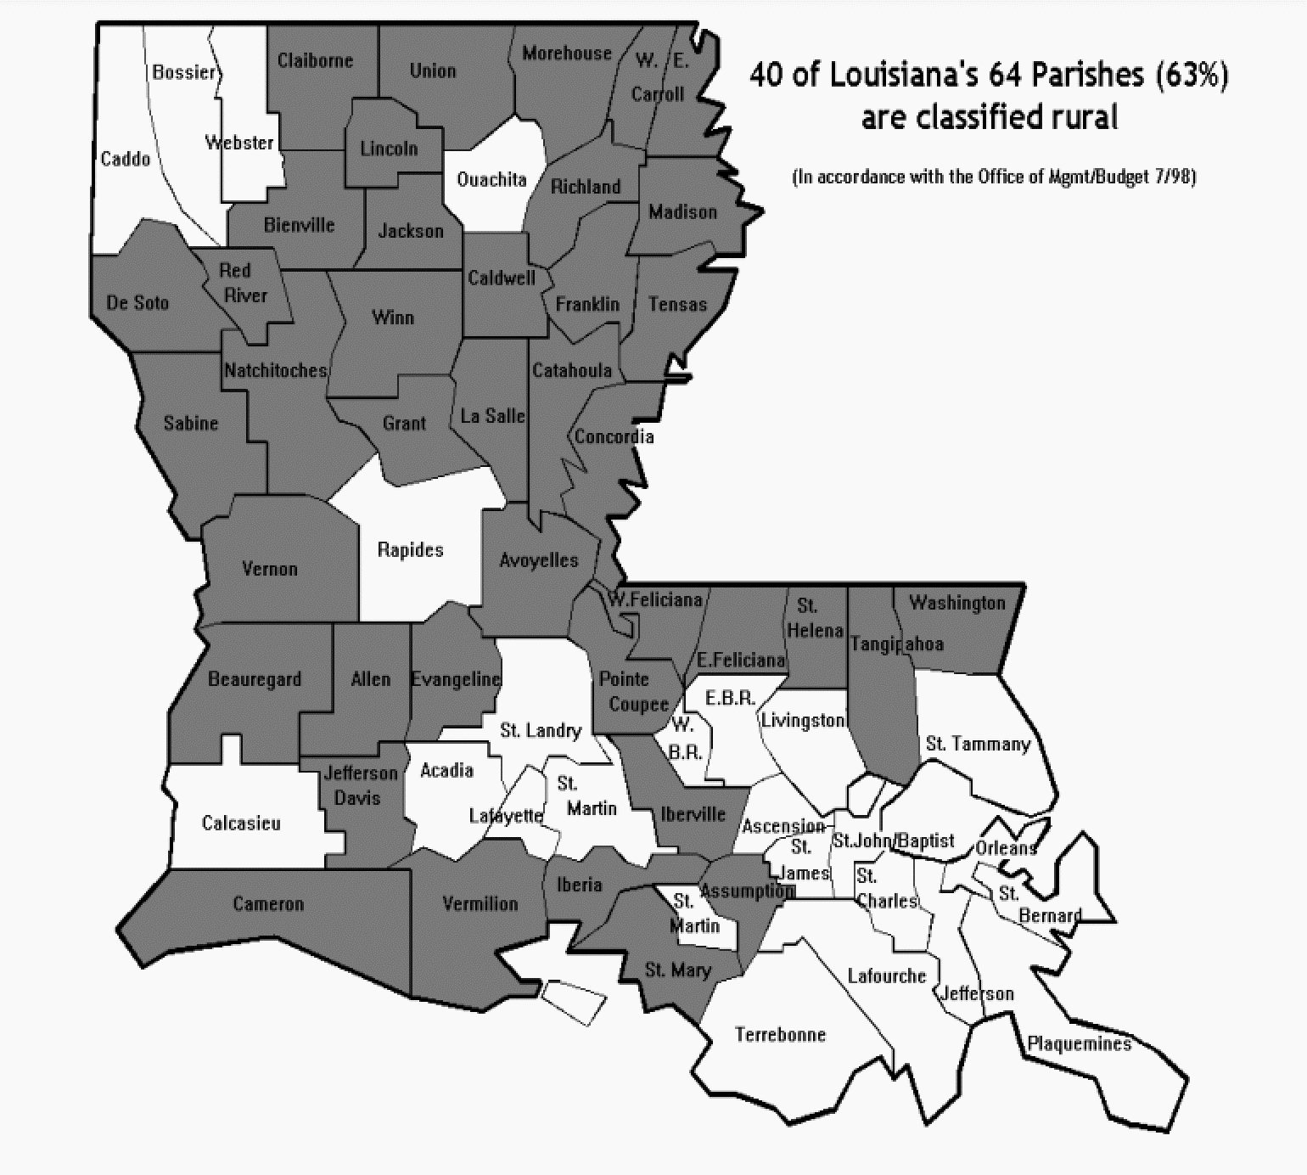
Urban
VS
Rural

Slide 10
Total: 10790
Total: 4513
1127
3628
7162
3386

Slide 11
Urban Parishes
% controlled = 18.8%
% controlled = 12.3%
Notes:
East baton rouge; 1044, 241

Slide 12
Rural Parishes

Slide 13
Urban Parishes
Total average number of visits with primary diagnosis of HTN = 3.117

Slide 14
Rural Parishes
Total average number of visits with primary diagnosis of HTN = 3.179

Slide 15
Rural Parishes, Outliers Removed
Total average number of visits with primary diagnosis of HTN with outliers removed = 2.987

Slide 16
Summary & Recommendations
Social media campaign to emphasize the long-term health outcomes associated with uncontrolled HTN
Asian Americans, though a small subset, have substantially better control rates when compared to other races
Investigate what factors could contribute to this group’s success
Pts in rural parishes have significantly decreased likelihood of having controlled BP
Investigate if medication availability is a factor
Targeted educational material for lifestyle interventions
Younger age groups tend to have lower % controlled HTN and less office visits
Notes:
Make Every Calorie Count
Current
Make Every Calorie Count weight
management program with 2 visits
yearly with registered dietitian plus
gym membership or at-home fitness
kit, for members who qualify, Lowered BMI requirement (30 to 28) and begin allowing members with HTN and Diabetes as primary diagnosis entry (in the past only members with primary obesity dx allowed)
322 completed the program in 2022 reported on Diabetes and Obesity Report submitted to LDH, % completion UTD (Finalized) decision to address HE in MECC participation for AA population in 2023 goal)
Pts with HTN and T2Diabetes have a slightly increased chance of having uncontrolled HTN
Targeted educational pamphlets for diets/exercise to assist with both HTN and diabetes
Younger age groups tend to have lower % controlled HTN and less average office visits
Social media campaign to emphasize the long term health outcomes associated with uncontrolled HTN
Asian Americans, though a small subset, have substantially better control rates when compared to other races
Investigate what factors could contribute to this group’s success
Pts in rural parishes have significantly decreased likelihood of having controlled BP
Investigate if medication availability is a factor
Targeted educational material for lifestyle interventions

Slide 17
References
Health threats from high blood pressure. American Heart Association. https://www.heart.org/en/health-topics/high-blood-pressure/health-threats-from-high-blood-pressure. Accessed Nov. 12, 2023.
Hypertension. Louisiana Department of Health. https://ldh.la.gov/page/hypertension. Accessed Nov. 12, 2023.

