Slide 1
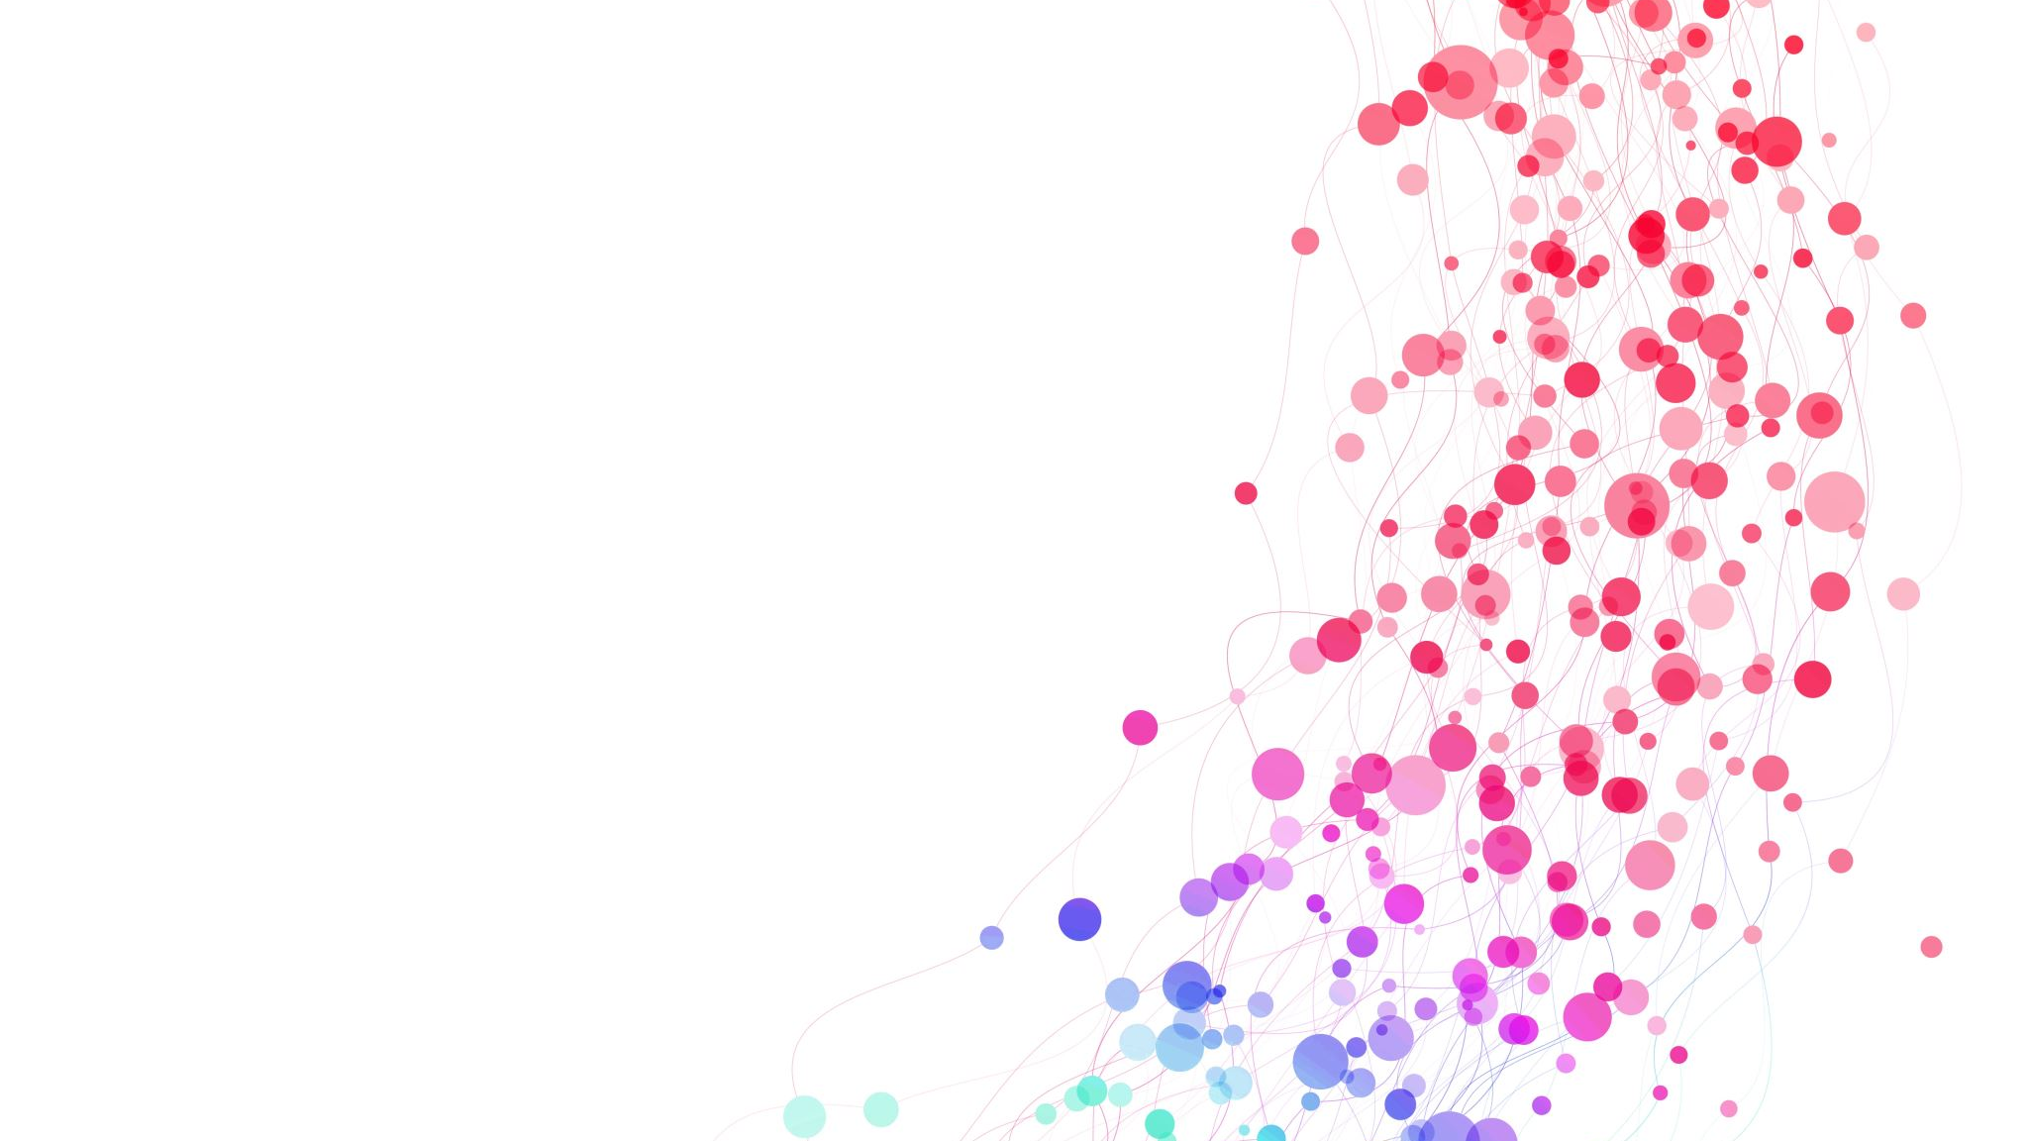
ACLA Behavioral Health Measures: a Post-Pandemic World
Sanjana Easwar
LSUHSC School of Medicine – Population Health Management
11/16/23

Slide 2
Overview
Background
Definitions
Findings and pertinent data
Current interventions
Future interventions

Slide 3
Background
Declaration of the pandemic by the WHO: 3/11/2020
Uptick of symptoms of anxiety and depressive disorder
Increased burden of mental health issues post-COVID:
New-onset mental health issues
Relapse of pre-existing mental illnesses
Suicidal behaviors
Vulnerable populations: children and adolescents, elderly, homeless persons, healthcare workers, individuals with prior psychiatric illnesses, pregnant women, migrants/refugees, LGBTQ+ individuals, racial and ethnic minorities
Notes:
New-onset mental health issues: due to COVID-19-related stress, fear and loneliness; enduring neuropsychiatric symptoms or disorders (eg, acute ischaemic stroke, headache, dizziness, ataxia, delirium and seizures) of COVID-19 infection due to cytokine storms.²⁷
Relapse of pre-existing mental illness: due to reduced access to therapeutic resources, disruption of therapies, service provision and social support.⁴ ¹⁰
Suicides: due to neuropsychiatryic manifestations and the socioeconomic impact of COVID-19.⁴
The surge in mental health issues may remain untreated or undiagnosed due to interrupted mental health services
Children and adolescents have especially been affected: research has shown elevated depressive sx, increase in substance use esp alcohol, and increase in social media use (negative impact on girls in terms of depressive sx, negative perceptions of body image

Slide 4
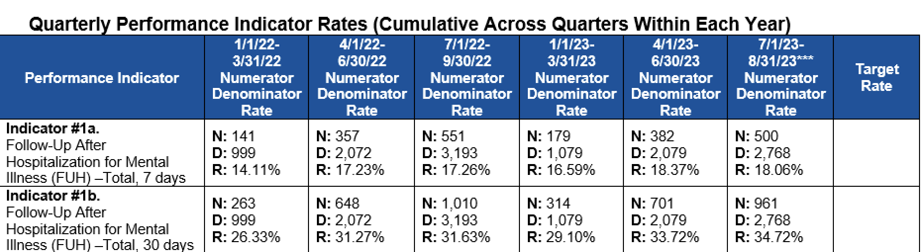
Behavioral Focus Measures
FUH: Follow-up after hospitalization for mental illness (30 days after discharge)
The percentage of discharges for members 6 years of age and older who were hospitalized for treatment of selected mental illness or intentional self-harm diagnoses and who had a follow-up visit with a mental health provider.
Total: 6+ year old individuals who were hospitalized and discharged with a mental illness diagnosis or episode of self-harm
Factors focused on:
Age
Gender
Member region
Race
Ethnicity
Primary diagnosis
Data from 2021 and 2022
Notes:
Follow up rates do not meet goals

Slide 5
Findings – Age and Gender of Follow-Ups
Notes:
When comparing 2021 and 2022, we can see that the ratio of females to males presenting for follow-ups were about the same: 59 to 41 vs 58 to 42 in 2022. More females presenting for follow up in both years.
The largest age group following up fell in the 13 to 17 year category in both 2021 and 2022. In 2021, we see that many adolescents presented for follow up compared to adults and older age groups. We can see a sharp uptick in the older age groups following up in 2022, especially in 18-29, 30-39, and 40-49 when comparing their follow ups in 2021.

Slide 6
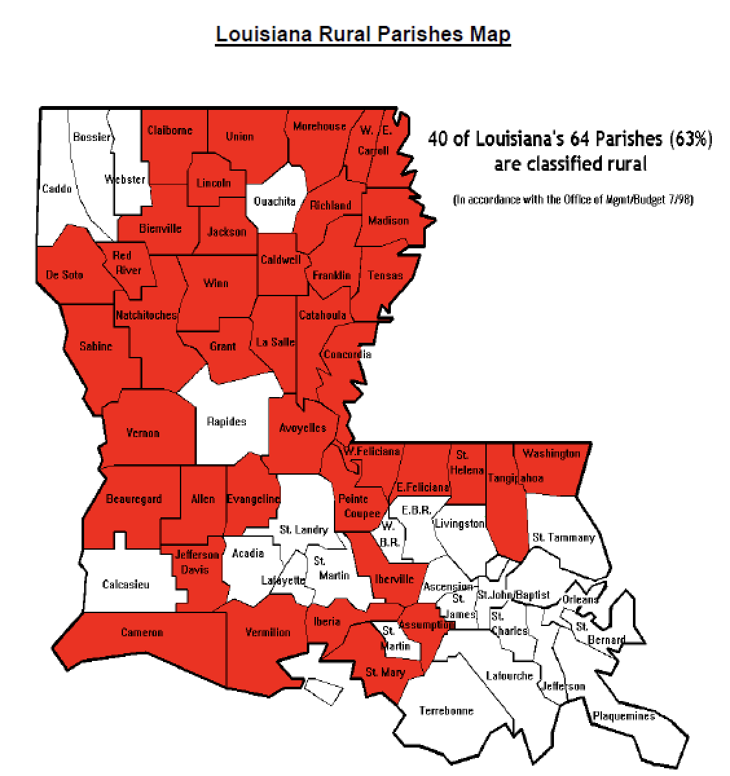
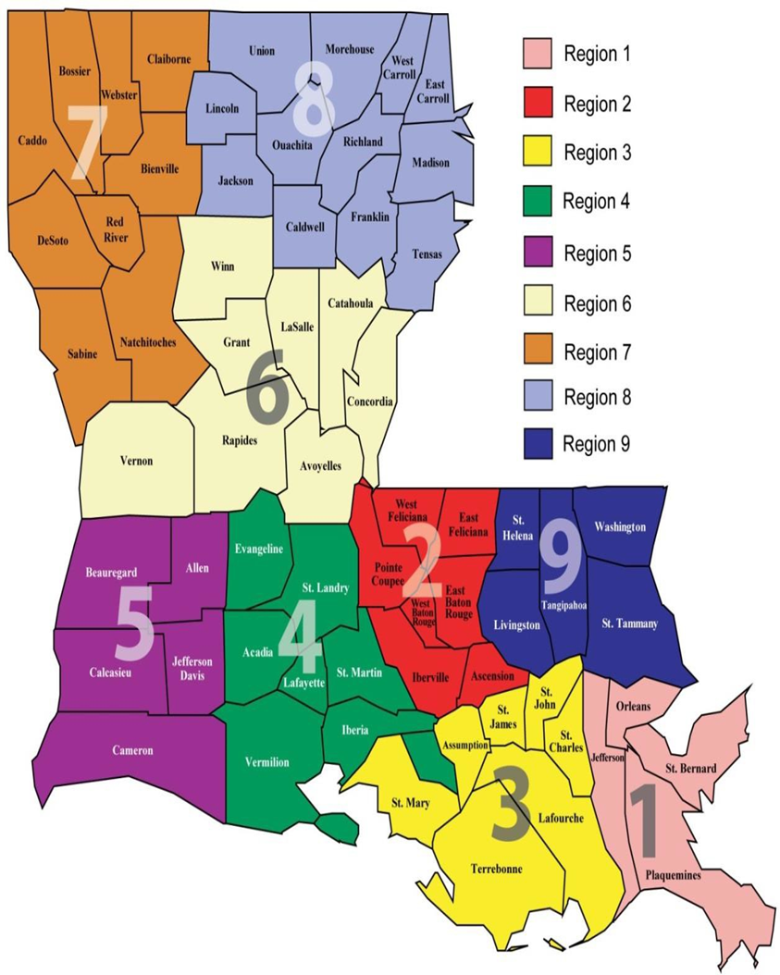
Findings – Member Regions of Follow-Ups
 | 2021 | 2022
Region 1 | 689 | 732
Region 2 | 1073 | 1650
Region 3 | 773 | 1594
Region 4 | 640 | 671
Region 5 | 454 | 721
Region 6 | 611 | 977
Region 7 | 1433 | 1779
Region 8 | 811 | 1534
Region 9 | 598 | 751
*89 members did not identify a region in 2022
Notes:
This slide shows the different regions 1-9 as defined by the Louisiana department of health. The table shows the number of members that followed up in each region. The highest follow ups were in region 2 and in region 7 in both 2021 and 2022. Lowest numbers in regions 4, 5, 9. Big increase in region 8. More follow ups in all regions in 2022 compared to 2021. The rural parishes map shows which regions in LA are rural vs urban. You can see that a lot of these regions are a mix of rural and urban such as region 2, 7. Region 8 is largely urban.

Slide 7
Findings – Race & Ethnicity of Follow-Ups
Notes:
More black in 2021 and 2022 compared to white, but big jump in white from 2021 to 2022 and slight decrease in black from 2021 to 2022
Majority not Hispanic or latino but lot of people reported unknown ethnicity
This slide shows the number of members belonging to different races and ethnicities that followed up 30 days after hospitalization. In 2021, white and black were approximately equal and there was an increase in both populations in 2022, but more white than black. Very few Asians, American Indians, native Hawaiians. In both years, those who did not identify with a Hispanic or latino ethnicity were the majority. Rise in Hispanic or latino ethnicity in 2022. but a large group did not report their ethnicity or said they weren’t sure of their ethnicity.

Slide 8
Findings – Primary Diagnoses of Follow-Ups
Notes:
This slide shows the diagnoses of the members who followed up 30 days after hospitalization. I grouped diagnoses together under some big umbrellas: MDD single episode, MDD recurrent episodes; MDD with psychosis; primary psychosis disorders including schizophrenia, schizophrenia, unspecified psychosis, delusional disorders, paranoia; other affective disorders; postpartum depression; disruptive mood dysregulation disorder which is primarily in adolescents; dysthymic disorder; bipolar disorder and or manic/depressive episodes with and then without psychotic features, bipolar disorder in remission; and schizoaffective disorder.;
In 2021, the largest group of follow ups were those with MDD either single epiode or recurrent, as well as those with primary psychosis-related diagnoses.
In 2022, there seems to be a larger uptick in bipolar disorder without psychotic features and primary psychosis and schizoaffective disorder when compared to their rates in 2021. MDD seems to have leveled off more in 2022 compared to these, but MDD with psychosis was higher in 2022 than in 2021.
Disruptive mood dysregulation disorder was more common in 2021 which matched up with the large group of adolescents following up in 2021..

Slide 9
Current interventions
Discharge Plans
Ensure member has a discharge plan (current medication list, appointment with aftercare provider(s) at a time/location convenient to member/based on member preferences, and interventions to address barriers to care (e.g., transportation, language etc.).
Ensure member understands discharge plan using teach-back methods to address health literacy.
Educate members on purpose and importance of aftercare appointments, and how to reschedule appointments if the scheduled time does not work.
Provide follow-up to member within 72 hours following discharge from hospital or emergency department to identify and address any unmet needs.
Provide ongoing MCO case management to members with special health care needs.
Warm transfer from MCO to high volume provider to complete follow-up, within 7 days of discharge
Follow-Up appointment reminder call 1-2 days prior to the scheduled appointment by MCO Case Managers. Assist member with transportation as needed.
Behavioral Health Texting Campaign to members recently discharged from emergency department or inpatient hospital with a diagnosis of mental illness or intentional self-harm
October 2023: Offer member reward for FUM members discharged from emergency departments who complete 30-day follow-up appointments with the appropriate provider type.
In January 2024: Pilot program with a high-volume hospital to offer outpatient/telehealth bridge follow-up appointments following inpatient discharge
Notes:
. Enhance hospital-to-MCO workflow for notification of hospital and emergency department admissions, discharges, and transfers:
a. Develop or enhance real-time/near-real-time admit, discharge, transfer (ADT) data exchange for behavioral health-related emergency department visits and hospital stays.
b. Streamline and improve processes for obtaining and documenting member’s consent to share information with aftercare providers.
c. Ensure hospitals and emergency departments have user-friendly, accessible provider directories, which indicate BH providers with availability for urgent aftercare appointments.
d. Perform medication reconciliation to ensure medication is on approved formulary and member has access to medication.
e. UM performs review of all FUH discharges to ensure member has a scheduled follow-up appointment and document appointment date/time in easily visible location for CM/member facing teams.
2. Link members to aftercare with BH providers prior to discharge from hospital or emergency department
Develop and implement at least three (3) strategies to:
a. increase warm hand-offs to BH providers to ensure member continuity of care. At least, one (1) strategy must relate to increasing warm hand-offs to residential substance use providers. To start, consider partnering with a large volume ID with whom you have an established relationship, then spread successes over the course of the PIP.
i. Warm transfer from MCO to high volume provider to complete follow-up, within 7 days of discharge
ii. Partner with high volume provider to schedule MH/SUD follow-up visits within 7 days of discharge.
iii. Face-to-Face visits with members in MH Hospital while IP. Community Health Navigator to complete on-site assessment including discharge needs and barriers.
b. Develop and implement strategies for reminding members regarding upcoming behavioral health appointments.
i. Follow-Up appointment reminder call 1-2 days prior to the scheduled appointment by MCO Case Managers. Assist member with transportation as needed.
Share critical member information which is necessary for patient care (including but not limited to MCO plan of care if applicable, discharge plan, and current medication listing) with aftercare BH providers within 3 days following member’s discharge from the
a. hospital or emergency department through provider-friendly, automated processes (e.g., provider portal) in accordance with the privacy requirements at 45 CFR Parts 160 and 164, 42 CFR Part 2, and other applicable state and federal laws.
Attribute members to the most appropriate BH providers (BH provider most seen; one or more visits to provider within the previous 12 months)
3. Identify and address needs of sub-populations by stratifying data by member race/ethnicity, member region of residence, gender, high-utilizers, SMI diagnosis, co-occurring disorders, age, and if available LGBTQ.
a. Initiate care coordination services for FUH members with a diagnosis of Homelessness/Housing Insecurities.
Initiate care coordination services for FUH members with a dual diagnosis of SUD.
4. Initiate a broader intervention to facilitate follow-up with members with an appropriate mental health provider (per NCQA Appendix 3) e.g., text messaging, letter to member and member’s PCP with list of follow-up providers in member’s location).
Behavioral Health Texting Campaign to members recently discharged from emergency department or inpatient hospital with a diagnosis of mental illness or intentional self-harm
5. Assistance with care coordination services when BH member chooses to “opt out” of participation in Care Management Program (1.2% of total population engaged in CM).
a. To “opt out” members must be successfully contacted via telephone
To be engaged in CM, members must complete an assessment and have an established Plan of Care
6. Offer provider incentive for members discharged who complete 30-day f/u appointments with the appropriate provider type.
7. October 2023: Offer member reward for FUM members discharged from emergency departments who complete 30-day follow-up appointments with the appropriate provider type.
8. In January 2024: Pilot program with a high-volume hospital to offer outpatient/telehealth bridge follow-up appointments following inpatient discharge

Slide 10
Summary/Additional Recommendations
Continue to formulate clear discharge plans
Continue text reminders for following up
Social media campaigns
Telepsychiatry
Alternative outpatient services – partial hospitalizations, community mental health centers (ACT teams)
Notes:
We saw that follow up rates from 2022-2023 are pretty low, the increased burden of mental illness after the pandemic requires extensive interventions to improve follow up rates and improve treatment. We saw that more females than males followed up,, and that there were a lot of adolescents following up, which says that this population is likely at increased need of services. Can see low follow up in Hispanic/latino individuals, low follow up in rural areas due to poverty and reduced mental health providers in the area.
Need to fight against stigma – stigma against metal health contributes to less males following up, to cultural differences and beliefs about mental healthcare. also, Sometimes it’s difficult for members to understand the importance of follow up appointments and staying on medications. They may opt to discontinue meds if they feel better and that sets up a cycle. For this reason, it’s important to increase education about mental health and the importance of follow ups.. - social media campaigns; take advantage of the ubiquity of smartphones and the uptick in social media use. Improve education and reduce misconceptions about mental healthcare and continued treatment
Rural areas – lack of providers in the area; encourage hospitalists to form discharge plans with follow up with psychiatrists or therapists who have provide telehealth services
Although spending on medicaid has increased for the state, the percentage devoted to behavioral health has decreased (down from 11 to 8%).
Reimbursement rates for psychiatrists from medicaid is really low, so a lot of them don’t take medicaid
Community based services like ACT are great option since medicaid isn’t always accepted. In these, the providers go out to the community so like going out to schools and meeting kids, etc
Intensive outpatient encounters, partial hospitalizations, community mental health centers (ACT team)
community-based group of medical, behavioral health and rehabilitation professionals who use a team approach to meet the needs of an individual with severe and persistent mental illness. An individual who is appropriate for ACT does not benefit from receiving services across multiple, disconnected providers and may become at greater risk of hospitalization, homelessness, substance use, victimization and incarceration. An ACT team provides person-centered services addressing the breadth of an individual’s needs

Slide 11
Resources
file://Amerihealth_LA2023_PIP-Val_BH_TOC_Quarter 3 Submission.doc
https://gpsych.bmj.com/content/34/1/e100424
https://www.tc.columbia.edu/articles/2023/april/need-to-know-about-the-pandemics-lasting-effects-on-youth-mental-health-/
https://www.kff.org/mental-health/issue-brief/the-implications-of-covid-19-for-mental-health-and-substance-use/
https://www.thecommunityguide.org/media/pdf/healthcomm-AJPM-recs-campaigns.pdf
https://www.apa.org/health/behavioral-integration-fact-sheet

