Slide 1
Pediatric MSSA and MRSA Skin and Soft Tissue Infections

Slide 2
Brief History
Staphylococcus aureus is a commensal human pathogen that is a common cause of skin and soft tissue infections – as well as other more serious infections^{1,2}
S. aureus strains that are resistant to penicillin-based antibiotics are called MRSA (methicillin-resistant S. aureus), and strains that are methicillin susceptible are called MSSA (methicillin-sensitive S. aureus)^{1,2}
MRSA emerged as a community acquired pathogen in the mid 1990s, and in the early 20th century infections rates with MRSA increased drastically ³
Notes:
Staph aureus is a gram positive bacteria, that is a commensal human pathogen. Which is to say that it part of the natural human flora of healthy skin, butis also that it is capable of causing disease – notably skin and soft tissue infections like abscess, carbuncles, and cellulitis. It is also a common cause of other serious infections such as infective endocarditis, osteomyelitis, and pneumonia
Typically when talking about staph, we say a stain is either MRSA – methicillin resistant, or MSSA which is to say methicillin sensitive
MRSA emerged as CA pathogen that affected otherwise healthy people in the mid-1990s, previously only seen in hospital patients, and in the early 20th century infections rates with MRSA increased drastically

Slide 3
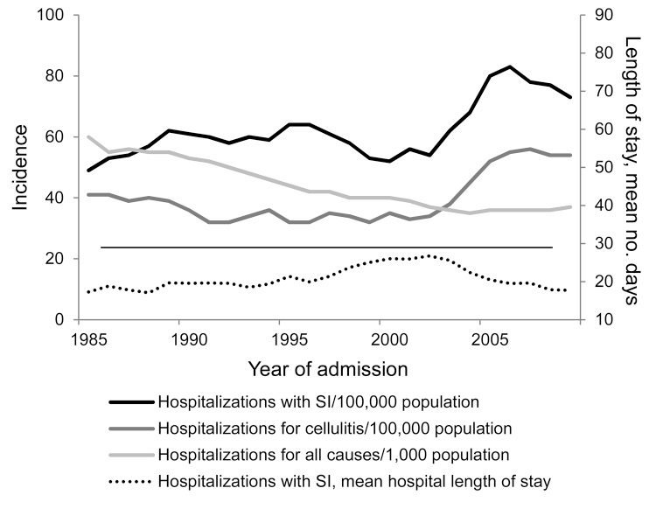
Gutierrez K, Halpern MS, Sarnquist C, Soni S, Arroyo AC, Maldonado Y. Staphylococcal infections in children, California, USA, 1985-2009. Emerg Infect Dis. 2013 Jan;19(1):10-20; quiz 185. doi: 10.3201/eid1901.111740. PMID: 23260060; PMCID: PMC3557972.
Notes:
For example this, graph is from a 15 year retrospective study of hospitalization of children with staph infection. It found an increase 49/100,000 in 1985 to a peak of 83/100,000 in 2006 and dropped to 73/100,000 in 2009.
Another study examining whether rise in CA-MRSA corresponded with increased ED visits and outpatient care, or increased antibiotic prescription examined outpatient and ED visits for SSTI from 1997 to 2005 National Ambulatory Medical Care Survey and National Hospital Ambulatory Medical Care Survey found an overall statisticallt significant increase of 32.1 to 48.1 visits per 1000 population (50%; P = .003 for trend) for SSTI, with the largest relative increase being in Eds (Especially safety-net EDS in the south), among patients under 18 and black patients⁴
- More recently, a study reviewing patient data from 2009-2011 among members of a Northern California Health plan found a rate of clinically diagnosed SSTIs of 496 per 10,000 person years, with at risk groups being diabetics and patients under 5, with he majority (81%) of cultured SSTIs being staph aureus and about half of the SA being MRSA ⁵

Slide 4
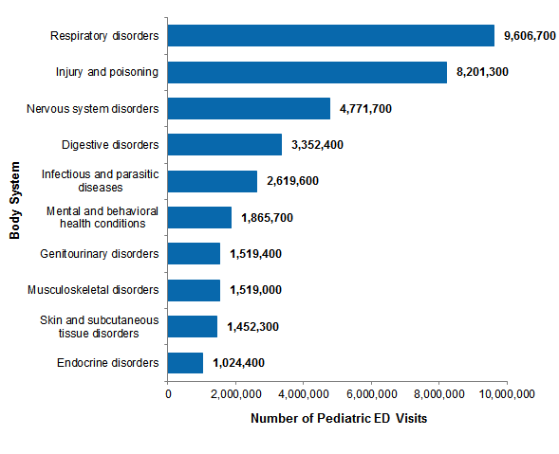
Ten most common all-listed reasons for pediatric ED visits by body system, FY 2015
McDermott KW (IBM Watson Health), Stocks C (AHRQ), Freeman WJ (AHRQ). Overview of Pediatric Emergency Department Visits, 2015. HCUP Statistical Brief #242. August 2018. Agency for Healthcare Research and Quality, Rockville, MD. www.hcup-us.ahrq.gov/reports/statbriefs/sb242-Pediatric-ED-Visits-2015.pdf.
Notes:
- In terms of overall ED visitsm This graph from Healthcare Cost and Utilization Project (HCUP) Statistical Brief presents data on pediatric ED visits in 2015, shows the skin and subcutaneous tissue disorders are listed among the 10 most reason for pediatric ED visits
AN HCUP report from 2005, meanwhile lists skin and soft tissue infections as the 8th most common reason for pediatric ED visits resulting in hospitalization (making up 1.8% of all pediatric ED visits, with 12.7% of ED visits for this condition being hospitalized) ⁷
- So there fore we can conclude that SSTI – while not as common as respiratory disease and injury - are an important burden on pediatric ED and hospital utilization, and that many SSTIs are caused by SA

Slide 5
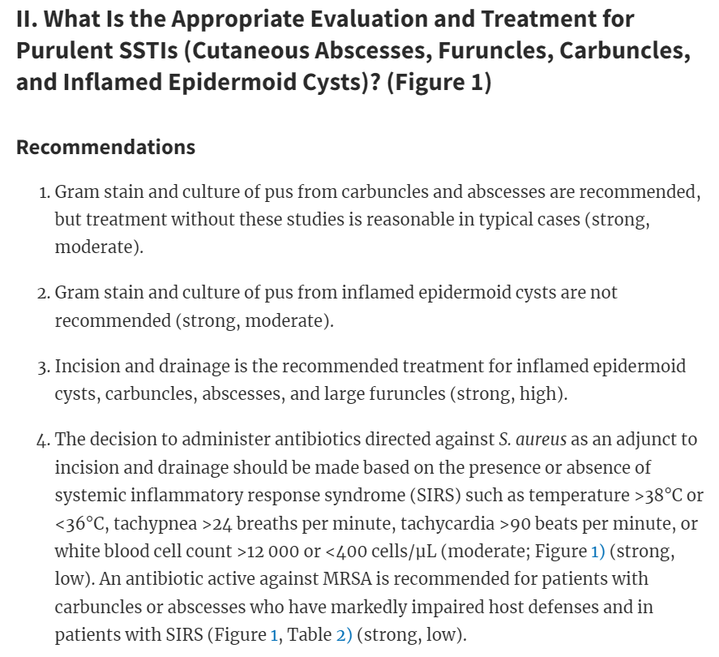
Current Guidelines from the Infectious Disease Society of America
Notes:
- The current recommended treatment from the ID society of America are from 2014 and recommend Incision and Drainage as the mainstay treatment, with adjuvant antibiotics active against S. aureus to be added if patient appears to have a systemic response to infection or impaired immune system, as it was found that antibitoics did not improve cure rates in their review ⁸

Slide 6
Recurrence and Colonization
Recurrence is a major problem with skin and soft tissue infections from MRSA
One study having found recurrence to be as high as 28% in pediatric population at 3-month mark ⁹
While the ID society also has guidelines on treating recurrent skin and soft tissue infections ⁸, they tend to be vague, are rated as having weak supportive evidence
A study of pediatric ED providers showed wide variability in when they chose to provide adjuvant treatment ¹⁰
Notes:
Recurrence is a major problem with skin and soft tissue infections, that is to say that if someone has developed an abcess, they are are very likely to develop one again. One prospective cohort study found that in pediatric patients not prescribed adjuvant treatment, the recurrence rate at 3 months was as high as 28%
The ID society also has guidelines for reccurent SSTI – but if there is not an underlying direct cause such as an immune system disorder or foreign body – these guidliens tend to be vague and they rate them as having low supporting evidence
The recommendations are to prescribe a 5-10 day course of antibiotic active against the pathogen causing the infection, and to have the affected patient decolonize themselves with actions such as bleach baths (that is to say, remove MRSA as a commensal pathogen)
A study involving sending sample cases to pediatric ED providers to test how they would treat varying cases found there was a wide variability in when these providers chose to prescribe antibiotics

Slide 7
However, More Recent Studies Show
Household decolonization as effective in preventing recurrence in pediatric population
Large review article found that MRSA cases tend to cluster in households and the family members be colonized with same strand of MRSA as patient
While studies of inviduals undergoing decolonization did not show significance, the study of household decolonization did ^{15, 16}
Adjuvant antibiotics being associated with:
Higher cure rates ^{13, 14}
Reduced risk of recurrence ^{11, 12, 13}
Notes:
While the evidence supporting individual decolonization through varying means has been weak, there has been stronger evidence supporting household decolonization. Which is to say, all members of the household undergoing decolonization procedures
Additionally, several more recent studies – including a large multicenter study published in the New England journal of medicine in 2017 – have shown increased cure rate and reduced risk of recurrence in MRSA abscess patients treated with antibiotics active against MRSA
Knowledge of these new measures could help physicians better cure and prevent recurrence of MRSA abscesses

Slide 8
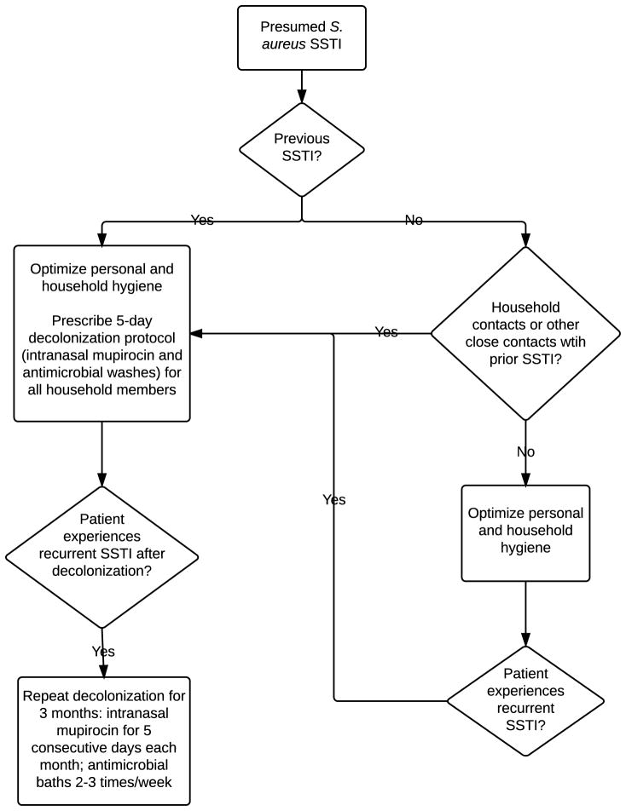
Creech CB, Al-Zubeidi DN, Fritz SA. Prevention of Recurrent Staphylococcal Skin Infections. Infect Dis Clin North Am. 2015 Sep;29(3):429-64. doi: 10.1016/j.idc.2015.05.007. PMID: 26311356; PMCID: PMC4552962.
Notes:
- This is a proposed guideline for prescribing for prescribing decolonization to patients with a history of SSTI

Slide 9
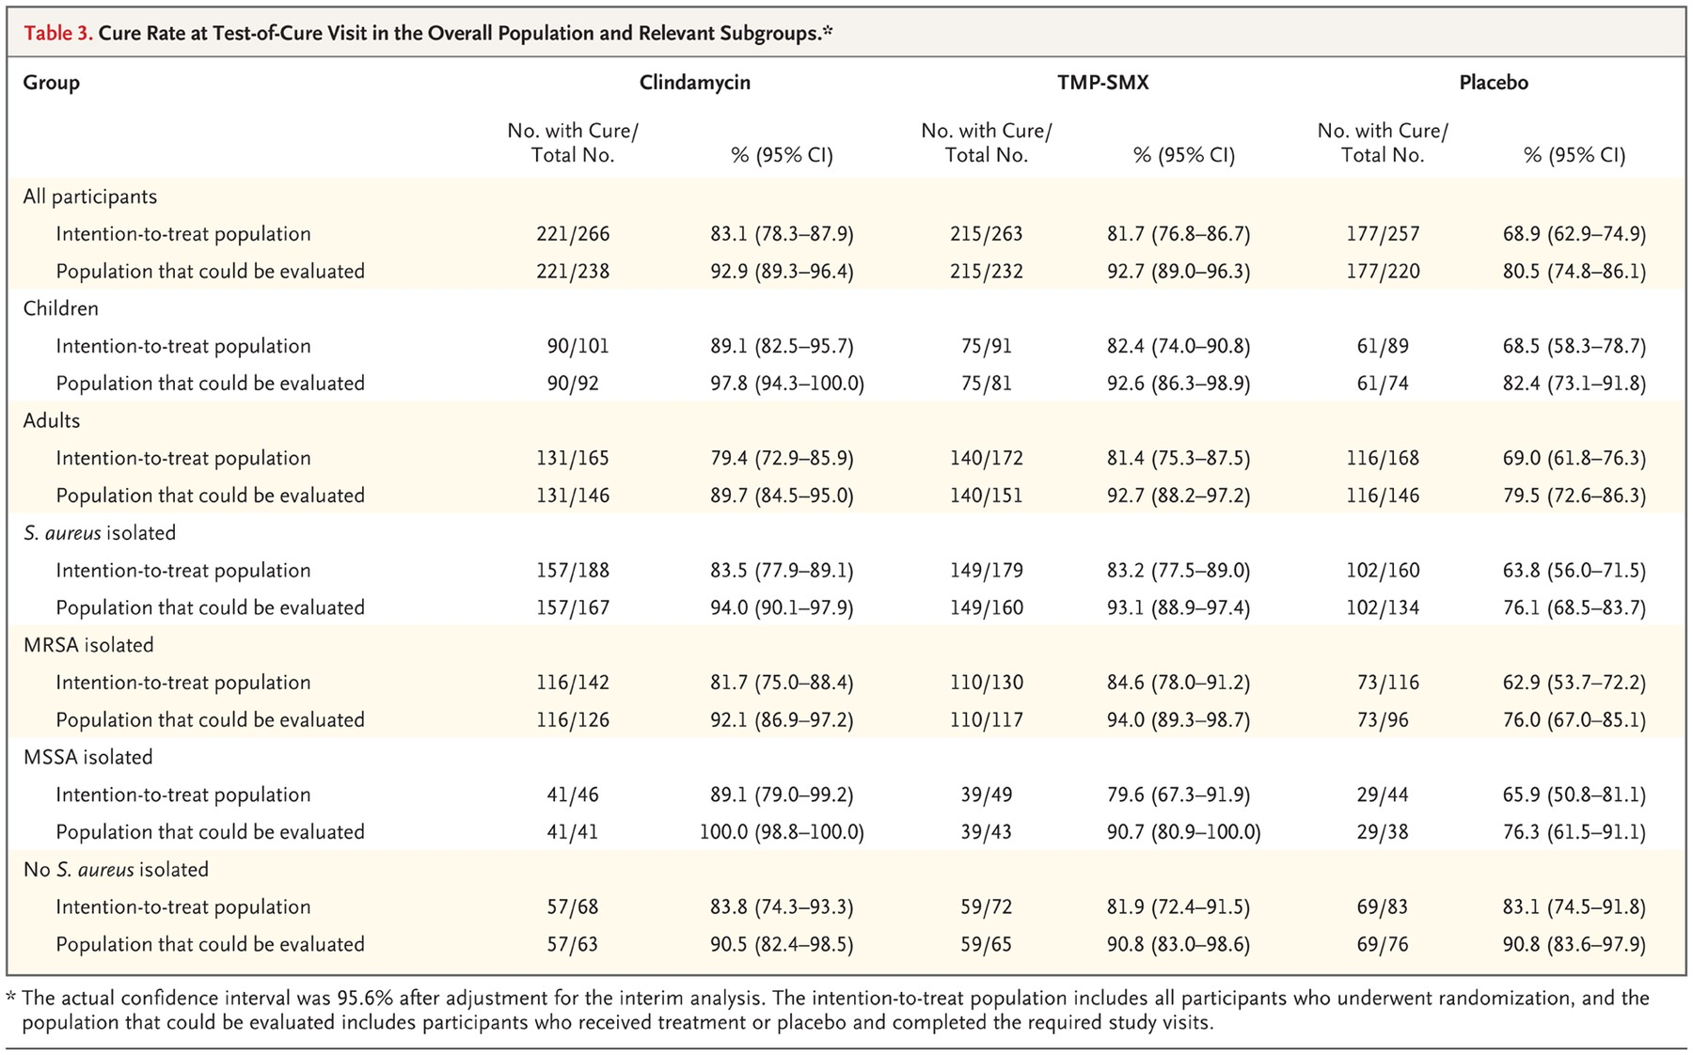
12. Daum, Robert S., et al. "A placebo-controlled trial of antibiotics for smaller skin abscesses." New England Journal of Medicine 376.26 (2017): 2545-2555.
Notes:
- This is the table showing cure rates for the previously mentioned New England Journal of Medicine study. In this study there was no statistically significant difference between the cure rates between the two different types of antibiotics, but the beneficial effect of these antibiotics was only found in patients with s. aureus isolated

Slide 10
In Brief
MRSA and MSAA SSTIs make-up a significant amount of ED visits and have a high risk of recurrence
Per ID Guidelines, incision and drainage are mainstay treatment
However, recent evidence has shown (1) adjuvant antibiotics and (2) household decolonization can decrease recurrence
In short, educating ED physicians or updating hospital guidelines about these new findings could decrease recurrence and need for ED utilization
Notes:
So in summary “read slide”

Slide 11
Citations
Taylor TA, Unakal CG. Staphylococcus Aureus. [Updated 2022 Jul 18]. In: StatPearls [Internet]. Treasure Island (FL): StatPearls Publishing; 2023 Jan-. Available from: https://www.ncbi.nlm.nih.gov/books/NBK441868/
Lowy, F. D. 1998. Staphylococcus aureus infections. N. Engl. J. Med. 339:520-532
Gutierrez K, Halpern MS, Sarnquist C, Soni S, Arroyo AC, Maldonado Y. Staphylococcal infections in children, California, USA, 1985-2009. Emerg Infect Dis. 2013 Jan;19(1):10-20; quiz 185. doi: 10.3201/eid1901.111740. PMID: 23260060; PMCID: PMC3557972.
Hersh, A. L. , Chambers, H. F. , Maselli, J. H. & Gonzales, R. (2008). National Trends in Ambulatory Visits and Antibiotic Prescribing for Skin and Soft-Tissue Infections. Archives of Internal Medicine, 168 (14), 1585-1591.
Ray GT, Suaya JA, Baxter R. Incidence, microbiology, and patient characteristics of skin and soft-tissue infections in a U.S. population: a retrospective population-based study. BMC Infect Dis. 2013 May 30;13:252. doi: 10.1186/1471-2334-13-252. PMID: 23721377; PMCID: PMC3679727.
McDermott KW (IBM Watson Health), Stocks C (AHRQ), Freeman WJ (AHRQ). Overview of Pediatric Emergency Department Visits, 2015. HCUP Statistical Brief #242. August 2018. Agency for Healthcare Research and Quality, Rockville, MD. www.hcup-us.ahrq.gov/reports/statbriefs/sb242-Pediatric-ED-Visits-2015.pdf.
Merrill, CT (Thomson Healthcare), Owens PL (AHRQ), and Stocks, C (AHRQ). Pediatric Emergency Department Visits in Community Hospitals from Selected States, 2005. HCUP Statistical Brief #52. May 2008. Agency for Healthcare Research and Quality, Rockville, MD. http://www.hcup-us.ahrq.gov/reports/statbriefs/sb52.pdf.
Dennis L. Stevens, Alan L. Bisno, Henry F. Chambers, E. Patchen Dellinger, Ellie J. C. Goldstein, Sherwood L. Gorbach, Jan V. Hirschmann, Sheldon L. Kaplan, Jose G. Montoya, James C. Wade, Practice Guidelines for the Diagnosis and Management of Skin and Soft Tissue Infections: 2014 Update by the Infectious Diseases Society of America, Clinical Infectious Diseases, Volume 59, Issue 2, 15 July 2014, Pages e10–e52, https://doi.org/10.1093/cid/ciu296
Duong M, Markwell S, Peter J, Barenkamp S. Randomized, controlled trial of antibiotics in the management of community-acquired skin abscesses in the pediatric patient. Ann Emerg Med. 2010 May;55(5):401-7. doi: 10.1016/j.annemergmed.2009.03.014. Epub 2009 May 5. PMID: 19409657.
Mistry RD, Hogan PG, Parrish KL, Thompson RM, Fritz SA. Skin and Soft Tissue Infection Treatment and Prevention Practices by Pediatric Emergency Medicine Providers. Pediatr Emerg Care. 2022 Jul 1;38(7):e1348-e1354. doi: 10.1097/PEC.0000000000002618. Epub 2022 Jan 20. PMID: 35766929.
Patrick G Hogan, Marcela Rodriguez, Allison M Spenner, Jennifer M Brenneisen, Mary G Boyle, Melanie L Sullivan, Stephanie A Fritz, Impact of Systemic Antibiotics on Staphylococcus aureus Colonization and Recurrent Skin Infection, Clinical Infectious Diseases, Volume 66, Issue 2, 15 January 2018, Pages 191–197, https://doi.org/10.1093/cid/cix754

Slide 12
Citations
12. Patrick G Hogan, Marcela Rodriguez, Allison M Spenner, Jennifer M Brenneisen, Mary G Boyle, Melanie L Sullivan, Stephanie A Fritz, Impact of Systemic Antibiotics on Staphylococcus aureus Colonization and Recurrent Skin Infection, Clinical Infectious Diseases, Volume 66, Issue 2, 15 January 2018, Pages 191–197, https://doi.org/10.1093/cid/cix754
13. Daum, Robert S., et al. "A placebo-controlled trial of antibiotics for smaller skin abscesses." New England Journal of Medicine 376.26 (2017): 2545-2555.
14. Talan, David A., et al. "Trimethoprim–sulfamethoxazole versus placebo for uncomplicated skin abscess." N Engl J Med 374 (2016): 823-832.
15. Creech CB, Al-Zubeidi DN, Fritz SA. Prevention of Recurrent Staphylococcal Skin Infections. Infect Dis Clin North Am. 2015 Sep;29(3):429-64. doi: 10.1016/j.idc.2015.05.007. PMID: 26311356; PMCID: PMC4552962.
16. Fritz SA, Camins BC, Eisenstein KA, Fritz JM, Epplin EK, Burnham CA, Dukes J, Storch GA. Effectiveness of measures to eradicate Staphylococcus aureus carriage in patients with community-associated skin and soft-tissue infections: a randomized trial. Infect Control Hosp Epidemiol. 2011 Sep;32(9):872-80. doi: 10.1086/661285. PMID: 21828967; PMCID: PMC3528015.

