Slide 1
Cervical Cancer Screening
Taylor Lambert
LSUHSC 4th Year Medical Student
AmeriHealth Caritas Louisiana Intern
September 20,2023

Slide 2
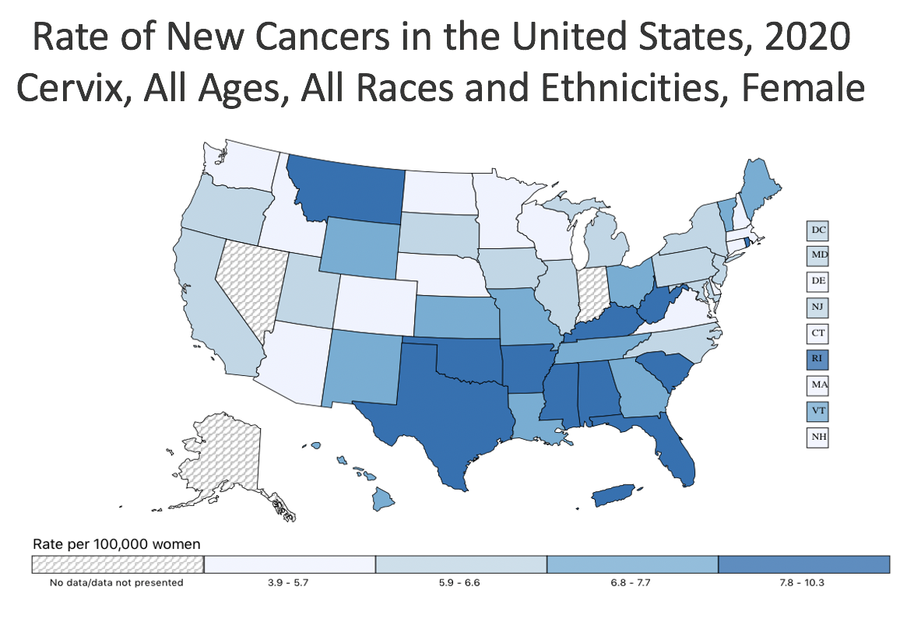
Background
Cervical cancer is the 4th most common cause of cancer in females worldwide
About 11,500 new cases of cervical cancer are diagnosed and 4,000 women die from this cancer each year in the U.S.
Over 90% of cervical cancer cases are related to infection with human papillomavirus (HPV).
HPV vaccination and cervical cancer screening are paramount in the early detection and prevention of cervical cancer.
Incidence rate of cervical cancer in the U.S., 2020:
6.8 per 100,000 women
Incidence rate of cervical cancer in Louisiana, 2020:
7.5 per 100,000 women

Slide 3
Cervical Cancer Screening
Women 21-64 years of age: cervical cytology every 3 years
Women 30-64 years of age: cervical cytology/ high-risk HPV (hrHPV) co-testing every 5 years
Total population: ALCA members turning 24-64 years of age by 12/31/2023
Guidelines from USPSTF
Notes:
Women meeting the above criteria were considered compliant
Total eligible members were those turning 24-64 years of age in the calendar year- use this measure because allows for women to be screened within 3 years of turning 21

Slide 4

Program Goals
Increase rate of women aged 21-64 who receive appropriate cervical cancer screening
1
Highlight the significance of early detection of cervical cancer
2
Reduce the risk of cervical cancer in women aged 21-64 by promoting early HPV vaccination and regular screening tests
3

Slide 5
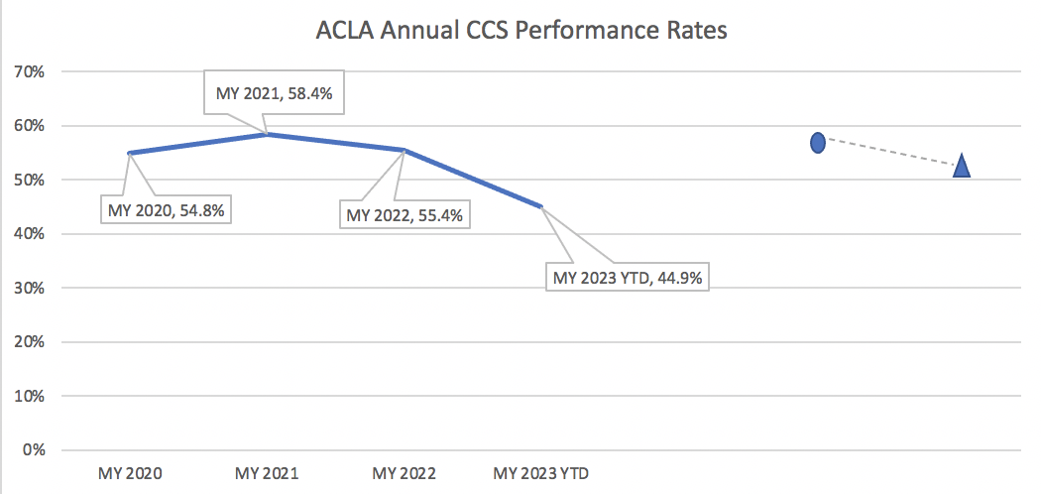
Annual Performance Goals and Rates
HEDIS MY 2023
NCQA’s Quality Compass National 50th %ile Rate
(TARGET OBJECTIVE)
57.64%
MY 2023 Target Rate
57.74%
MY 2023 Predicted Final Rate
52.61%
HEDIS MY 2023 2% IMPROVEMENT GOAL
57.36%
YTD and predicted final rate suggest a low likelihood that the target rate or 2% improvement goal will be met for CCS for MY 2023.
Projected data also suggest an overall decrease in CCS compliance rates for MY 2023 compared to the year prior.
Notes:
YTD rate as of September 1= 44.92%

Slide 6
Current ACLA Interventions and Barriers
Interventions
Member and multidisciplinary provider education
Member and provider incentives
  Member: CARE Card ($10 for CCS)
  Provider: performance incentives
Social media and mPulse reminder texting campaigns
Student Wellness Survey
Community partnerships
  Feist-Weiller/CENLA Mobile Units
  Southeast Community Health Center
  Wellness and Opportunity Centers (New Orleans and Shreveport)
  Community and Faith Based Organization Education
Barriers
Lack of knowledge of importance of CCS
Member fear of cancer and screenings for disease, lack motivation to be regularly screened
Not discussing preventative screening if only go to provider for sick visits
Difficulty with management due to member noncompliance
Provider lack of medical record documentation
Providers discuss screening options, but fail to follow up with scheduling the screening
Low success rate of member outreach calls
  Difficulty staying up to date with patient contact information

Slide 7
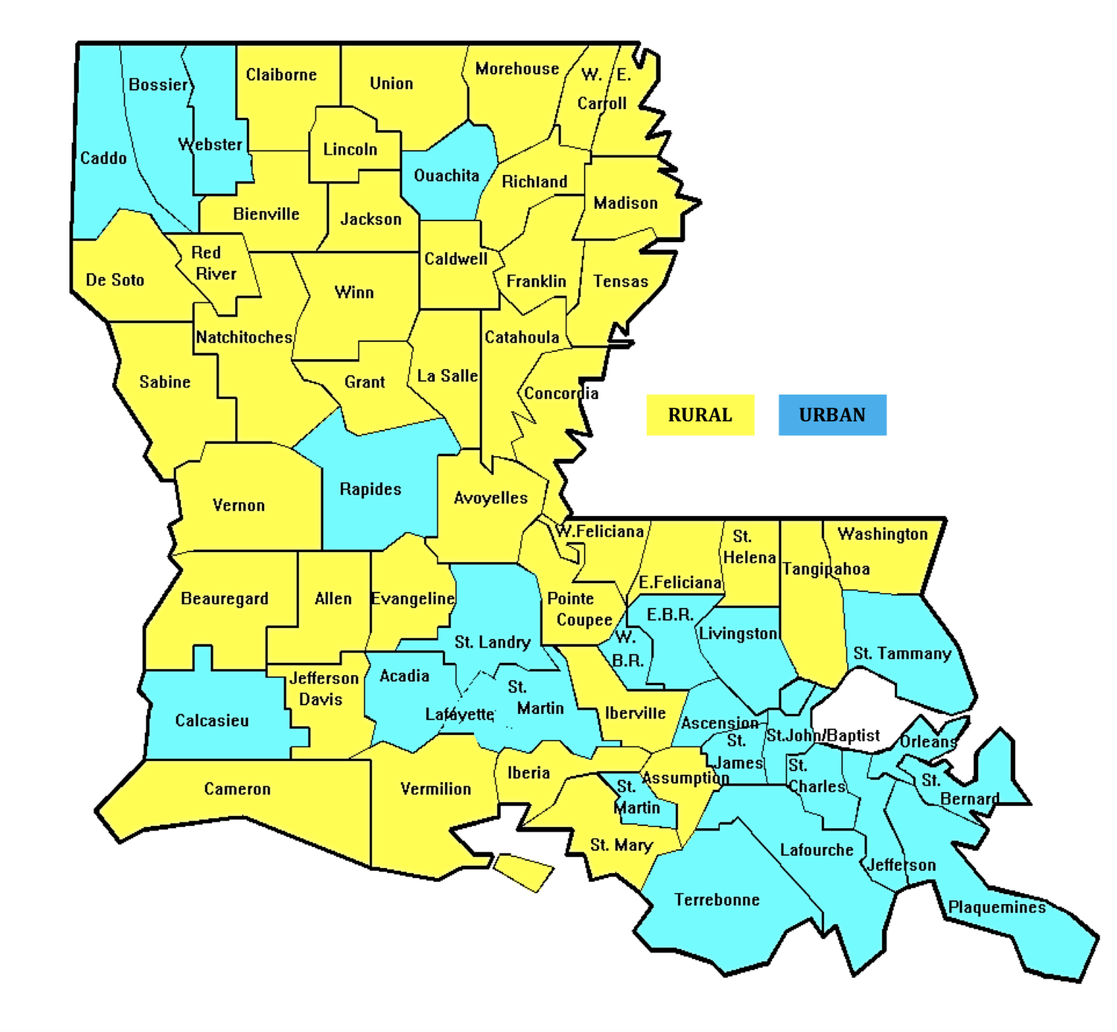
CCS Rates of Rural vs. Urban Members
Rural: 38% compliant
  Total members: 19,103
Urban: 34% compliant
  Total members: 49,871
Notes:
Similar compliance rates in urban and rural populations (rural a little higher)

Slide 8
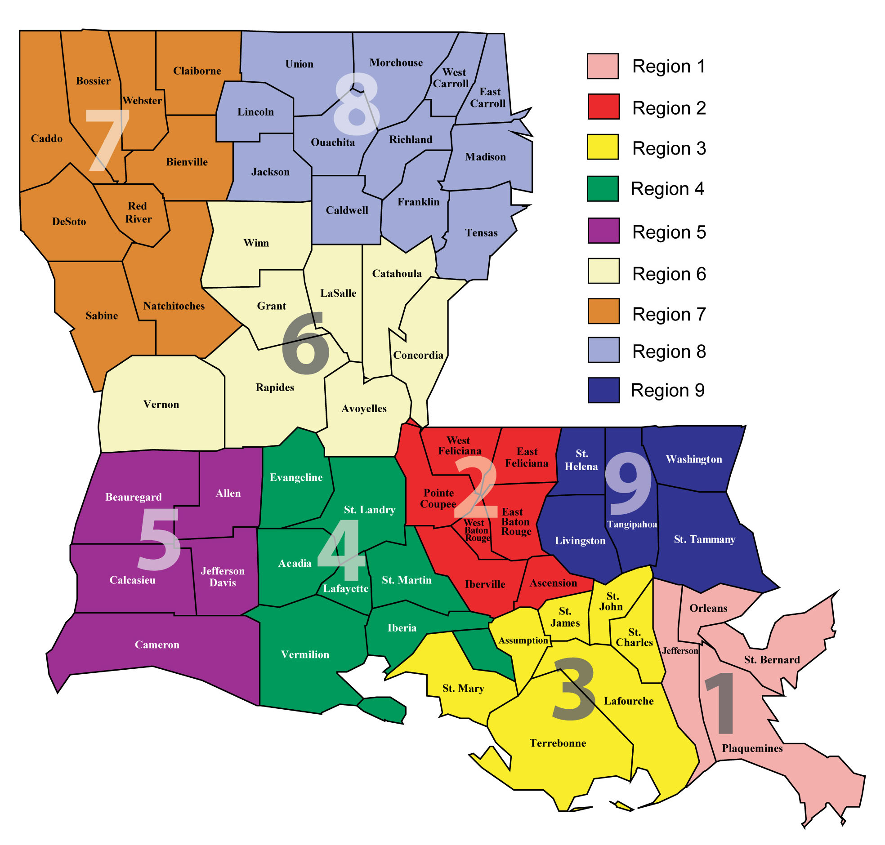
Cervical Cancer Screening Rates Per Region
Region | % Compliant
Region 1 | 36%
Region 2 | 41%
Region 3 | 43%
Region 4 | 35%
Region 5 | 33%
Region 6 | 34%
Region 7 | 27%
Region 8 | 28%
Region 9 | 42%
Notes:
Regions 7 and 8 had lowest % of population compliant
Regions 3 highest % compliant

Slide 9
PCPs/OBGYNs in Network per Region
 | Region 1 | Region 2 | Region 3 | Region 4 | Region 5 | Region 6 | Region 7 | Region 8 | Region 9
Number of Healthcare providers that agree to full PCP responsibility for adults | 462 | 339 | 152 | 282 | 144 | 217 | 280 | 375 | 275
Ratio of adult PCPs: adult enrollees (1 PCP:2,500 adult enrollees minimum standard for adequate access) (.04%) | 1.41% | 2.35% | 1.23% | 1.36% | 1.87% | 1.69% | 1.26% | 1.81% | 2.40%
Number of OBGYNs | 169 | 96 | 46 | 77 | 41 | 32 | 67 | 26 | 53
Ratio of OBGYNs: eligible members | 1.12% | 1.16% | 0.9% | 0.9% | 1.26% | 0.51% | 0.69% | 0.35% | 1.04%
Notes:
Number of Healthcare providers that are in Amerihealth caritas network: Includes family med, internal med, NP, PA, certified nurse midwife, FQHC, RHC
PCP:
All regions meet requirement for adequate network access
not much correlation between PCP access and ccs compliance rates. In fact, Region 3 actually has the lowest ratio but the highest compliance rate at 43%
OBGYN:
not able to find a standard ratio that is used to assess network access adequacy for OBGYNs
Regions 6,7, and 8 had the lowest ratios of OBGYNs to eligible members. Access to OBs could be a potential factor in compliance rates given that Regions 7 and 8 had the lowest compliance

Slide 10
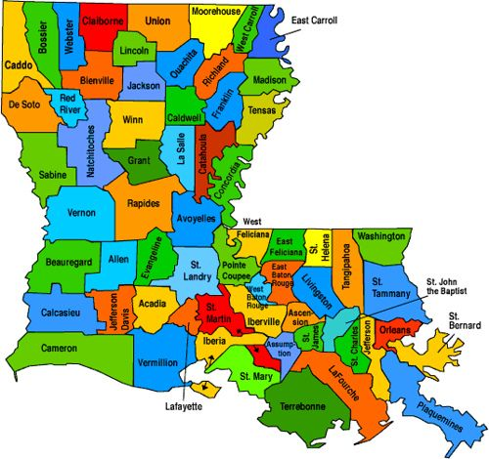
CCS Rates at the Parish Level
Urban Parishes (Average compliance = 37%)
Jefferson: 41%
East Baton Rouge: 38%
Rapides: 30%
St. Tammany: 40%
Rural Parishes (Average compliance= 35%)
Evangeline: 42%
Allen: 33%
Natchitoches: 30%
Franklin: 36%
Notes:
Wanted to see if same results held true at the Parish level.
Due to time constraints, I was unable to gather some of the data needed for this analysis. Parishes that had missing information were excluded and I tried to randomly select as best possible these 8 parishes that met the data requirements and represent 8 of the 9 regions across Louisiana
Not much difference in compliance rates between rural vs urban
Community outreach strategies could play a part in this ex: mobile units, faith based education could play role in targeting rural areas

Slide 11
Access to PCPs/OBGYNs at the Parish Level
Parish | Total Population | Number of PCPs | Ratio of PCP: total population 1:2,500 (0.04%) | Number of OBGYNs | Ratio of OBGYN: total population
Jefferson | 439,402 | 10,723 | 2.4% | 12,199 | 2.8%
East Baton Rouge | 455,447 | 5,775 | 1.3% | 6,165 | 1.4%
Rapides | 130,459 | 3,466 | 2.7% | 4,277 | 3.3%
St. Tammany | 262,799 | 2,745 | 1.04% | 2,824 | 1.1%
Evangeline | 32,538 | 691 | 2.1% | 783 | 2.4%
Allen | 23,085 | 430 | 1.9% | 494 | 2.1%
Natchitoches | 37,896 | 29 | 0.08% | 31 | 0.08%
Franklin | 19,964 | 1,028 | 5.1% | 997 | 5.0%
U
R
B
A
N
R
U
R
A
L
Notes:
clarify these are not the same numbers as shown before. unable to obtain network data at the parish level. The number included here represent the total population in each parish as well as the total number of providers in each parish
The Ratio of PCP to population does not seem to correlate with compliance rate and there is not much difference in terms of provider access between rural and urban parishes
Natchitoches does have the lowest ratio of both PCP and Obs, possibly playing a role in their low compliance rate. However, Rapides was tied with them for the lowest compliance rate yet they have higher ratios of both PCP and OBGYNS
Does not seem to be too much of a correlation between access to providers in rural and urban parishes and compliance rates

Slide 12
Recent PCP/OBGYN Visit in the American Indian/Alaska Native Population
PCP or OBGYN visit within last 12 months | CCS Non-Compliant | CCS Compliant | Total | Percent of members compliant
No visit | 361 | 16 | 377 | 4.2%
Yes visit | 184 | 10 | 194 | 5%
Total | 545 | 26 | 571
Notes:
Was not able to get all data in time to look at all members who had a recent visit to PCP or OBGYN and still noncompliant. Looking at a specific population of interest which data, the American Indian Alaska native population
This include members who had visit in rolling 12 month period
Compliance rates similar in pts who had visit and who did not– though looking at a small population, the big picture here is that there is a lot of potential missed opportunity for appropriately screening patients

Slide 13
Summary
No substantial difference in compliance rates between overall rural and urban populations and at the parish level.
No meaningful difference in access to PCPs/OBGYNs and compliance rates at both the regional and parish level.
No difference in CCS rates between American Indian/Alaska Native members who had a recent PCP/OBGYN visit in the rolling 12-month period compared to those who did not have a visit

Slide 14
Recommendations
Continue to Enhance Provider Awareness
Provider Education: Regional provider training, quality meetings Focused provider outreach, HEDIS documentation guidelines Provider Reminders: Increase frequency of provider alerts Provider newsletter Provider incentives Provider assessment and feedback Survey providers in network to see how many actually perform CCS in their practice
Continue Current Interventions
Member Education Email, text, or call reminders Incentive Assistance with setting up appointments Community partnerships Increase frequency of events Mobile units in more areas Social Media Campaigns Target towards specific groups or populations Target toward providers in areas of lower compliance rates
Further Analysis..
Number of those who had a PCP/OBGYN visits in rolling 12-month period and still non-compliant– expand analysis to look at more of the population Disparities among American Indian/Alaska Native group specifically Expand parish level analysis to look at differences in provider access Access to providers in network at the parish level
Notes:
Some of these interventions are currently in progress ex: provider newsletter
Provider assessment and feedback- might be difficult at the provider level but could possibly be done at the practice or institutional level
Disparities among American Indian/Alaska Native group specifically- current ACLA PIP project

Slide 15


Thank you!
Dr. Gregory Randolph
Dana Smith
Renee Wells
Carrie Blades
Shea Good
Rhonda Baird
LSU School of Medicine
ACLA Quality Improvement Team
Questions?

Slide 16
References
https://ldh.la.gov/assets/docs/BayouHealth/Dental/Louisiana_Rural_Parishes_Map.pdf
https://www.uspreventiveservicestaskforce.org/uspstf/recommendation/cervical-cancer-screening
https://www.thecommunityguide.org/media/pdf/Cancer-AJPM-recs-screening-2008.pdf
https://gis.cdc.gov/Cancer/USCS/#/AtAGlance/
U.S. Cancer Statistics Working Group. U.S. Cancer Statistics Data Visualizations Tool, based on 2022 submission data (1999-2020): U.S. Department of Health and Human Services, Centers for Disease Control and Prevention and National Cancer Institute; https://www.cdc.gov/cancer/dataviz, released in June 2023.

Slide 17
Breakdown by Member Demographics
Member Age | CCS Non-compliant | CCS Compliant | Total | Compliance Rate
21-30 | 13,899 | 8,239 | 22,138 | 37%
31-64 | 31,154 | 15,903 | 47,057 | 33.8%
Member Race | CCS Non-compliant | CCS Compliant | Total | Compliance Rate
American Indian or Alaska Native | 377 | 194 | 571 | 34%
Asian or Pacific Islander | 555 | 277 | 832 | 33%
Black or African American | 22,006 | 11,763 | 33,769 | 35%
Middle Eastern/North African | 29 | 49 | 78 | 63%
White/Caucasian | 17,181 | 9,176 | 26,357 | 35%
Other | 928 | 763 | 1,691 | 45%
Decline to State | 1,077 | 969 | 2,046 | 47%
Not Provided/Unknown | 2,900 | 951 | 3,851 | 25%

