Slide 1
Improving Diabetes Measure Rates of AmeriHealth Caritas Louisiana Members
Theresa Cao
Louisiana State University Health Sciences Center – New Orleans, LA
School of Medicine, Class of 2024
AmeriHealth Caritas Louisiana Medical Intern
August 23, 2023

Slide 2
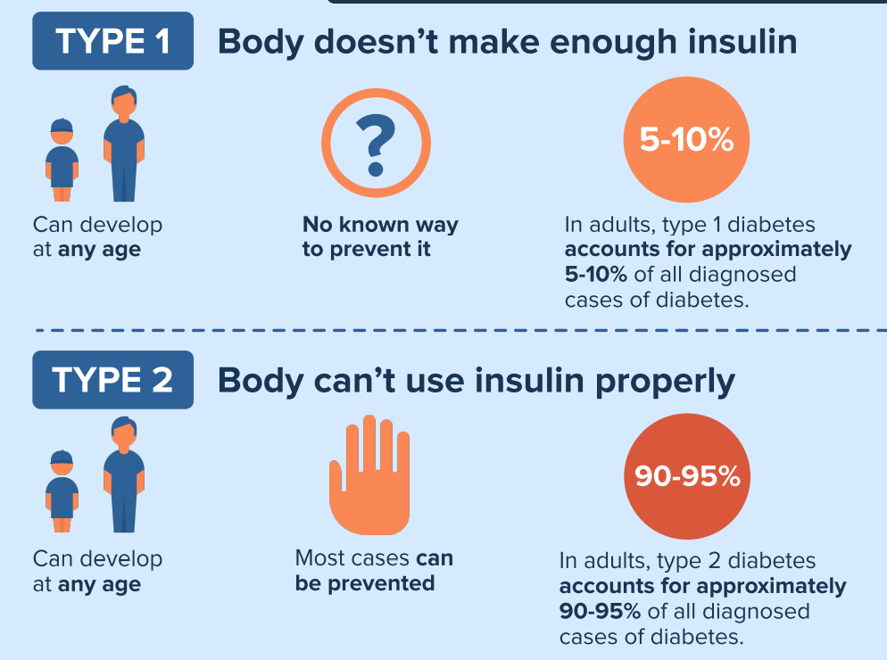
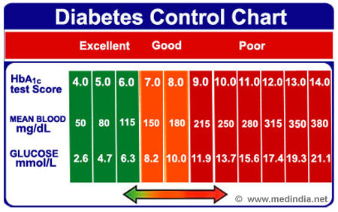
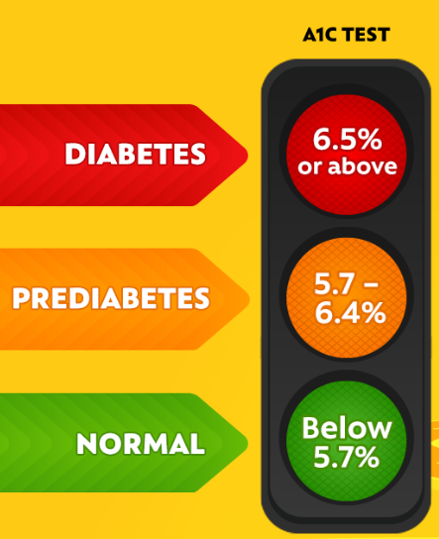
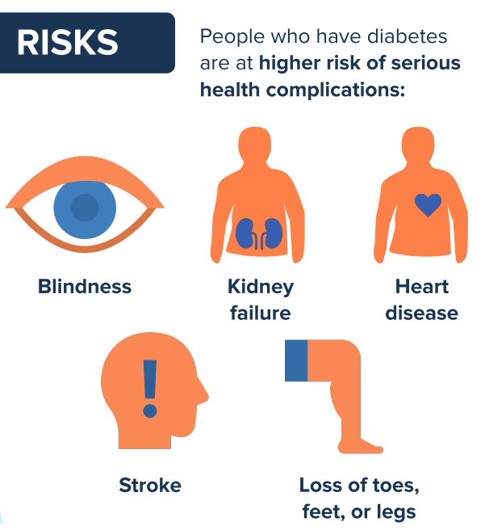

DIABETES
Combined diet and physical activity programs
Counseling, coaching, individualized guidance
Engaging community health workers for diabetes prevention and management
Mobile phone apps for self-management (Type 2 Diabetes)
Team-Based Care
Notes:
Diabetes – chronic health condition when there is not enough insulin (in type 1 DM) or insulin not be used well (in type 2 DM), causing too much sugar in bloodstream
Higher risk of health complications such as blindness, kidney failure, heart disease, stroke, loss of limbs
Measurement to help diagnose DM is HbA1c – which measures the average blood sugar level over the past 2 or 3 months. An A1C below 5.7% is normal, between 5.7 and 6.4% is prediabetes, and 6.5% or higher is diabetes.
Within Diabetes, there is good control as well as poor control, good control is considered an HbA1c <8.0% and poor control is considered >9.0%
Current strategies recommended to prevent and manage DM according to the Community Guide are…

Slide 3
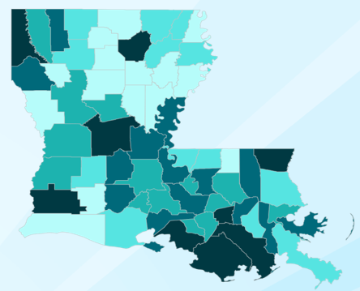
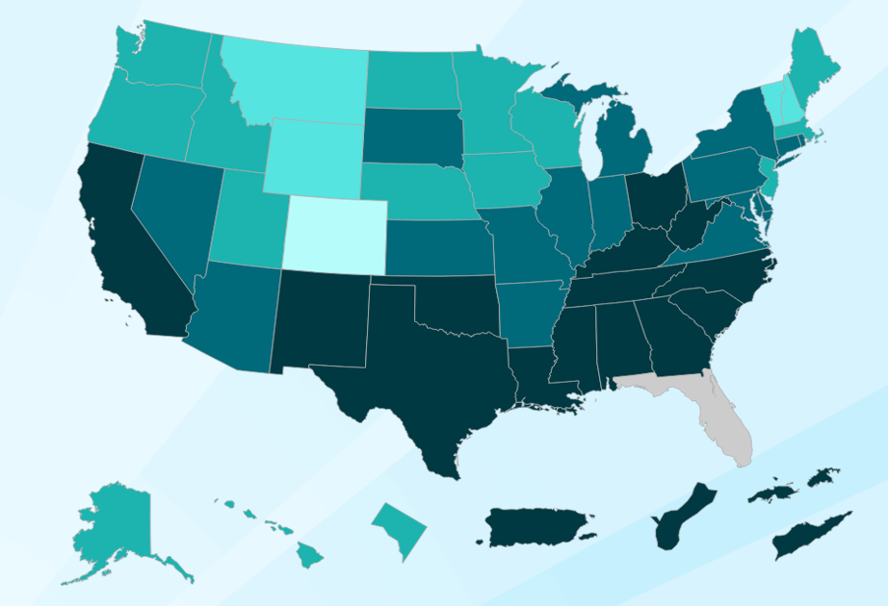
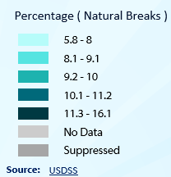
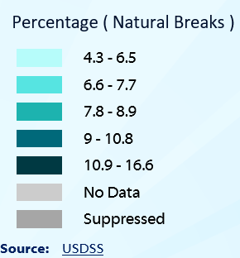
Comparing Louisiana to National Data
 | National | Louisiana
% of Total Diagnosed Aged 18+ Years (2021) | 8.5% | 12.4%
Number of Total Diagnosed Aged 18+ (2021) | 24 million | 487,000
Estimated Economic Costs (2017) | $327 billion | $5.7 billion
Notes:
Louisiana is ranked 9th in US diabetes prevalence
Diabetic patients have medical expenses approximately 2.3 times higher than those who do not have diabetes
Every year, an estimated 32,000 people in the US are diagnosed with diabetes

Slide 4
Healthy Louisiana Medicaid Program Goals
Improve diabetes measure rates at least 2% annually
Expand efforts on social determinants of health and diabetes by working to identify, address, and monitor health disparities and close care gaps for improved health outcomes
Reinforce the importance of annual visits and routine screenings
Decrease avoidable urgent care visits, emergency room visits and hospitalizations among diabetic population

Slide 5
Past and Present Performance Rates
 | MY 2020 | MY 2021 | MY 2022 | MY 21-22 | Stat Sig.
Measure/Data Element | Rate | Rate | Rate | Change in % points | Y/N
(HBD) HbA1c poor control (>9.0%)* Inverse Measure, Less is Better | 48.66% | 43.80% | 39.66% | +4.14% | Y
(HBD) HbA1c control (<8.0%) | 41.85% | 46.96% | 53.04% | +6.08% | Y
Measure | Previous Year Rate (June) | Interim Results | Comparison Goal
(HBD) HbA1c poor control (>9.0%)* Inverse Measure, Less is Better | 73.90% | 68.04% | 2022 Plan 2% annual decrease goal, 37.66% (Goal Not Met)
(HBD) HbA1c control (<8.0%) | 21.96% | 27.95% | 2022 Plan 2% annual increase goal, 55.04% (Goal Not Met)
Notes:
MY – measurement year
*2022 LDH Withhold Measure

Slide 6
Identified Barriers and Challenges
Members
Health literacy: knowledge about importance of routine visits
Affordability: cannot afford weight loss program
Access to resources: living in food desert areas, reliable transportation, reliable phone lines for appointment reminders, hesitancy to doctors visits due to COVID-19
Providers
Availability: appointment availability, PCPs in network in area, continuity of care with established PCP
Billing issues: unaware of measure incentives
Provider practice variation with recommended guidelines
Managed Care Organization
Internal resources
Lengthy internal approval process for member materials

Slide 7
Current Strategies and Interventions
Members
Education: social media campaigns, MPulse texting, Population Health Disease Management mailing
Telehealth visits, home visits, mobile units
Care Card member incentive, Make Every Calorie Count weight management program
Providers
Education: HEDIS coding guidelines and newsletters, Provider Report Card
After hours incentive through Wellness Days
Increase urgent care network
Managed Care Organization
Increase collaborations with communities
Notes:
Mpulse - text messaging member detailed health reports
Population Health Disease Management Mailing - mailings sent to newly diagnosed diabetic members
Care Card Member Incentive - $10 annually for completing all three: hemoglobin A1C (HbA1c) testing, dilated eye exam, and kidney screening
Make Every Calorie Count weight management program - 2 visits yearly with registered dietitian plus gym membership or at-home fitness kit

Slide 8
Data Analysis
Total population: Data obtained from 10,469 diagnosed diabetics aged 18 – 75 years old ACLA members during year 2022
Adequate Control HbA1c Population: Members with most recent HbA1c level < 8.0% | Poor Control HbA1c Population: Members with most recent HbA1c level > 9.0% or identified as 0, indicating HbA1c test is missing or was not done during 2022
< 8.0% : 1850 | > 9.0%: 458 Missing or not tested HbA1c: 7943
Included other data corresponding to: LDH Region of Residence Gender Age Race Language Spoken
Notes:
No differentiation between Type 1 or Type 2 DM

Slide 9
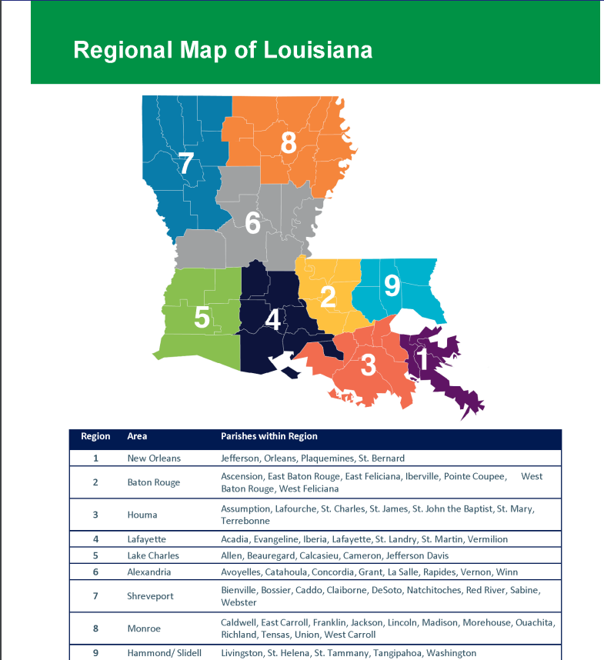
Louisiana Department of Health Regional Map

Slide 10
Demographic Characteristic | Proportion of Members in Region with Adequate Control |  | Proportion of Members in Region with Poor Control |  | Region Ranking
 | Count | % within each region | Count | % within each region
Region
Region 1 | 442 | 22% | 1541 | 78%
Region 2 | 395 | 28% | 1010 | 72%
Region 3 | 93 | 11% | 718 | 89% | 3rd
Region 4 | 191 | 17% | 948 | 83%
Region 5 | 33 | 8% | 394 | 92% | 1st
Region 6 | 154 | 21% | 574 | 79%
Region 7 | 126 | 10% | 1158 | 90% | 2nd
Region 8 | 126 | 15% | 736 | 85% | 4th
Region 9 | 206 | 19% | 862 | 81%
Unknown | 79 | 17% | 387 | 83%
Total | 1850 |  | 8401
Notes:
Region 5 – Lake Charles
Region 7 – Shreveport
Region 3 – Houma
Region 8 - Monroe
Total <8: 1850
Total >9+NC: 8401
PPI (% HbA1c >9/ % HbA1c <8)?
1.0 = proportions of subgroups are equal
<1.0 = Subgroup is less prevalent in the outcome group
>1.0 = Subgroup is more prevalent in the outcome group
HbA1c >9 + NC:
R1: 94, 1447
R2: 112, 898
R3: 28, 690
R4: 63, 885
R5: 10, 384
R6: 43, 531
R7: 29, 1129
R8: 8, 728
R9: 18, 844
U: 12, 375

Slide 11
Gender Distribution
Age Groups Distribution

Slide 12

Demographic Characteristic | Proportion of Members in Group with Adequate Control |  | Proportion of Members in Group with Poor Control |  | Ranking
 | Count | % within each group | Count | % within each group
Gender
Male | 605 | 17% | 3646 | 83%
Female | 1245 | 19% | 6605 | 81%
Age Groups
< 30 | 108 | 12% | 714 | 88% | 1st
30 - 39 | 270 | 17% | 1268 | 83% | 2nd
40 - 49 | 451 | 18% | 1931 | 82% | 3rd
50 - 60 | 684 | 19% | 2771 | 81%
> 60 | 337 | 20% | 1259 | 80%
Total | 1850 |  | 8401
Notes:
Men had more % of poorly controlled members than women
Trend of younger age groups being more poorly controlled than older age groups; as age increased, proportion of adequate control also increased
Total <8: 1850
Total >9+NC: 8401

Slide 13
Demographic Characteristic | Proportion of Members in Group with Adequate Control |  | Proportion of Members in Group with Poor Control |  | Ranking
 | Count | % within each group | Count | % within each group
Race
White | 656 | 18% | 2953 | 82% | 2nd
Black / African American | 1010 | 18% | 4665 | 82% | 2nd
Asian or Pacific Islander | 32 | 25% | 97 | 75%
American Indian / Alaskan Native | 14 | 15% | 82 | 85% | 1st
Unknown | 134 | 19% | 568 | 81%
Total | 1846 |  | 8365
Language Spoken
English | 1799 | 18% | 8244 | 82%
Spanish | 31 | 20% | 127 | 80%
Total | 1830 |  | 8371
*Due to total groups of n < 20, subgroups of race (such as Hispanic, Native Hawaiian, Asian Indian, Guamania or Chamorro, Samoan) and language spoken (Vietnamese, French, Cambodian, Portuguese, Unknown) were no included in chart analysis
Notes:
American Indian / Alaskan Native had ranked 1st in proportion of poorly controlled than all other race groups, with White and Black / African American coming in 2nd
English speaking group had higher poor control than Spanish
RACE
Total <8, for recorded: 1846
>9: 456
NC: 7909
Total >9+NC: 8365
Key:
White (1)
Black / African American (2, 10)
Asian or Pacific Islander (4)
American Indian / Alaskan Native (3)
Unknown (9)
Other (including Hispanic, Native Hawaiian, Asian Indian, Guamania or Chamorro, Samoan) (5, 6, 11, 12, 13, 7, 8)
Language Spoken
Total <8, for recorded: 1830
>9: 457
NC: 7914
Total >9+NC: 8371
Other including Vietnamese, French, Cambodian, Portuguese, Unknown

Slide 14
Data Summary
Region of Residence
Region 5, 7, 3, 8 (Lake Charles, Shreveport, Houma, Monroe) had the most % of poorly controlled members
Gender
Men had more % of poorly controlled members than women
Age
Trend of younger age groups being more poorly controlled than older age groups; as age increased, proportion of adequate control also increased
Race
American Indian / Alaskan Native had ranked 1st in proportion of poorly controlled than all other race groups, with White and Black / African American ranking 2nd
Language Spoken
English speaking group had higher poor control than Spanish

Slide 15
Recommendations
Group-specific | General
Emphasizing current interventions specifically in regions of Lake Charles, Shreveport, Houma, and Monroe | Providing incentive to provider and members of yearly clinic visits and HbA1c testing
Providing more infographics appealing to younger audiences | Increasing awareness of established ACLA programs and incentives to both members and providers
Increasing texting alerts, reminders and diabetes educational facts to younger members | Providing ACLA providers with monthly reports of poorly controlled and non-compliant diabetic members
Increasing program engagement especially in American Indian, Alaskan Native, and African American communities | Providing more flyers and infographics to all diabetic members at every office visit and in community settings
Encouraging provider discussions on health equity, implicit and explicit bias with non-White groups

Slide 16


Acknowledgments
Renee Wells
Dr. Gregory Randolph
Dana Smith
Shea Good
Agnes Robinson
Lekitha Gregory
Carrie Blades
Rhonda Baird
Thank you!

Slide 17
References
Centers for Disease Control and Prevention. National Diabetes Statistics Report website. https://www.cdc.gov/diabetes/data/statistics-report/appendix.html.
Centers for Disease Control and Prevention. Diabetes State Burden Toolkit website. https://nccd.cdc.gov/Toolkit/DiabetesBurden/Prevalence
Centers for Disease Control and Prevention. United States Diabetes Surveillance System. Division of Diabetes Translation. https://gis.cdc.gov/grasp/diabetes/diabetesatlas-surveillance.html
American Diabetes Association. The Burden of Diabetes in Louisiana. https://diabetes.org/sites/default/files/2021-10/ADV_2021_State_Fact_sheets_Louisiana.pdf
The Community Guide. CPSTF Findings for Diabetes. Interventions to Prevent or Manage Diabetes. https://www.thecommunityguide.org/pages/task-force-findings-diabetes.html

Slide 18
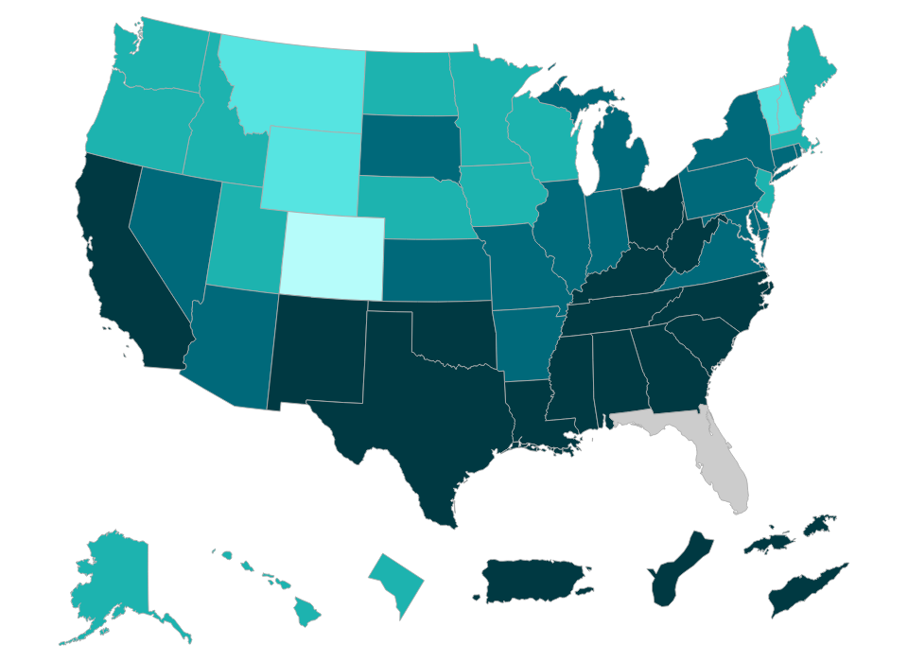
Diagnosed Diabetes, Total, Adults Aged 18+ Years, Age-Adjusted Percentage, U.S. States, 2021
Percentage ( Natural Breaks )
4.3 - 6.5
6.6 - 7.7
7.8 - 8.9
9 - 10.8
10.9 - 16.6
No Data
Suppressed
Source:
USDSS
Disclaimer: This is a user-generated report. The findings and conclusions are those of the user and do not necessarily represent the views of the CDC.
National Center for Chronic Disease Prevention and Health Promotion
Division of Diabetes Translation

Slide 19
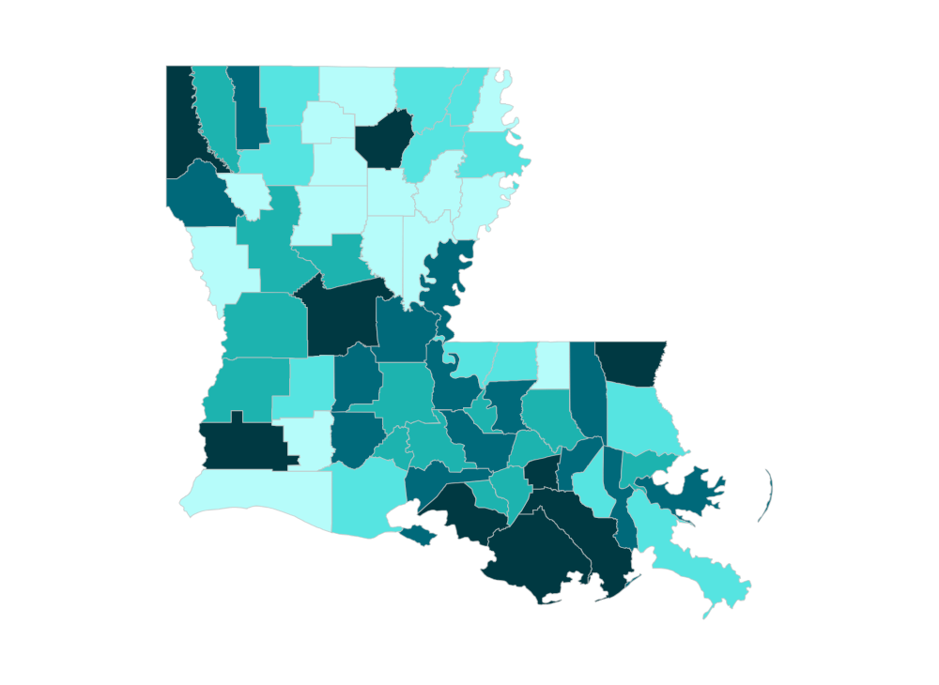
Diagnosed Diabetes, Total, Adults Aged 20+ Years, Age-Adjusted Percentage, Louisiana, 2020
Percentage ( Natural Breaks )
5.8 - 8
8.1 - 9.1
9.2 - 10
10.1 - 11.2
11.3 - 16.1
No Data
Suppressed
Source:
USDSS
Disclaimer: This is a user-generated report. The findings and conclusions are those of the user and do not necessarily represent the views of the CDC.
National Center for Chronic Disease Prevention and Health Promotion
Division of Diabetes Translation

